Slide 1
PhD Proposal Defense
Edwin Alexani
Rochester Institute of Technology

Slide 2
Overview
Technology Introduction
Completed Work and Results
  Dark Current
  Read Noise
  Crosstalk
  Conversion Gain
  Capacitance of Floating Diffusion
  Quantum Efficiency
  Persistence
  Telescope Observing Results
  Simulation of Earthlike Exoplanet
Remaining Work
  Understanding Low Signal Nonlinearity
  Understanding Quantum Yield
  Understanding the Dark Current Plateau and Glow (Multiplexer and Unit Cell)
  Leveraging Single-Photon Counting to Introduce Rounding Step Using Bit Error Rate to Improve SNR
Schedule

Slide 3
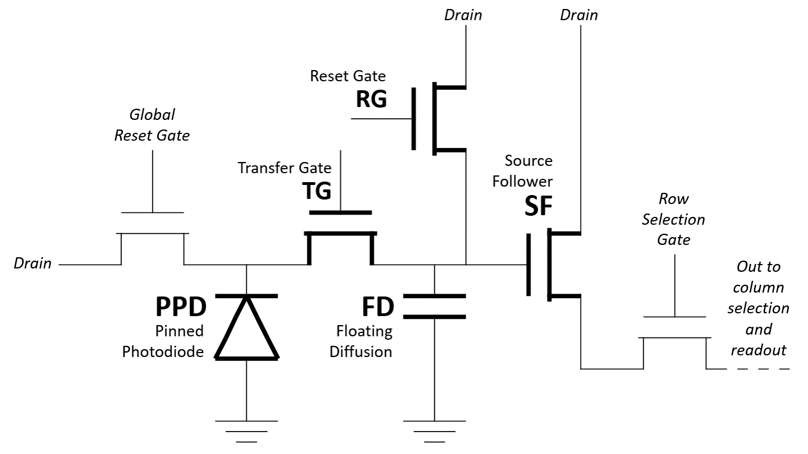
Technology Introduction
CMOS Single-Photon Counting Detectors
Uses 5T pixels, which have 5 transistors: global reset gate, transfer gate, reset gate, source follower, row selection gate.
The capacitance of the floating diffusion is small such that the pixel has a large voltage response to a single charge carrier, and the read noise is smaller than this response.

Slide 4
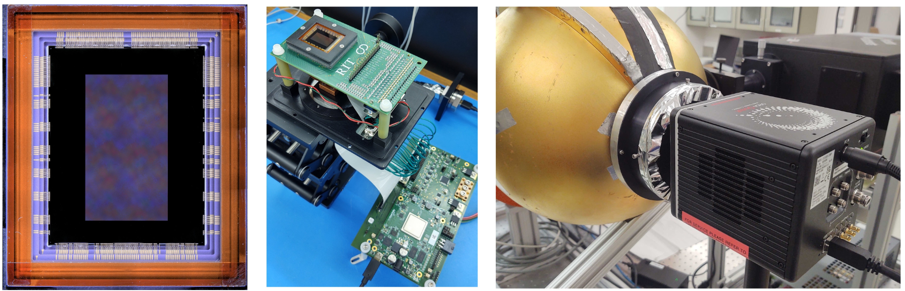
Completed Work and Results
Dark Current
Read Noise
Crosstalk
Conversion Gain
Capacitance of Floating Diffusion
Quantum Efficiency
Persistence
Telescope Observing Results
Simulation of Earthlike Exoplanet

Slide 5
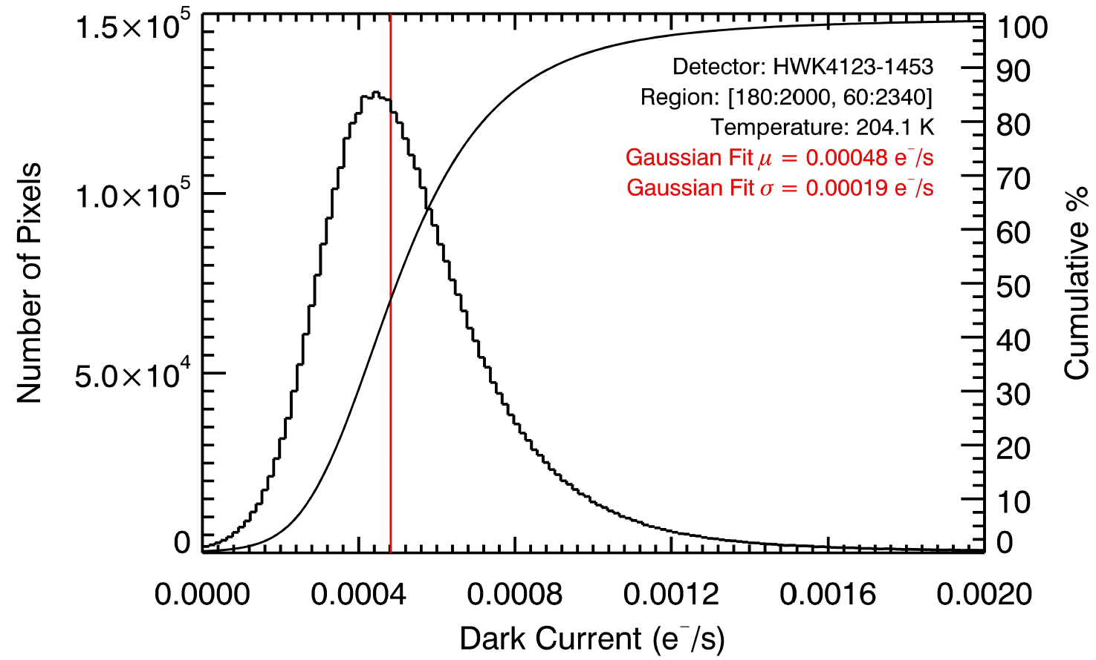
Dark Current
Dark current is the rate at which charge accumulates in a detector in the absence of light.
Significant sources are dark current include thermal processes, electron diffusion, and generation at Si-SiO₂ interface states.
The lowest dark current we measure is 0.00041 e⁻/s/px.

Slide 6
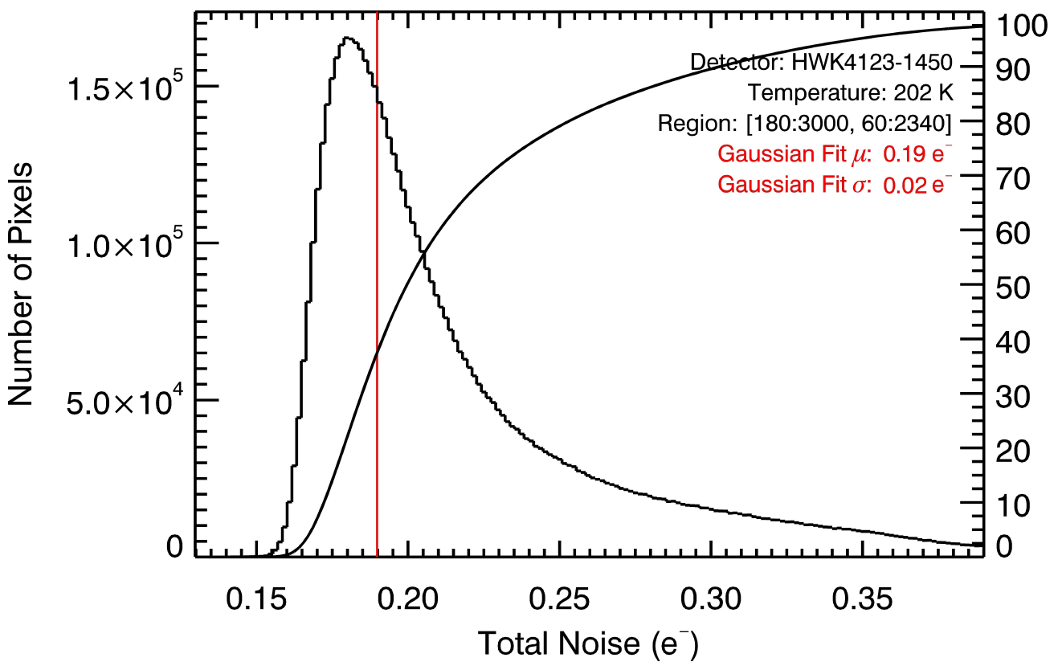
Read Noise
Read noise is the uncertainty in a pixel’s measured signal.
Stochastic processes during readout contribute to read noise.
The lowest read noise we measure is 0.19

Slide 7
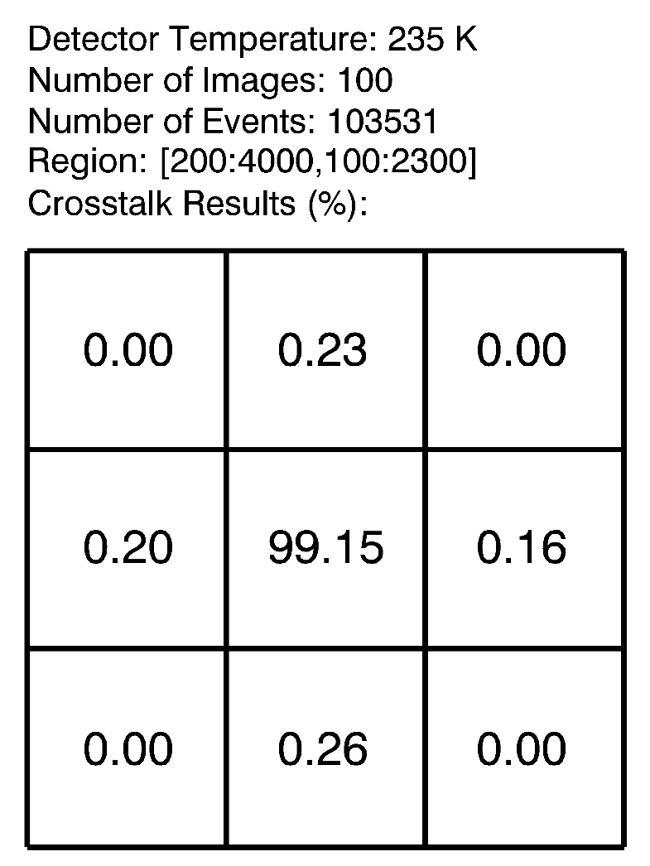
Crosstalk
Crosstalk is the phenomenon where signal in one pixel changes the performance of a nearby pixel.
Sources of crosstalk include interpixel capacitance, charge diffusion, and incomplete settling.
We measure negligible crosstalk.

Slide 8
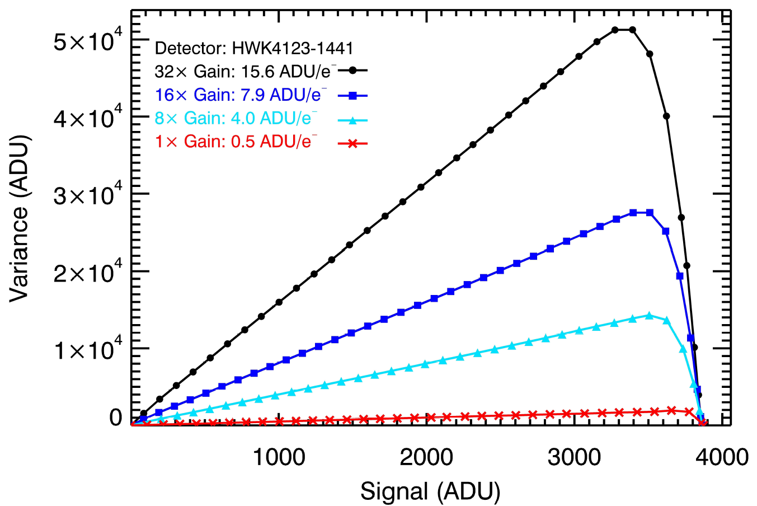
Conversion Gain
There are many “conversion gains” in a pixel. Unless stated otherwise, we mean “system conversion gain” which is ADU/e⁻ from start to finish.
We measure this using two methods: the photon transfer experiment, and the photon counting histogram.
The value depends on the programmable gain amplifier used.

Slide 9
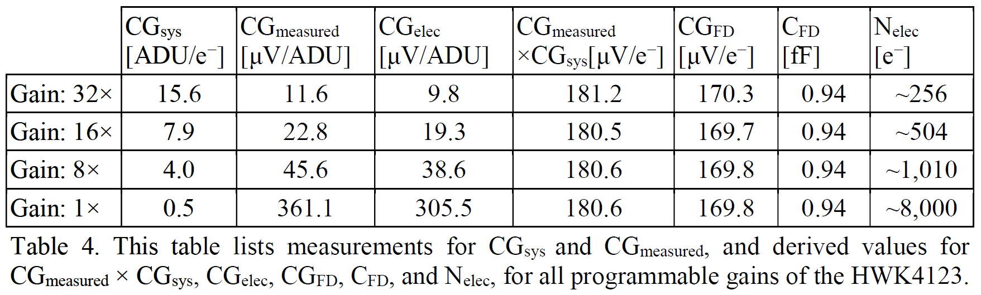
Capacitance of Floating Diffusion
The capacitance of the floating diffusion defines the magnitude of the voltage response of the pixel to a single charge carrier.
In SPSCMOS, the voltage response to a single charge carrier must exceed the read noise.

Slide 10
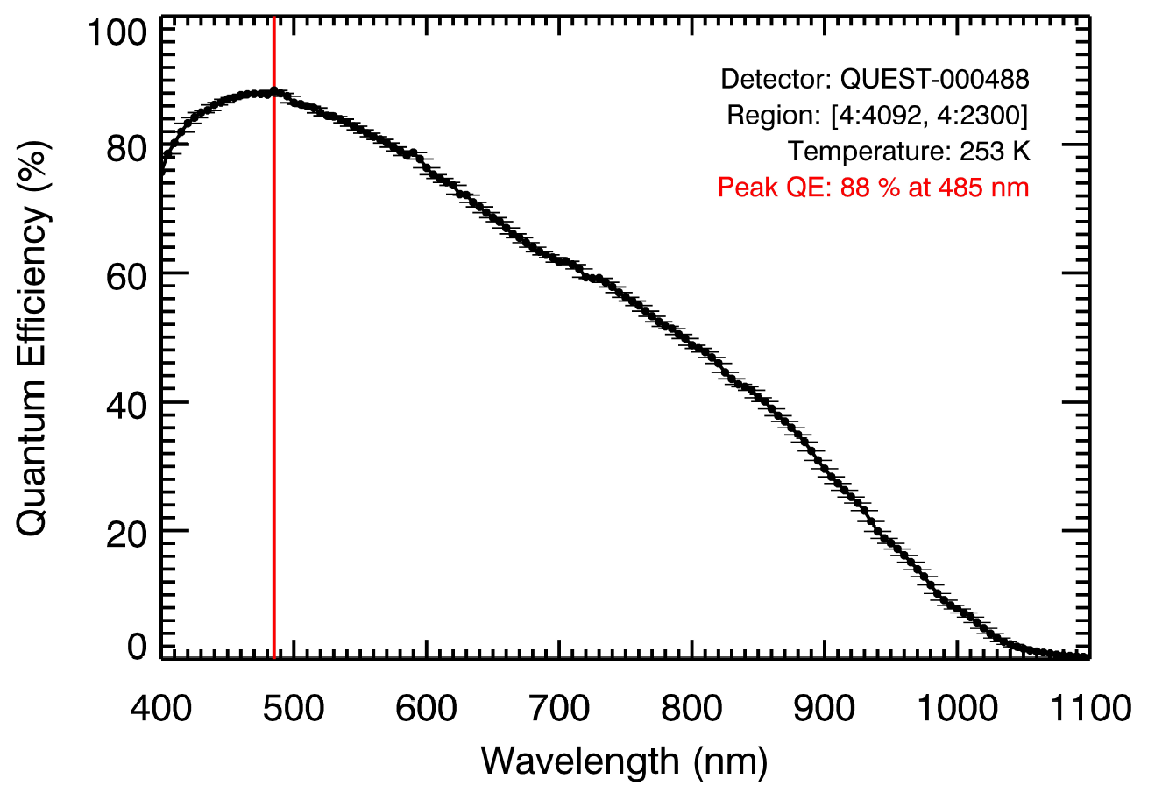
Quantum Efficiency
Quantum efficiency is the ratio of the number of electrons measured by the detector to the number of photons incident on the detector.
This definition is “total quantum efficiency” where we do not distinguish between external and internal quantum efficiency.

Slide 11
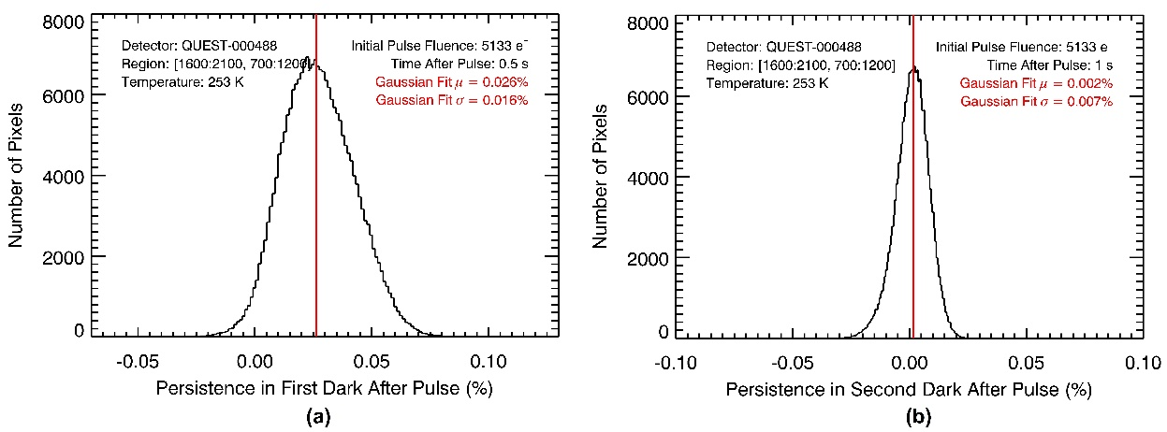
Persistence
Persistence, also called lag, is the portion of a pixel’s signal due to charge carriers produced by sources in previous images.
Persistence is caused by trapped charges. Traps can be permanent defects in the material lattice, or temporary potential wells caused by the voltages applied to the pixel during readout.

Slide 12
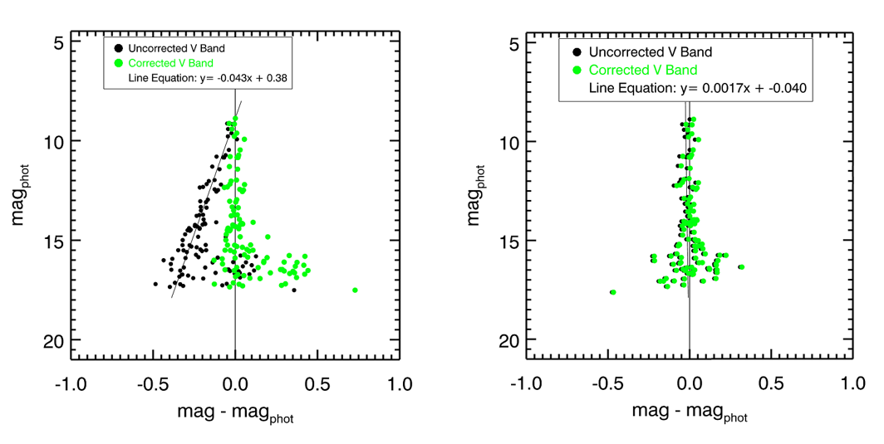
Telescope Observing Results
We have observed multiple objects at the C.E.K. Mees observatory.
Our reduction has focused on M36 in the B, V, and R bands.
We notice nonlinearity in the data, consistent with low-signal nonlinearity in the sensor.

Slide 13
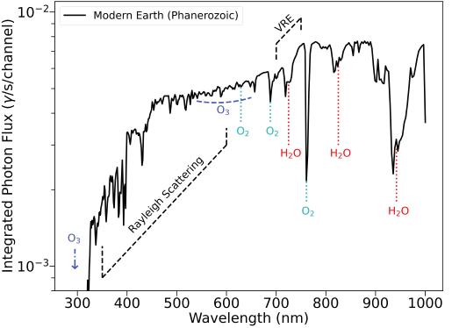
Simulation of Earthlike Exoplanet
A future goal of astrophysics is to directly image earthlike exoplanets and characterize their atmospheres.
We have simulations of such systems, and how current detectors would perform when characterizing them.

Slide 14
Remaining Work
Understanding Low Signal Nonlinearity
Understanding Quantum Yield
Understanding the Dark Current Plateau and Glow (Multiplexer and Unit Cell)
Leveraging Single-Photon Counting to Introduce Rounding Step Using Bit Error Rate to Improve SNR

Slide 15
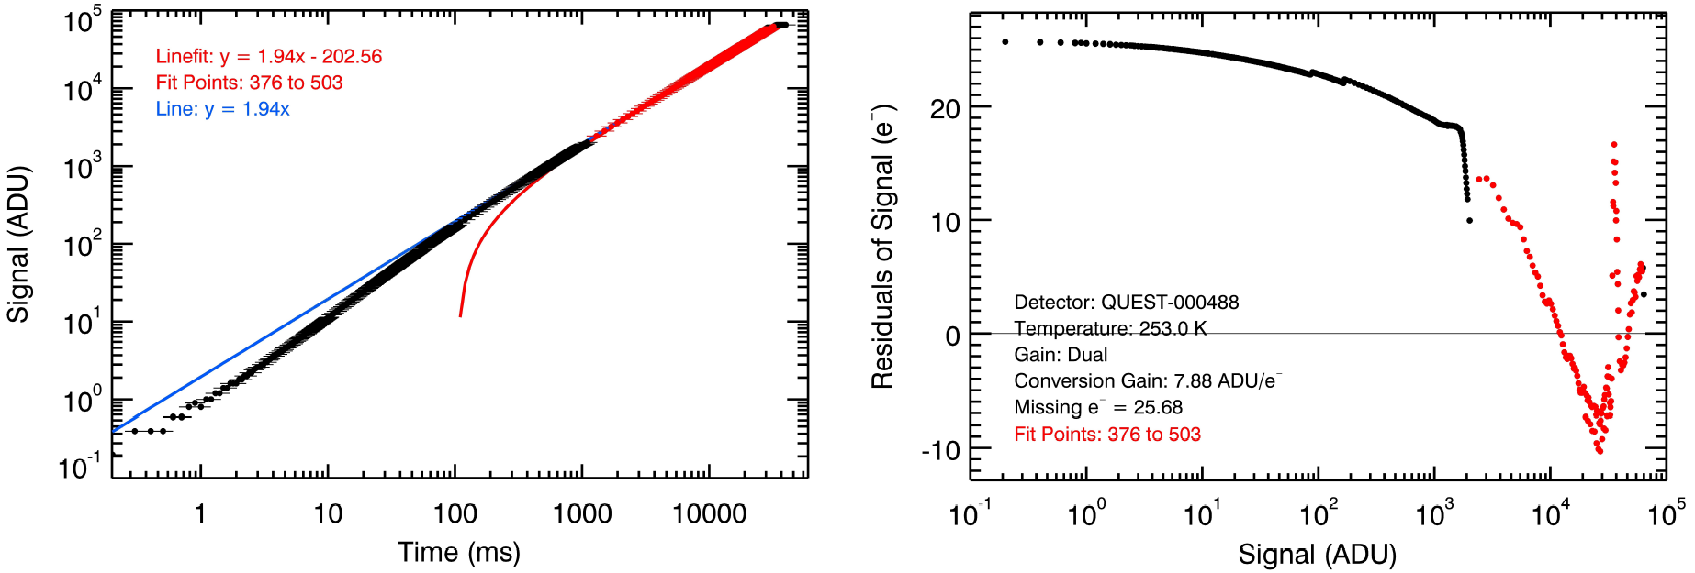
Understanding Low Signal Nonlinearity
The sensor has low-signal nonlinearity.
Potential causes of this low-signal nonlinearity are defect traps, potential well traps during charge collection, or other processes after the programmable gain stage.
Each cause has specific symptoms that we can diagnose.
We also need to properly correct for this effect in our pipeline.

Slide 16
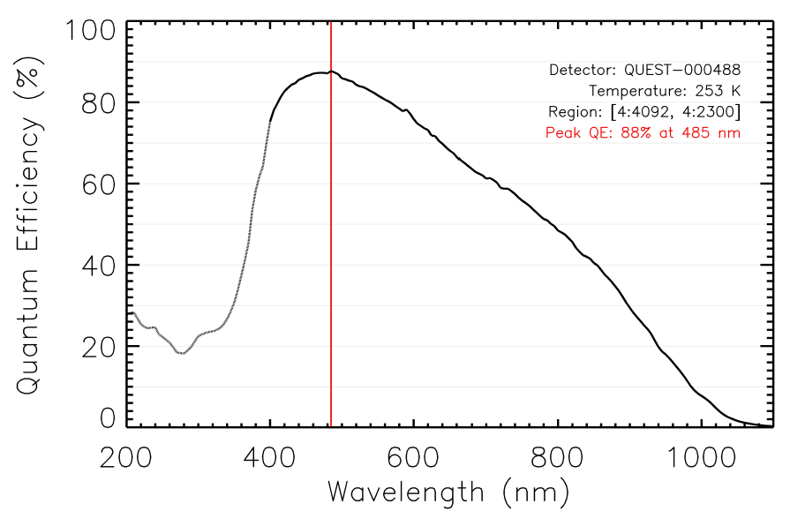
Understanding Quantum Yield
Quantum yield is the number of electrons generated per absorbed photon.
For 400 – 1000 nm, we assume quantum yield is 1.
For shorter wavelengths, quantum yield is greater than 1.
We need to measure and correct for quantum yield.

Slide 17
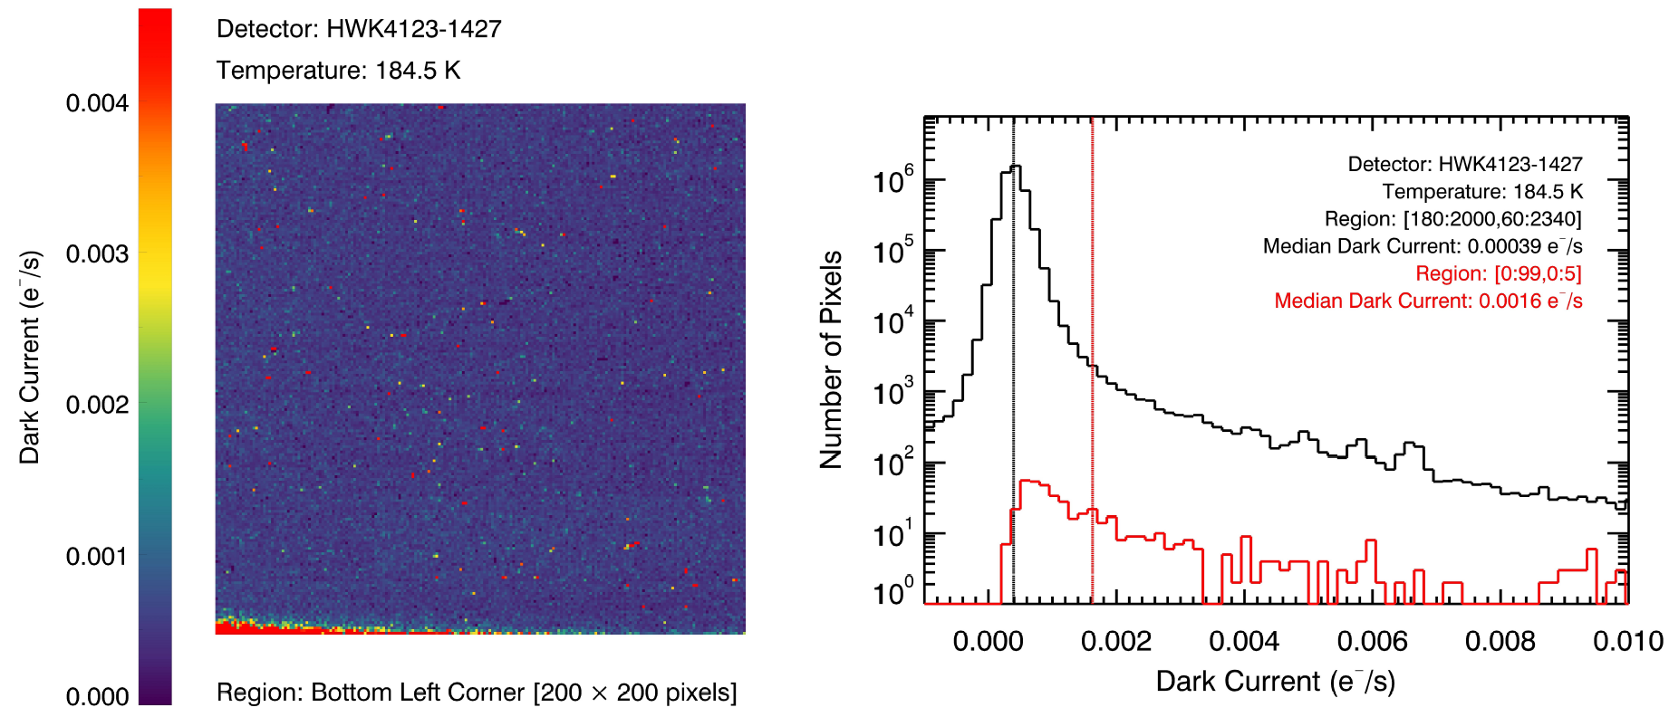
Understanding the Dark Current Plateau and Glow (Multiplexer and Unit Cell)
Silicon devices encounter a dark current plateau at lower temperatures.
If there is a nonthermal component, is it from the detector or the system?
Glow may contribute to the nonthermal component (multiplexer glow has been found, do we have unit cell glow?)

Slide 18
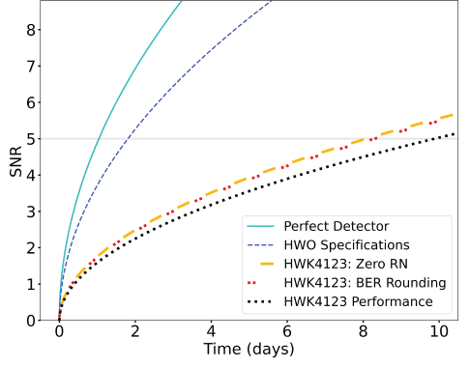
Leveraging Single-Photon Counting to Introduce Rounding Step Using Bit Error Rate to Improve SNR
We round floating point electron values to the nearest integer number.
The rate of failure of this rounding step is the Bit Error Rate.
The uncertainty associated with reporting the final value changes from analog read noise to the variance of a Bernoulli trial.

Slide 19
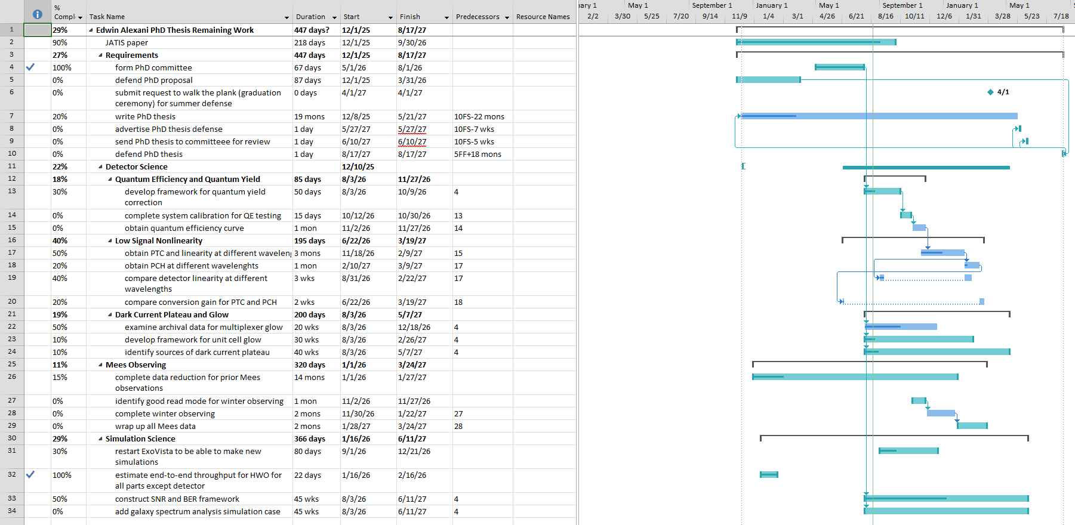
Schedule

