Slide 1
University Astronomy
Professor Don Figer
Instruments and Detectors I

Slide 2
Aims for Lecture
Introduce modern Optical/NIR/UV instrumentation (6.5-6.7)
  instrument requirements
  instrument examples
Describe capabilities of commonly used instruments.
  HST
  Spitzer
  Chandra
  JWST
  ELTs
  WFIRST (Roman)

Slide 3
instrument and discovery

Slide 4
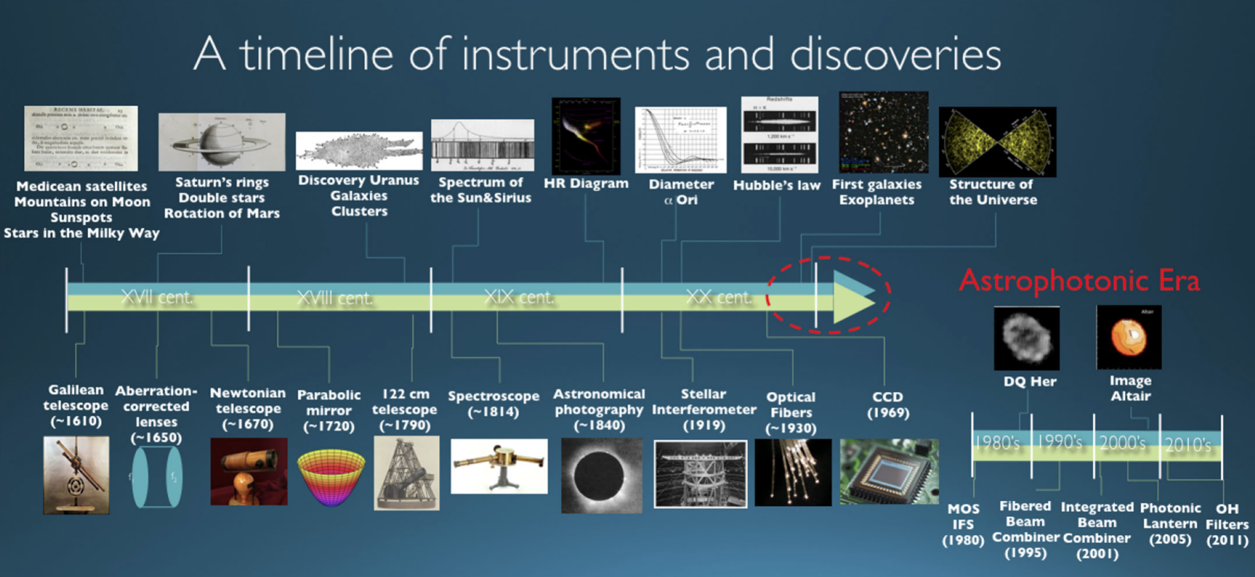
Discovery Led by Technology

Slide 5
instrument types

Slide 6
Instruments
Astronomical instruments receive light from a telescope and convert it into measureable signals.
They generally come in two forms.
  cameras
  spectrographs
Some instruments have both capabilities.
A third specialized form is a coronagraph (which can be followed by a camera or spectrograph).

Slide 7
Camera
A camera images an object plane onto a focal plane.
A detector is at the final focal plane.
A camera often serves the function of
  changing the plate scale to match the point spread function of the image to the pixel size
  narrowing the light to the wavelengths of interest
  controlling the environment of the detectors, i.e. the temperature

Slide 8
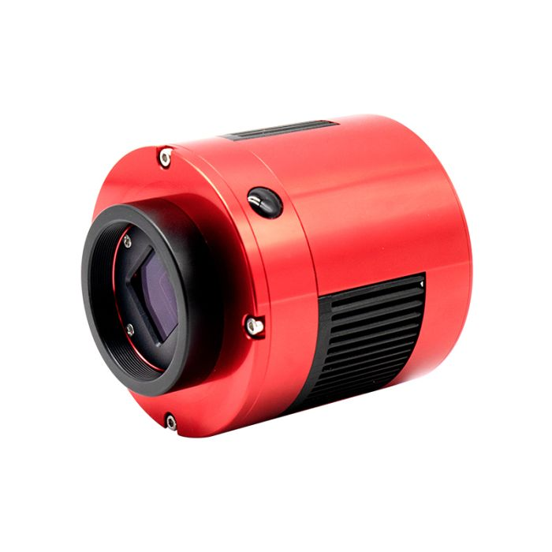
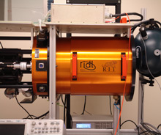
Simple vs. Complex Camera
A simple camera could consist of just a detector and a housing.
For better sensitivity, the detector is cooled.
To cool the detector requires a cooling system, such as a cryostat, and a vacuum vessel.

Slide 9
Camera Changing Plate Scale
red=optics
blue=rays
black=focal/pupil planes
green=optical axis
primary
prime focal plane
final focal plane
collimator
pupil plane
camera
θ_{T}
s_{T}
s_{cam}
F_{T}
F_{coll}
F_{cam}

Slide 10
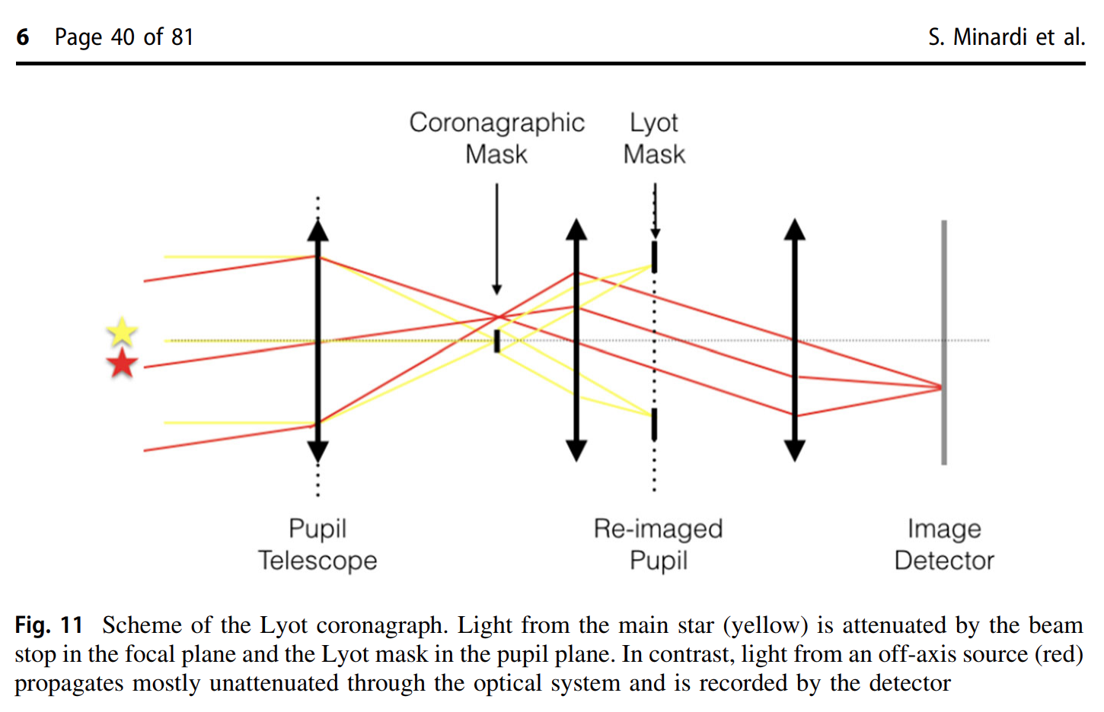
Coronagraph
A coronagraph is the name of an optical system that blocks the light from a point source.
It allows light from nearby objects to reach the detector.
The purpose is typically to block the bright light of a star in order to allow one to see the faint light of a nearby planet.
Other methods include nulling interferometer and phase mask.

Slide 11
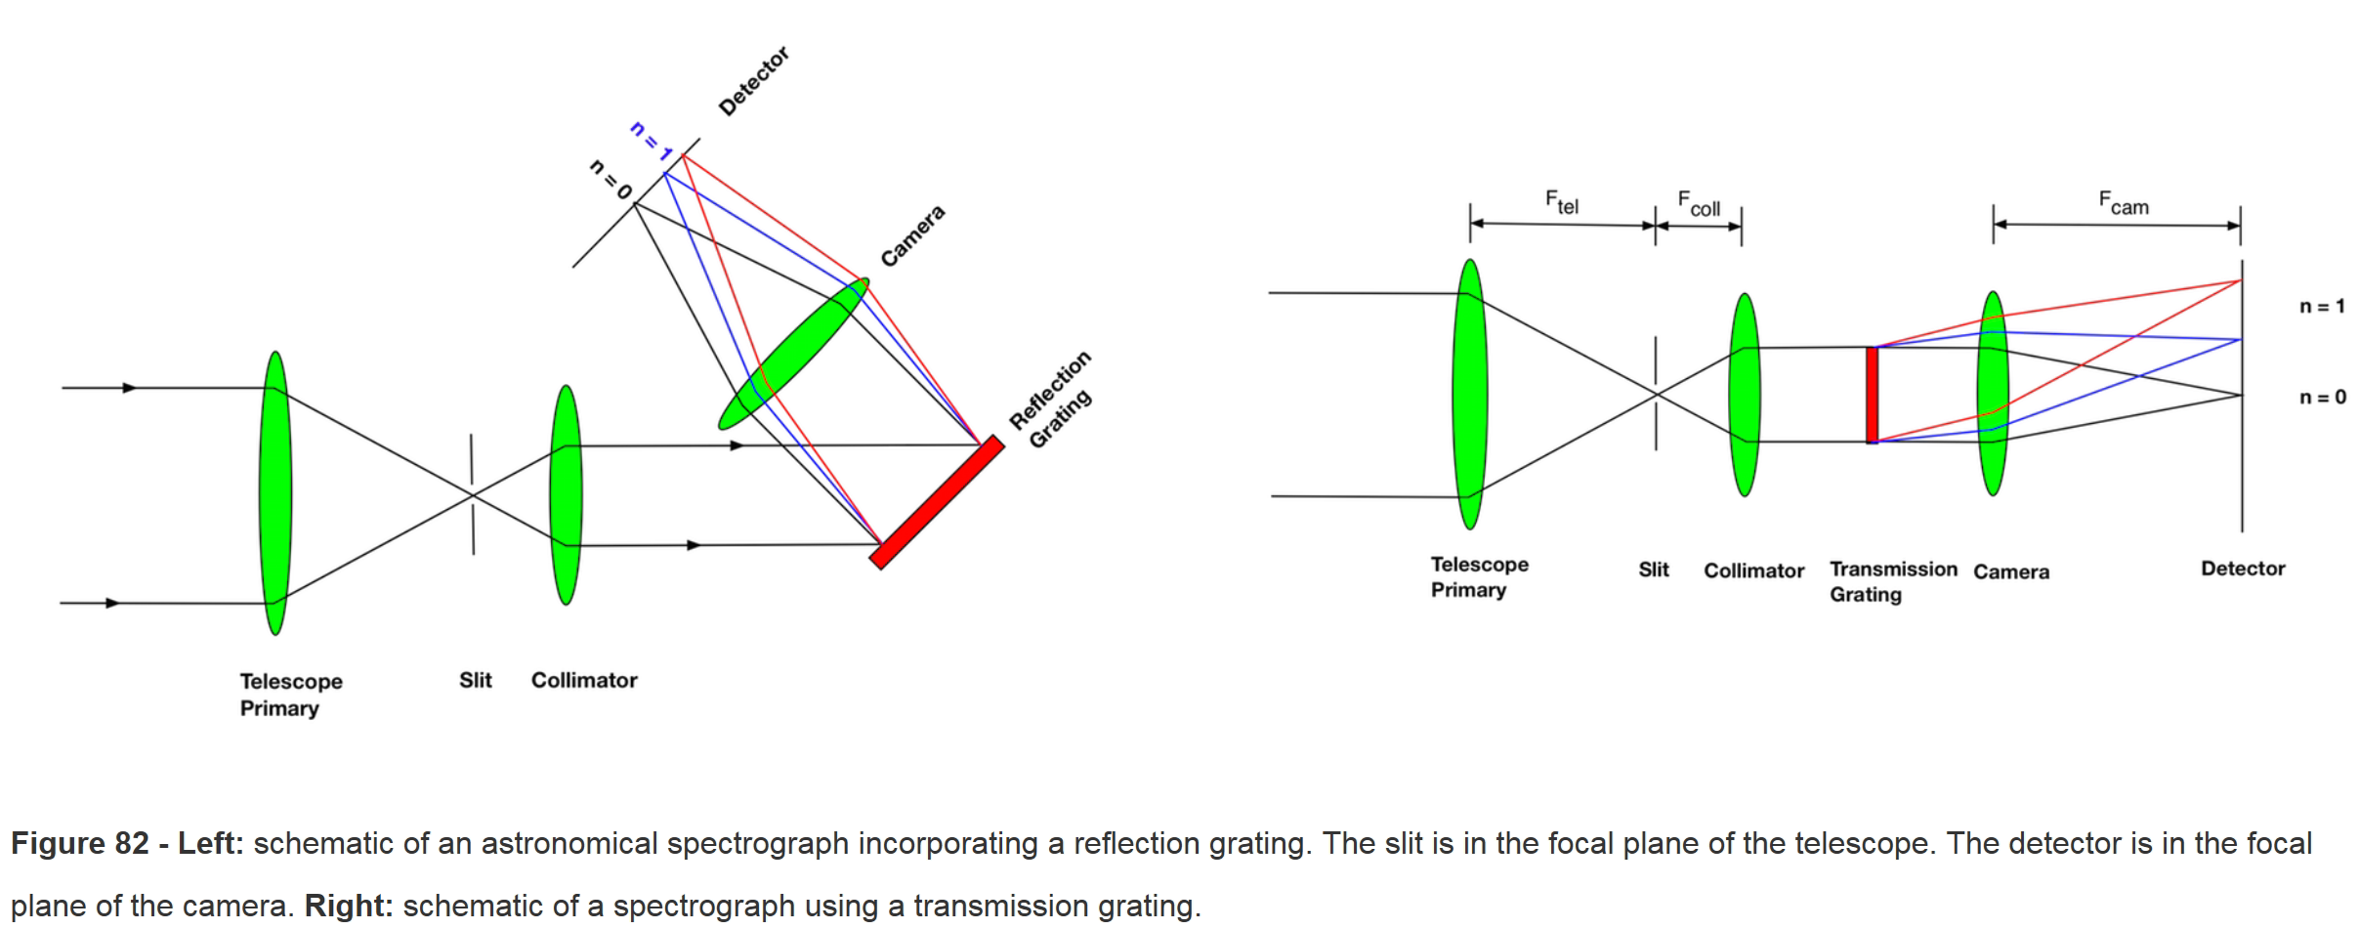
Spectrograph
A spectrograph produces an image of an object at a range of wavelengths.
It typically consists of a slit, collimator, grating, camera, and a detector.

Slide 12
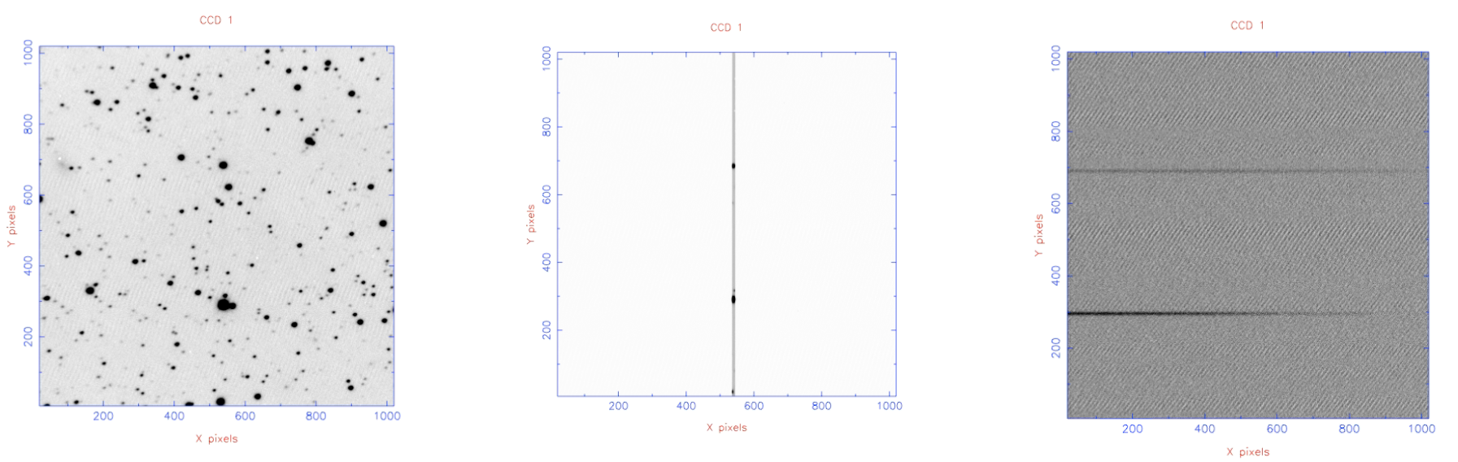
Spectrograph Output – Single Slit
In a single slit spectrograph, all the light is blocked except for light corresponding to objects aligned on to the slit.
The light that goes through the slit is dispersed according to wavelength and imaged onto the detector.
In the example below, there is light at all locations in the slit (middle image), but the brightest corresponds to the objects at x=550 and y=300 and x=550 and y=700.

Slide 13
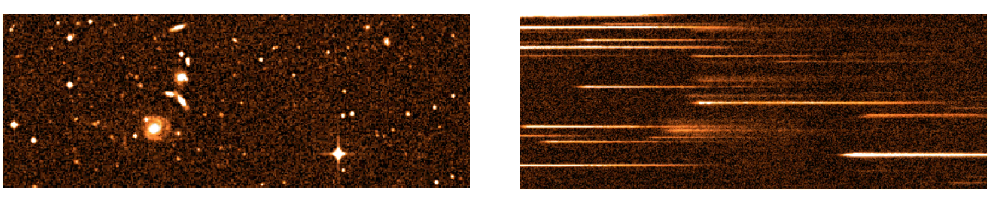
Spectrograph Output – Multislit
In a multiple slit spectrograph, small slits can be placed randomly on objects in the focal plane.
The light that goes through the slits is dispersed according to wavelength and imaged onto the detector.
In the example below, light from many objects goes through the slits.
It is important that the spectra do not overlap.

Slide 14
instrument requirements

Slide 15
Instrument Science Requirements
Astronomers carefully design and build instruments to satisfy science-driven requirements.
  spatial resolution
  spectral resolution
  wavelength coverage
  sensitivity
  dynamic range
  field of view

Slide 16
Instrument System Requirements
spectrograph and/or camera
sampling
filters
exposure time cadence (short/long)
stability
  photometric
  spectral

Slide 17
Instrument Engineering Requirements
detector/electronics
  pixel size
  quantum efficiency
  noise
  dark current
  supported exposure times
  sampling speed
optics
  materials
  irregularity/wavefront error
  f/number
  optics efficiency
  coatings
mechanics
environment
  pressure
  temperature
  stability

Slide 18
Instrument Constraints
cost
schedule
volume
mass
power

Slide 19
instrument components

Slide 20
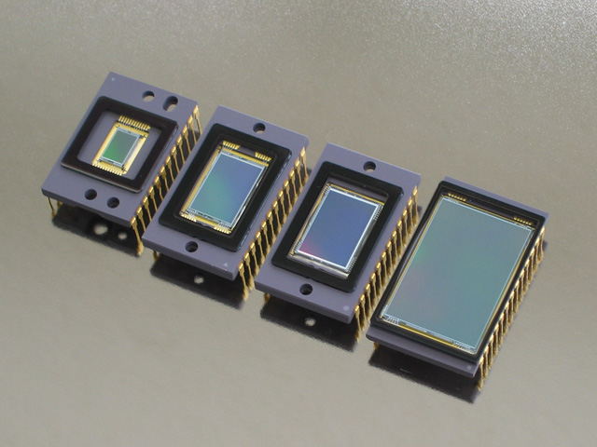
Detectors
Detectors convert light into a measureable signal.
The signal is often a voltage that is proportional to the incoming light level.
Charge-Coupled Devices (CCDs) are commonly used in the optical-through-x ray bands.

Slide 21
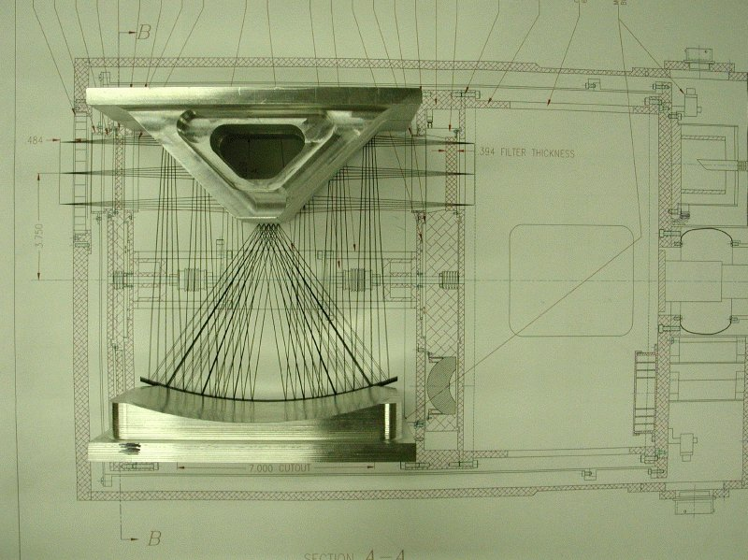
Optics

Slide 22
Electronics
There are many kinds of electronics in an instrument.
Detector
  control
    clock
    bias
  data acquisition
    readout multiplexer
    pre-amplifier
    digitizer
Motion control
Thermometry
Computer(s)

Slide 23
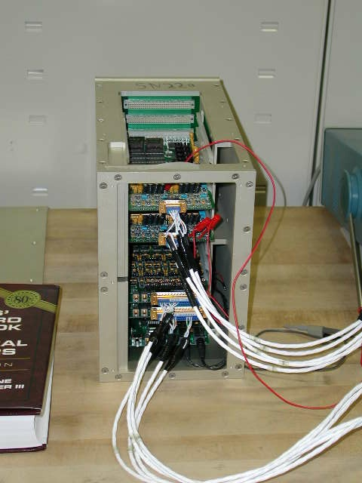
Electronics: Leach Controller
Astronomical Research Cameras, Inc. (Bob Leach)
8 channels per board
1 MHz, 16-bit A/D
Clocks
Biases
Voodoo/OWL software

Slide 24
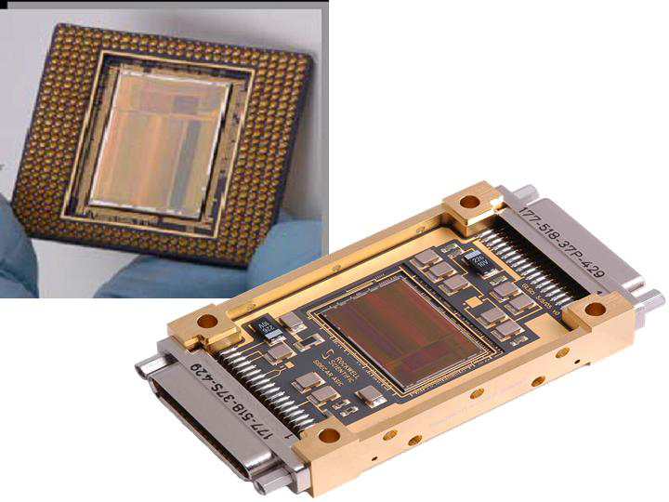
Electronics: JWST SIDECAR
Teledyne
Cryogenic (40 K)
36 channels
1 MHz, 16-bit A/D
Clocks
Biases
Custom microcode
Flying on JWST
First use on HST

Slide 25
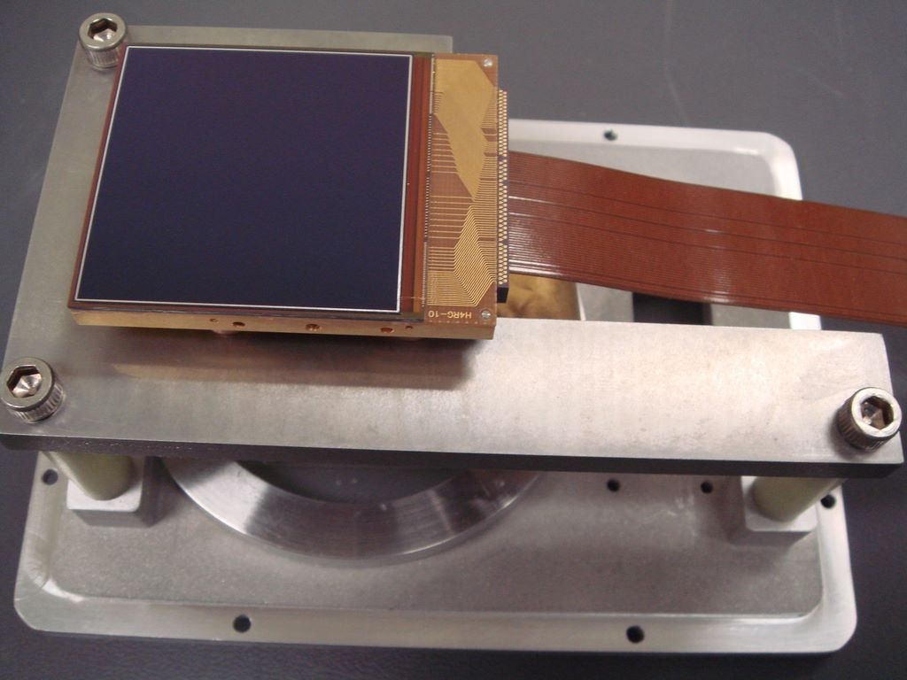
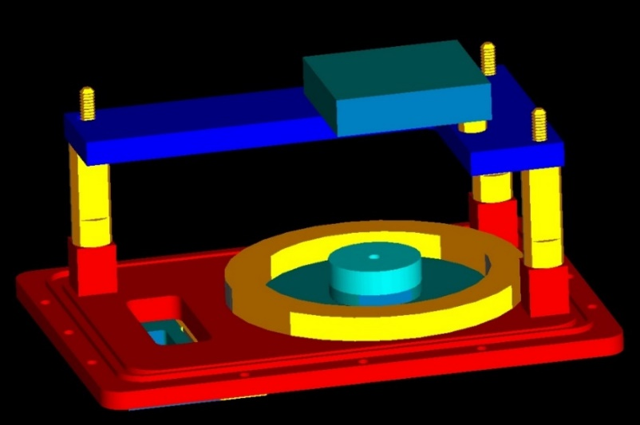
Focal Plane Assembly
The FPA contains the detector(s) and provisions for optical, mechanical, thermal, and electrical interfaces.
The upper picture is of a 16 megapixel detector that was a prototype for those on JWST.
The lower picture shows the detector head assembly in a 3D rendering.

Slide 26
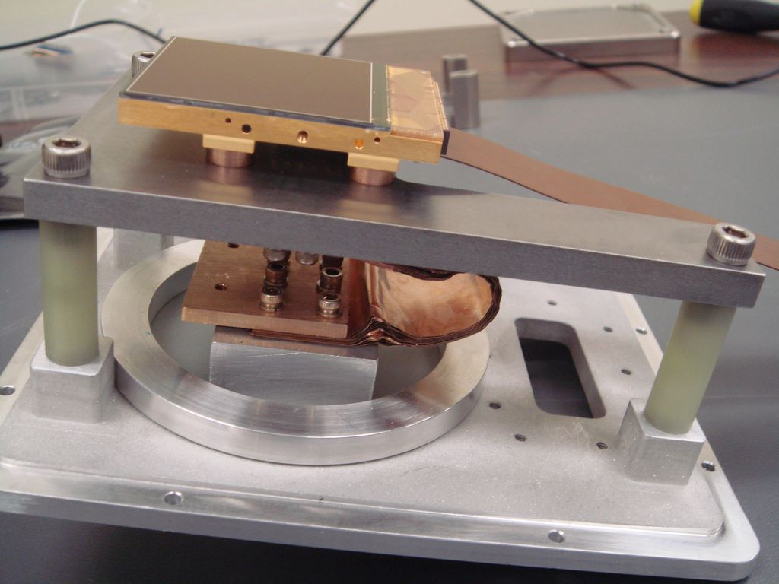
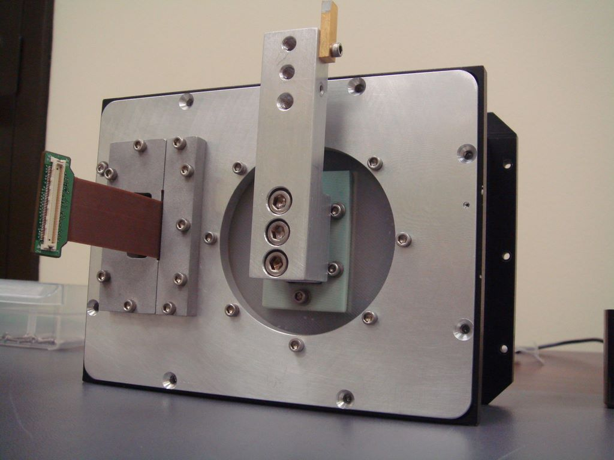
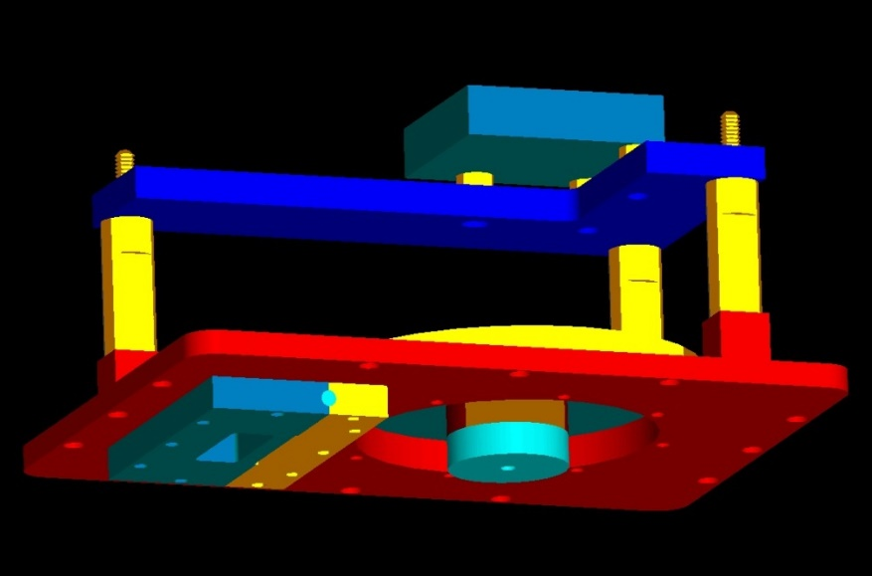

Focal Plane Assembly: example

Slide 27
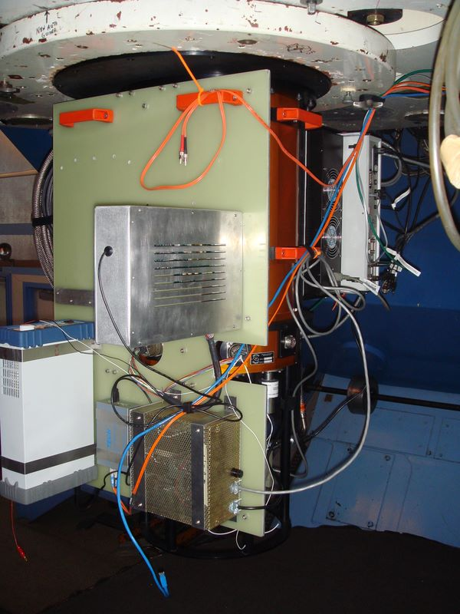
Mechanics: Telescope Interfacing

Slide 28
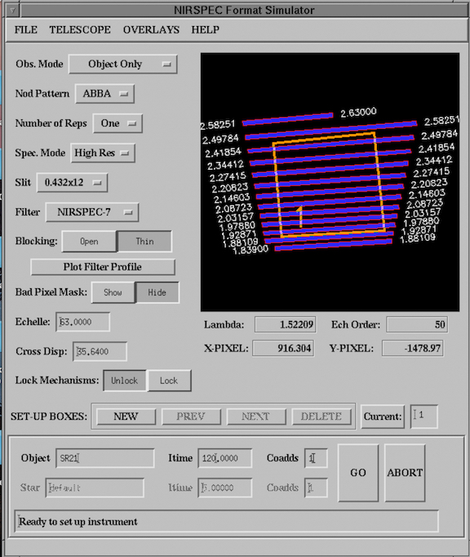
Software
data acquisition
control
virtual instrument
quick look
quick pipeline
data reduction pipeline
simulators

Slide 29
instrument examples - existing

Slide 30
NIRSPEC/Keck Optical Layout

Slide 31
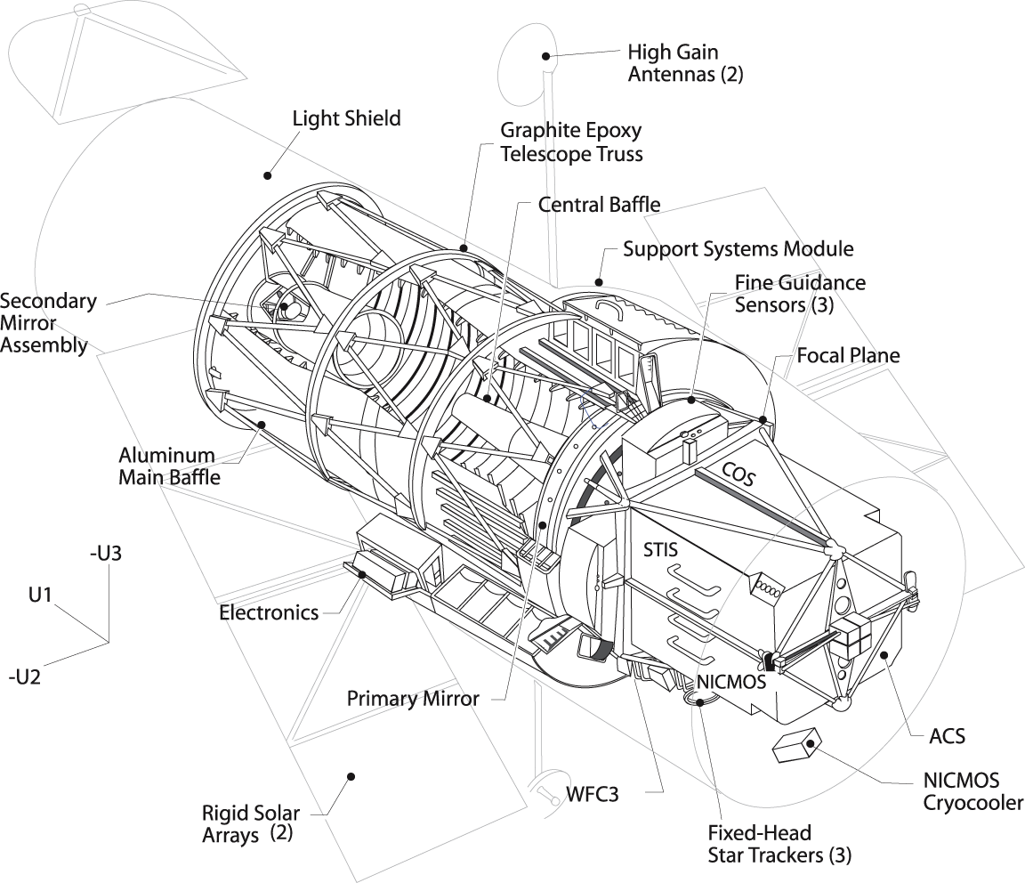
Hubble Space Telescope Cutaway

Slide 32
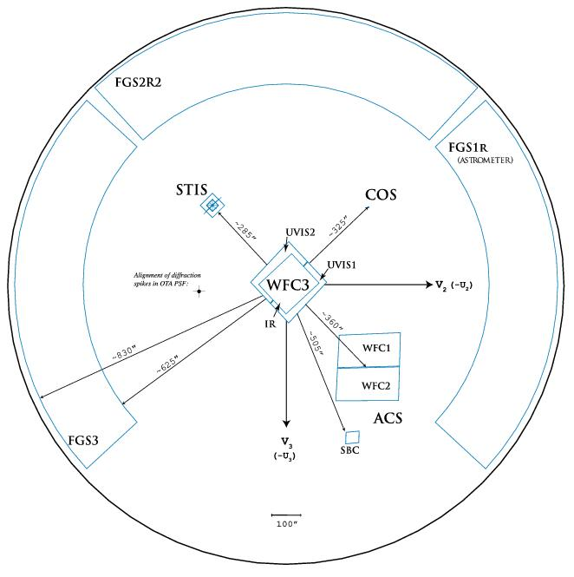
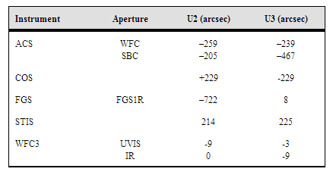
Hubble Space Telescope Field of View
WFC3
ACS
STIS
COS
FGS

Slide 33
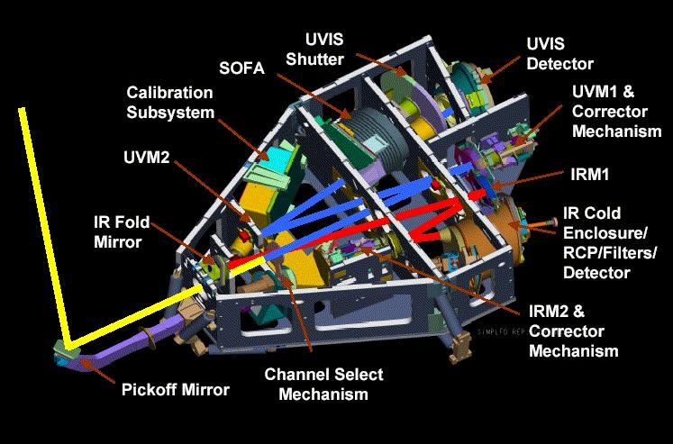
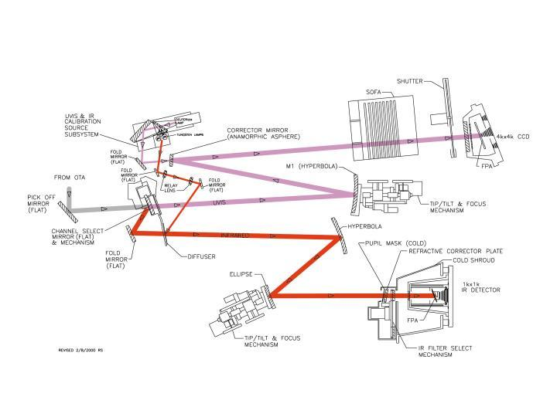
HST: WFC3

Slide 34
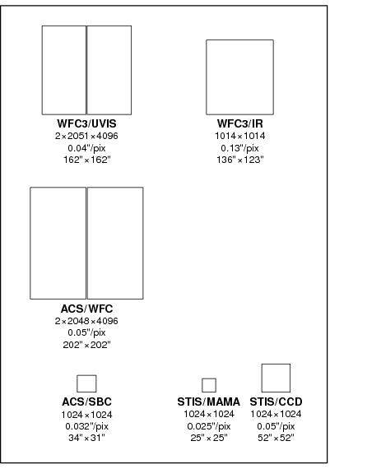
HST: WFC3

Slide 35
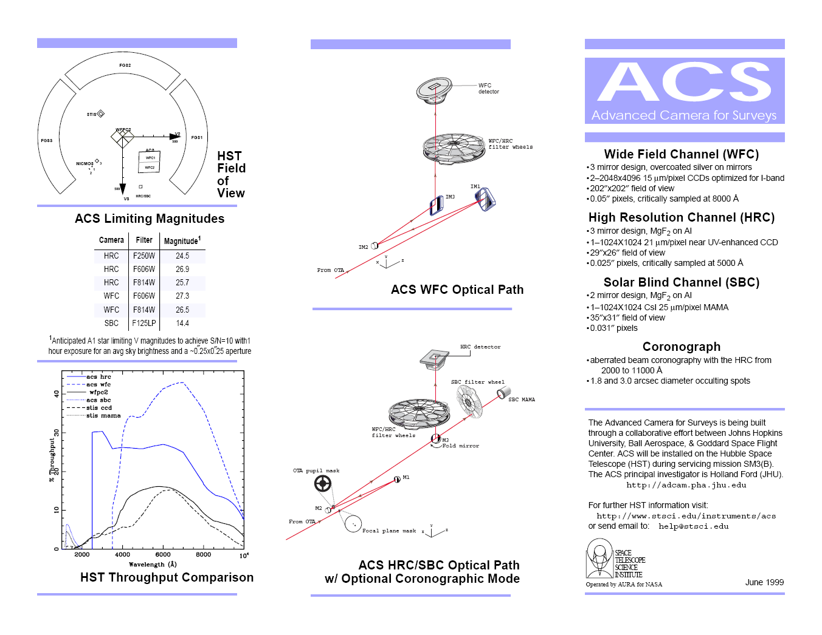
HST: ACS

Slide 36
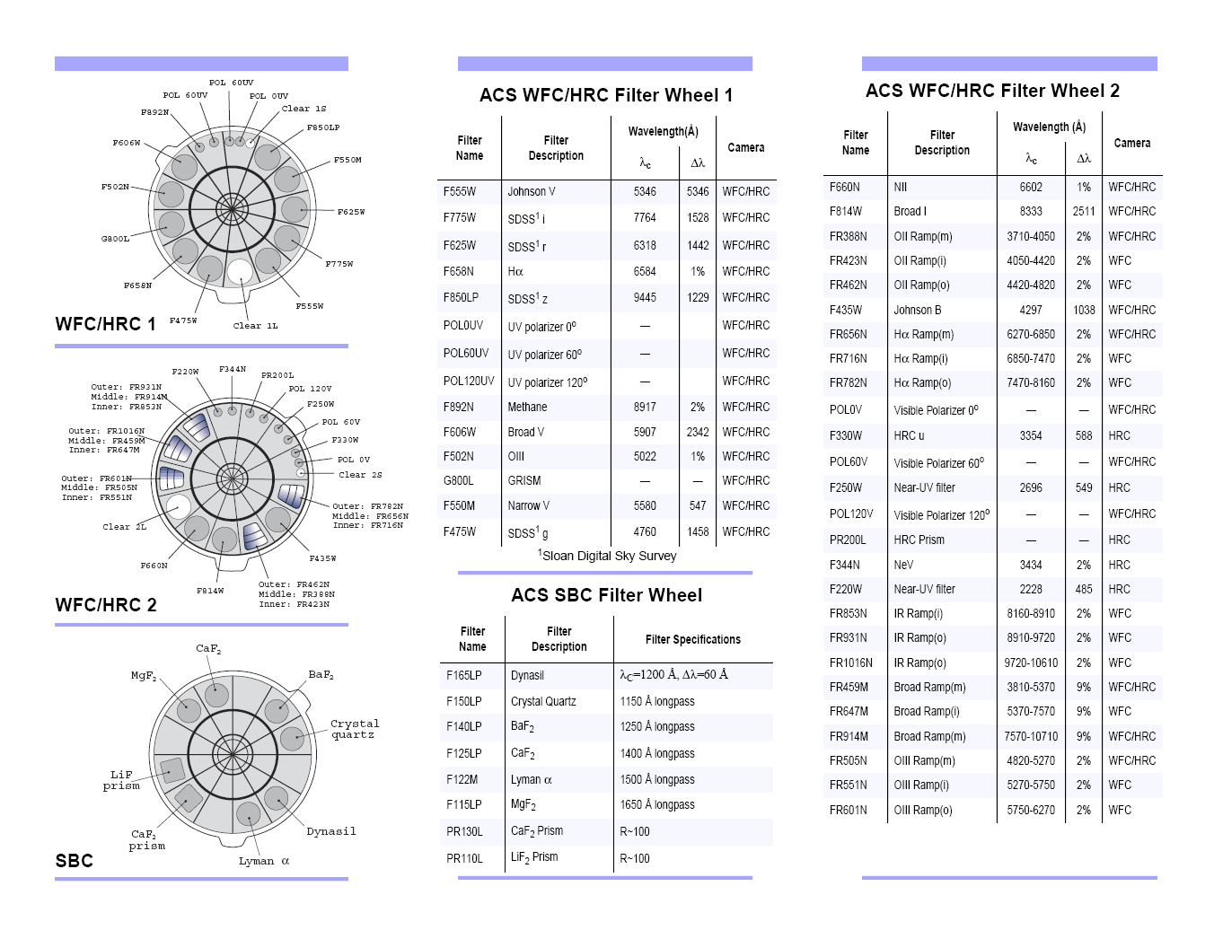
HST: ACS

Slide 37
Chandra Space Telescope
ACIS: Advanced Charged Couple Imaging Spectrometer (ACIS): Ten CCD chips in 2 arrays provide imaging and spectroscopy; imaging resolution is 0.5 arcsec over the energy range 0.2 - 10 keV; sensitivity: 4x10⁻¹⁵ ergs/cm²/sec in 10⁵ s
HRC: High Resolution Camera (HRC): Uses large field-of-view mircro-channel plates to make X-ray images: ang. resolution < 0.5 arcsec over field-of-view 31x31 arc0min; time resolution: 16 micro-sec sensitivity: 4x10⁻¹⁵ ergs/cm²/sec in 10⁵ s
Spectral modes
  High Energy Transmission Grating (HETG): spectral resolution of 60-1000 over energy range 0.4 - 10 keV
  Low Energy Transmission Grating (LETG): spectral resolution of 40-2000 over the energy range 0.09 - 3 keV

Slide 38
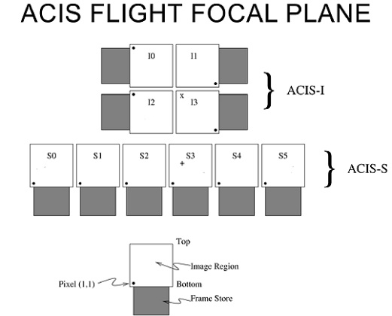
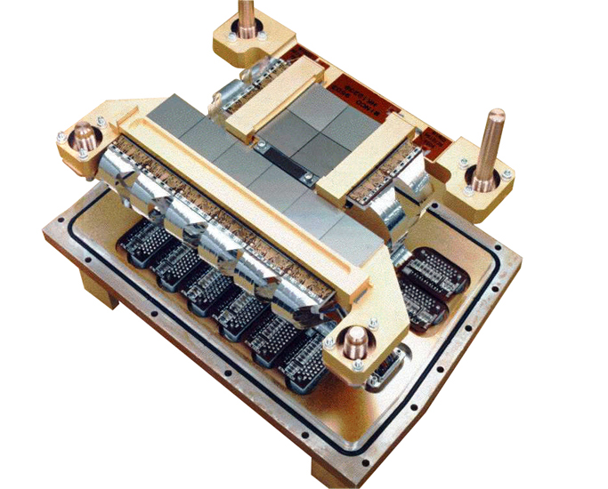
Chandra Focal Plane

Slide 39
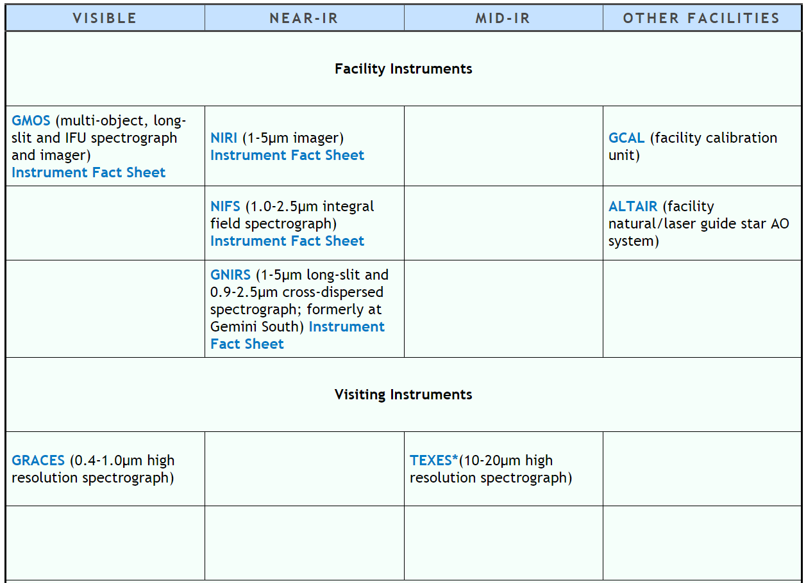
Gemini (North)

Slide 40
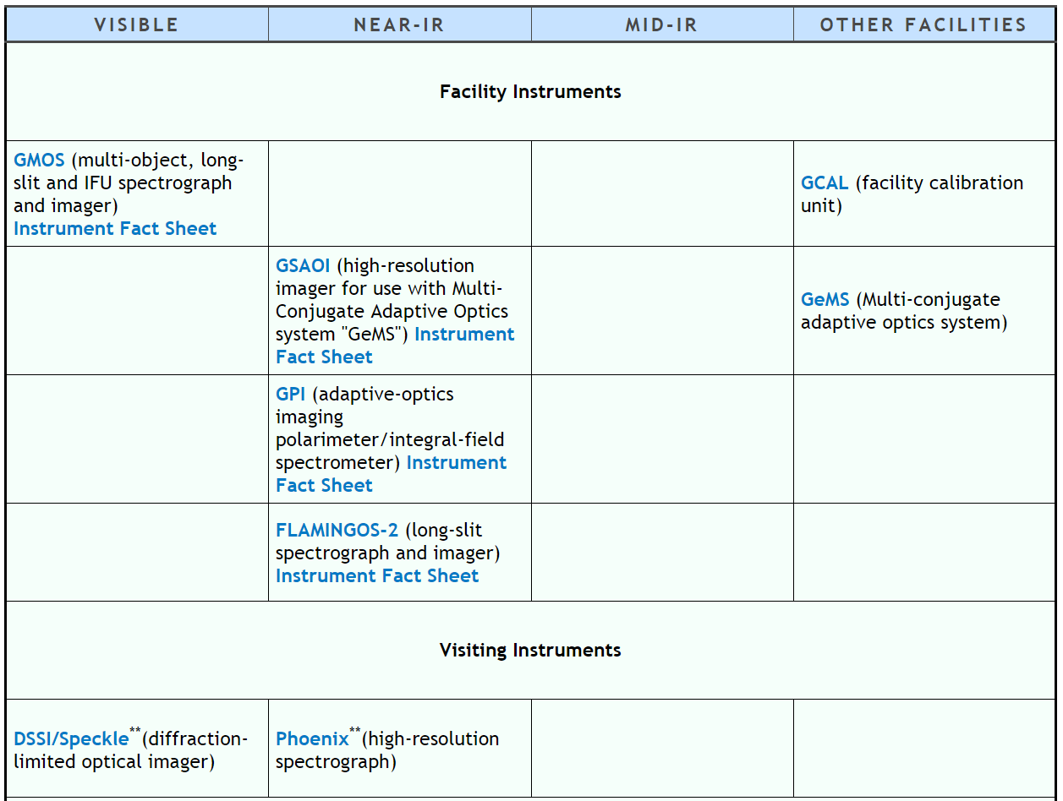
Gemini (South)

Slide 41
instrument examples - JWST

Slide 42
JWST
NIRCAM: near-infrared camera
NIRSPEC: near-infrared spectrograph
MIRI: mid-infrared imager

Slide 43
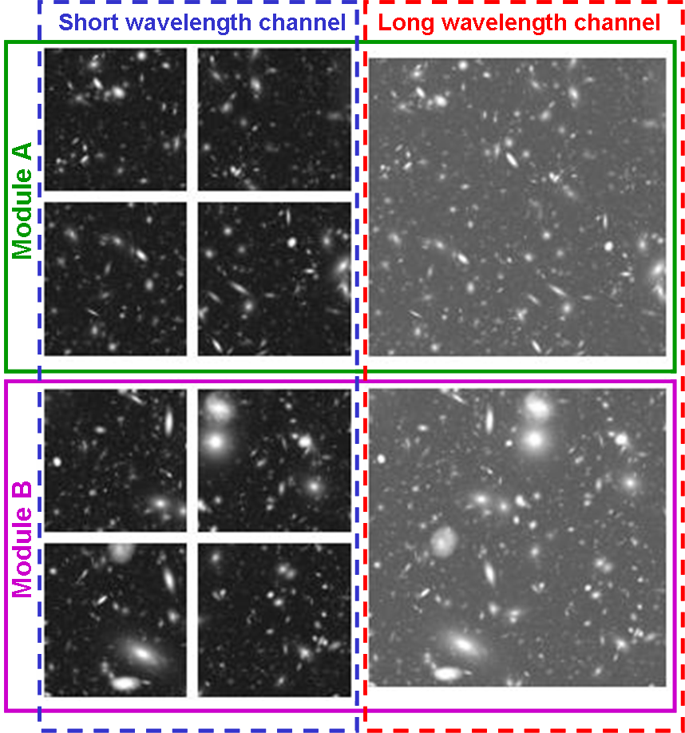
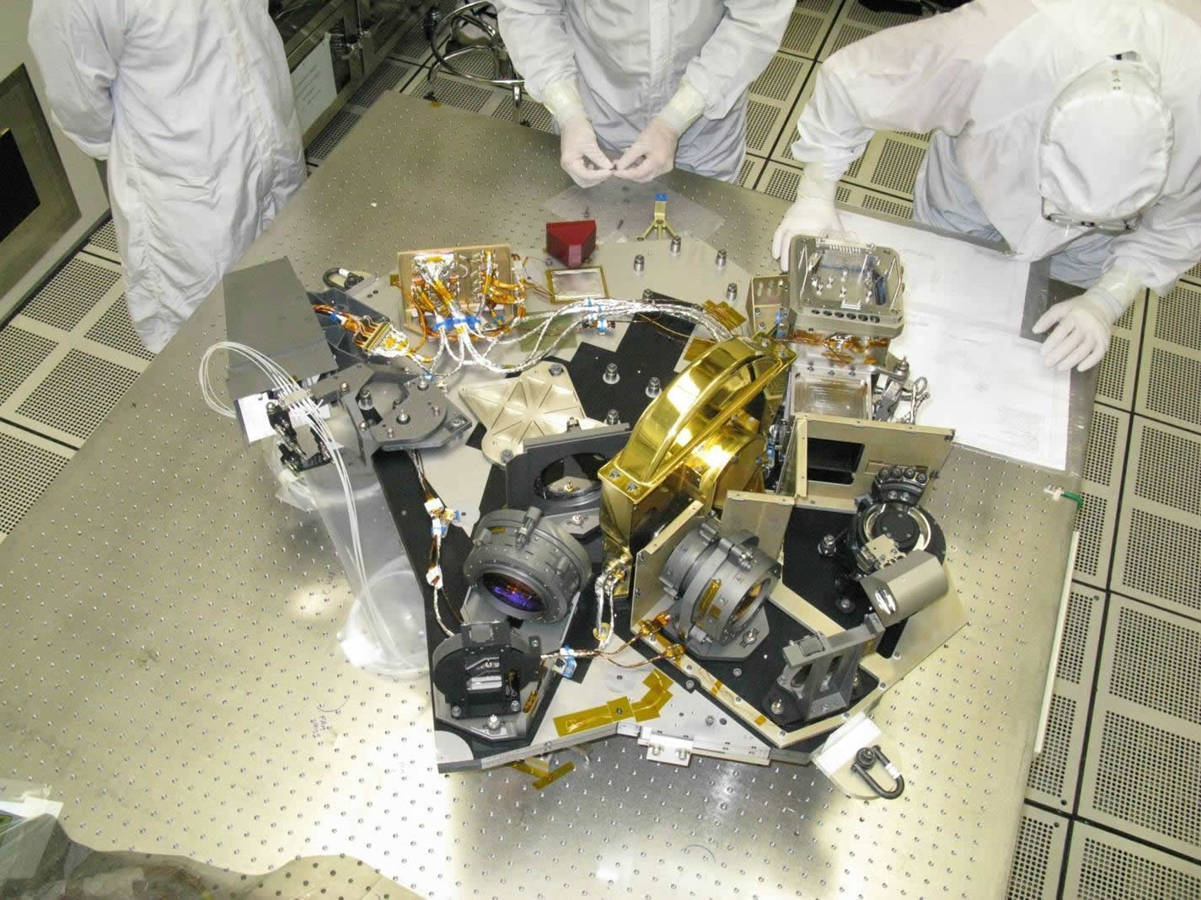
JWST: NIRCAM
Nyquist-sampled imaging at 2 and 4 microns -- short wavelength sampling is 0.032"/pixel and long wavelength sampling is 0.065"/pixel
2.2'x4.4' FOV for one wavelength provided by two identical imaging modules, two wavelength regions are observable simultaneously via dichroic beam splitters.

Slide 44
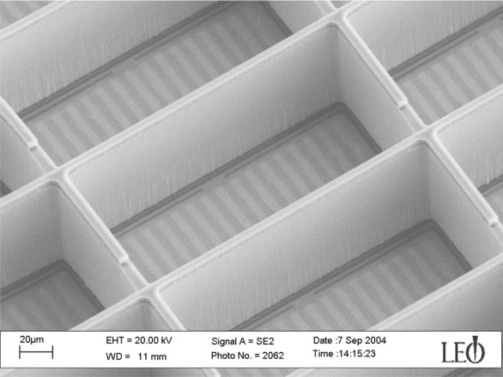
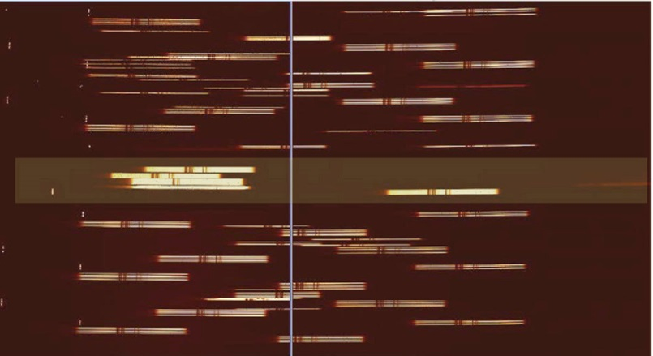
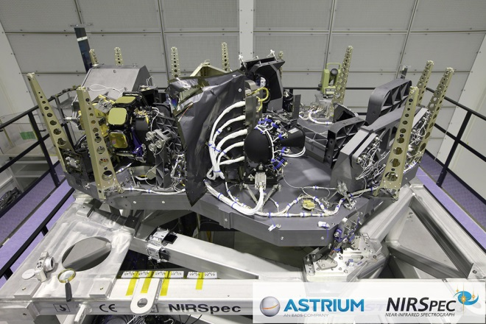
JWST: NIRSPEC
1-5 um; R=100, 1000, 3000
3.4x3.4 arcminute field
Uses a MEMS shutter for the slit

Slide 45
JWST: MIRI
5-27 micron, imager and medium resolution spectrograph (MRS)
MIRI imager: broad and narrow-band imaging, phase-mask coronagraphy, Lyot coronagraphy, and prism low-resolution (R ~ 100) slit spectroscopy from 5 to 10 micron.
MIRI will use a single 1024 x 1024 pixels Si:As sensor chip assembly. The imager will be diffraction limited at 7 microns with a pixel scale of ~0.11 arcsec and a field of view of 79 x 113 arcsec.
MRS: simultaneous spectral and spatial data using four integral field units, implemented as four simultaneous fields of view, ranging from 3.7 x 3.7 arcsec to 7.7 x 7.7 arcsec with increasing wavelength, with pixel sizes ranging from 0.2 to 0.65 arcsec. The spectroscopy has a resolution of R~3000 over the 5-27 micron wavelength range. The spectrograph uses two 1024 x 1024 pixels Si:As sensor chip assemblies.

Slide 46
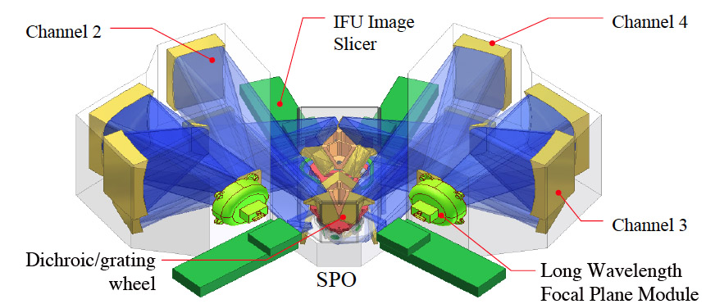
JWST: MIRI MRS

Slide 47
instrument examples - future

Slide 48
Extremely Large Telescopes
Future ELTs include
  Thirty Meter Telescope (TMT)
  Giant Magellan Telescope (GMT)
  European ELT (E-ELT)
Each telescope will have a suite of optical and infrared instruments, including cameras and spectrographs.
There will be seeing-limited and diffraction-limited (aided by Adaptive Optics) instruments.
The spectrographs will include single slit and multi-object designs.

Slide 49
Thirty Meter Telescope
The Wide Field Optical Spectrometer (WFOS) is a seeing-limited instrument and will provide near-ultraviolet and optical (0.3 – 1.0 μm wavelength) imaging and spectroscopy over a more than 40 square arcminute field-of-view.
The Infrared Imaging Spectrometer (IRIS) will provide diffraction-limited imaging and integral-field spectroscopy at near-infrared wavelengths (0.8 – 2.5 μm).
The Infrared Multi-object Spectrometer (IRMS) will allow close to diffraction-limited imaging and slit spectroscopy over a 2 arcminute diameter field-of-view at near-infrared wavelengths (0.8 – 2.5 μm).

Slide 50
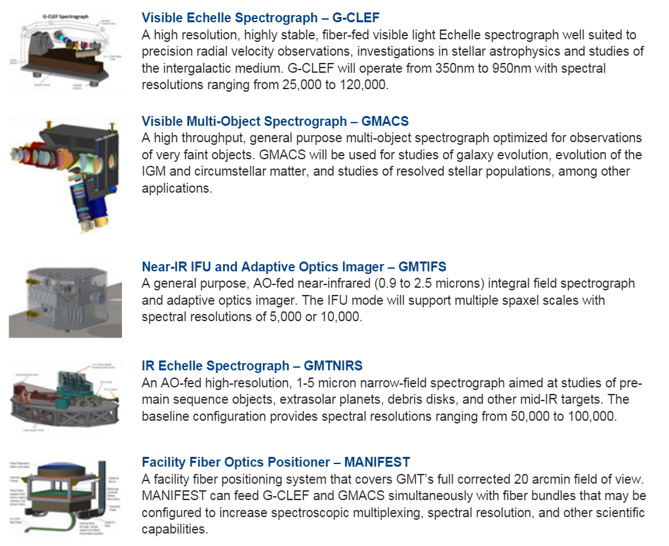
Giant Magellan Telescope

Slide 51
European ELT
Two first-light instruments have been identified: a diffraction-limited near-infrared imager (ELT-CAM) and a single-field near-infrared wide-band integral field spectrograph (ELT-IFU), including the adaptive optics systems required to deliver their science cases.
The next three instruments, a mid-infrared imager and spectrometer (ELT-MIDIR), a high resolution spectrometer (ELT-HIRES) and a multi-object spectrometer (ELT-MOS), were considered of equal scientific importance.
Fabrication is underway with the consortia that will build ELT-IFU (HARMONI), ELT-CAM (MICADO), the MCAO system (MAORY) and ELT-MIDIR (METIS).

Slide 52
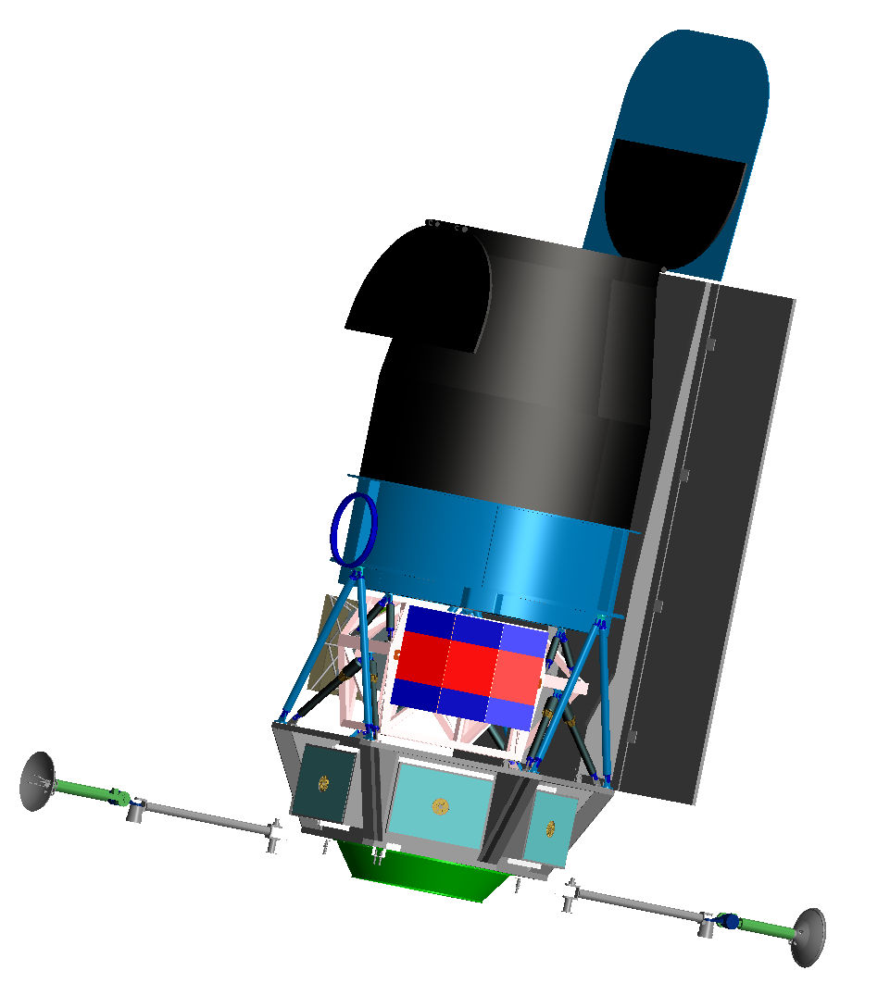
Roman Observatory
Roman uses an old 2.4 m spy telescope.
It seeks to unravel the secrets of dark energy and dark matter, search for and image exoplanets, and explore many topics in infrared astrophysics.
Instruments
  Wide Field Imager/Spectrometer & Integral Field Unit
  Internal Coronagraph with Integral Field Spectrometer
It has a GEO orbit.
Launch in a few years?

Slide 53
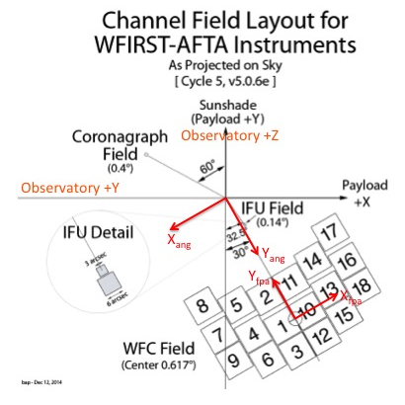
Roman Field Layout

