Slide 1
University Astronomy
Professor Don Figer
Stellar Remnants II

Slide 2
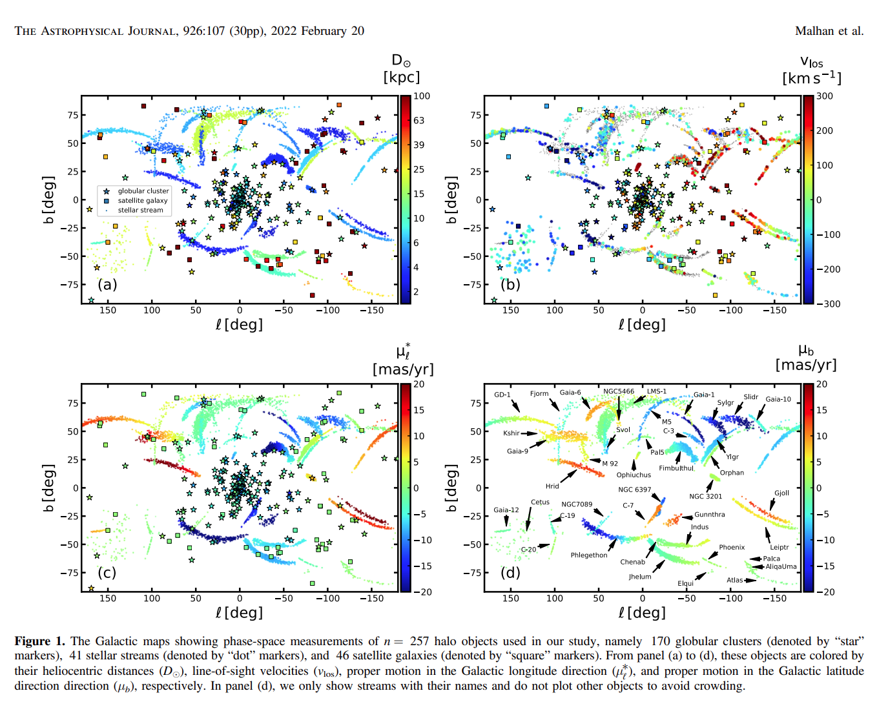
Recent from GAIA
Notes:
2

Slide 3
pulsars

Slide 4
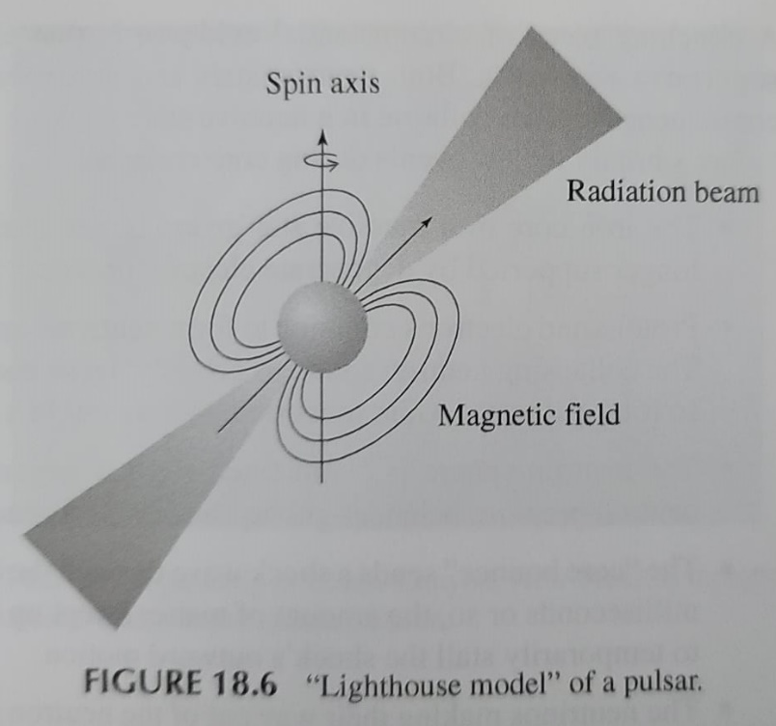
Pulsars (18.2)
Pulsars are neutron stars that appear to “blink” rapidly.
This effect is produced by radiation that the star emits along its poles, combined with a line of sight that sweeps the radiation into our direction.
Neutrons spin at a high rate, so the blinking rate is many times a second.
As an example, the Crab pulsar has a period of 33 ms (30 times a second).
Notes:
2

Slide 5
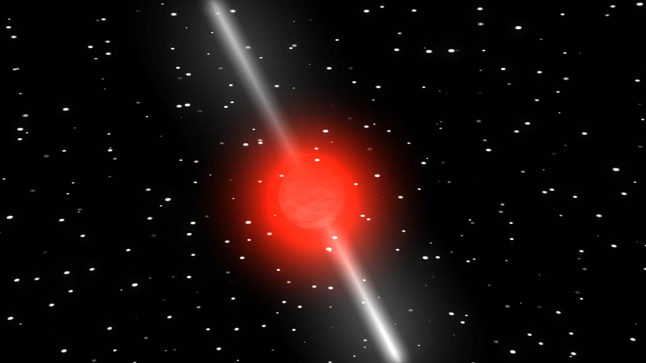
Pulsar Animation
Notes:
2

Slide 6
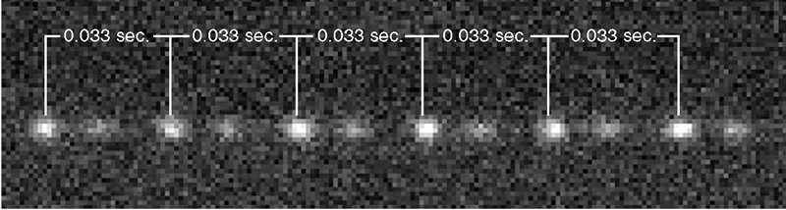
Crab Pulsar Light Variation
Notes:
2

Slide 7
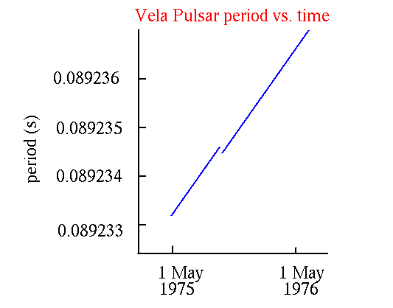
Pulsar Period vs. Time
A rotating object has energy stored in its rotation.
The faster the rotation, the more energy.
Pulsars lose energy.
They radiate energy away that we see in the pulsations.
The Crab pulsar lights up the whole Crab Nebula.
Therefore it should be slowing down.
Careful measurements show that pulsars are very gradually slowing down.
Notes:
2

Slide 8
Pulsar Starquake
The glitch in the plot represents an abrupt change in period.
This apparent speedup is likely due to a disruption on the surface of the neutron star that causes it to become a bit smaller.
The disruption is thought to be associated with cracking of the external crust of the star.
Notes:
2

Slide 9
magnetars

Slide 10
An Energetic Flash
On March 5, 1979, two Soviet spacecraft drifting through the Solar System were hit by a blast of gamma radiation at approximately 10:51 EST.
The measured signal increased from a normal 100 counts per second to over 200,000 counts a second, in only a fraction of a millisecond.
Notes:
2

Slide 11
An Energetic Flash
Eleven seconds later, Helios 2, a NASA probe, was saturated by the blast of radiation.
It soon hit Venus, and the Pioneer Venus Orbiter's detectors were overcome by the wave.
Seconds later, Earth received the wave of radiation, where the powerful output of gamma rays inundated the detectors of three U.S. Department of Defense Vela satellites, the Soviet Prognoz 7 satellite, and the Einstein Observatory.
Just before the wave exited the Solar System, the blast also hit the International Sun-Earth Explorer.
Notes:
2

Slide 12
An Energetic Flash
This extremely powerful blast of gamma radiation constituted the strongest wave of extra-solar gamma rays ever detected; it was over 100 times more intense than any known previous extra-solar burst.
Because gamma rays travel at the speed of light and the time of the pulse was recorded by several distant spacecraft as well as on Earth, the source of the gamma radiation could be calculated to an accuracy of about 2 arcseconds.
The direction of the source corresponded with the remnants of a star that had gone supernova around 3000 BC.
It was in the Large Magellanic Cloud and the source was named SGR 0525-66.
Notes:
2

Slide 13
Magnetars
Magnetars are neutron stars that have a much higher magnetic field strength than is typical.
Normal neutron stars already have strong magnetic fields, billions of Gauss.
Magnetar magnetic fields are stronger, ~10¹⁵ G = petagauss.
It is not clear why magnetars have such strong magnetic fields.
The field strength is estimated through the spin down rate.
Notes:
2

Slide 14
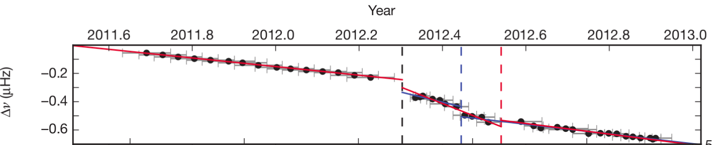
Magnetar Spin Down
As with any neutron star, the spin down rate (frequency, ν) gradually decreases as rotational energy is lost to radiation emission.
Occasionally, there is an abrupt change, representing a massive star quake.
The change is correlated with enormous gamma-ray emission.
Notes:
2

Slide 15
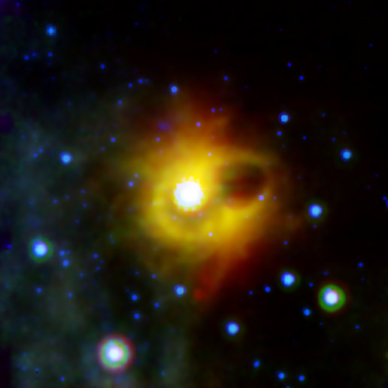
SGR 1900+14
20,000 light years away and ionized
Earth’s atmosphere in 1998!
at center of image, but not visible
Notes:
2

Slide 16
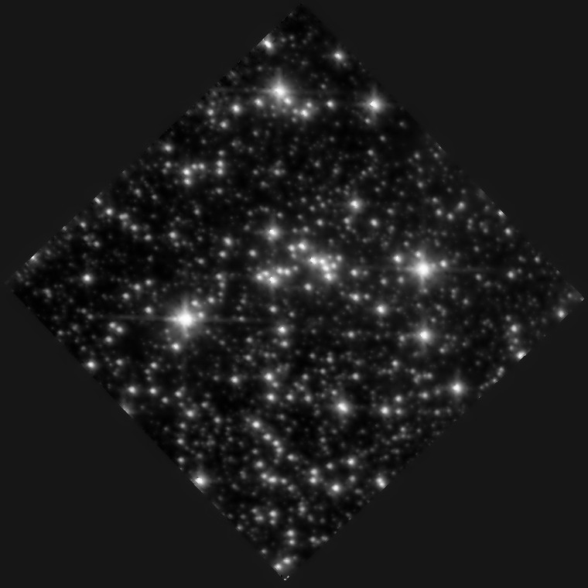
SGR 1806-20
Most magnetic object in Universe!
at center of image, but not visible
Notes:
2

Slide 17
SGR 1806-20 Mass
The cluster around SGR 1806-20 has a main sequence turnoff corresponding to approximately 50 M_{Sun}.
This is a bit puzzling.
Shouldn’t such a massive star make a black hole?
Why hasn’t it?
Notes:
2

Slide 18
gamma ray bursts

Slide 19
Gamma Ray Bursters (GRBs)
GRBs are extremely energetic explosions that have been observed in distant galaxies.
They are the brightest electromagnetic events known to occur in the universe.
Bursts can last from milliseconds to several hours.
For a long time, it was not known if they were located within our galaxy or outside of it.
GRBs have now been associated with galaxies far away, given their isotropic distribution.
They are related to massive star supernovae.
Their energies are ~10⁴⁶ J.
Notes:
2

Slide 20
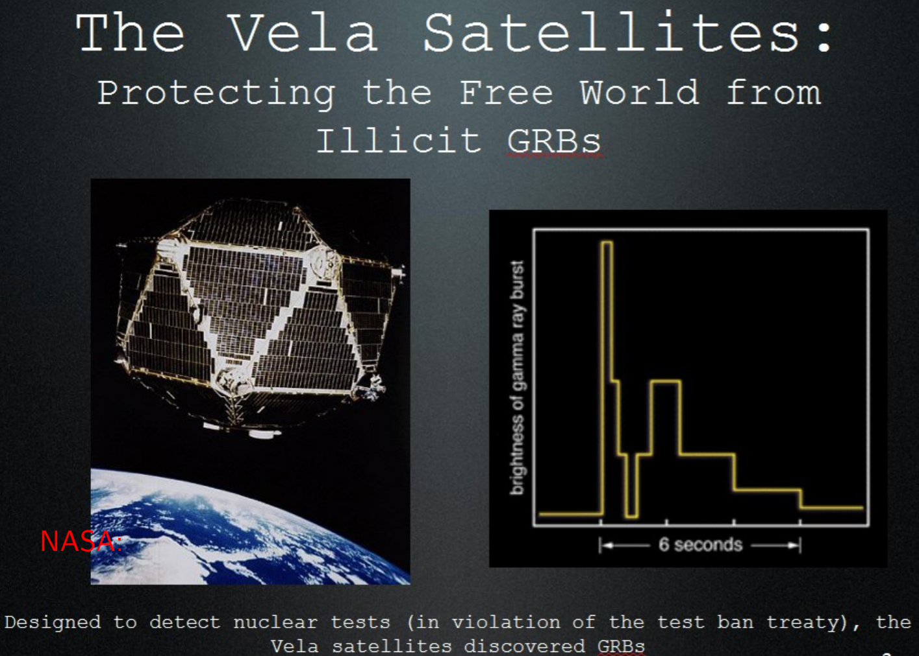
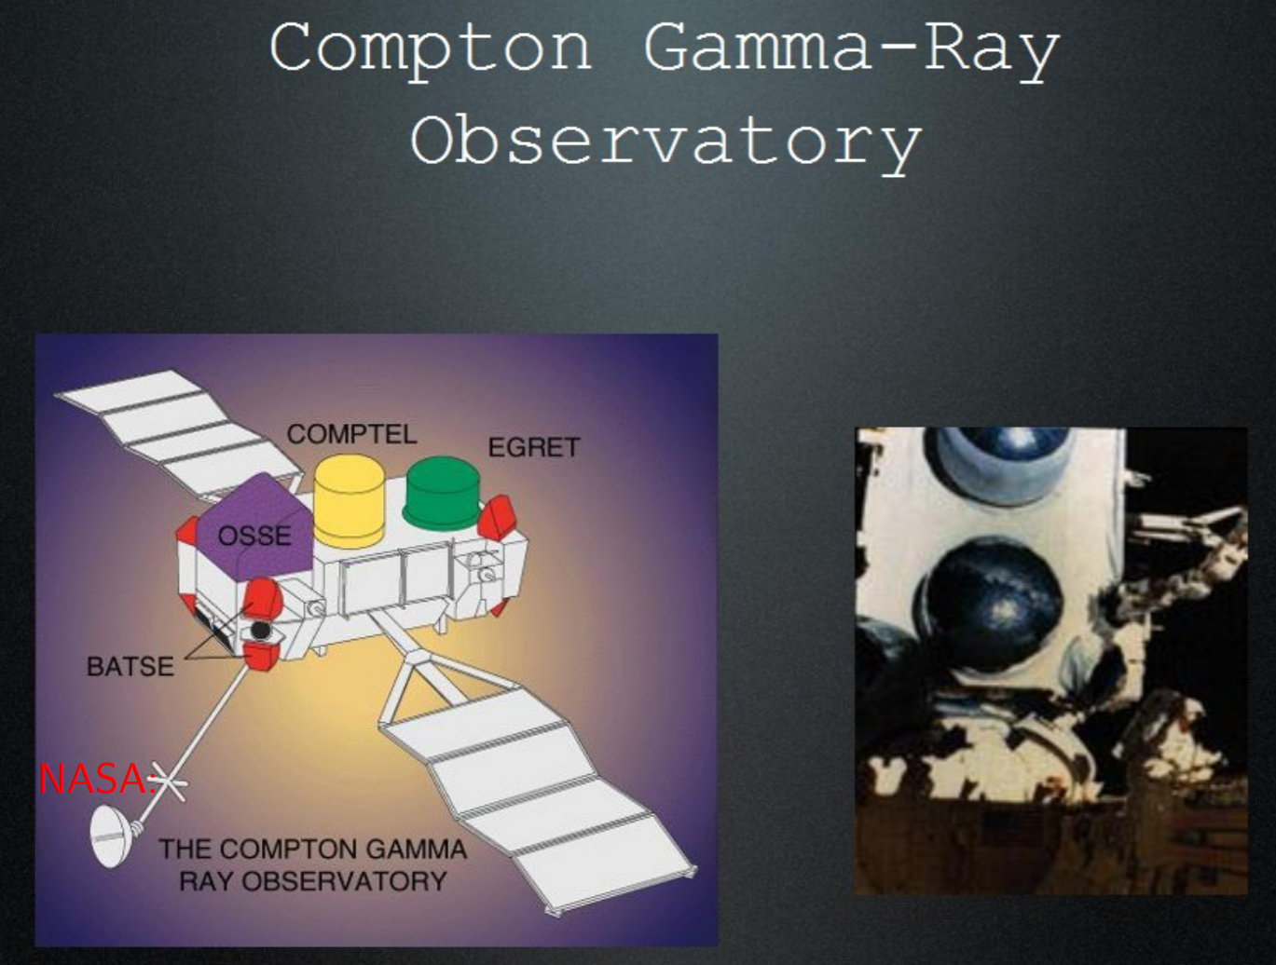
GRB Distribution
GRBs were first observed in 1967 by military Vela satellites.
They did not look like nuclear explosions.
The observations were declassified in 1973.
The Burst and Transient Source Explorer (BATSE) on Compton GRO showed that the distribution is isotropic, and therefore cosmological in origin.
In 1997 BeppoSAX detected burst GRB 970228.
The x-ray camera detected fading emission and optical observations showed the same. Deep observations found a host galaxy.
BeppoSAX found a second GRB at 6 Glyr away.
Notes:
2

Slide 21
Vela Satellites
Notes:
2

Slide 22
Compton Gamma-Ray Observatory
Notes:
2

Slide 23
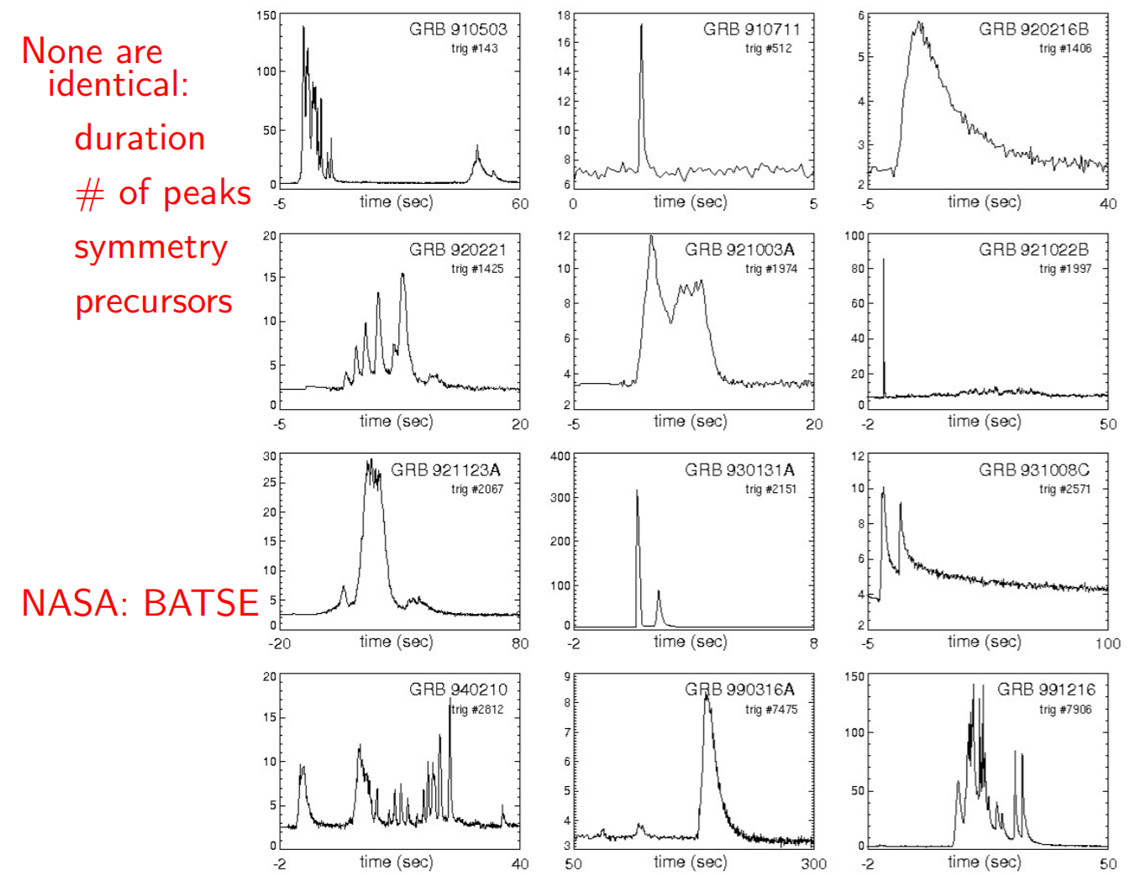
GRB Light Curves
Notes:
2

Slide 24
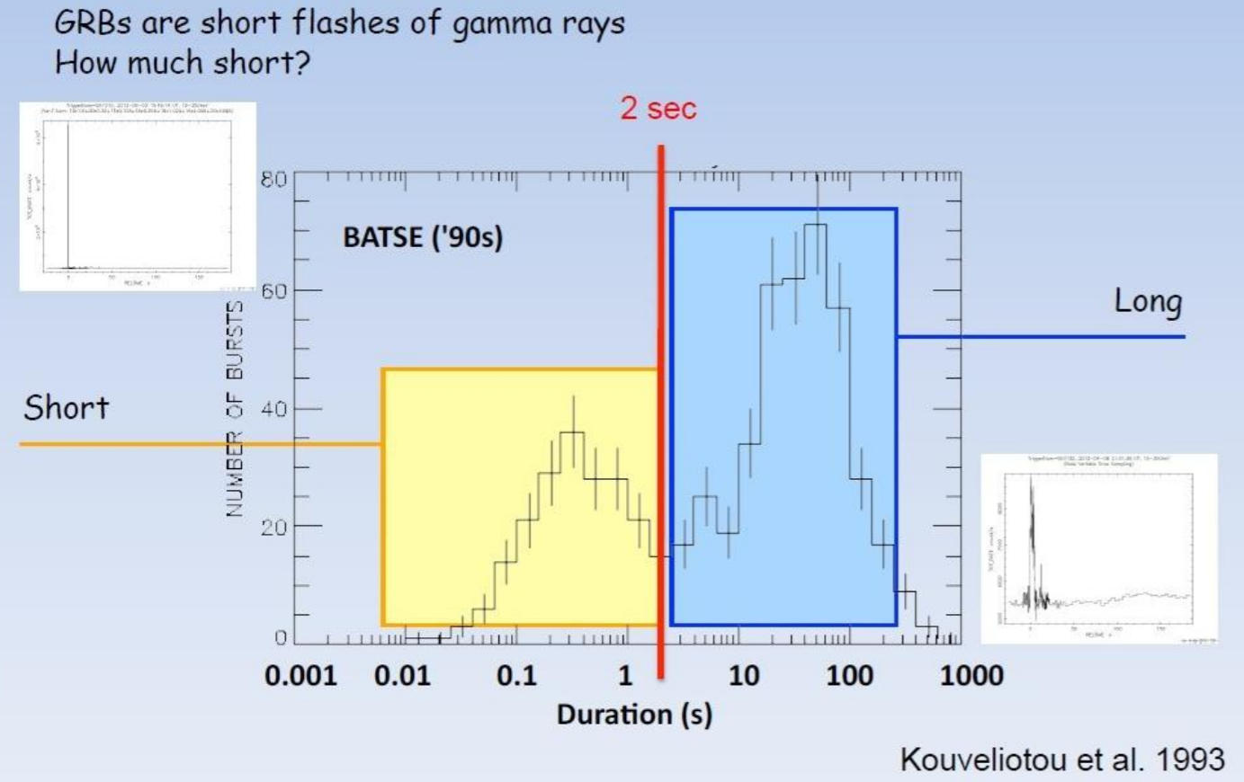
Two Types of GRBs
Notes:
2

Slide 25
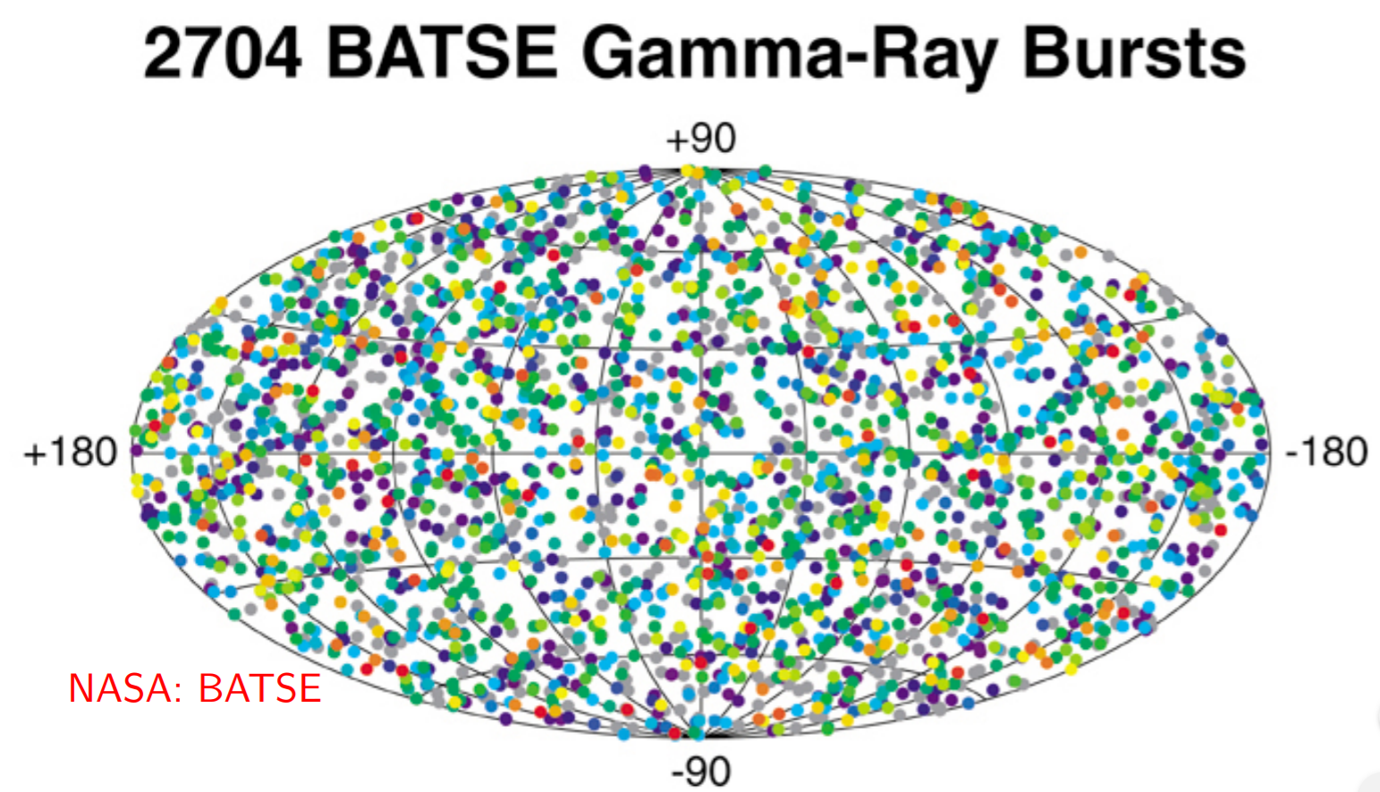
GRB Distribution
colors correspond to x-ray brightness, with red brightest and purple faintest
Notes:
2

Slide 26
GRB Progenitors
GRBs come in two varieties, short-duration and long-duration.
The long-duration GRBs are thought to be caused by “collapsars,” in which a massive star collapses while forming an accretion disk in the core that directs all the energy into narrow bipolar beams that can escape in stars without hydrogen.
  seen in star formation regions
  followed by massive star supernovae (Type Ic)
The short-duration GRBs might come from compact object binary mergers.
  seen in galaxies without much star formation
  not followed by supernovae
Notes:
2

Slide 27
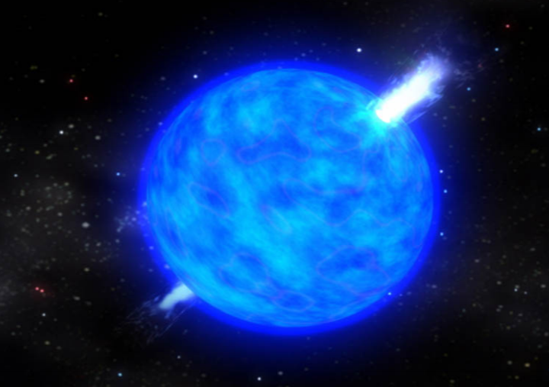
GRB Energetics
The energy is typically >10⁴⁶ J.
This is too high for normal objects, so emission must be beamed.
A rapidly rotating and highly magnetized black hole is formed.
It beams relativistic electrons into nearby material, causing the emission of gamma rays.
Some are optically muted due to local dust.
Notes:
2

Slide 28
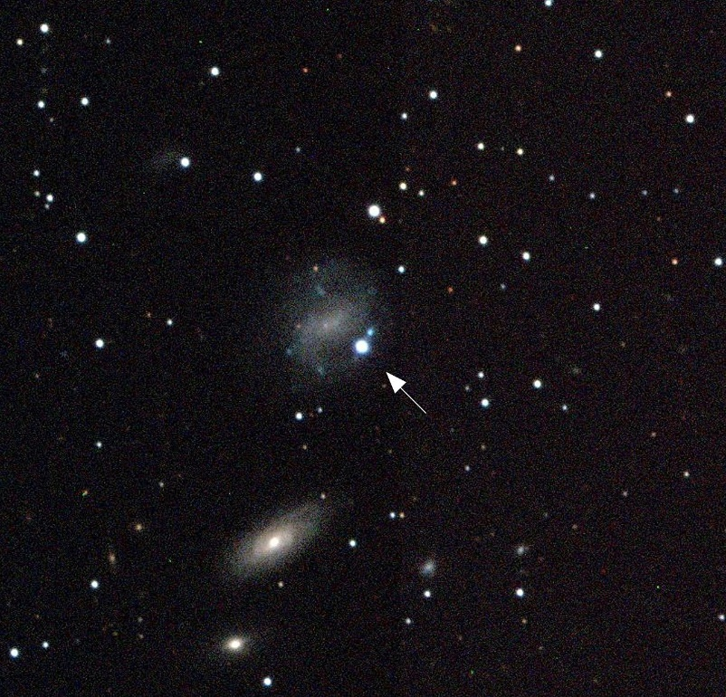
GRB Example
The picture shows a Type Ib SN (1998bw) one day after a GRB 980425 at the same location.
The host galaxy has massive stars near the SN.
This is the first evidence that GRBs are related to massive stars.
It is thought that the progenitor had initial mass of 25-40 M_{Sun}.
Notes:
2

Slide 29
black holes

Slide 30
Black Holes (18.3)
Black holes are objects so massive that they cannot be supported by neutron degeneracy pressure.
The escape velocity exceeds the velocity of light.
The consensus is that objects with more than 3 M_{Sun} at the ends of their lives will collapse to become black holes.
Note that massive stars have strong winds that remove much of their envelope before the collapse.
For example, some data and models suggest that stars with ~20 M_{Sun} in initial mass will end their lives with only 3 M_{Sun} of mass.
Notes:
2

Slide 31

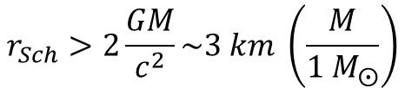
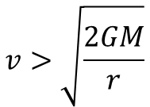
Escape Velocity
The escape velocity corresponds to the velocity a particle must have in order to escape from the gravity of another object.
We can calculate this by requiring that the kinetic energy of the particle exceed the gravitational potential energy of the object.
$$KE=\frac{1}{2}mv^{2}>G\frac{M}{r}m$$
$$v>\sqrt{\frac{2GM}{r}}$$
Setting v=c, we find the “size” of the object that would be able to “pull” light inward.
$$r_{Sch}>2\frac{GM}{c^{2}}\sim 3 km \left(\frac{M}{{1 M}_{⨀}}\right)$$
r_{Sch} is the “Schwarzchild” radius.
Notes:
2

Slide 32
Event Horizon
The event horizon is the surface around the black hole that separates the region for which nothing can escape from the rest of the Universe. It is the point of no return!
It is located at the Schwarzchild radius.
An object near (but outside) the event horizon appears red-shifted and slows down when viewed by an external observer due to relativity. The object does not sense these effects.
The material just outside the event horizon accretes on to the black hole in a disk. This generates friction and high temperatures. In turn, the material radiates energy that can be seen at high energies, such as x-rays and gamma rays.
Notes:
2

