Slide 1
University Astronomy
Professor Don Figer
The Galaxy

Slide 2
Aims and outline for this lecture
describe the properties, morphology, and constituents of the Galaxy

Slide 3
introduction

Slide 4
Our Galaxy Seen From Earth
The stars in the sky are not distributed evenly.
When we look at the sky from a dark site (out of the city) we can see a faint fuzzy band of light circling the sky.
The fuzzy band reminded the Ancient Greeks of spilt milk, so they called the band the Milky Way.
The Greek word for milk is gala and in Greek the word for Milky Way is Galaxy.
Today we use the word galaxy to describe any large collection of stars.
In the winter sky you can see the Milky Way pass through the "feet" of Gemini, through Auriga, through the "head" of Perseus and into Cassiopeia.
Through a telescope (or binoculars) you can see that there are many more stars in the regions in and near the Milky Way than in directions far from the Milky Way.
The Milky Way is composed of lots of stars, most of which are too far away for us to see individually.
Instead of seeing lots of point-like stars, we just see a fuzzy glow from the added light of the stars.

Slide 5
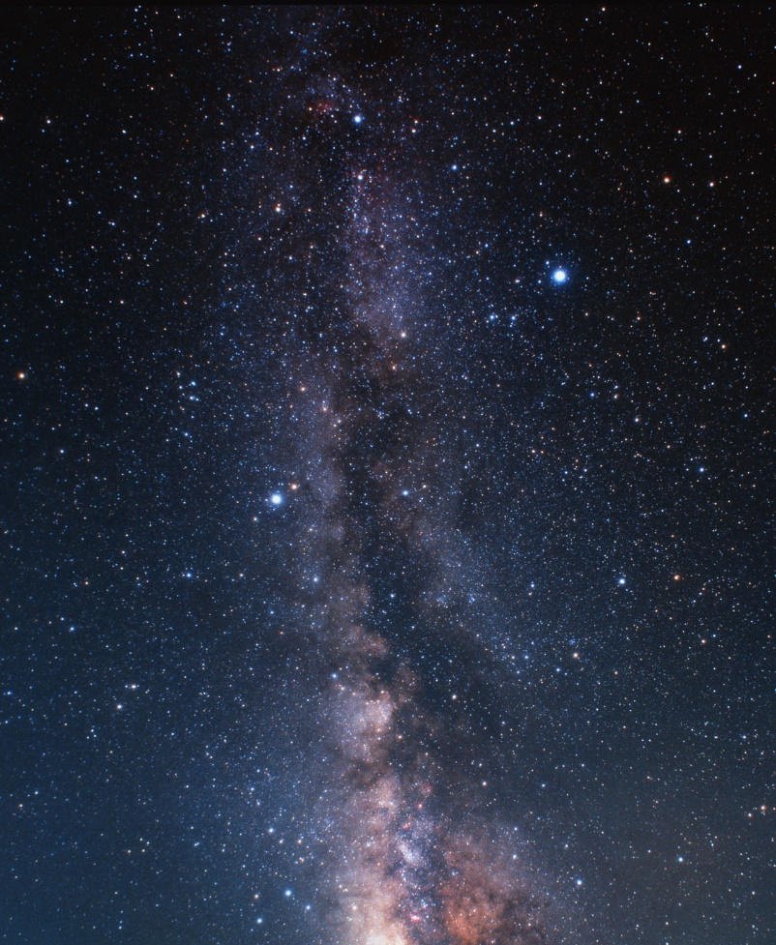
Our Galaxy
Our Galaxy, sometimes called “the Milky Way,” contains the Sun, a few hundred billion other stars, gas, dust, planets, etc.
You can see evidence of it in the night sky as a “milky” splash of light on the celestial sphere.
This diffuse emission is actually the light from the many stars in the disk of the Galaxy.
We see fewer stars when we look above and below this disk.

Slide 6
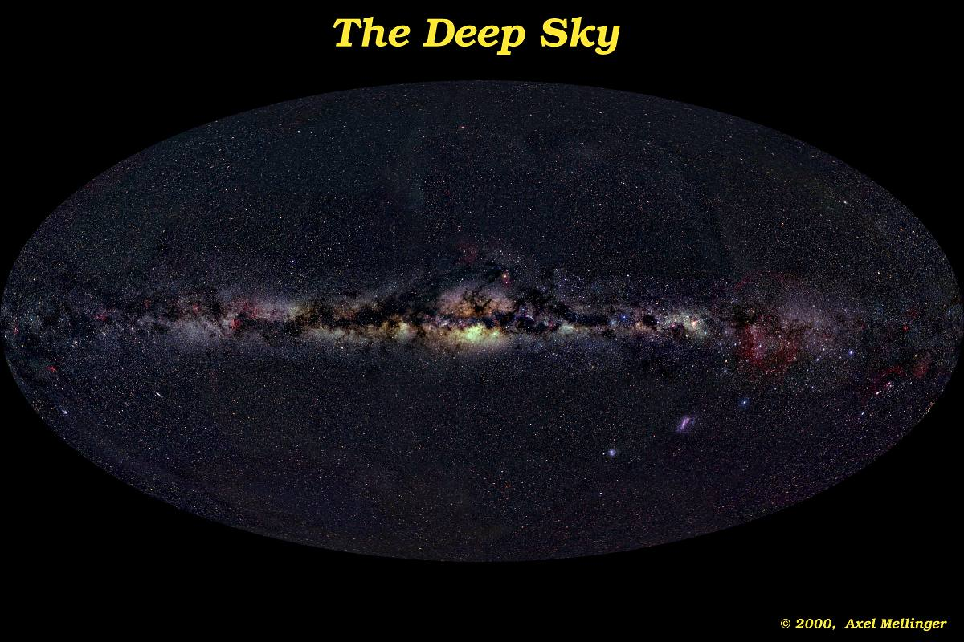
Our Galaxy Seen From Earth

Slide 7
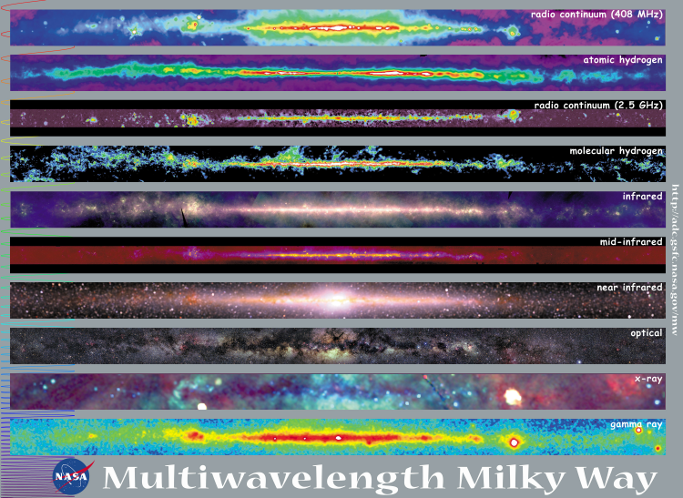
Our Galaxy at Various Wavelengths

Slide 8
Our Galaxy Fast Facts
a few hundred billion stars
a few trillion solar masses in material (mostly dark matter)
approximately 120,000 ly across, 1,500 ly thick
spiral shape
disk (young stars, gas, dust)
bulge (intermediate-age, metal rich stars)
halo (old, metal poor stars)
several satellite galaxies
old as the Universe
supermassive black hole in center
part of Virgo supercluster

Slide 9
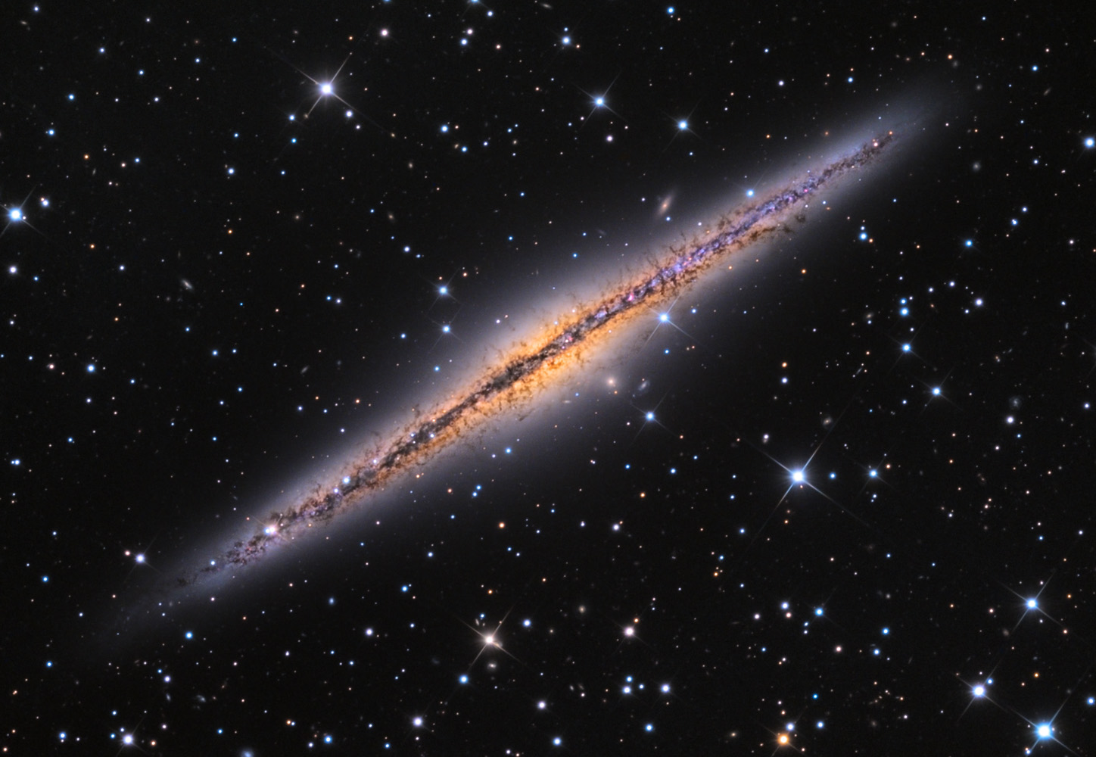
Similar to NGC 891

Slide 10
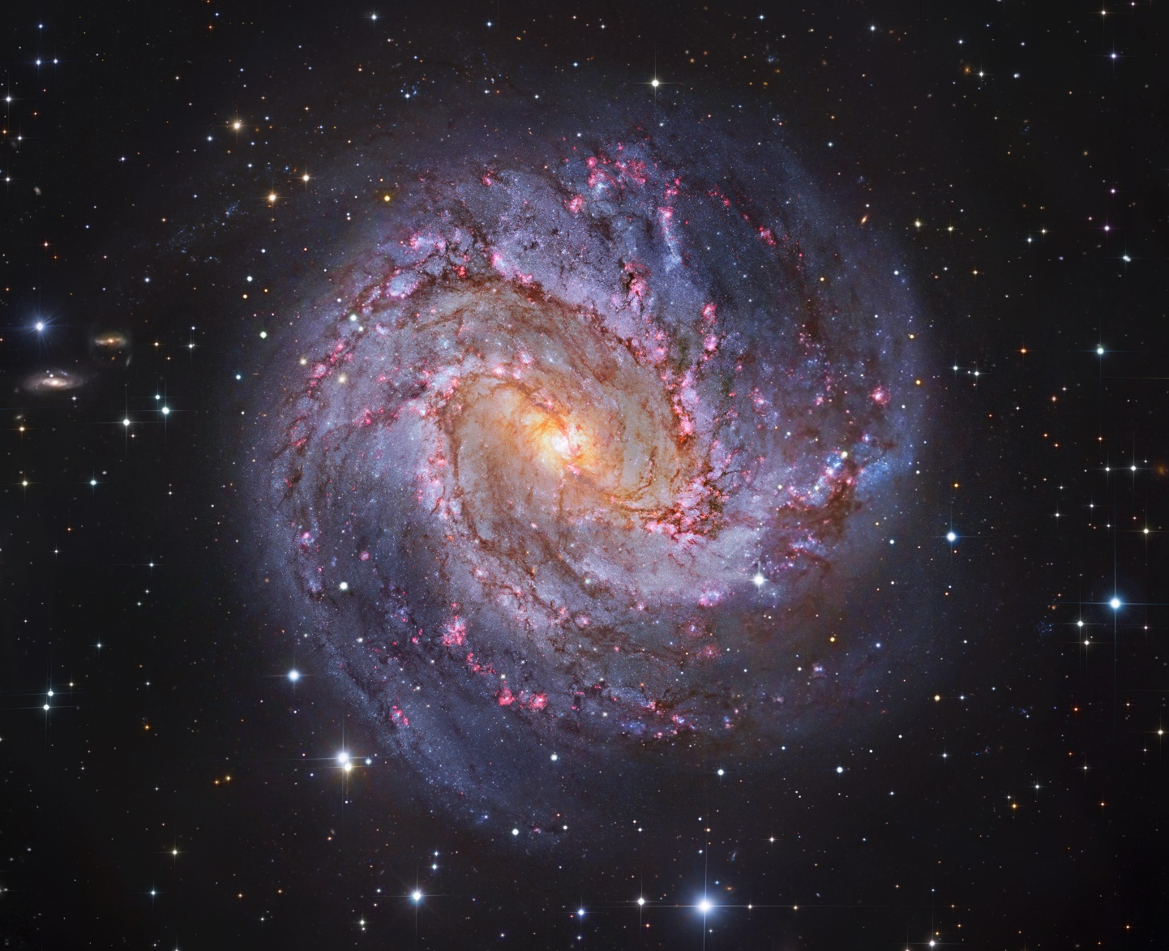
Similar to M83

Slide 11
morphology

Slide 12
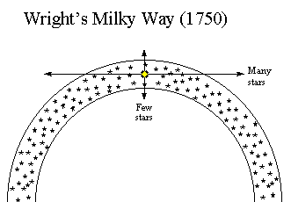
Shape of the Galaxy (1750)
Thomas Wright (1750), motivated by theological considerations, made no new observations, but created a model of the Galaxy as a thin spherical shell of stars. The Sun is located inside the shell about midway between the inner and outer edges.

Slide 13
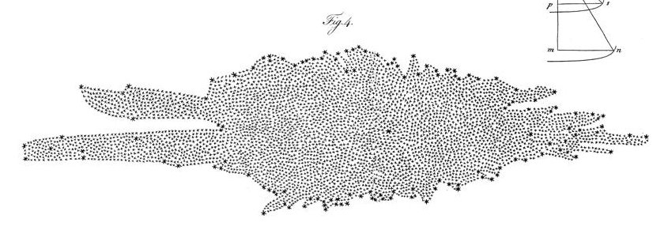
Shape of the Galaxy (1785)
The graphic below is a map of the Milky Way by William Herschel, from On the Construction of the Heavens, published in Philosophical Transactions of the Royal Society of London, Vol. 75 (1785), pp. 213-266.
Herschel assumed all stars equally luminous.

Slide 14
Shape of the Galaxy (~1920)
Jacobus Kapteyn (1901 thru 1922):
  Used photographic star counts
  Estimated distances statistically based on parallaxes & proper motions of nearby stars.
  Neglected interstellar absorption of starlight (assumes that stars were faint only because they far away, not because interstellar absorption blocks some of the light).
In his model, the Milky Way is a flattened disk ~15 kpc across & ~3 kpc thick.
The Sun is located slightly off-center.

Slide 15
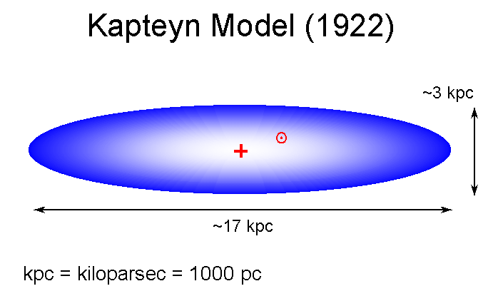
Kapteyn Model

Slide 16
Shape of the Galaxy (~1920)
Harlow Shapley (1915 thru 1921) made a model.
He was an Astronomer at the Harvard College Observatory who was working on the nature of Globular Clusters of Stars.
Shapley noted two facts about Globular Clusters:
  They are uniformly distributed above & below the plane of the Milky Way.
  They are concentrated on the sky toward the direction of the constellation of Sagittarius, where the Milky Way appears brightest.
Observations:
  Estimated Globular Cluster distances from observations of their RR Lyrae stars and their magnitudes and diameters.
  Used these distances to map the globular cluster distribution in space.

Slide 17
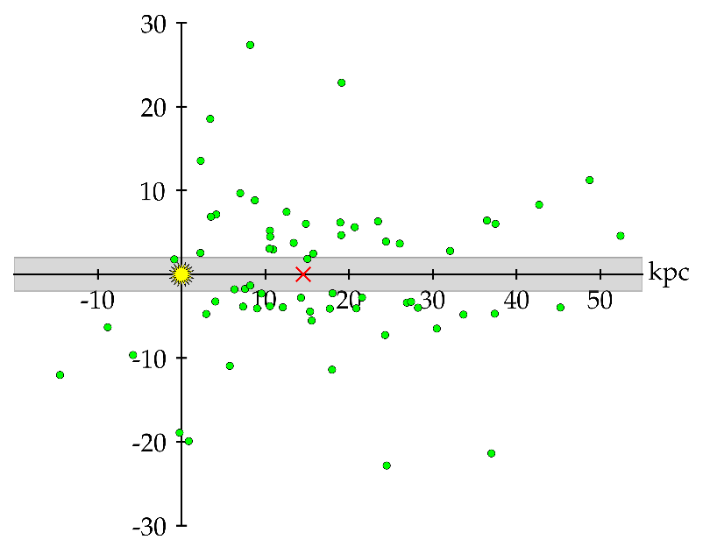
Globular Distribution
The graph is based on Shapley's original 1918 globular cluster data.
The Sun is located at the center of the axes as the yellow sun symbol, and the center of the Milky Way inferred from the distribution of globular clusters is marked by the red X at about 15kpc from the Sun.
The gray horizontal band is a region of obscuration noted by Shapley.

Slide 18
Shapley’s Conclusions
Shapley's Results (1921):
  Globular clusters form a subsystem centered on the Milky Way.
  The Sun is ~15 kpc from the MW center.
  MW is a flattened disk ~100 kpc across
The basic result is correct, but the size estimate is too large. This is because
  Shapley ignored interstellar absorption
  Caused him to overestimate the distances.

Slide 19
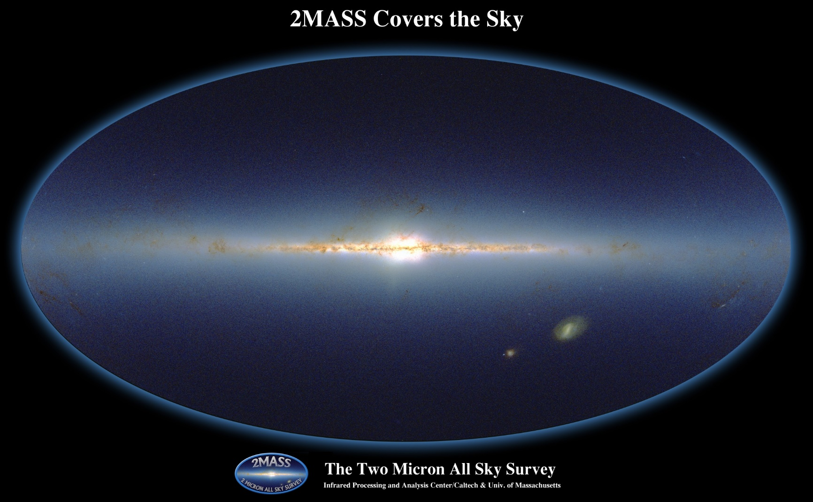
2MASS

Slide 20
OB Stars and HII Regions
Since spiral arms are the location of star-birth, we can map the location of the arms by mapping the location of O-B stars and ionized hydrogen regions.
This works for small distances (out to about 3 kpc) since the light from these objects is mainly visible light which is obscured by dust.
H and CO is concentrated in the spiral arms, so if we can find the distance out to H and CO clouds we can map the structure of the spiral arms.

Slide 21
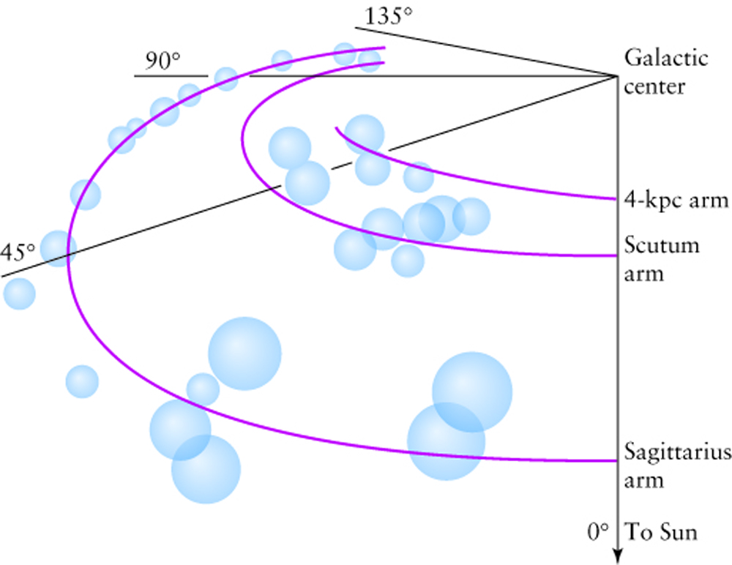
OB Stars and HII Regions

Slide 22
HI 21 cm Emission
Neutral Hydrogen at rest emits a photon with 21 cm wavelength when the electron spin flips.
If the Hydrogen cloud is moving along our line-of-sight, the emission line will be either redshifted or blueshifted.
We can determine the radial velocity (line-of-sight velocity) of H clouds.
Since we already know the rotation curve for our galaxy, which tells us how fast objects orbit the Galactic center, we can use trigonometry to reconstruct the locations of the spiral arms.
Reconstructions give a picture similar to the diagram on the next slide.

Slide 23
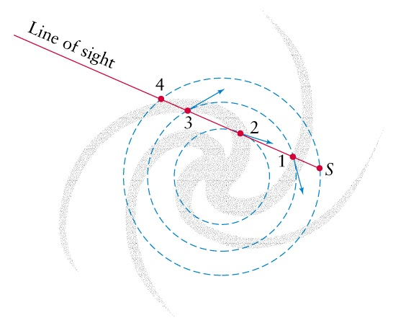
HI 21 cm Emission

Slide 24
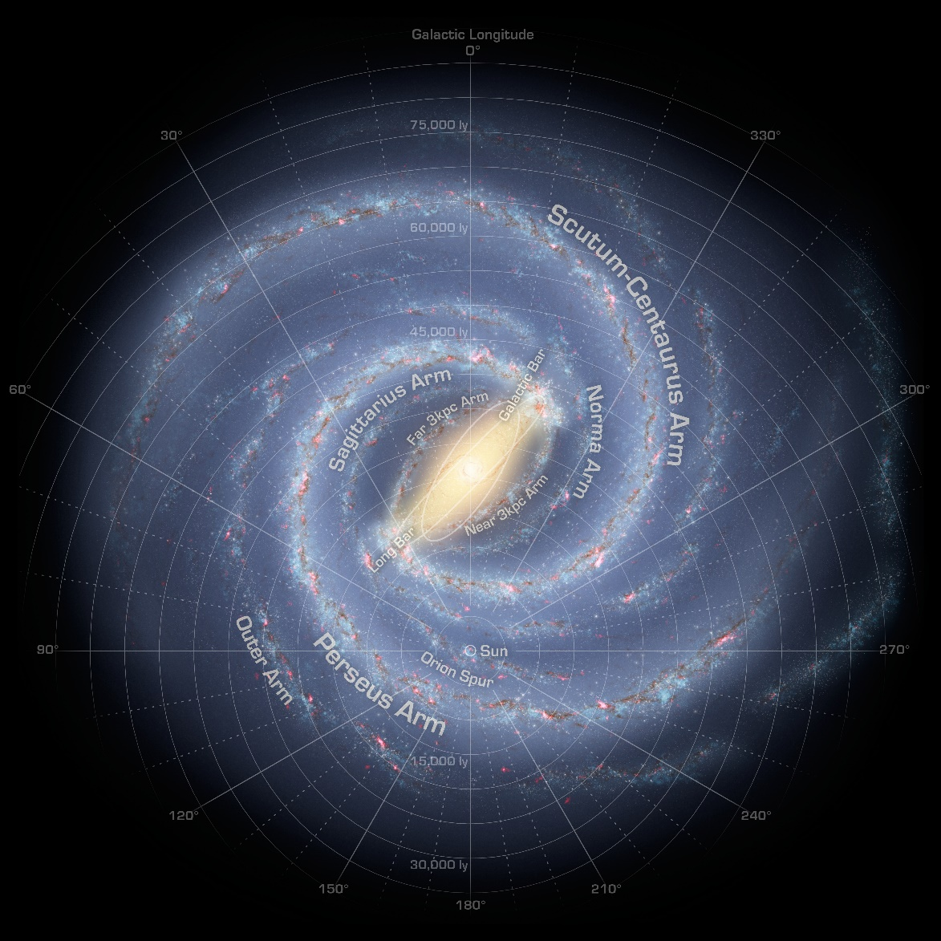
Current Model

Slide 25
galaxy formation

Slide 26
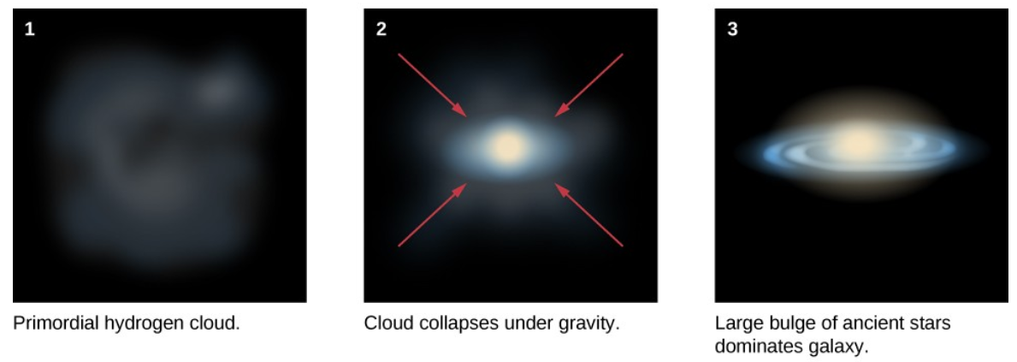
Pancake Model

Slide 27
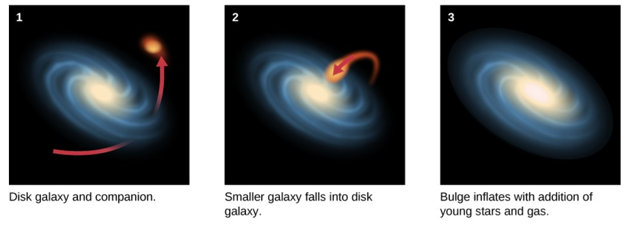
Collisions

Slide 28
local stellar motions

Slide 29
Stellar Velocity Definitions
Radial velocity is the velocity of an object along the line of sight.
Transverse velocity is the velocity in the plane of the sky.
Space velocity is the 3D velocity vector.
Proper motion is the apparent motion in the plane of the sky.

Slide 30
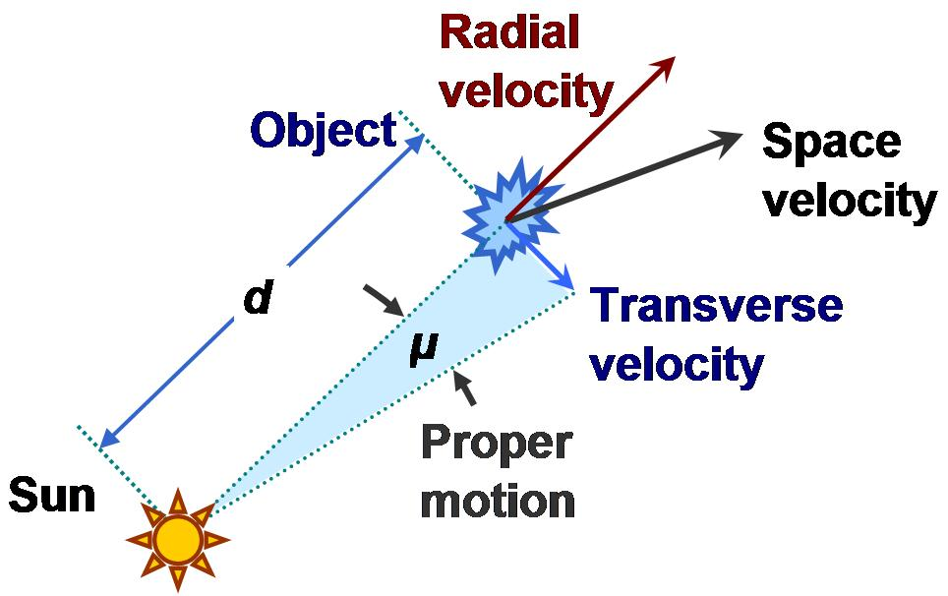
Velocities Diagram

Slide 31
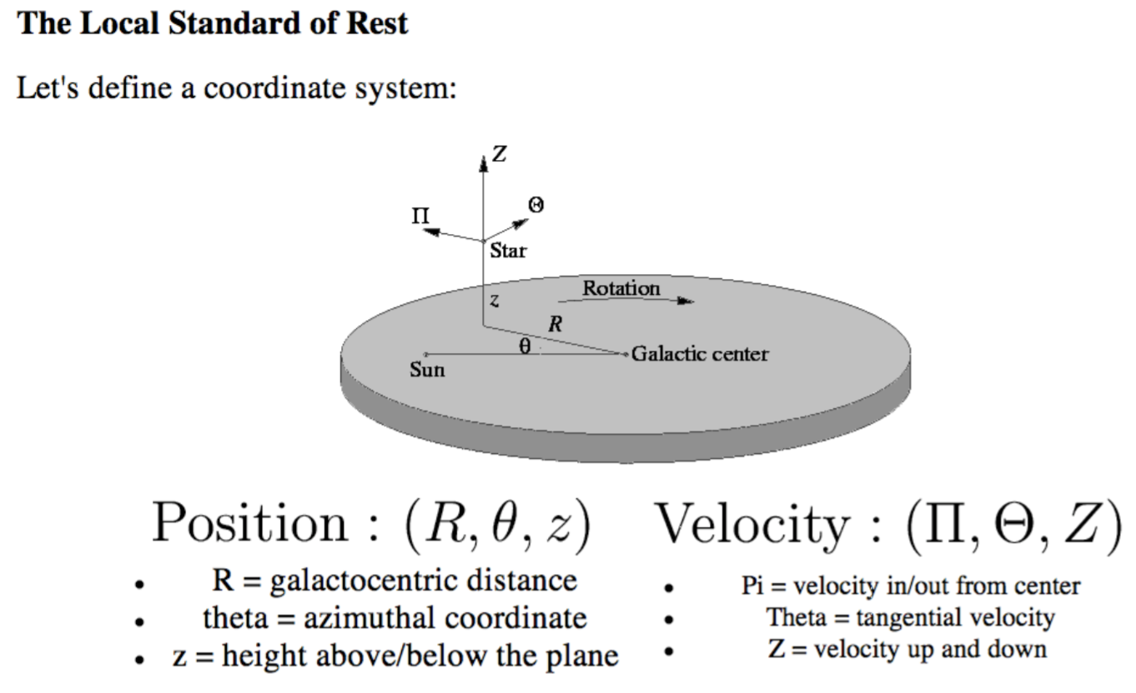
Stellar Velocities Near the Sun

Slide 32
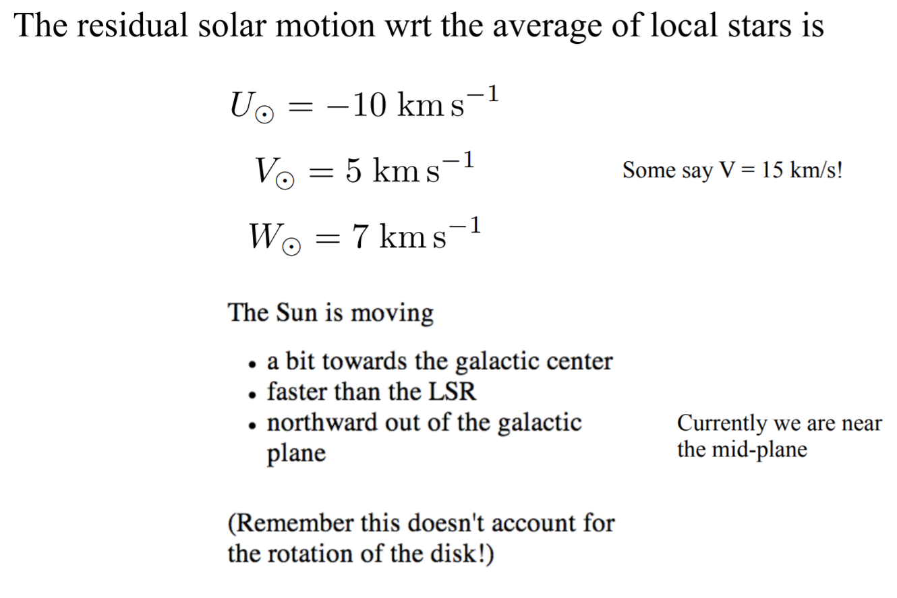
Velocity of Sun
Sometimes, Astronomers use U, V, and W, as variable names for the Solar motion, instead of Π, Θ, and Z.

Slide 33
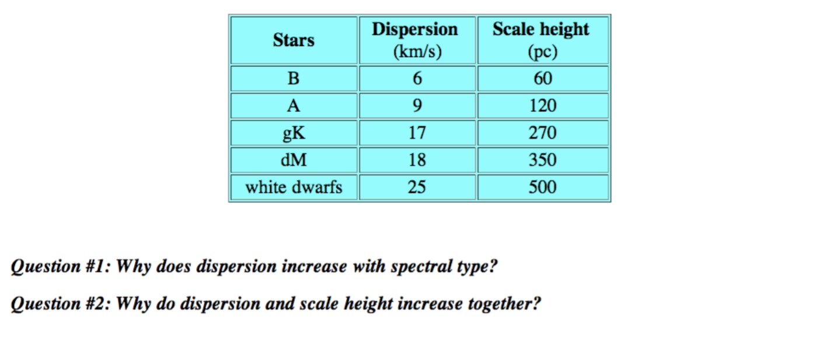
Velocity Dispersion of Stars

Slide 34
Velocity Dispersion of Stars
Younger stars have less velocity dispersion, suggesting that there must be a process for scattering stars.
Older stars have longer time to scatter.
The increased scatter throws older stars further away from the disk.
Perhaps the scattering is due to molecular clouds, but that does not fully account for the observed dispersions.

Slide 35
kinematics and dynamics

Slide 36

Stellar Motions
Stars orbit clockwise in the diagram shown on the right.
The Sun is at a distance of 8 kpc from the Galactic center.
It has v=220 km s⁻¹ and therefore orbits at a rate of once per 220 Myr.

Slide 37
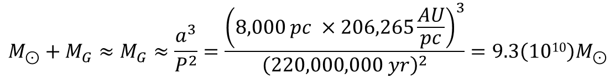
Mass Inside the Sun’s Orbit
We can use the Sun’s motion to estimate the mass in the Galaxy within the orbit of the Sun.
Using Kepler’s 3rd law, we find,
$$M_{⊙}+M_{G}≈M_{G}≈\frac{a^{3}}{P^{2}}=\frac{{\left(8,000 pc ×206,265\frac{AU}{pc}\right)}^{3}}{{\left(220,000,000 yr\right)}^{2}}=9.3\left(1010\right)M_{⊙}$$
We can compare this to the luminosity from stars in the Galaxy in order to get an idea of the average mass for a star.
The total luminosity of the Galaxy is ~2.3(10¹⁰) L_{Sun}, and most of the luminosity is generated by stars inside the Sun’s orbit.
Therefore, M/L~4.
So the mass-to-luminosity ratio must be higher than that for the Sun for much of the matter between the Sun and the Galactic center.

Slide 38

Mass Outside the Sun’s Orbit
We can estimate the mass in the outer Galaxy by measuring stellar velocities for stars that orbit there.
A typical velocity at a distance of twice that of the Sun from the Galactic center is approximately 270 km s⁻¹.
$$M\left(R\right)=\frac{{v(R)}^{2}R}{G}$$
For R=2R_{Sun}, M(R)~3(10¹¹) M_{Sun}.
Based on stellar velocity, it seems that the mass outside the Sun’s orbit is approximately three times greater than the mass inside the Sun’s orbit.
But, the luminosity from stars outside the Sun’s orbit is small compared to the luminosity generated by stars inside the Sun’s orbit.
This suggests that there must be some unseen mass.

Slide 39
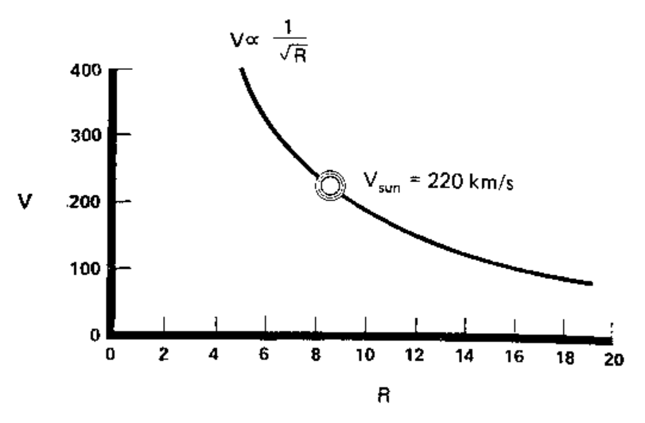
What Is Velocity Around Point Mass?

Slide 40
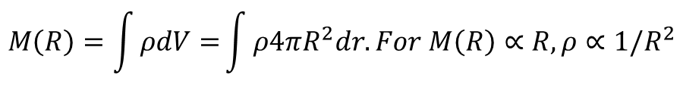
Stellar Velocities and Dark Matter
The average rotational velocity does not fall as 1/r^{1/2}, as one would expect around a point mass, e.g. as in the Keplerian case.
Instead, it appears to be constant.
$$M\left(R\right)=\frac{{v(R)}^{2}R}{G}→{v(R)}^{2}=\frac{M\left(R\right)G}{R}. For v=constant, M\left(R\right)∝R.$$
$$M\left(R\right)=\int{ρdV=}\int{ρ4πR^{2}dr. For M\left(R\right)∝R, ρ∝1/R^{2}}$$
The stellar number density is falling at a much higher rate.
Therefore, there must be some sort of matter that we cannot see in order to explain the velocities.

Slide 41
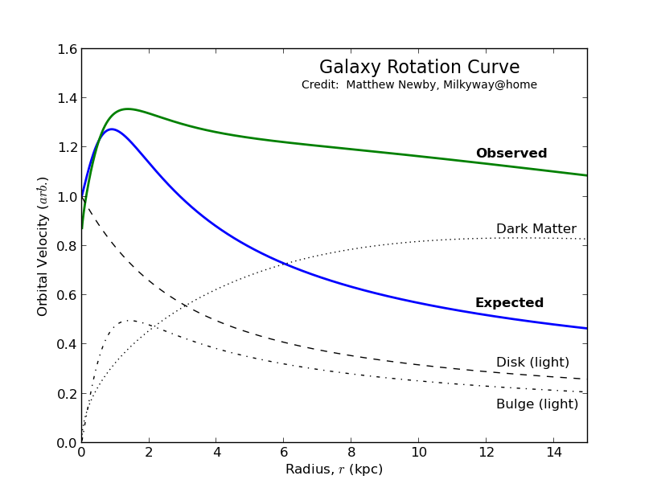
Rotation Curve

Slide 42
Dark Matter
Stellar Dark Matter
  black holes, rare but could make up some of dark matter
  brown dwarfs, low-mass prestellar objects, never stars
  white dwarfs, relic low mass stellar objects, no longer generating energy
  faint, low-mass red dwarfs, Hubble Space Telescope examined a globular cluster with extreme sensitivity and did not see the red dwarfs, so they are ruled out
exotic subatomic particles
  WIMPs (Weakly interacting massive particles)
  direct detection of WIMPs are being searched for in underground detectors
  the Large Hadron Collider is attempting to produce WIMPs in proton-proton collisions
modified law of gravity at large distances

Slide 43
spiral arms

Slide 44

Question
What is in spiral arms?

Slide 45
Answer
Molecular clouds
Star formation regions
OB stars
HII regions
SNRs
Why?

Slide 46
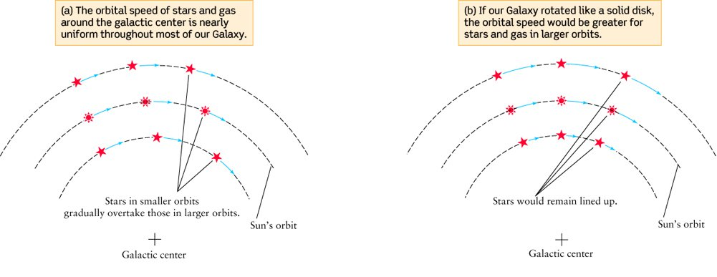
Differential Rotation

Slide 47
components of the galaxy

Slide 48
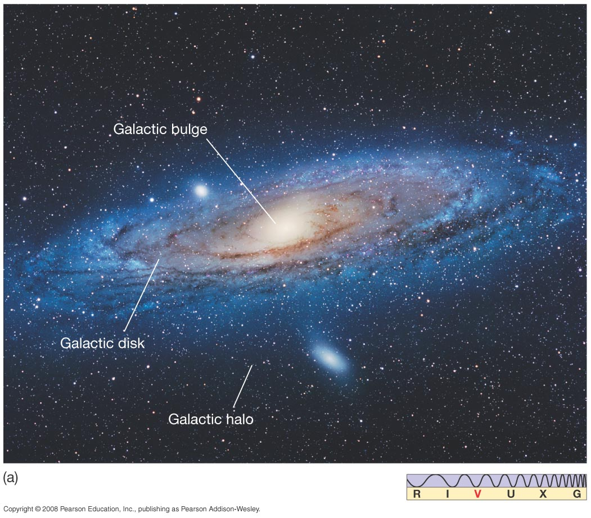
Components of the Galaxy

Slide 49
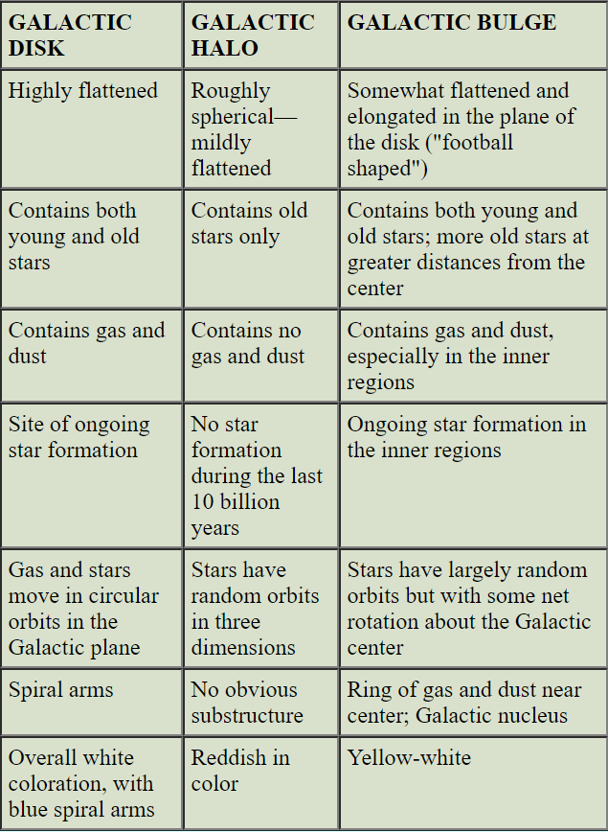
Disk, Halo, Bulge

Slide 50
Galactic Center
Direction from Earth known from globular clusters
Clouds of gas and dust obscure view, cannot see into center with visible light
Largest optical telescopes can see about 1/10 the distance to the center, but can use can use infrared light, radio, x-rays, gamma-rays
1930's Karl Jansky detected static on his receiver at approximately the same time each day (just 4 minutes earlier each day) this turned out to be radio noise from the center of the galaxy which his "directional" antenna pointed at once a day.
Very intense radio emission coming from center. For example, very large array ( VLA) in New Mexico (27 radio telescopes) produces detailed images region of Galactic Center in radio spectrum, apparent ring of rotating matter of a few parsecs
Infrared data shows very intense source at the center
brightness = 80,000,000 suns (bright)
size = 10 light years (compact)
gamma-rays shows intense (-rays from matter/anti-matter annihilation) corresponds to ten billion tons of anti-matter annihilation per second
X-rays show very intense emission

Slide 51
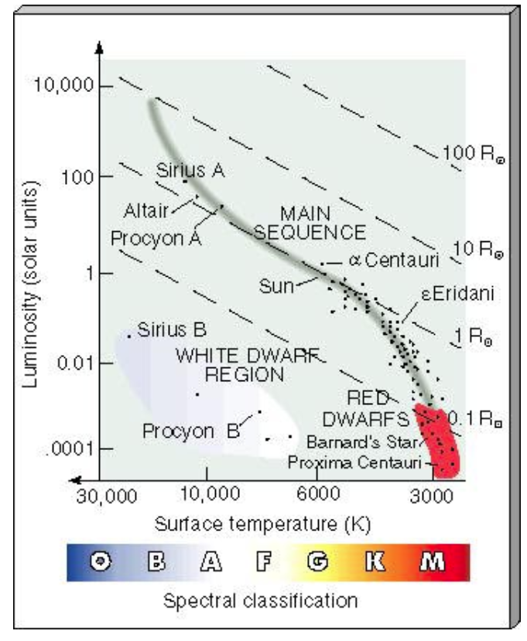
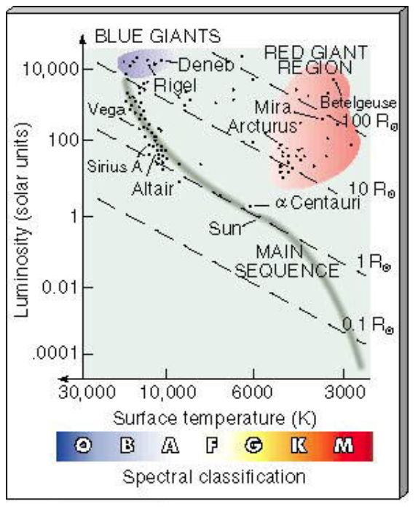
Stars in the Sky
Nearby Stars
Bright Stars

