Slide 1
University Astronomy
Professor Don Figer
Introduction

Slide 2
Course Information
Instructor: Professor Don Figer
Teaching Assistant: Sara Rosborough
Class Time: MWF 2:00 PM – 2:50 PM

Slide 3
Your Instructor
Professor Don Figer
Professor in College of Science
Professor in Astrophysical Sciences and Technology PhD Program
Director of the Center for Detectors
Director of the Future Photon Initiative
At RIT since 2006
Previously
  Space Telescope Science Institute (operates Hubble and will operate James Webb Space Telescope)
  UCLA (designed optics for infrared spectrograph on Keck)
Research Interests: Detectors, Massive Stars, Massive Star Clusters, Galactic Center
3 daughters, no pets, a few plants

Slide 4
How to Reach Me
In person:
  Office: ENG-3111
  Office Hours: Thursdays 11:00 AM – 11:50 AM
  Other times by appointment
By email: figer@cfd.rit.edu
Your emails must be structured formally, addressed to me as Professor Figer, and signed with your name.
Include PHYS-220 in the subject line.
Yo, bruh, wazzzuuuuuuuupp? Class is lit Gucci, yeeeeeeet!
Dear Professor Figer, I enjoy the class. Sincerely, John Doe.

Slide 5
Your Teaching Assistant (TA)
Name: Sara Rosborough
Office Hour: Wednesdays 10:00 – 10:50 am, ENG-3115 (which is inside ENG-3113)
Email: sr8690@g.rit.edu
Astrophysical Sciences and Technology PhD program
Duties
  attend class
  assist with group activities
  grade homework
  host office hours (ENG-3110)
  hold review sessions

Slide 6
Course Summary and Objectives
This course is an introduction to the basic concepts of astronomy and astrophysics for scientists and engineers. Topics include the celestial sphere, celestial mechanics, methods of data acquisition, planetary systems, stars and stellar systems, cosmology, and life in the universe. (Prerequisites: PHYS-211 or PHYS-211A or PHYS-207 or PHYS-216 or (MECE-102 and MECE103 and MECE-205) or equivalent courses.)
This is a survey course covering the whole Universe!
We will learn about objects in the Universe, and the observations and instrumentation we use to study them.

Slide 7

Textbook
The book is Foundations of Astrophysics.
You do not need to read all of it.
I will assign specific sections to complement the lectures.
Some material that you read in the book will not be covered in the lectures.

Slide 8
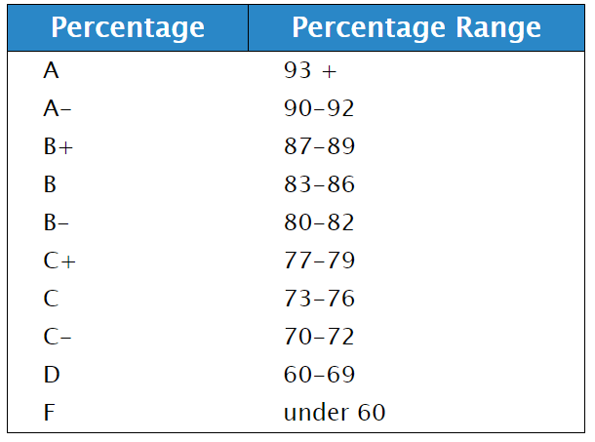
Grading
Homework – 30%
Midterm exams – 30%
Final exam – 40%
When assigning final grades, I may alter these division points based on the overall evaluation of individual or class performance and effort.

Slide 9
Attendance
Students are expected to attend each lecture.
Absences, for whatever reason, do not relieve students of their responsibility for fulfilling normal requirements in any course.
In particular, it is the student’s responsibility to make individual arrangements in advance of missing class due to personal obligations such as religious holidays, job interviews, athletic contests, etc., in order that he or she may meet his or her obligations without penalty for missing class. (RIT Governance Policy D4.0, Section I.B)
It is the student’s responsibility to notify the faculty member in advance of the planned absence. With advance notice of the planned absence, it is the faculty member’s responsibility to ensure that the student can fulfill all class assignments and expectations without penalty or bias.

Slide 10
Homework
Homework sets will generally be assigned on Mondays.
They are due the following Monday before class (although there are a few exceptions). See the syllabus for official due dates.
They can be retrieved through MyCourses or will be on the last slide of the lecture.
Your answers should be uploaded to MyCourses.
There is a penalty for handing in your homework after it is due. The penalty is 10% per day, until four days after the homework is due (typically Fridays). After the start of class time on that day, the score goes to zero.
See syllabus for more detailed information.

Slide 11
Midterm Exams
The midterm exams are not cumulative.
There is a review session during the class meeting time before each midterm.
The midterms are on February 21 and March 25.

Slide 12
Class Expectations
Attend each lecture.
Be on time, or as quiet as a ninja.
Participate in class.
Be a good team member when working in groups.
Regularly access MyCourses.
Complete assignments on time.
Read the assigned book sections.

Slide 13
Technology in the Classroom
Cell-phones, tablets, and laptop computers are not to be used in class.
These devices are distracting to the user as well as other students in the classroom, and there is ample evidence that students who regularly use these devices during class perform significantly lower than those who don’t.
Please turn off all sounds / vibrations on your phone.
If for any reason you feel it is necessary to be able to use one of these devices during this class, please see the instructor after class or during office hours.

Slide 14
Statement on Reasonable Accommodations
RIT is committed to providing reasonable accommodations to students with disabilities. If you would like to request accommodations such as special seating or testing modifications due to a disability, please contact the Disability Services Office. It is located in the Student Alumni Union, Room 1150; the Web site is www.rit.edu/dso.
After you receive accommodation approval, it is imperative that you see me during office hours so that we can work out whatever arrangement is necessary.

Slide 15
In-class Questions
I will ask questions in class.
You will vote for the correct answer.
#nojudgementzone (“wrong” answers are often interesting to hear because they might have some element of truth and they can also be instructive when dispelling misconceptions)
An example is on the next slide.

Slide 16
Question
What kind of bear is best?
  a) panda
  b) polar
  c) Pooh
  d) False. Black bear.
Vote!

Slide 17
Answer
What kind of bear is best?
  a) panda
  b) polar
  c) Pooh
  d) False. Black bear.
Bears eat beets. Bears. Beets. Battlestar Galactica.

Slide 18
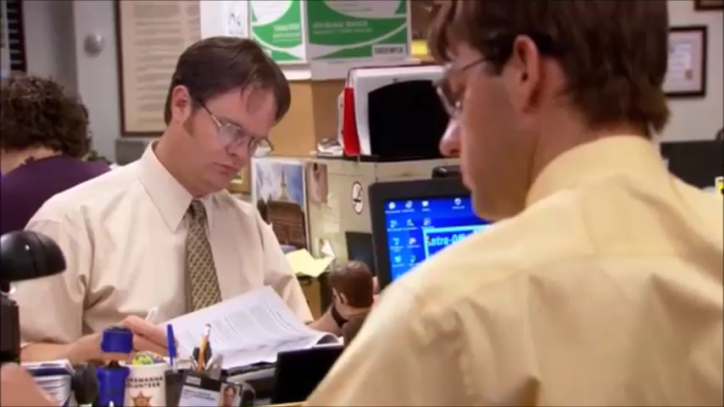
Answer - Proof

Slide 19
Why are you taking this class?
a) to fulfill a requirement
b) because I love astronomy
c) it is required for my major/minor
d) I have no idea

Slide 20
Other Forms of Class Participation
worksheets
group activities
discussion questions
example problems
ask questions

Slide 21
What Do You Want to Learn?

Slide 22
Any Questions?

Slide 23
homework

Slide 24
Homework
By Wednesday’s class time, visit the following website and play with the scale slide bar:
http://scaleofuniverse.com/
Also, watch a “powers of ten” video (search on Youtube).
1.2, 1.3, 1.4, 1.5, 1.6, 1.7 (see next slide)

Slide 25
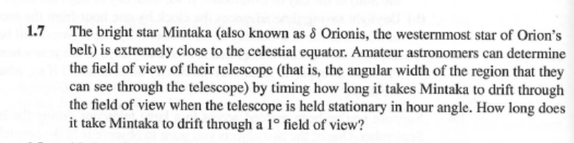
Homework

