Slide 1
Radiation Interactions: eV to GeV

Slide 2
Objectives
Describe fundamental physics governing behavior of light and particles while interacting with matter
Explain the experiments used to discover these interactions
Show the uses of these governing equations in practical detectors
References: Knoll, ‘Radiation Detection and Measurement’
Notes:
In this talk we will focus on the time-resolved imaging method as a way to measure the total heat released and thus the fire effect.

Slide 3
There are four major categories of radiation interactions
We use ‘radiation’ to cover antique notion of ‘radioactive’ emissions
Charged Particles Uncharged Particles
Heavy Charged Particles Neutrons
(Characteristic Distance = 10⁻⁵m) (Characteristic Distance = 10⁻¹m)
Fast Electrons X-rays, γ-rays, light
(Characteristic Distance = 10⁻³m) (Characteristic Distance = 10⁻¹m)
Notes:
We have devised a method to measure heat release from a fire. We now would like to know whether the heat patterns generated by prescribed fires which are usually ignited to produce the maximum effect in the shortest time using line ignition, is similar to naturally occurring, free running fires which are usually ignited at a point or series of points.

Slide 4
Interaction of heavy charged particles
This category includes protons, alpha particles (helium nuclei), other ‘complex’ particles
Charged particle interacts with electrons in material, electrons feel an impulse
Impulse may raise electron to higher energy level (excitation) or remove it from bound state (ionization)
Maximum energy transferred during this electrostatic exchange is:
4Em_{e}/ m
Where E is energy of incoming particle, Me is mass of electron and m is mass of incoming particle
For a proton interaction, m_{e} = 0.511 MeV/c² , m = 938 MeV/c², so energy transfer is about 1/500 per collision, so many interactions are required to stop the particle
Notes:
In this talk we will focus on the time-resolved imaging method as a way to measure the total heat released and thus the fire effect.

Slide 5
Interaction of heavy charged particles (2)
Since the electric field is a long range field (remember 1/r2) many electrons interact with the particle at any one time
The result is a continuously slowing down of the incoming particle until it is stopped
Summarizing: lots of interactions, each one doing little, from forces distributed around the incoming particle path → stragiht slowing down path with definite endpoint
As a result of these encounters, ion pairs are produced in the absorber – and electron + remaining ion
These ion pairs may be detected using electronics!!!
Notes:
In this talk we will focus on the time-resolved imaging method as a way to measure the total heat released and thus the fire effect.

Slide 6
Interaction of heavy charged particles (3)
Bethe formula describes energy loss as function of path:
Typical energy loss along an alpha particle (helium nuclei) path
Notes:
In this talk we will focus on the time-resolved imaging method as a way to measure the total heat released and thus the fire effect.

Slide 7
Interaction of electrons with matter
Electrons are different from heavy charged particles:
Light (2000 times lighter than proton)
Opposite charge
‘Fermions’ vs. ‘Bosons’
Follow a tortured path because energy transfer is large per interaction
Bethe formula for specific energy loss:
Energy may also be lost by radiative processes as well as Coulomb interactions (electrostatic interactions)
Notes:
In this talk we will focus on the time-resolved imaging method as a way to measure the total heat released and thus the fire effect.

Slide 8
Interaction of electrons with matter
Electrons are different from heavy charged particles:
Light (2000 times lighter than proton)
Opposite charge
‘Fermions’ vs. ‘Bosons’
Follow a tortured path because energy transfer is large per interaction
Bethe formula for specific energy loss:
Energy may also be lost by radiative processes as well as Coulomb interactions (electrostatic interactions)
Notes:
In this talk we will focus on the time-resolved imaging method as a way to measure the total heat released and thus the fire effect.

Slide 9
Interaction of electrons with matter (2)
Range is not a good concept for fast electrons because particles get deflected OUT of beam…because of large individual interactions
Path loss is much less …~ 1-2 mm /MeV is typical ‘range’
Electrons, because they are light, can undergo a single LARGE deflection in the opposite direction (‘bounce’ off of orbital electron or nucleus) this is called ‘back scattering’
Notes:
In this talk we will focus on the time-resolved imaging method as a way to measure the total heat released and thus the fire effect.

Slide 10
Interaction of photons with matter
Three distinct method of interactions of photons with matter, depending on photon energy
Photoelectric absorption: photon interacts with absorber atom and completely disappears! (low energy, like light)
Compton Scattering: incident photon and electron in absorber interact → photon transfers part of its energy to the electron and travels on
Pair Production: If incident photon has twice the rest energy of the electron (> 1.02 MeV) the photon, in the field of the nucleus (including many different kinds of force fields) can disappear and turn into an electron-positron pair.
This e⁻ e⁺ pair then annihilates (matter vs. anti-matter) and produces 2 0.511MeV photons, which can be detected by photo electric effect or Compton scattering
Notes:
In this talk we will focus on the time-resolved imaging method as a way to measure the total heat released and thus the fire effect.

Slide 11
Interaction of photons with matter (2)
Photons have a fixed probability of removal per length of absorber
Linear attenuation coefficient:
μ = τ(photo electric) + σ(Compton) + κ(Pair)
I/Io = e ^{–μt}
Mean free path λ= 1/μ
Since photons are taken out of beam continuously along path
Photoelectric absorption: photon interacts with absorber atom and completely disappears! (low energy, like light)
Compton Scattering: incident photon and electron in absorber interact → photon transfers part of its energy to the electron and travels on
Pair Production: If incident photon has twice the rest energy of the electron (> 1.02 MeV) the photon, in the field of the nucleus (including many different kinds of force fields) can disappear and turn into an electron-positron pair.
This e⁻ e⁺ pair then annihilates (matter vs. anti-matter) and produces 2 0.511MeV photons, which can be detected by photo electric effect or Compton scattering
Notes:
In this talk we will focus on the time-resolved imaging method as a way to measure the total heat released and thus the fire effect.

Slide 12
Interaction of photons with matter (3)
Pair Production: If incident photon has twice the rest energy of the electron (> 1.02 MeV) the photon, in the field of the nucleus (including many different kinds of force fields) can disappear and turn into an electron-positron pair.
This e⁻ e⁺ pair then annihilates (matter vs. anti-matter) and produces 2 X 0.511MeV photons, which can be detected by photo electric effect or Compton scattering
Notes:
In this talk we will focus on the time-resolved imaging method as a way to measure the total heat released and thus the fire effect.

Slide 13
High Energy Physics Detectors

Slide 14
What is the end-goal for detectors in high energy physics accelerators?
Tracking
Identification of mass and charge
In theory, you can identify mass using either a measurement of momentum, velocity or energy
Because particles are ultra relativistic (β ~ 1) small measurement errors in velocity or energy can make huge errors in mass or charge
Notes:
In this talk we will focus on the time-resolved imaging method as a way to measure the total heat released and thus the fire effect.

Slide 15
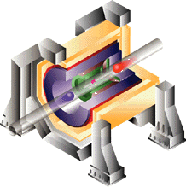
High energy physics detectors
The innermost layer, the vertex detector, about the size of a Coke can, gives the most accurate information on the position of the tracks.
The next layer, the drift chamber, detects the positions of charged particles at several points along the track. The curvature of the track in the magnetic field reveals the particle's momentum.
The middle layer, the Cerenkov detector, measures particle velocity.
The next layer, the liquid argon calorimeter, stops most of the particles and measures their energy. This is the first layer that records neutral particles. The large magnet coil separates the calorimeter and the next layer.
The outermost layer (magnet iron and warm iron calorimeter) detects muons.
Notes:
In this talk we will focus on the time-resolved imaging method as a way to measure the total heat released and thus the fire effect.

Slide 16
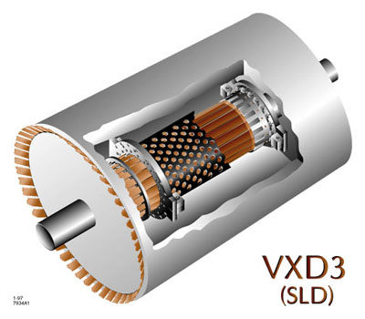
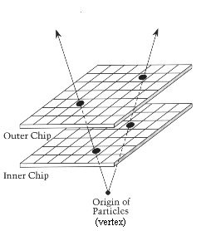
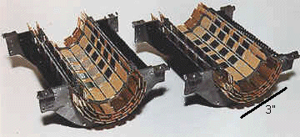
The Vertex Detectors
The vertex detector is a multi-layered CMS detector that can find the tracks through the detector at very high spatial resolution (also very near to the beam dump)
Notes:
In this talk we will focus on the time-resolved imaging method as a way to measure the total heat released and thus the fire effect.

Slide 17
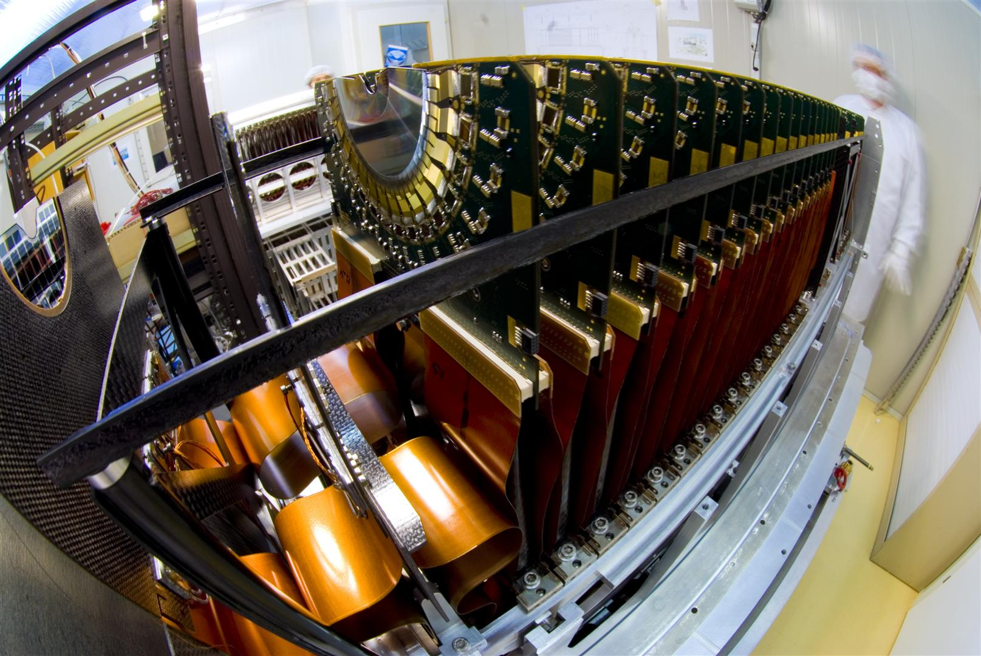
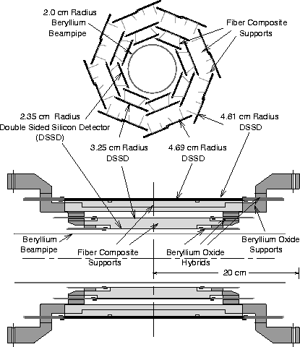
The Vertex Detectors
Notes:
In this talk we will focus on the time-resolved imaging method as a way to measure the total heat released and thus the fire effect.

Slide 18
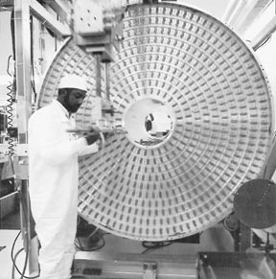
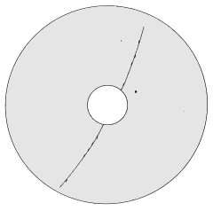
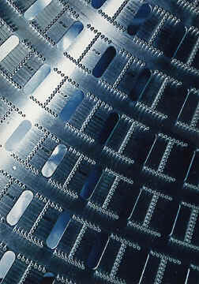
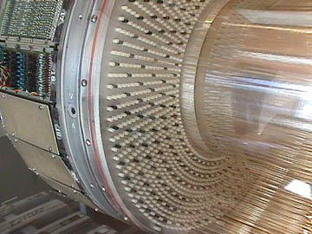
The Drift Chamber
Next layer out from the vertex detector is the drift chamber, a horizontal, thin-walled cylinder, six feet long and six feet in diameter, with a small tube through the center to accommodate the beam pipe and vertex detector
Some 35,000 fine wires are strung the length of the cylinder between precisely placed holes in the aluminum ends. When the chamber is filled with a gas mixture and high voltage is applied to groups of wires it becomes a giant set of Geiger counters.
Charged particles passing through the chamber temporarily knock a few electrons loose from gas atoms. These electrons are attracted to certain wires, known as sense wires, knocking loose more electrons on the way to give a large electronic signal when the cascade of electrons hits a sense wire.
Close-up view of the end plate of a drift chamber before insertion of wires
The wires are arranged in layers that pass through the cylinder at three different angles. The set of wires that give a signal can be used to allow computer reconstruction of the paths (or tracks) of all the charged particles through the chamber
Notes:
In this talk we will focus on the time-resolved imaging method as a way to measure the total heat released and thus the fire effect.

Slide 19
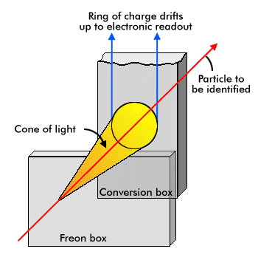
The Cerenkov Detection Ring
Outside the drift chamber is the Cerenkov detector, or more accurately, the Cerenkov Ring Imaging Detector (CRID). It is used to measure particle velocities through Cerenkov radiation. This form of radiation is somewhat like a sonic boom except it is light rather than sound. It occurs when a particle travels through a medium (here, freon gas) at a speed that is faster than the speed of light in the medium (but slower than the speed of light in a vacuum, of course), just as a sonic boom occurs when an object travels in a medium (air) faster than the speed of sound in the medium.
This two-step device converts light emitted by a particle in the first box into a ring of charge in the second box. Different speeds of particles can be identified by the different sizes of ring.
On entering the CRID, a particle passes through a small container of liquid Freon with just the right density to give it the desired optical properties. The particle radiates ultraviolet light in a cone-shaped pattern, with slower particles making narrower cones (note). The original particle carries on undisturbed and the light passes into another vessel containing ethane gas with a trace amount of an exotic chemical called TMAE that absorbs the light, leaving a ring of electric charge in its place.
The particle speed is related to the diameter of the ring, which now must be measured. After drifting the length of the box, the ring crosses a picket fence of high-voltage wires that produce signals. A computer analysis of when and where these signals originated allows one to reconstruct the ring - both its size and where in the chamber it was formed.
In the analysis of an event, the computer follows the tracks from the drift chamber through the CRID and looks up the size of the rings associated with each track. This allows it to calculate the particle's velocity.
Once both velocity and momentum (from the drift chamber) are known, the mass of the particle can be calculated and this identifies what kind of particle it was.
Note: This relationship is defined by where n is the refractive index of the material and ß is the velocity of the particle in units of c (speed of light). For , cos(cone angle) = 1 or angle = 0. So, as ß increases (particle moves faster), the cosine of the angle decreases. This means that the angle increases with the speed of the particle.
Notes:
In this talk we will focus on the time-resolved imaging method as a way to measure the total heat released and thus the fire effect.

Slide 20
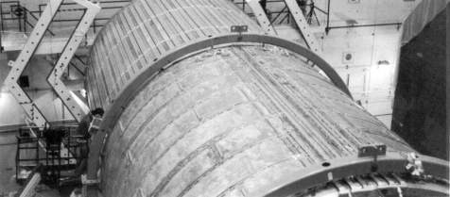
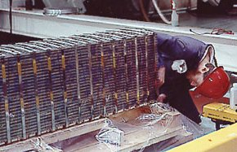
The Calorimeter
The calorimeter measures total energy deposition after the particle has been defined in space (spatial space and momentum space) by the vertex detector and drift chamber
This calorimeter module has alternating layers of lead sheets and lead tiles, immersed in liquid argon when in use. A high-energy particle makes a shower of other particles in the lead. Electronics attached to the module records the shower size (a measure of the particles energy) and its shape (a way to distinguish between certain types of particles).
Notes:
In this talk we will focus on the time-resolved imaging method as a way to measure the total heat released and thus the fire effect.

Slide 21
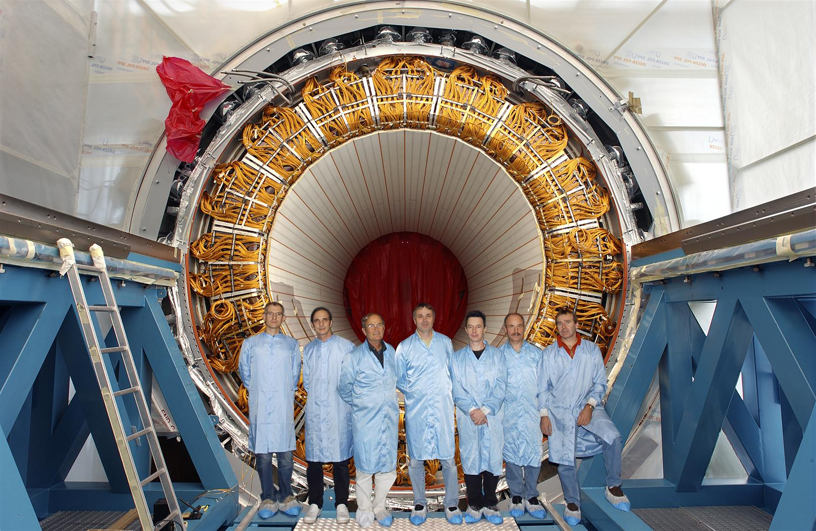
The Calorimeter
Notes:
In this talk we will focus on the time-resolved imaging method as a way to measure the total heat released and thus the fire effect.

