Slide 1

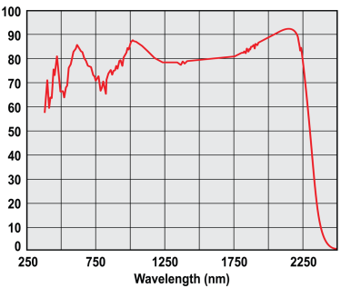
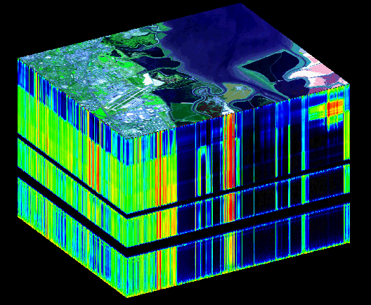
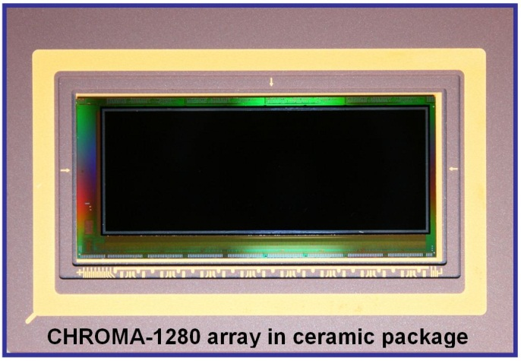
CHROMA Spectral Imaging Array for Earth Science
Configurable Hyperspectral Read Out for Multiple Applications – CHROMA
Teledyne’s strengths:
  Substrate-removed HgCdTe
    Lowest dark current in the industry
    Visible through infrared response
  High performance readout circuit
Teledyne leveraged a new readout circuit developed for NASA Earth Science for the spectral imaging (a.k.a. hyperspectral) market.
This product applies to both Earth Science (airborne and space) and planetary missions.
AVIRIS hyperspectral
data cube
Moffett Field, California
Provided by JPL
Spectral Imager Product
Formats (columns, rows): 640×480, 1280×480, 1600×480 pixels (1 port for every 160 columns)
Pixel size: 30 microns
Pixel properties: CTIA circuit, 700 ke- full well, 80 e- readout noise
    (CDS in pixel. Also full wells of 1 Me- (110 e- noise) and 5 Me- (600 e- noise)
Operating mode: Snapshot, integrate while read
Windowing: Available in the row direction (480 pixel direction)
Frame rate: 125 Hz full frame, 250 Hz for 240 rows read out
Digital input: Programmable, digital input: biases and clocks generated on-chip
Power dissipation 250 mW (for640×480 pixels, 125 Hz frame rate)

Slide 2
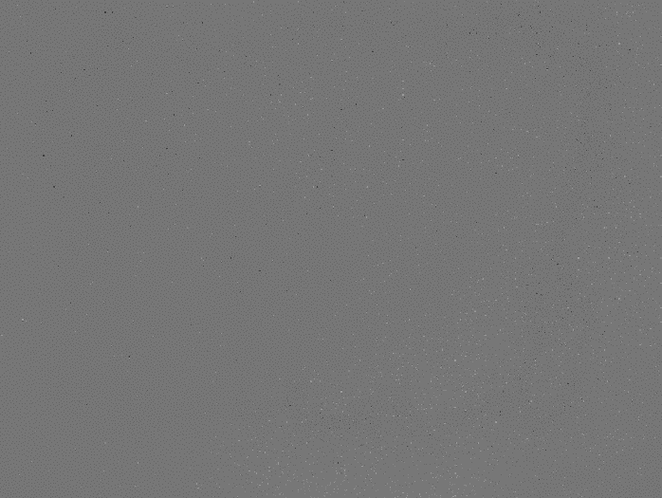
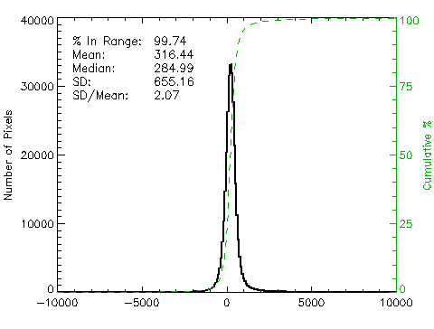
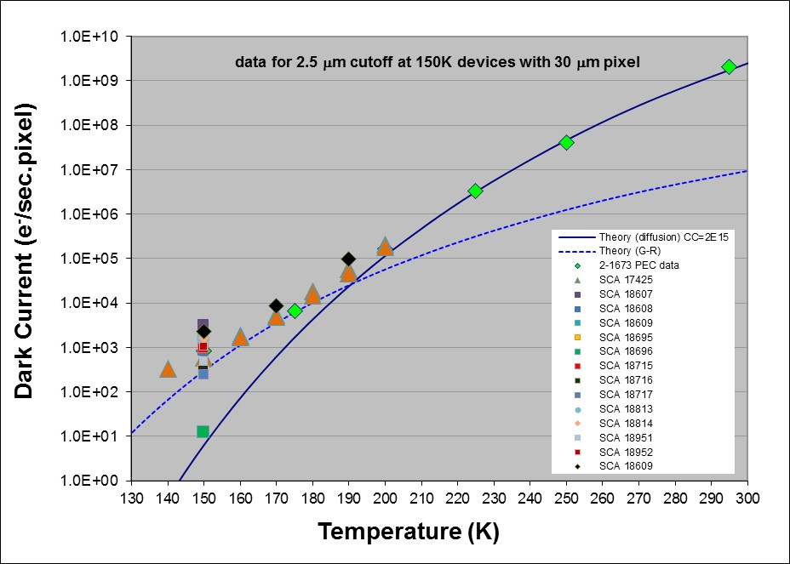
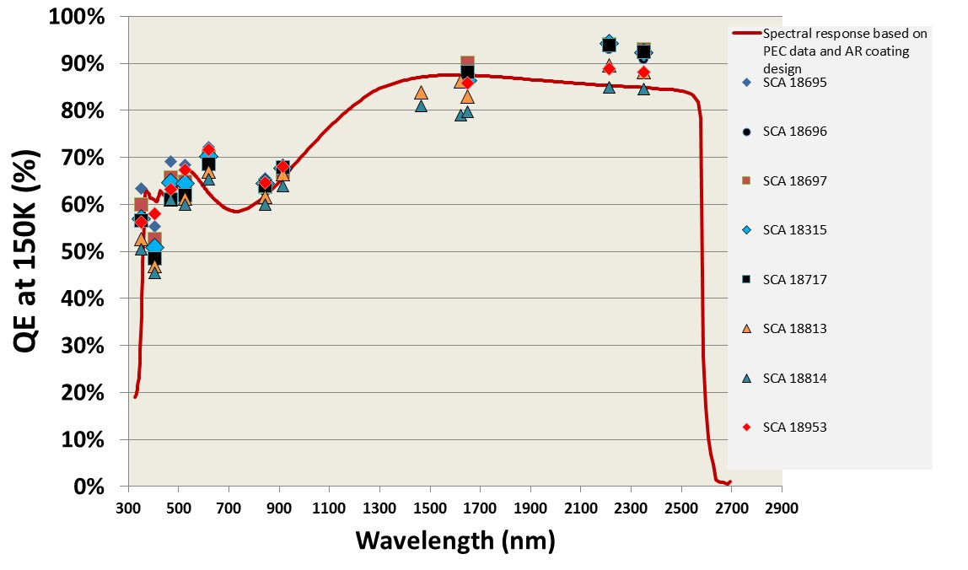
Performance of CHROMA SWIR 2.5 μm at 150 K
Space missions using Teledyne detectors for spectral imaging
CRISM (Compact Reconnaissance Imaging Spectrometer for Mars)
  NASA – JPL instrument
MMM (Moon Mineralogy Mapper)
  JPL instrument
PRISM (Portable Remote Imaging Spectrometer for the Coastal Ocean)
  NASA – JPL instrument
ARTEMIS
  U.S. Department of Defense and JPL mission
AVIRIS Next Generation
  NASA – JPL instrument, Carnegie Airborne Observatory
NEON (National Ecological Observatory Network) Design Verification Unit (DVU)
  NSF – JPL
CHROMA-640 SWIR flown in the HySICS Instrument Imaging spectroscopic scans collected over the earth at 129,000 ft
Idark Map at 150K
Idark = 316 e/s/pixel at 150K
Idark vs Temperature
QE and spectral response at 150K

