Slide 1
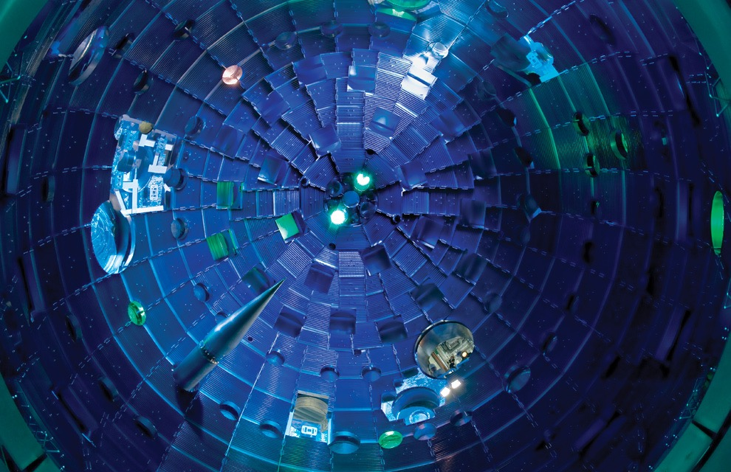
The National Ignition Facility at LLNL Presented by: Gary Sims, Spectral Instruments At LLNL: Perry Bell, Arthur Carpenter, Matthew Dayton, Dana Hargrove
At Spectral Instruments: Roger Cover, Dan Gilmore, Hans Meyer, Andy Peters, Bob Peyser

Slide 2
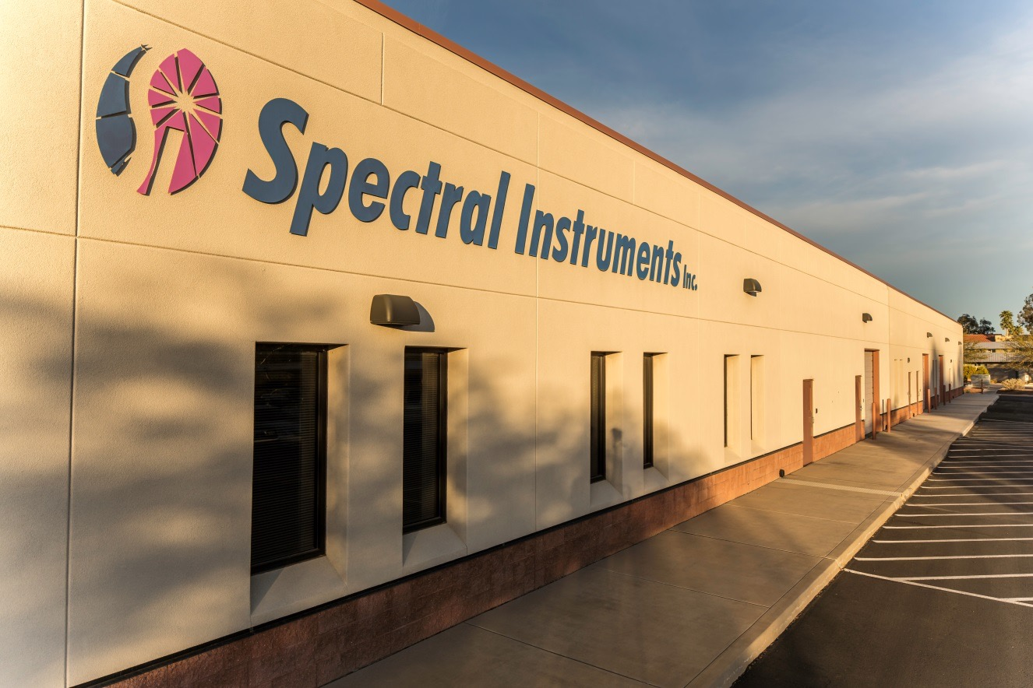
Who is Spectral Instruments?

Slide 3
“I am just a poor, dumb chemist”
M. B. Denton

Slide 4
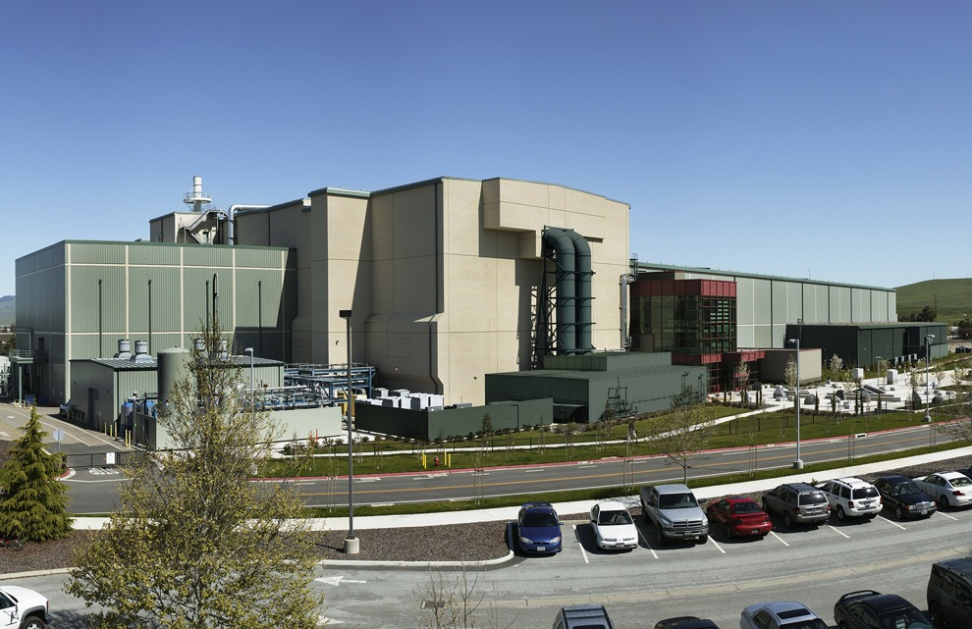
What is NIF?
National Ignition Facility - a large laser-based inertial confinement fusion (ICF) research device at the Lawrence Livermore National Laboratory.

Slide 5
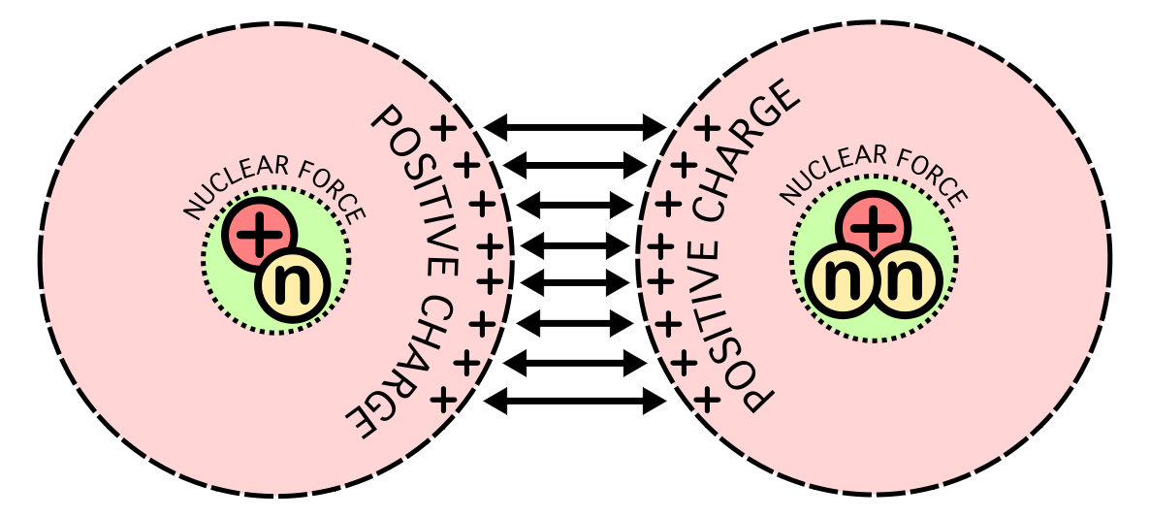
What is Nuclear Fusion?
The electrostatic force between the positively charged nuclei is repulsive, but when the separation is small enough, the quantum effect will tunnel through the wall. Therefore, the prerequisite for fusion is that the two nuclei be brought close enough together for a long enough time for quantum tunnelling to act.

Slide 6
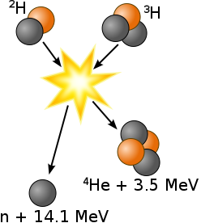
What is Nuclear Fusion?
Fusion of deuterium with tritium creating helium-4, freeing a neutron, and releasing 17.59 MeV as kinetic energy of the products while a corresponding amount of mass disappears, in agreement with kinetic E = Δmc2, where Δm is the decrease in the total rest mass of particles.

Slide 7
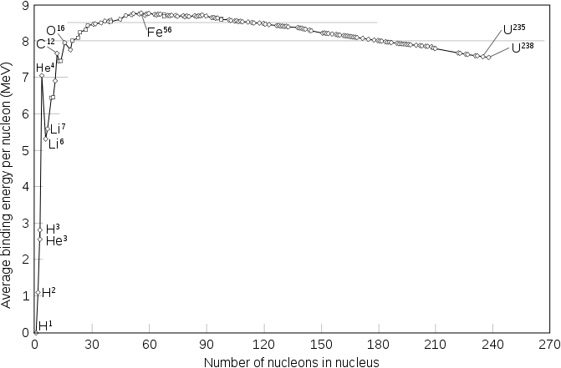
Nuclear Bining Energy
The nuclear binding energy curve. The formation of nuclei with masses up to Iron-56 releases energy, while forming those that are heavier requires energy input. This is because the nuclei below Iron-56 have high binding energies, while the heavier ones have lower binding energies, as illustrated above.

Slide 8
Why Do It?
Basic Research
Energy Production
No Chance of Meltdown
Short Lived Isotopes – No Nuclear Waste Problems

Slide 9
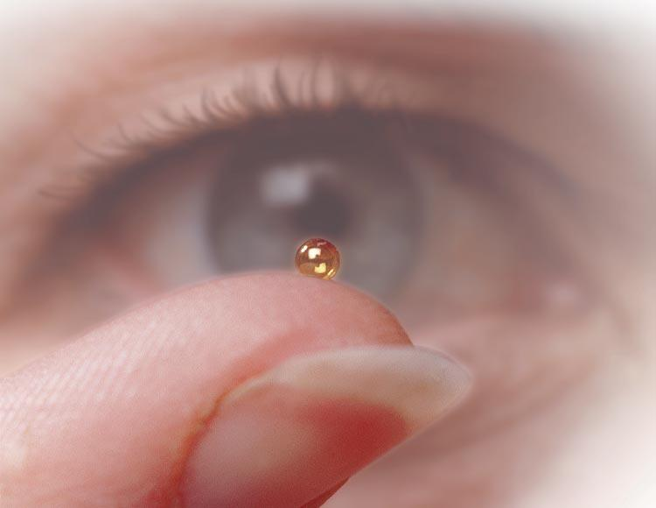
Deuterium - Tritium Fuel

Slide 10
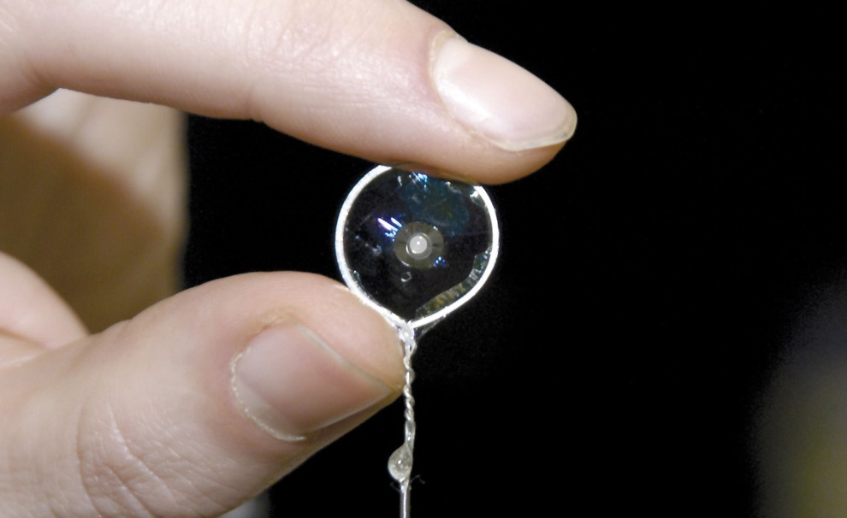
Fuel

Slide 11
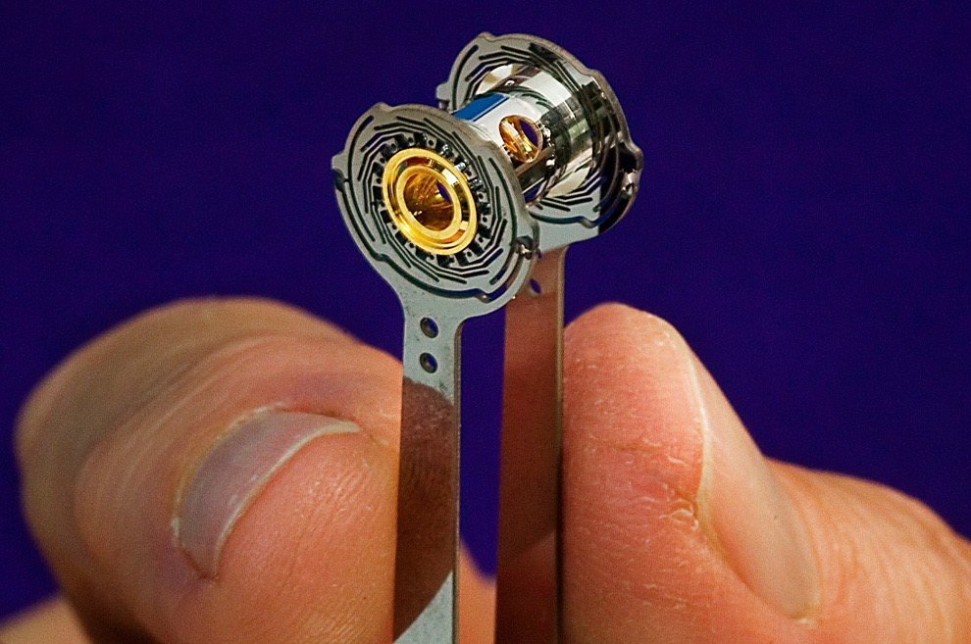
Hohlraum

Slide 13
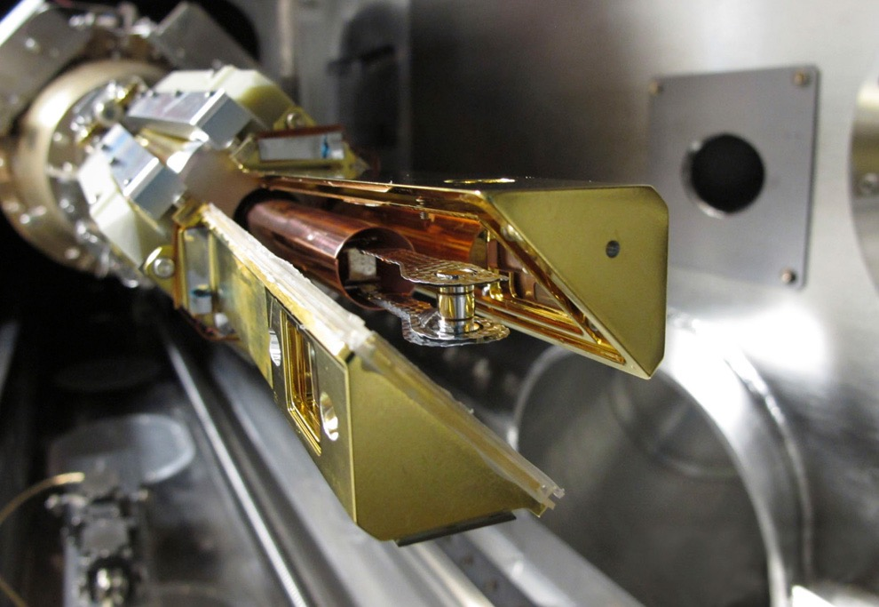
Target Assembly

Slide 14
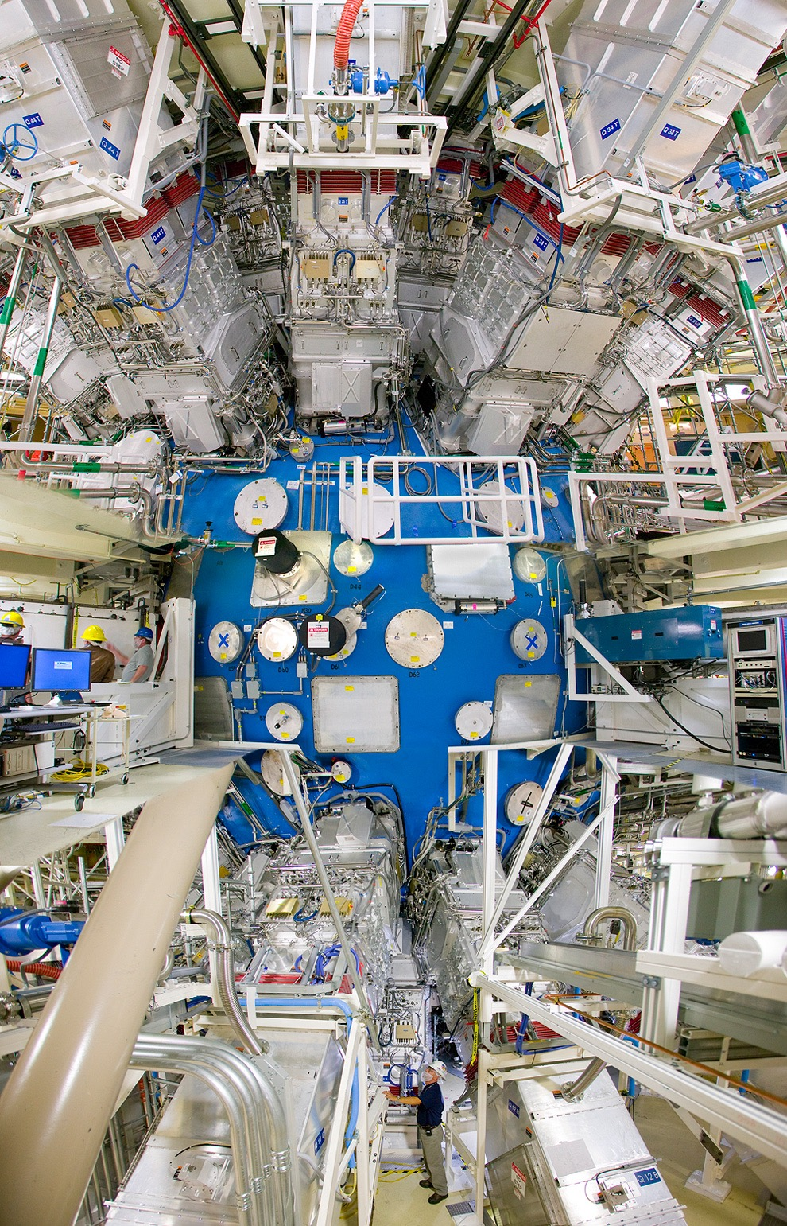
Target Chamber

Slide 15
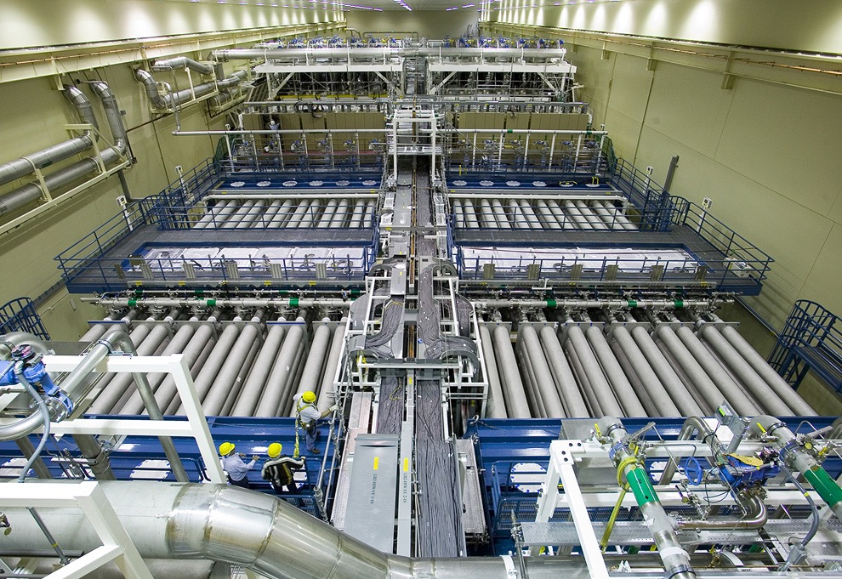
Laser Bay

Slide 16
Countdown to Laser NIF Shot

Slide 17
What Diagnostic Information is Important?
X-ray spatial information (x-ray pinhole camera)
X-ray emission as a function of time (x-ray streak camera)
Optical signal as a function of time (optical streak camera)

Slide 18
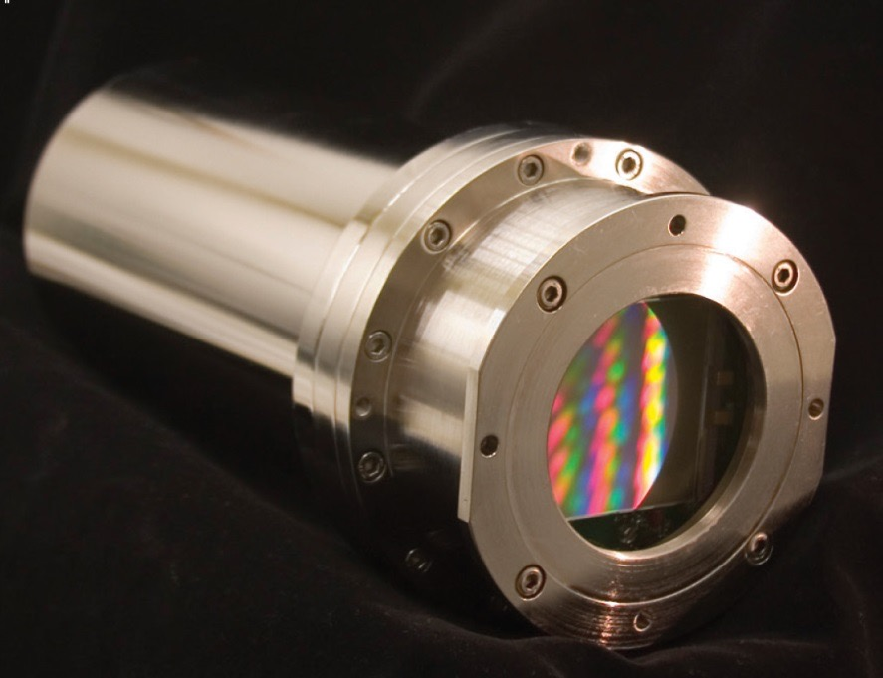
Pinhole X-Ray Cameras (SXI)
800Series platform modified for vacuum “bubble”
Tektronix (SITe) 2K x 2K 24 micron pixel backside
Dalsa 2K x 2K 24 micron pixel thinned by UA ITL
TE cooled, 2 port readout at 800 kHz/port

Slide 19
Generalized Streak Camera

Slide 21
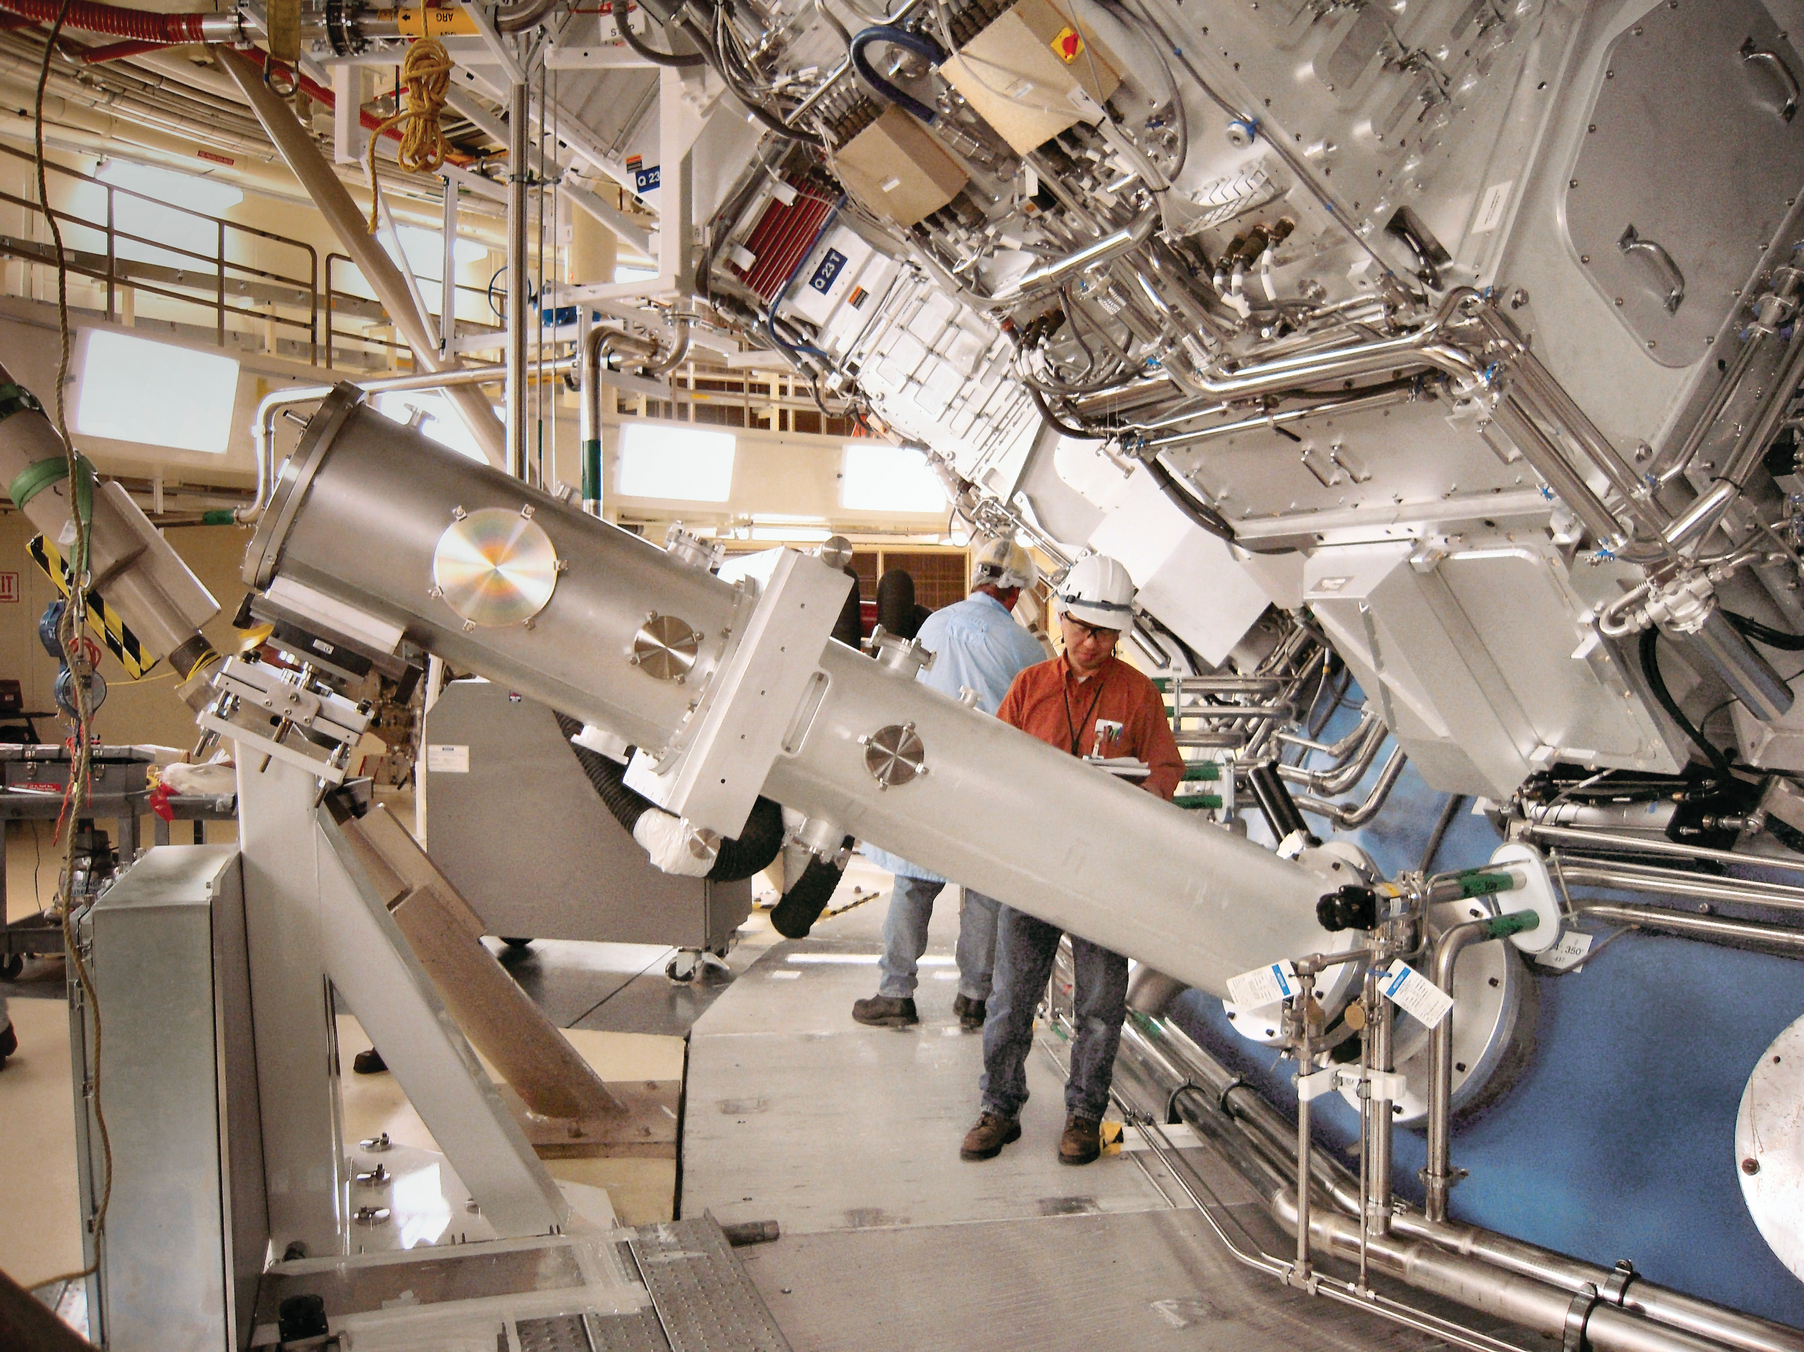

Slide 22
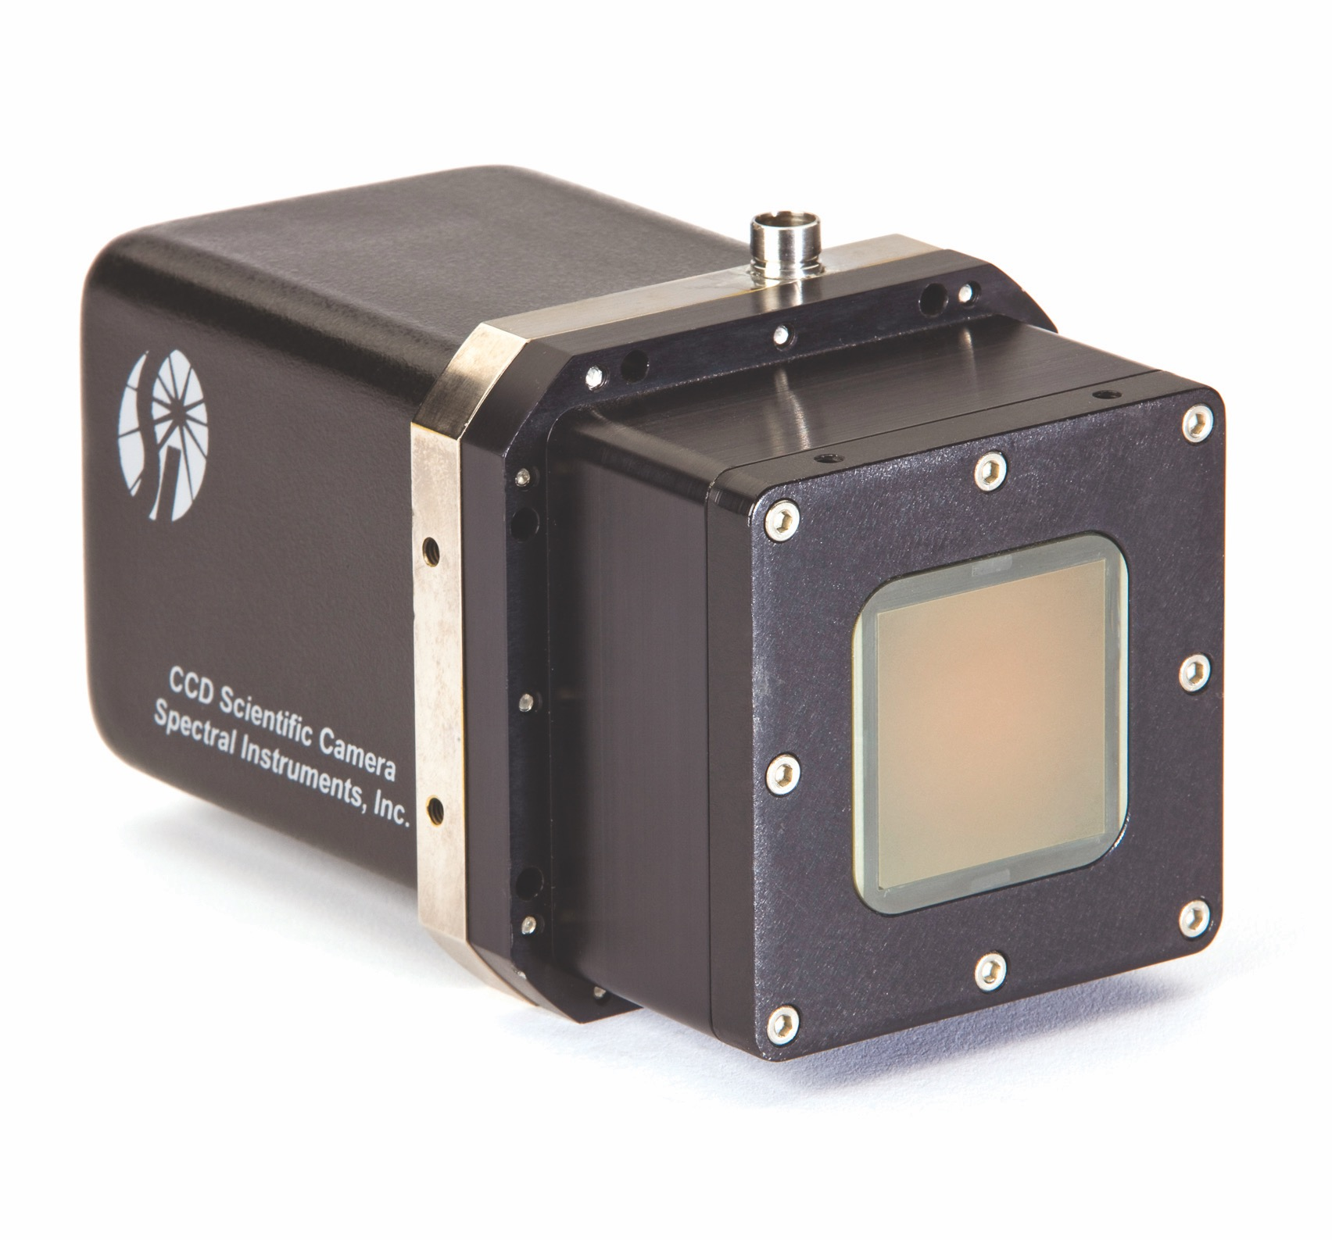
1000S camera using FO coupled KAF 16801 CCD replaced 35mm film

Slide 23
Successful Fusion Means Death of CCD’s
50 kRad TID
1 x 10¹¹ neutrons/cm²
Radiation comes in short, intense bursts
Back to using film for high yield shots
Need radiation tolerant cameras

Slide 24
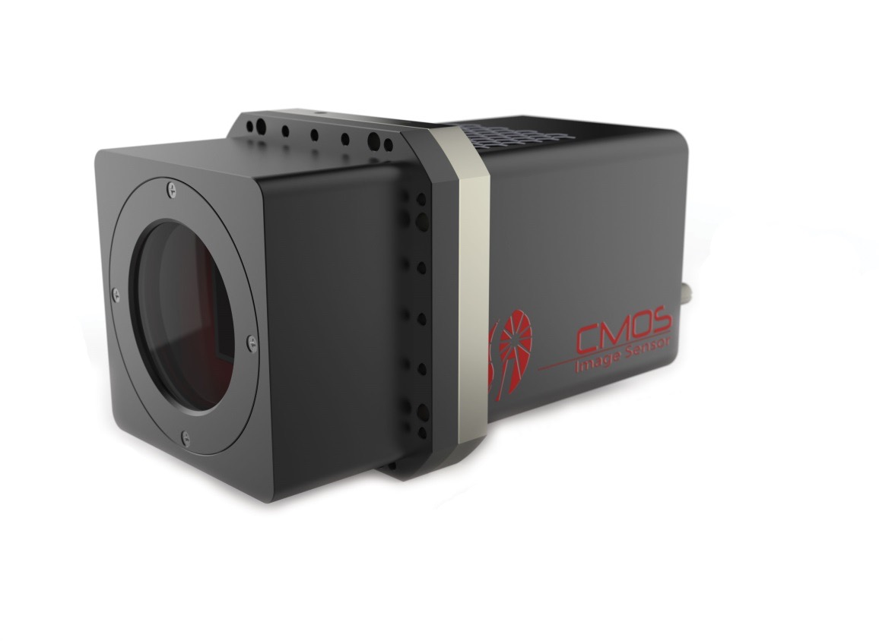
1600S Camera Design Philosophy
Mechanically and interface same as 1000S CCD camera
A camera platform that can be fitted with different sensors
Use as few electronic components possible in radiation area
Use commercially available tolerant components
Camera control FPGA held in reset, or powered down during shot
Sensor pixels held in global reset during shot

Slide 25
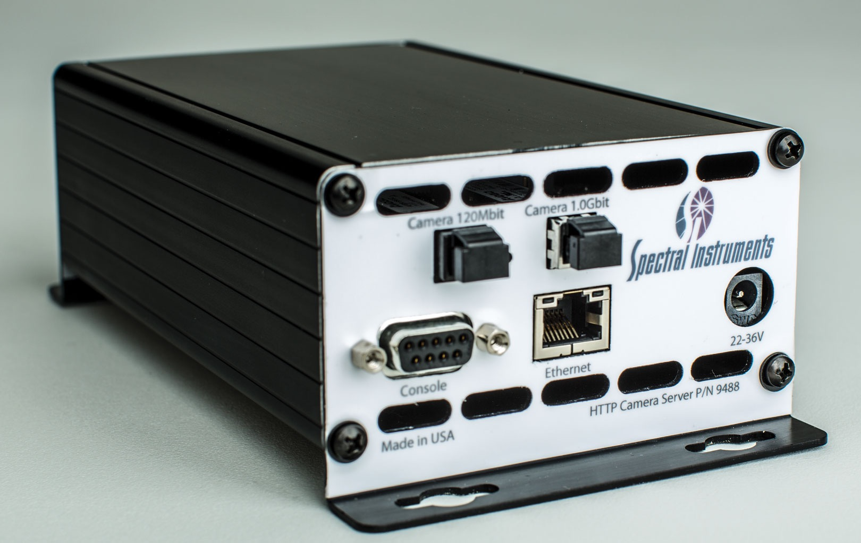
Camera HTTP Server

Slide 26
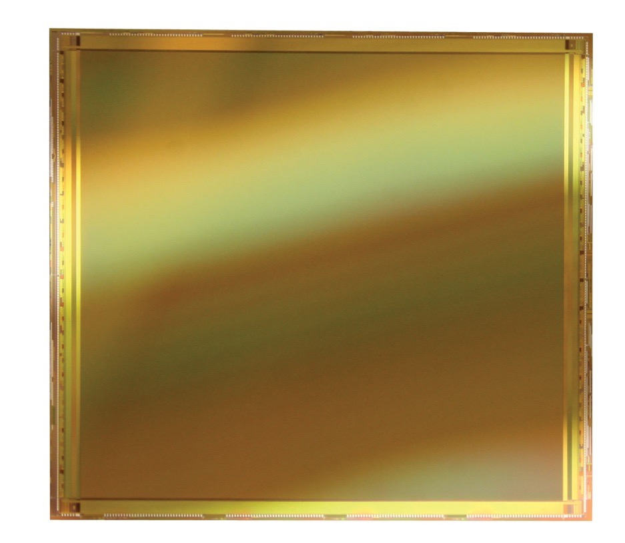
Sensors
CIS-31 8k x 8k, 6.5 micron 5T pixels, fast global shutter, backside
illuminated to replace SXI x-ray pinhole cameras
SRI (Janesick) Nk x Mk 4K x 4K, 10 micron 5T pixels frontside
illuminated to replace streak camera readout. FO coupled.
CIS-12 4K x 4K 6.5 micron 5T pixels, fast global shutter, backside
illuminated for direct electron readout of time dilation camera

Slide 27
