Slide 1
Microwave Kinetic Inductance Detectors for optical and near-IR astronomy
Kieran O’Brien
UCSB

Slide 2
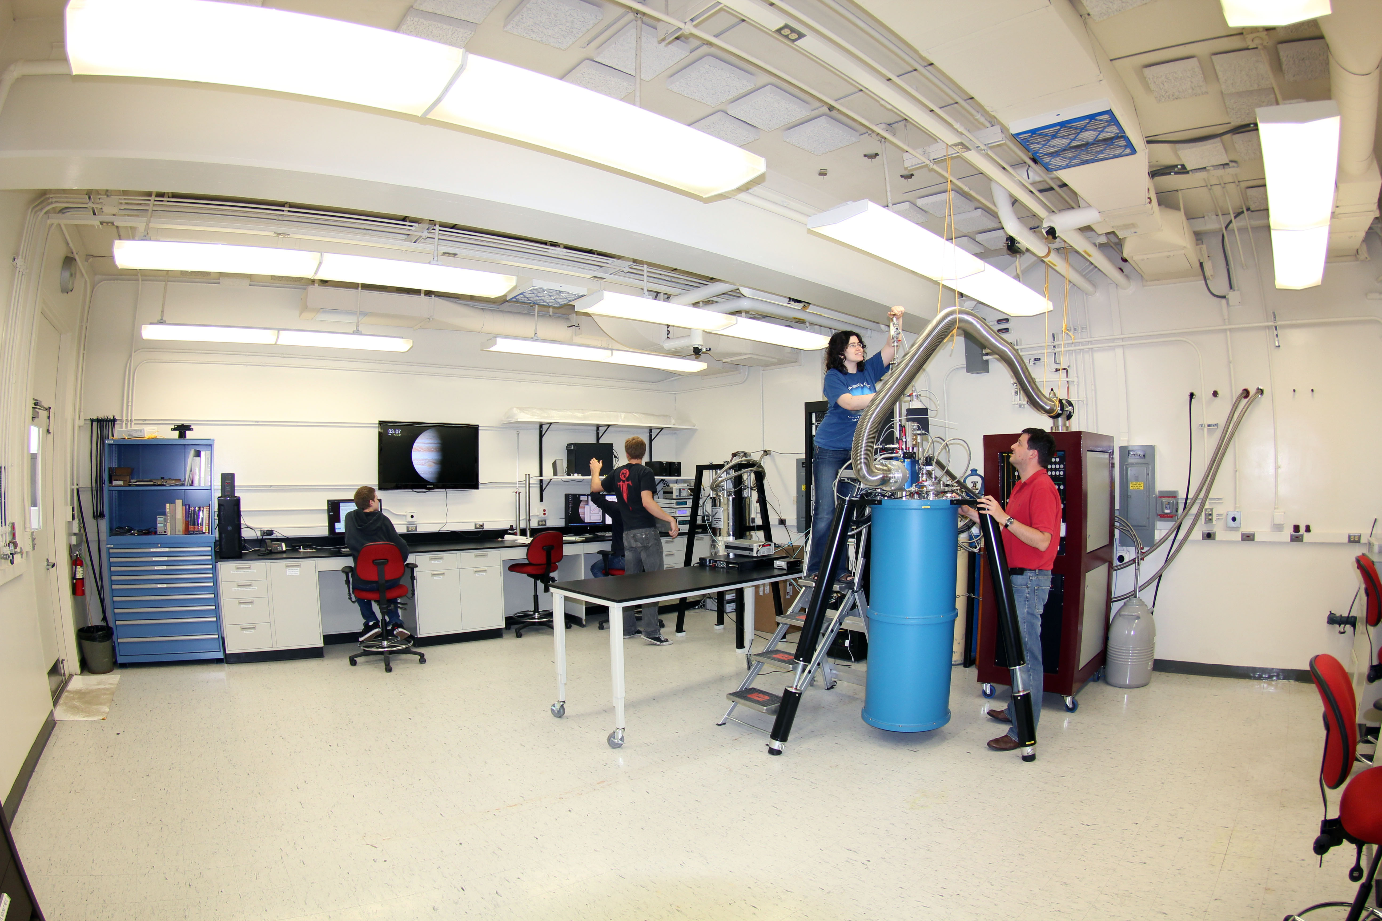



Mazin Lab
The Optical/UV MKID Team:
UCSB: Ben Mazin, Kieran O’Brien, Sean McHugh, Danica Marsden, Seth Meeker, Eric Langman
Caltech: Jonas Zmuidzinas, Sunil Golwala, David Moore
JPL: Bruce Bumble, Rick LeDuc
Mazin Lab @ UCSB

Slide 3
Outline of talk
What are Microwave Kinetic Inductance Detectors (MKIDs)?
Status of technology
ARCONS
Palomar commissioning run
ARCONS science
Future prospects

Slide 4
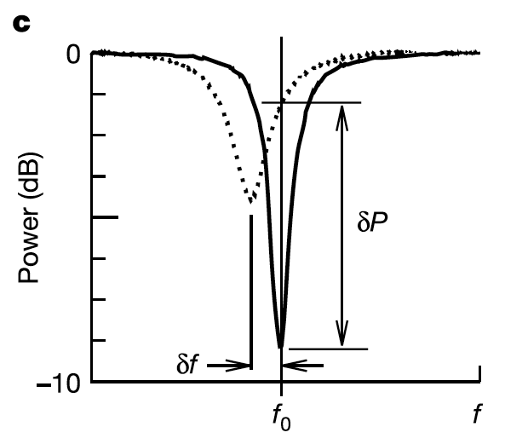
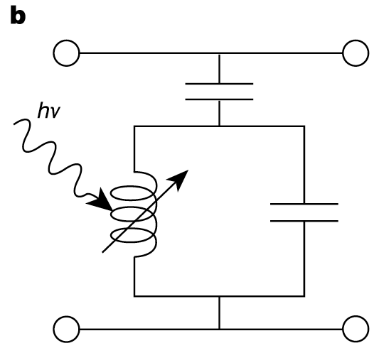
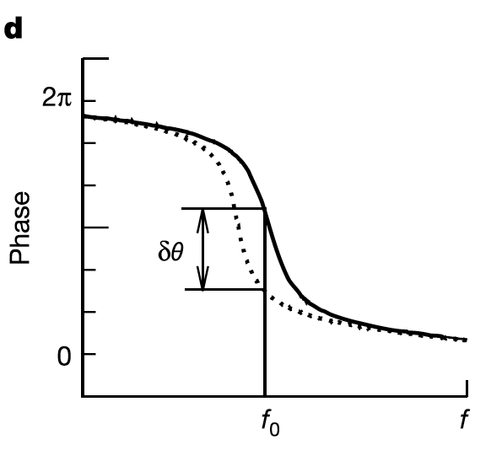
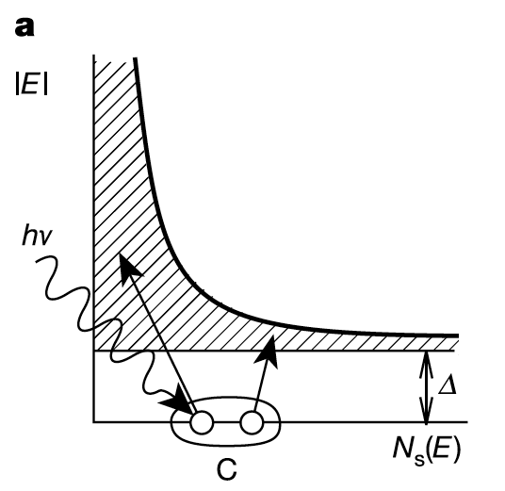
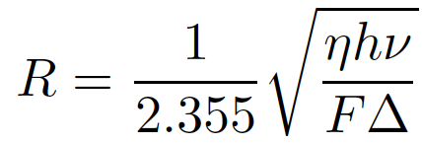
Microwave Kinetic Inductance Detectors
MKID Equivalent Circuit
Inductor is a
Superconductor!
Energy Gap
Silicon – 1.10000 eV
Aluminum – 0.00018 eV
Energy resolution:
Cooper Pair
Notes:
Inductance is in form of Kinetic inductance.
Kinetic Inductance = extra inductance from stored kinetic energy in Cooper Pairs
Inversely proportional to number of cooper pairs. Photon breaks pairs, thus inductance goes up and resonant frequency goes down.

Slide 5
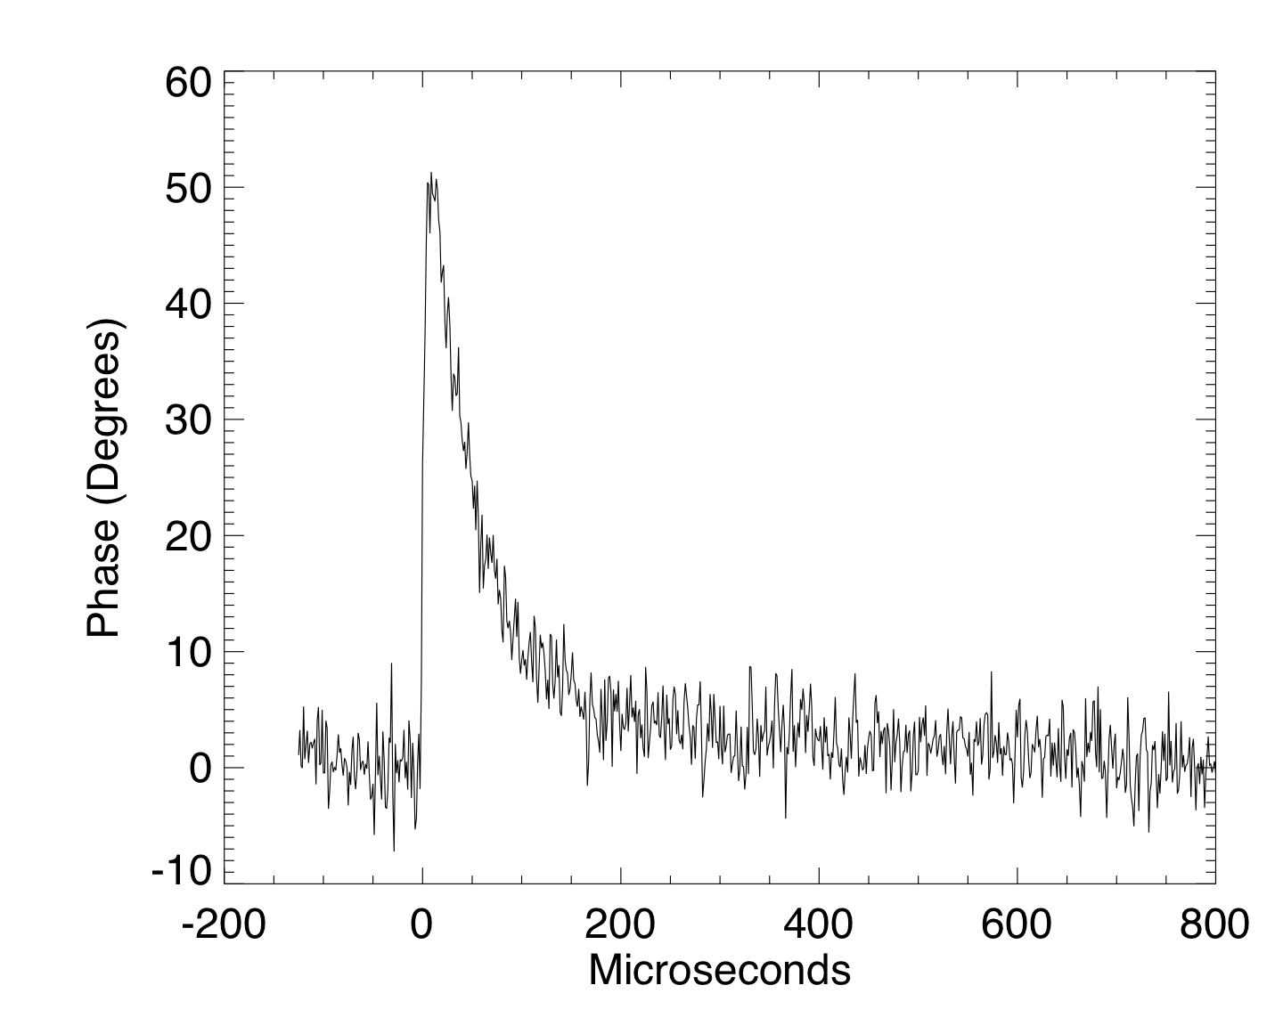
Phase-shift of probe signal
Typical Single Photon Event

Slide 6
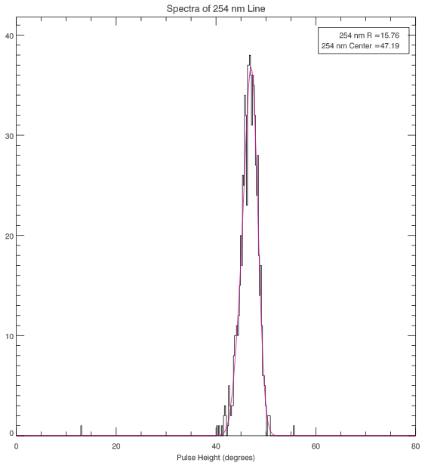
Energy resolving detector
Energy Gap
Silicon – 1.10000 eV
Aluminum – 0.00018 eV
Distribution of Photon Events
hν= 4.9eV, R <~ 100 for η~1

Slide 7
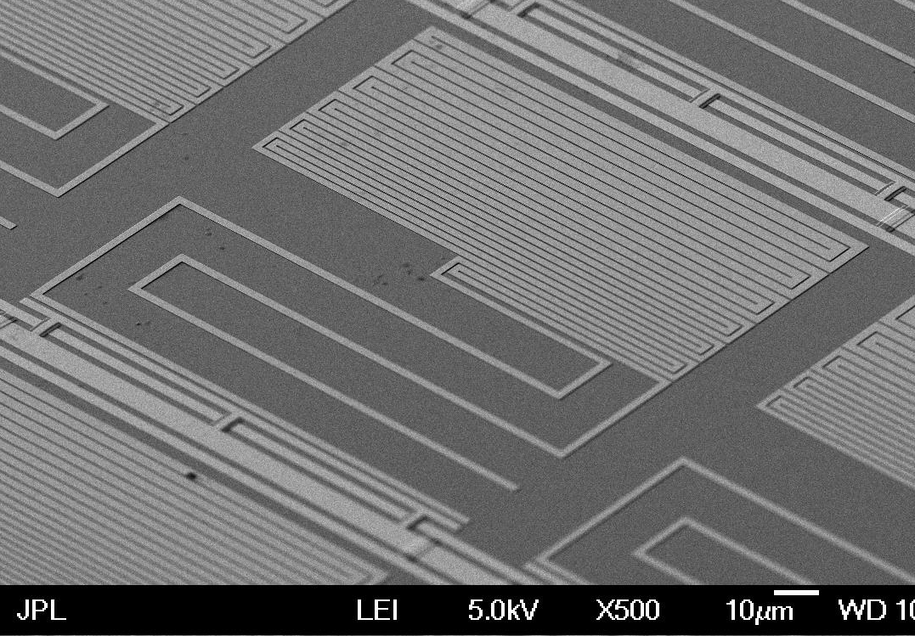
Lumped element pixels

Slide 8
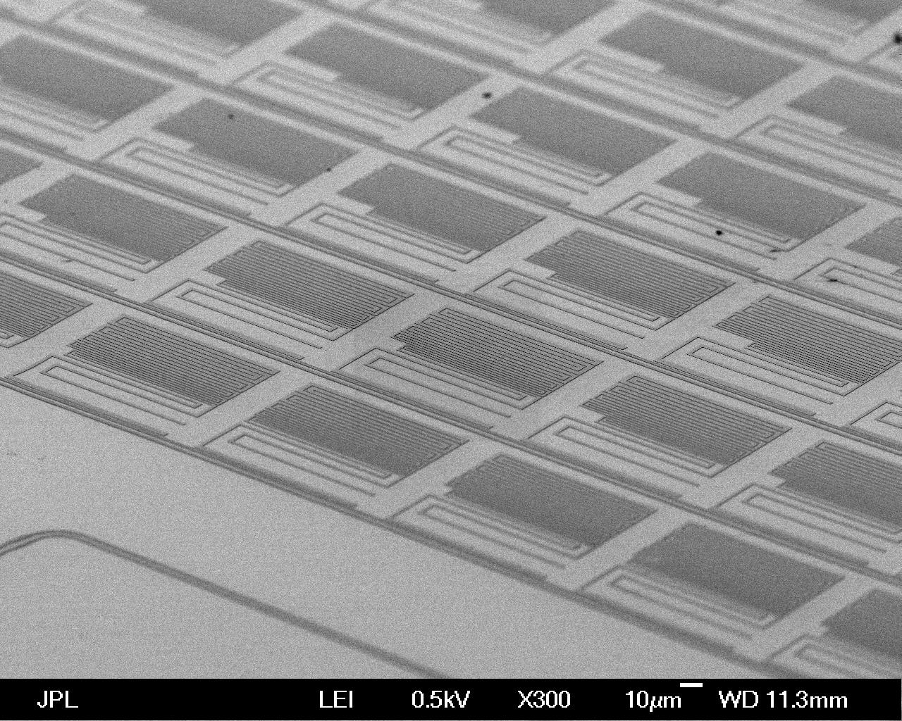
Arrays of MKIDs
Notes:
Resonators close in frequency are far apart in space

Slide 9
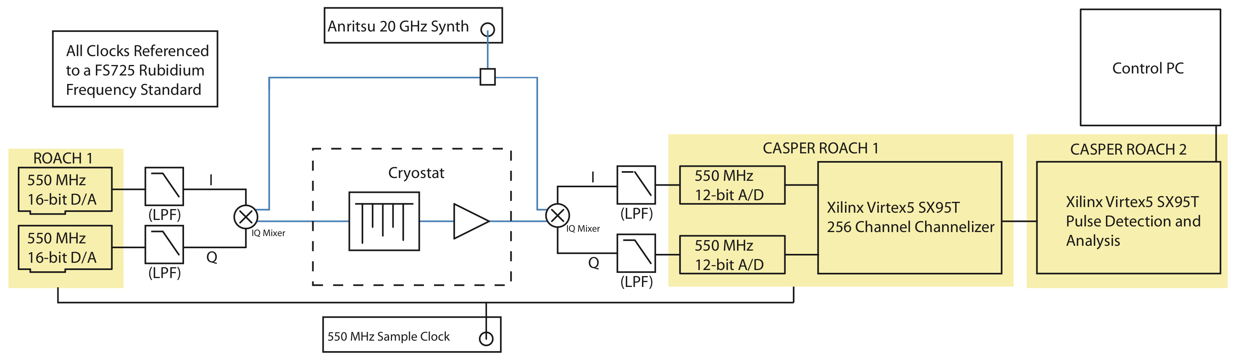
Digital MKID Readout
Software Defined Radio (SDR) Overview
  Leverages massive industry investment in ADCs/FPGAs
  Generate frequency comb and upconvert to frequency of interest
  Pass through MKID and amplify
  Downconvert and Digitize
  “Channelize” signals in a powerful FPGA
  Process pulses (optical/UV/X-ray) or just output time stream (submm)
From talk given by Ben Mazin

Slide 10
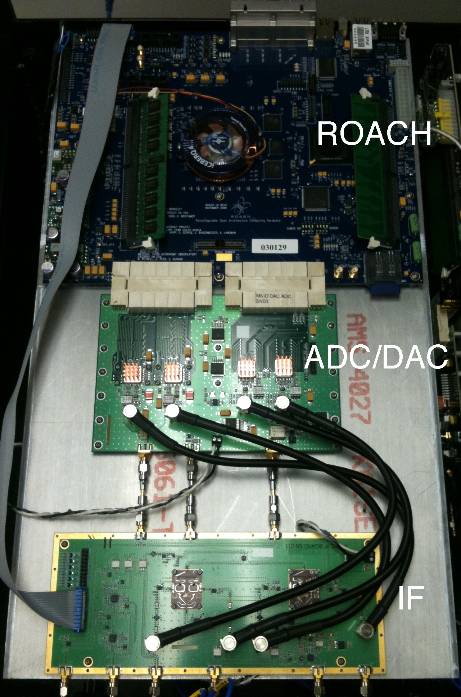
SDR Readout
ROACH Based readout cost ~$20/pixel
Readout up to ~10 kpix feasible now

Slide 11
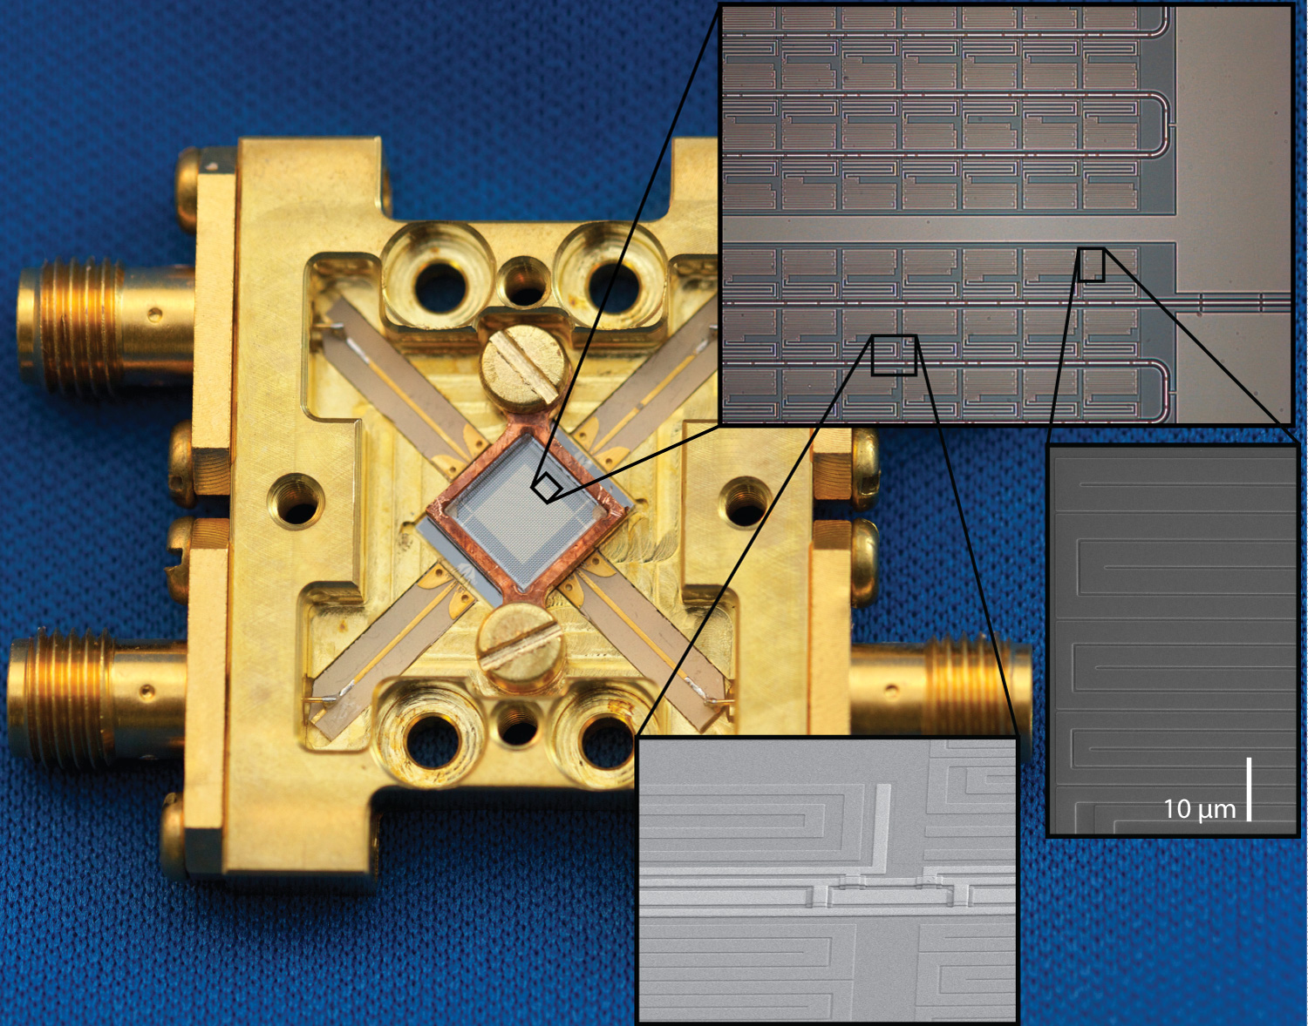
The science array
1024 pixel array (15x larger than any previous STJ/TES array)
2 feedlines with 512 resonators/feedline
Designed to have 2MHz spacing between resonators
Resonators close in frequency are far apart in space
839 resonators found in wide sweep (82%)
669 pixels accessible by read-out (4x512MHz)
65% of total array
Notes:
Gradient across wafer causes shift in frequency. Position algorithm makes clumping worse!

Slide 12
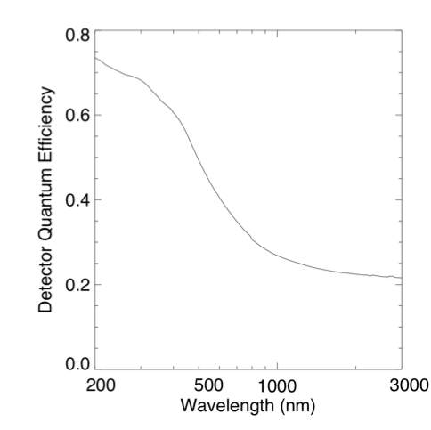
QE curve
QE is for TiN measured on a Sapphire substrate
Device remains sensitive up to mid-IR range
Sky background very high, so need to block IR photons

Slide 13
SCI-2B Uniformity

Slide 14
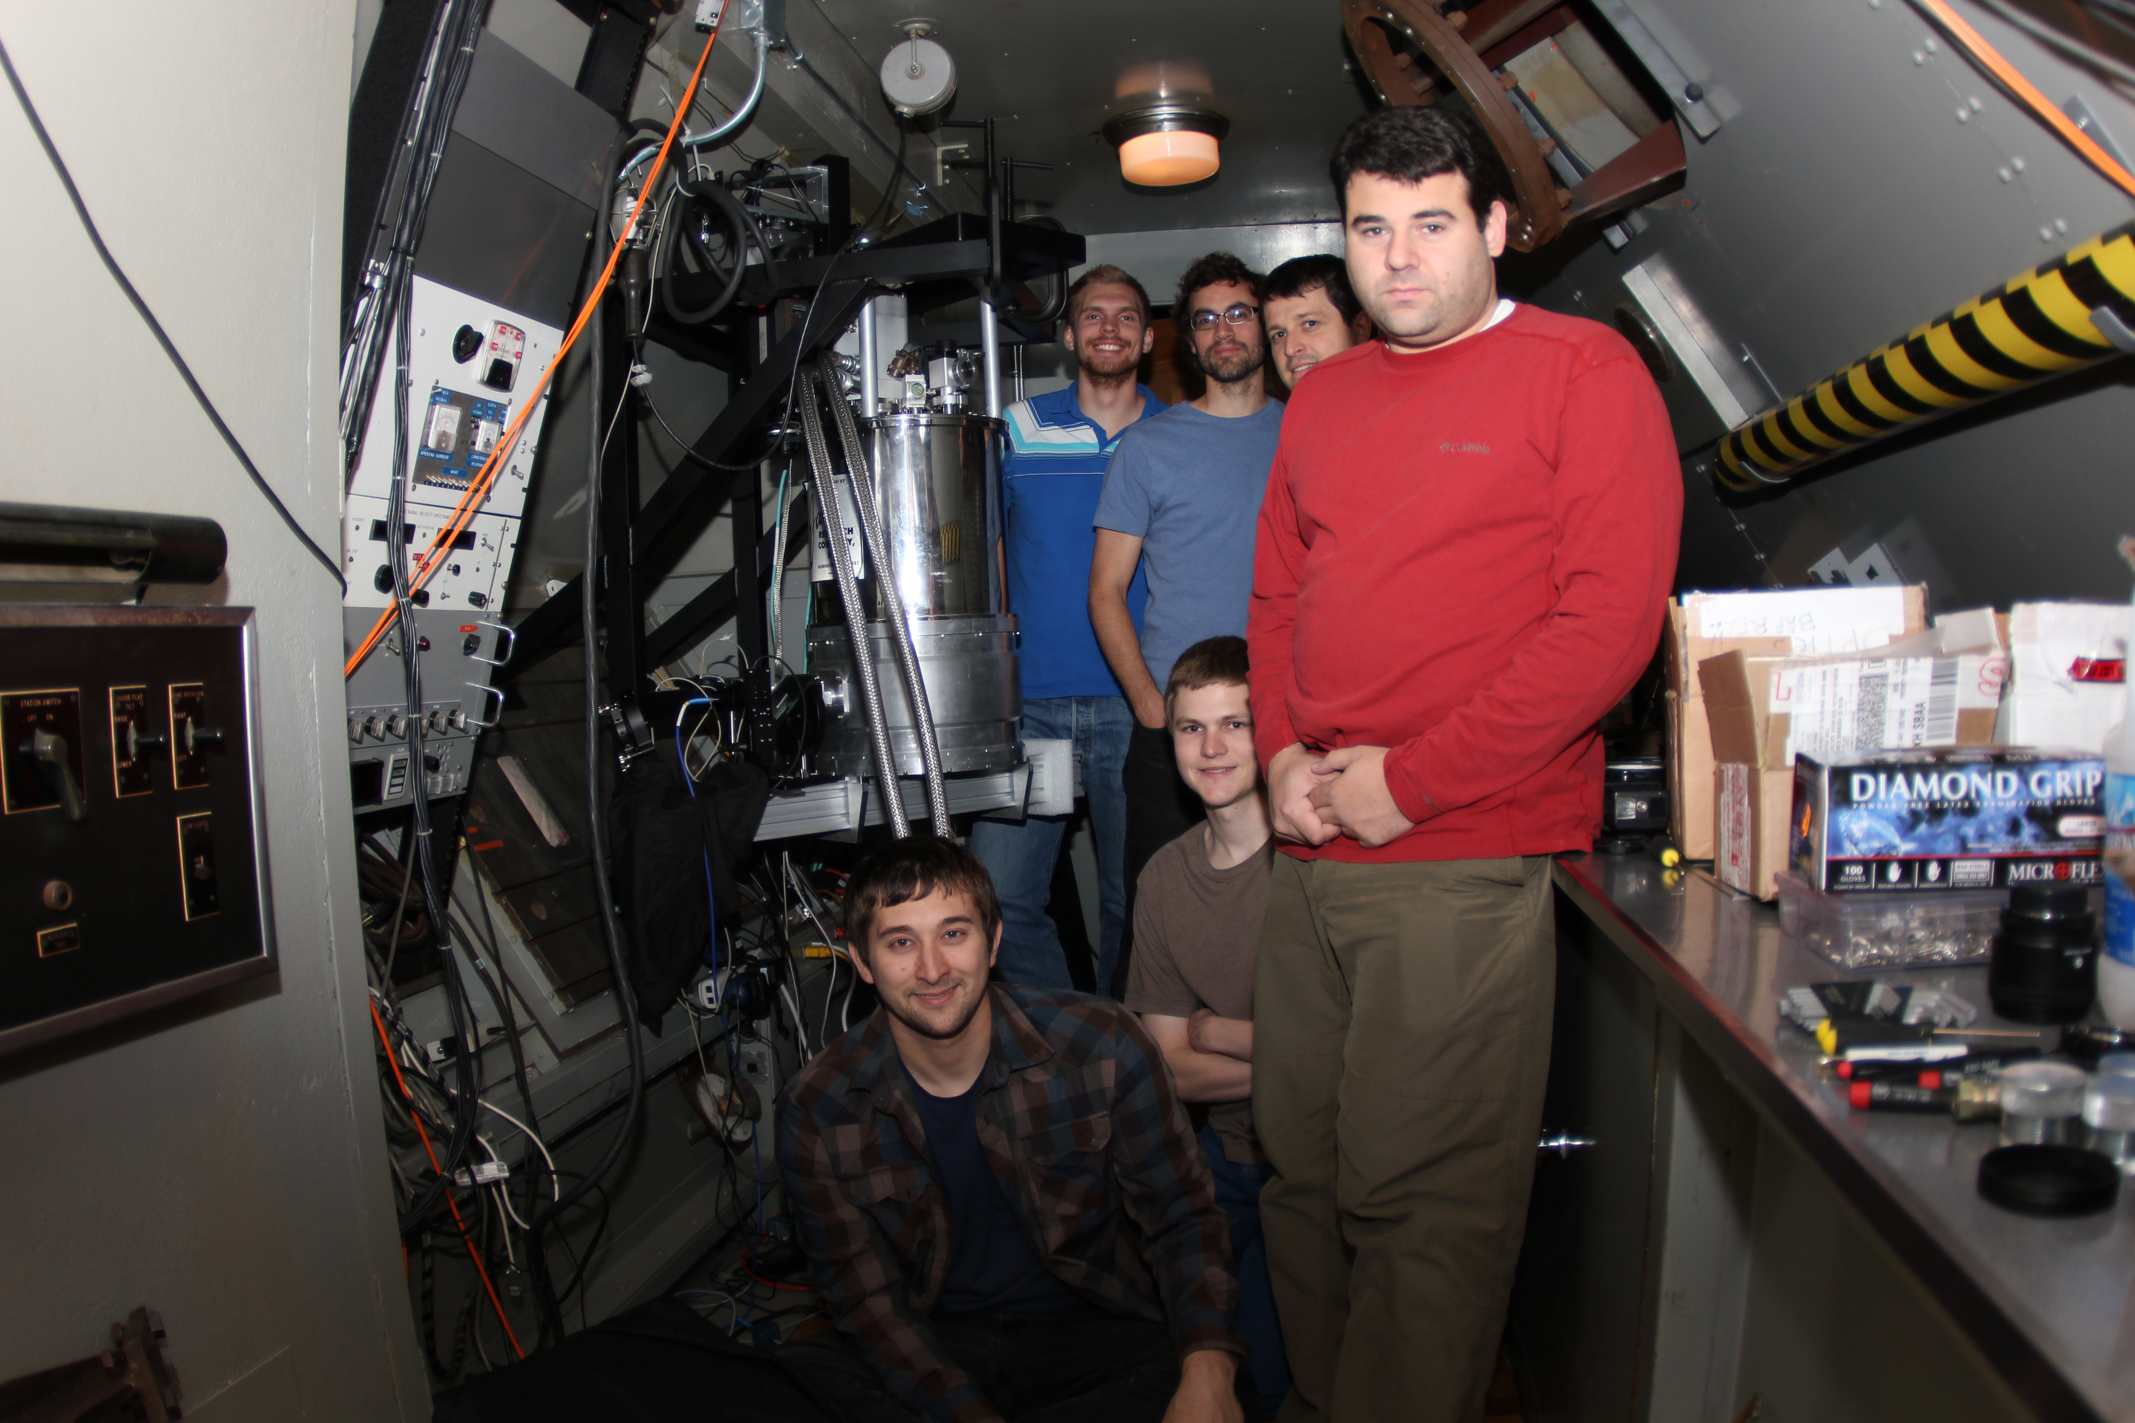
ARCONS
The Array Camera for Optical and Near-IR Spectrophotometry
1024 pixel MKID array (669 active pixels)
TiN lumped element pixels
Lens coupled
100mK cryogen-free ADR
0.23”/pixel plate scale
0.38-1.1μm passband
2000 cts/pixel/sec limit
Energy resolutuion R=10-20 at 400nm

Slide 15
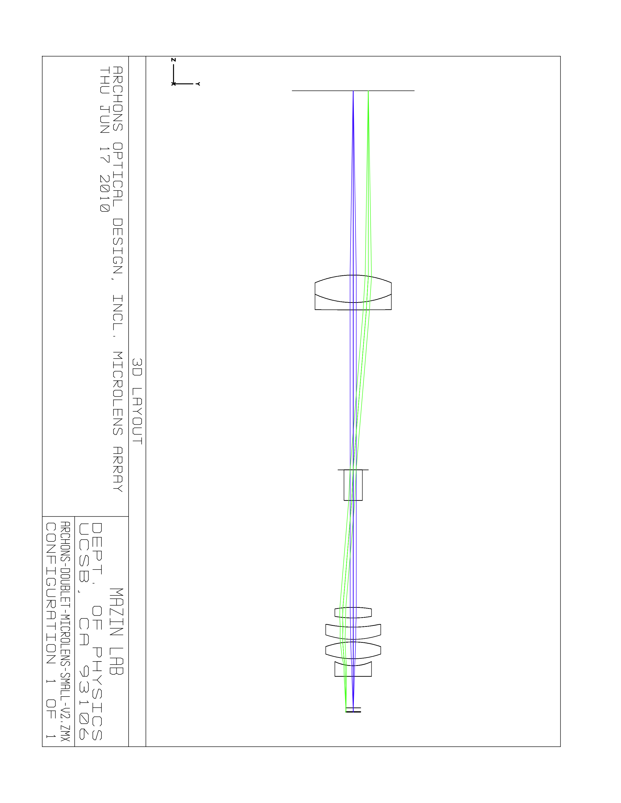
Optical design
300 K
4 K
0.1 K
MKID array
Lyot stop
Entrance window
Microlens array
IR blocking filter

Slide 16
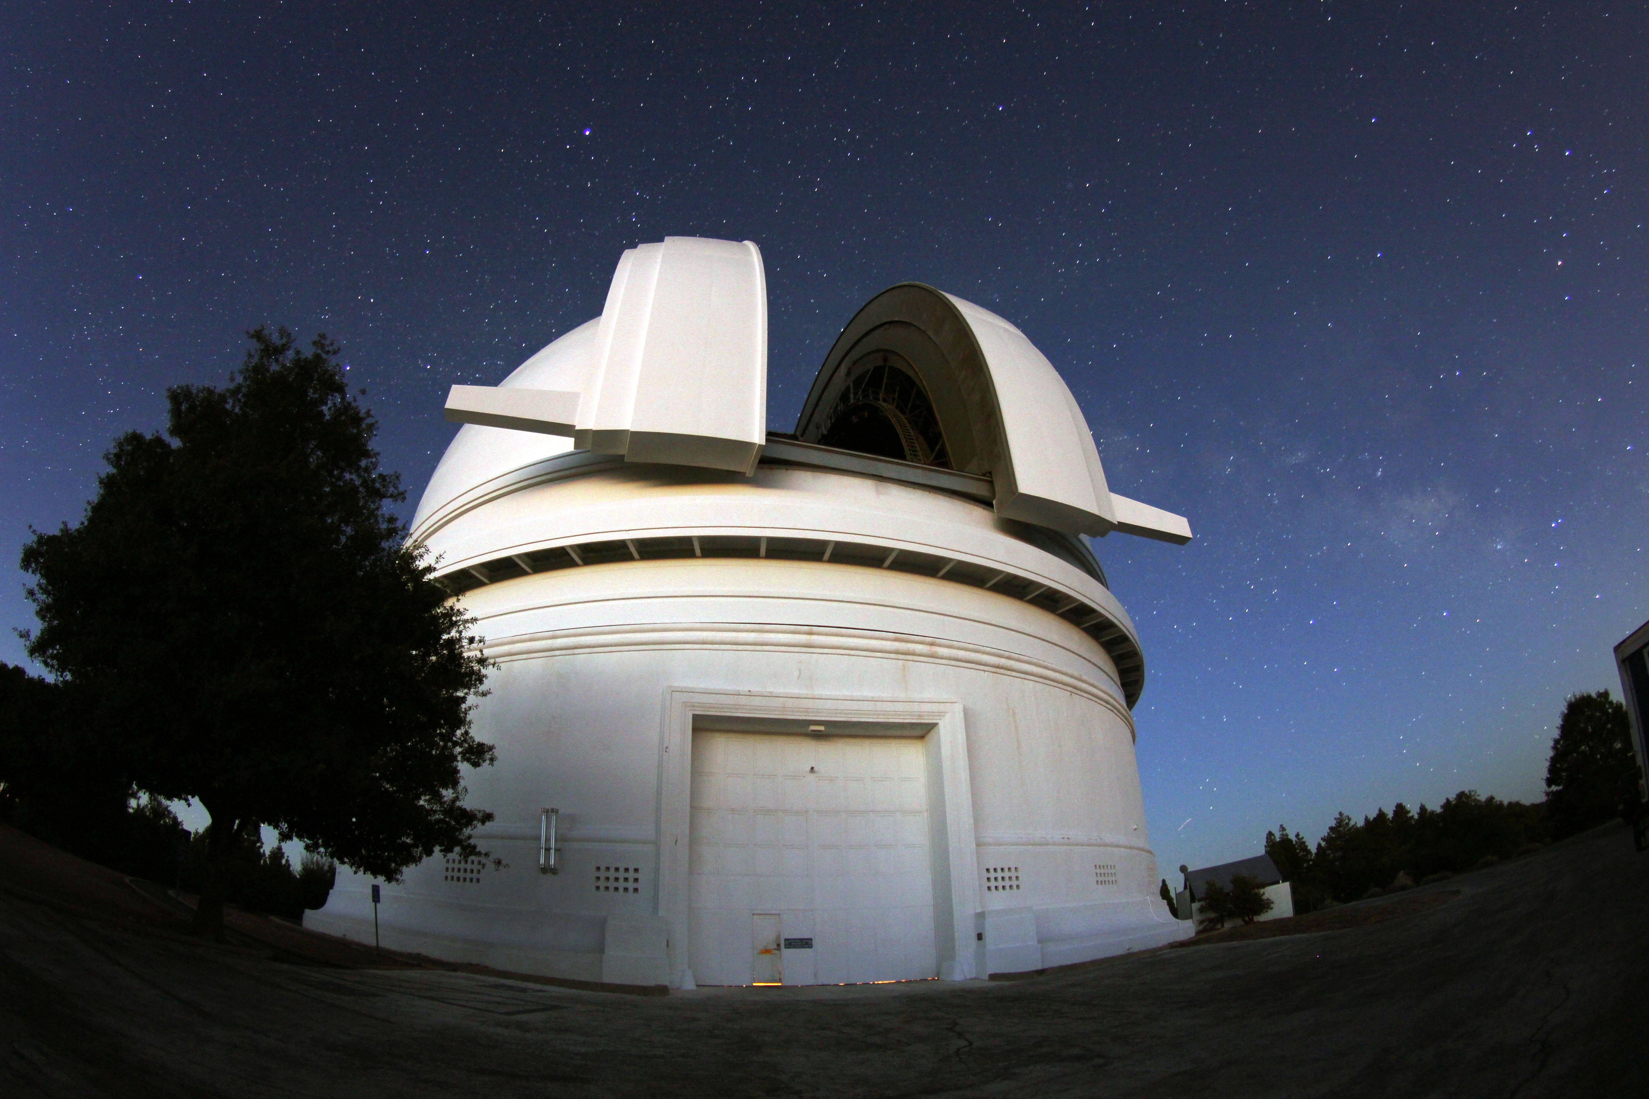
First MKIDs on sky!

Slide 17
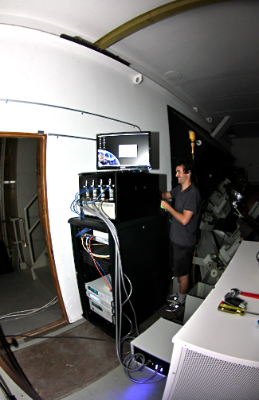
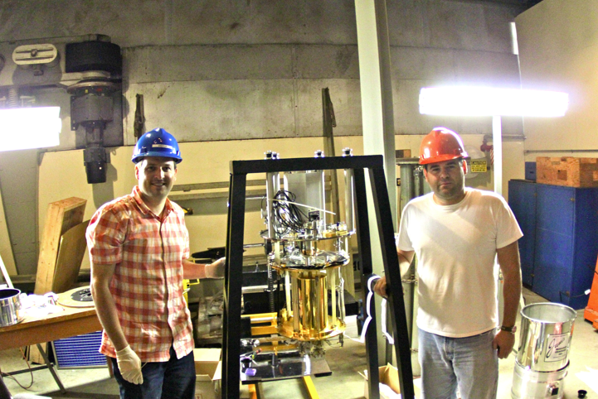
Some photos

Slide 18
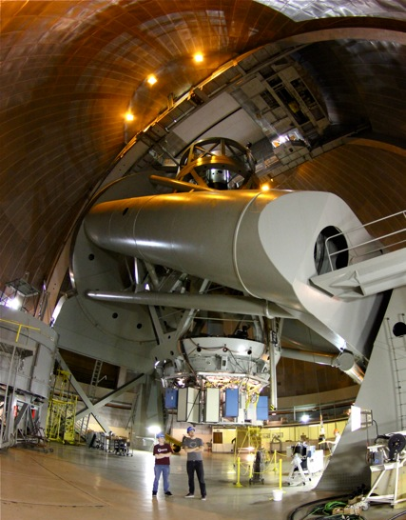
ARCONS

Slide 19
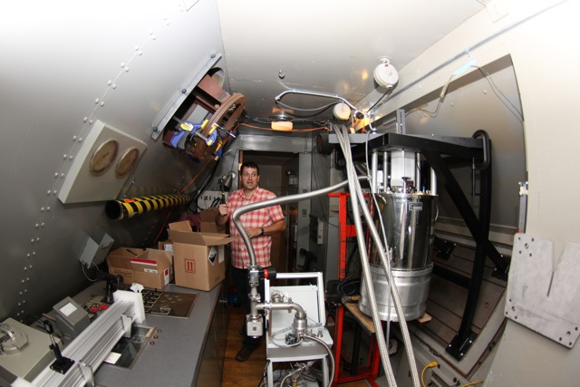
Installation

Slide 20
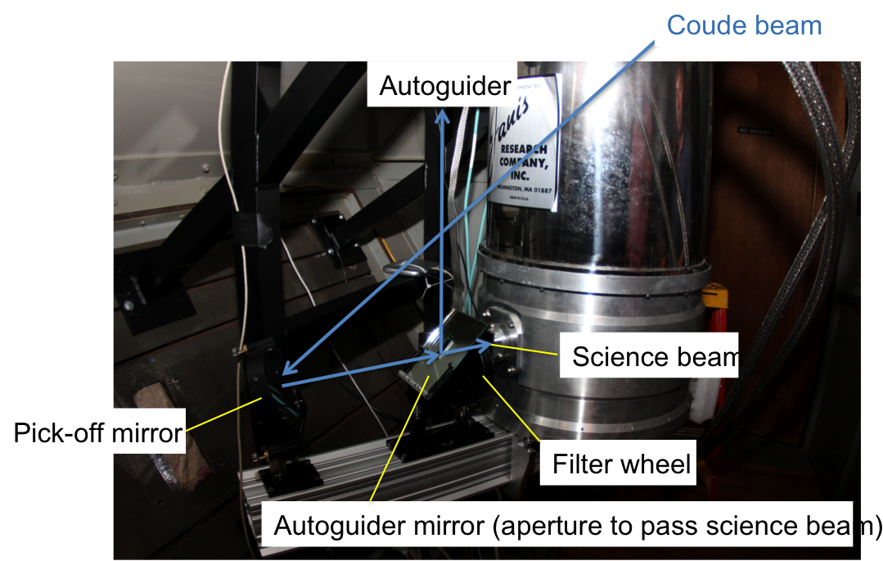
Optical layout

Slide 21
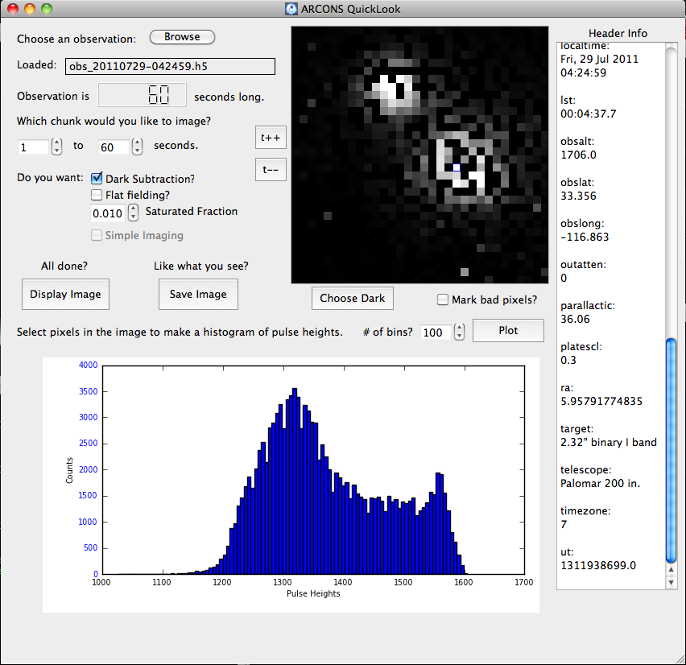
First light!
2.32” separation visual binary

Slide 22
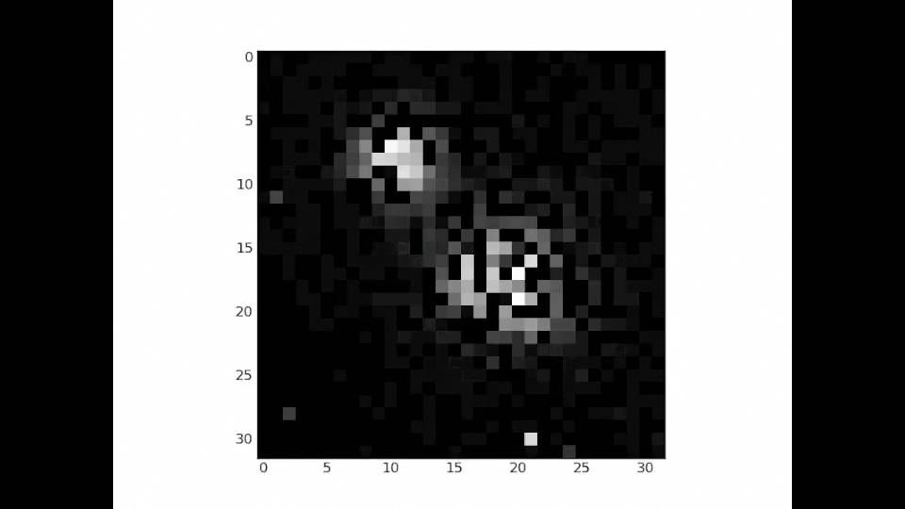
First light: the movie!
Courtesy: Seth Meeker
Notes:
Time domain astronomy talk….

Slide 23
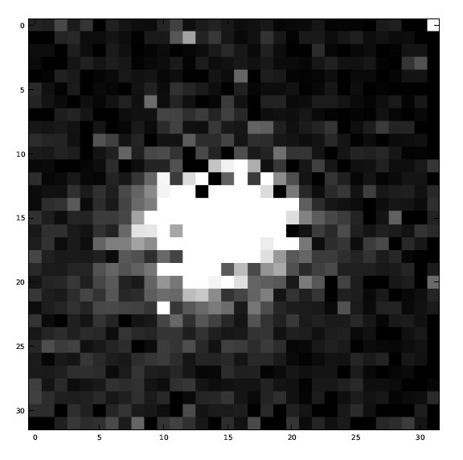
Results
‘Dithered’ reconstruction of 3 offset exposures of PG1633+099A
m_{v} = 15.26 standard star
20 second integration
I_{cousins} filter
S/N ~ 80
Limit of m_{I} ~ 22.5 for 10-sigma in 1 hr
Notes:
That’s the good news…

Slide 24
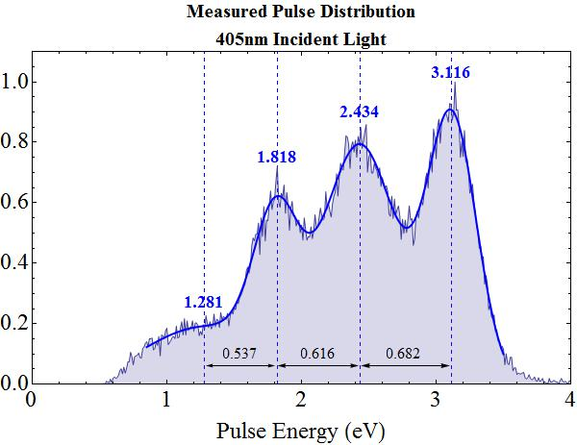
Substrate Event Problem
405nm input light shows at least 3 clear peaks in the profile.
First peak is as expected and is associated with photons absorbed in the device
Second (and subsequent) peaks are from photons that have travelled through the film and been absorbed in the (silicon) substrate. Some of the quasi-particles then diffuse back into superconductor and are detected.

Slide 25
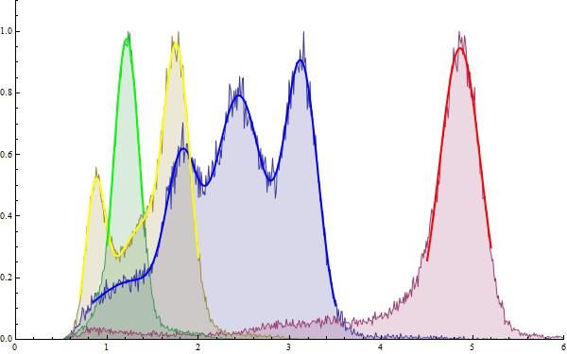
Energy calibration Problems
Expect to see clear single-peak response to monochromatic light source.
254nm
405nm
696nm
980nm

Slide 26
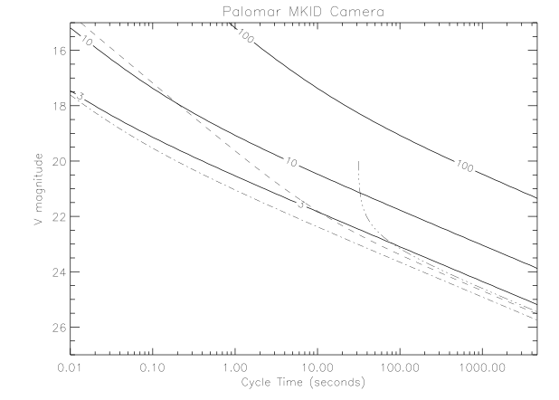
Sensitivity
m_{v}=23 for 10-sigma in 1hr
m_{v}=25 for 3-sigma in 1hr
3 dot-dash - conventional CCD on an 8-m telescope (FORS/VLT)
Dashed line - frame transfer CCD on an 8-m telescope (ULTRACAM/VLT)
Short duration observations are already better than those on a large telescope

Slide 27
Science demonstration targets
(or ‘what we hope to do!’)
Object | Description | Key fact | Goal
NN Serpentis | Post common-envelope binary | 0.13008017141(17) day period | Determine system parameters
PTF11jfm, PTF11hzx, PTF11htj | Supernovae from PTF survey |  | Demonstrate object classification
Einstein’s cross | Strongly lensed galaxy |  | Spectroscopically identify components
SDSS J0022+1431, SDSS J2321-0939, VBDS220339925, VBDS220265418, QSO 2308+098, QSO 1745+163 | Quasars | Known redshift | Demonstrate spectroscopic redshift determination
V404 Cygnus | Quiescent blackhole LMXB | 9M_{sun} Blackhole | Determine spectrum of flaring
V407 Vulpeculae | Double degenerate accreting binary | 9-min orbital period | Measure phase-resolved spectrum
NLTT 11748 | Detached double degenerate binary | Eclipsing
Crab Pulsar | Pulsar | 33msec pulsar | Determine spin resolved spectrum

Slide 28
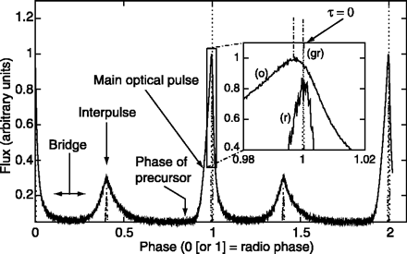
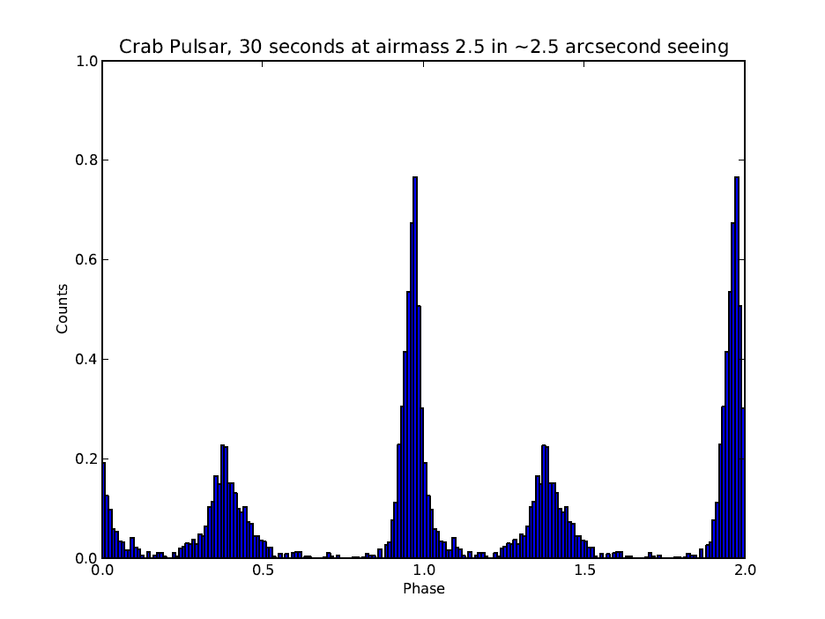
Crab Pulsar
Pulse profile measured with ARCONS
Archival pulse profile for Crab (Shearer 2003)

Slide 29
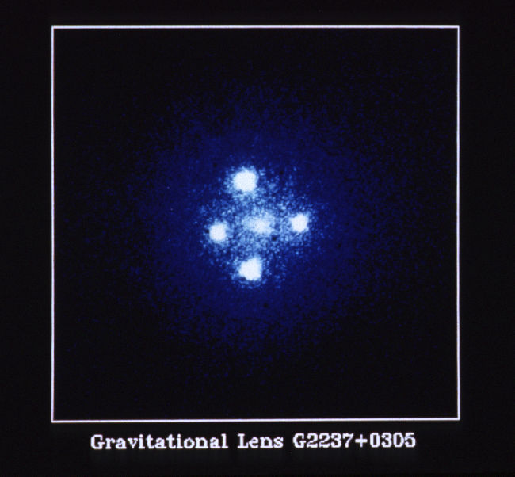
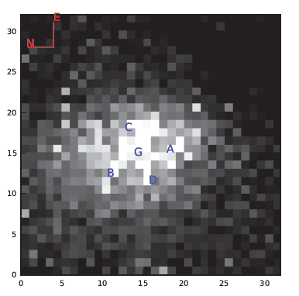
Einstein cross
HST Faint Object Camera
ARCONS

Slide 30
Summary of status of ARCONS
 | July 2011
Pixels | 1024
Quality | 82%
QE | 20-60%
R (spectral resolution) | 10-15
Time resolution | 10⁻⁶ secs
# MKID instruments | 1

Slide 31
Detectors for astronomy
sensitivity | Noise | Time resolution | Energy resolution | Array size | Cost/unit
Poor | Good | msec | Poor | Good | Free
Fair | Poor | minutes | none | Good | Moderate
Fair | Good | msec | none | Poor | High
Excellent | Good | seconds | none | Excellent | Moderate
Excellent | Fair | seconds | none | Excellent | Moderate
Fair | Good | msec | none | Poor | High
Fair | Excellent | μsec | Fair | Poor | High
Fair | Excellent | μsec | Fair | Poor | High
Fair | Excellent | μsec | Fair | Fair | Moderate
Eyes
Photographic plates
Photomultipliers Micro-channel plates
CCDs frame transfer, EMCCDs
CMOS
APD SPADs, Geiger-mode APD
STJ
TES
MKIDs

Slide 32
Detectors for astronomy
sensitivity | Noise | Time resolution | Energy resolution | Array size | Cost/unit
Poor | Good | msec | Poor | Good | Free
Fair | Poor | minutes | none | Good | Moderate
Fair | Good | msec | none | Poor | High
Excellent | Good | seconds | none | Excellent | Moderate
Excellent | Fair | seconds | none | Excellent | Moderate
Fair | Good | msec | none | Poor | High
Fair | Excellent | μsec | Fair | Poor | High
Fair | Excellent | μsec | Fair | Poor | High
Excellent | Excellent | μsec | Fair | Good | Moderate
Eyes
Photographic plates
Photomultipliers Micro-channel plates
CCDs frame transfer, EMCCDs
CMOS
APD SPADs, Geiger-mode APD
STJ
TES
MKIDs (2020)

Slide 33
Summary of status of ARCONS
 | July 2011 | 2016
Pixels | 1024 | 10⁴ - 10⁵
Quality | 82% | >99%
QE | 20-60% | 80-100%
R (spectral resolution) | 10-15 | 50
Time resolution | 10⁻⁶ secs | 10⁻⁶ secs
# MKID instruments | 1 | ???
Notes:
4” wafer can hold 600x600 array (3x10^5)

Slide 34
Instrument concepts
Classification of transients | Accretion onto compact objects | Dark matter/energy
High throughput, low spectral resolution Integral Field Spectroscopy | High time resolution and high spectral resolution single-object spectroscopy | Highly multiplexed, low spectral resolution spectroscopy
ARCONS-10K | KIDSPEC | Mega-Z

Slide 35
Instrument concepts
Classification of transients | Accretion onto compact objects | Dark matter/energy
High throughput, low spectral resolution Integral Field Spectroscopy | High time resolution and high spectral resolution single-object spectroscopy | Highly multiplexed, low spectral resolution spectroscopy
ARCONS-10K | KIDSPEC | Mega-Z

Slide 36
Classification of Transient sources
Important step between discovery and follow-up
PTF: 1.5Million candidates/night
1000 ‘real’ sources
300 variables
10 SNe
LSST: 100x volume of PTF
PTF: Josh Bloom
LSST: LSST science book
Notes:
Want expensive follow-up to concentrate on most interesting

Slide 37
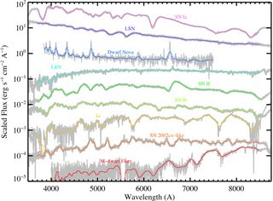
Classification spectrum of Transient sources
Low resolution spectroscopy on small-medium sized telescopes is key
Moderate (1’x1’) field of view
ARCONS-10K on a remotely controlled (/robotic) 2-m telescope(s) at a good site would give similar or better S/N with the addition of Y+J bands
Additional variability information
More efficient observing without need for fixed integration times
Source: Nick Konidaris, SED machine
Classify large number of candidates to marshall 8-10m telescope follow-up. Optimize discovery potential of upcoming transient surveys
Notes:
SED machine 3600 spaxels (60x60 over 45x45” FOV)

Slide 38
Instrument concepts
Classification of transients | Accretion onto compact objects | Dark matter/energy
High throughput, low spectral resolution Integral Field Spectroscopy | High time resolution and high spectral resolution single-object spectroscopy | Highly multiplexed, low spectral resolution spectroscopy
ARCONS-10K | KIDSPEC | Mega-Z

Slide 39
Instrument characteristics
Single object
Medium spectral resolution (R > ~3000) to distinguish velocity components in the emission lines of Interacting Binary systems (and many other applications)
Wide passband (0.35-2.2μm) to capture as much of the SED of the object as possible simultaneously
Good temporal resolution (< 0.1secs) to sample characteristic time-scales (frequencies of variability, light-travel times, orbital periods) in Interacting Binaries
Low noise to avoid penalty of time resolution
Optimizes collecting power of large telescopes, eg Keck, TMT

Slide 40
KIDspec
Dual-arm (Vis+IR) spectrograph, with echelle grating in low order (<20) to achieve spectral resolution of 5-10,000
Cross-disperser is replaced by energy resolution of MKIDs
Photon counting detector allows for excellent background subtraction (a problem for eg. X-shooter/VLT)
Combined with an image slicer, could give Integral-Field Spectroscopy as well.
See also, Cropper et al., 2003

Slide 41
Instrument concepts
Classification of transients | Accretion onto compact objects | Dark matter/energy
High throughput, low spectral resolution Integral Field Spectroscopy | High time resolution and high spectral resolution single-object spectroscopy | Highly multiplexed, low spectral resolution spectroscopy
ARCONS-10K | KIDSPEC | Mega-Z

Slide 42
Era of surveys
Current large surveys (eg. COSMOS) combine large area imaging in a few (5-10) filters with spectroscopy of a small fraction of the sample
Photometric redshifts are used to constrain clustering
Some surveys using multiple narrow band filters, very expensive in terms of telescope time
Too time consuming/expensive to perform spectroscopy of more than a subset of objects detected

Slide 43
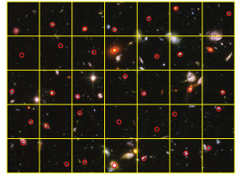
Mega-z
Redshift machine for Keck
Mask covers 10’x10’ FOV
R~50 spectra for 10,000
objects per telescope pointing
Limiting magnitude: m_{I} = 26 in 1hr
Grid of 6”x6” ‘patrol fields’
Each patrol field mapped onto a single MKID
4-6 square degrees in 25 nights producing redshifts of > 1M objects

Slide 44
Summary
We have demonstrated the use of MKIDs for optical/IR astronomy on sky for the first time
Challenges remain in increasing uniformity and responsivity of arrays
Their unique scalability amongst energy sensitive detectors makes them an excellent candidate for future instrumentation
Could transform astronomy in the same way as the transition from photographic plates to digital media

