Slide 1

Sensors and Detectors for Physical and Chemical Sciences
Don Figer
College of Science, Professor
Future Photon Initiative, Director
Center for Detectors, Director
October 29, 2025

Slide 2
Email from Jennifer Lyon Gardner from The University of Texas at Austin on 10/1/2025
Dear Don,
We are excited for you to join us at the CHIPS for Science conference on October 29-30. I'm writing today with some more details on the brief (~20-min) presentation we would like you to give at the conference.
We have you scheduled to give a presentation at 1:00 – 1:30 pm CT on Day 1 (October 29) on opportunities for heterogeneous integration and advanced packaging in sensors and detectors for physical and chemical sciences. More details on presentation length, format and suggested content:
Total time block on the agenda – 30 minutes
Aim for 20 min presentation with 3 min for intro and 7 min for audience Q&A
We encourage the use of slides as a visual aid; please upload your slides to https://utexas.app.box.com/f/61cc1b65545f4c7ab53eec480e64e17e by Monday, Oct 27 (two days before the conference)
Suggested content:
  Background: developments in detector technology are often applied first in astronomy/astrophysics use cases
  Describe how access to semiconductor facilities might advance the state-of-the-art in detectors for astrophysics or high-energy physics applications
  Example: how the ability to integrate multiple types of sensors together in a package or the integration of logic and memory into a package alongside the sensor to do in-package compute and local preprocessing of sensor data might be a benefit to advancing scientific research
Please let us know what questions you have. In addition, if you have any other logistical questions regarding travel, etc., you may direct those to RD-RSVP@austin.utexas.edu (CCed) for prompt response. We look forward to welcoming you to Austin later this month.

Slide 3
Outline
Speaker Bio
Sensors & Detectors: A History of Discovery
CMOS Imaging Detectors and Life in the Universe
Future Photon Initiative & Center for Detectors
CHIPs-related Activities at RIT
Back to the Future: Chips to the COSMOS

Slide 4
Speaker Bio

Slide 5
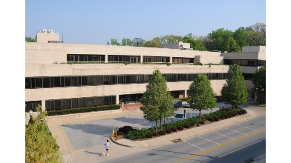
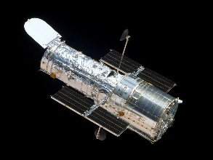
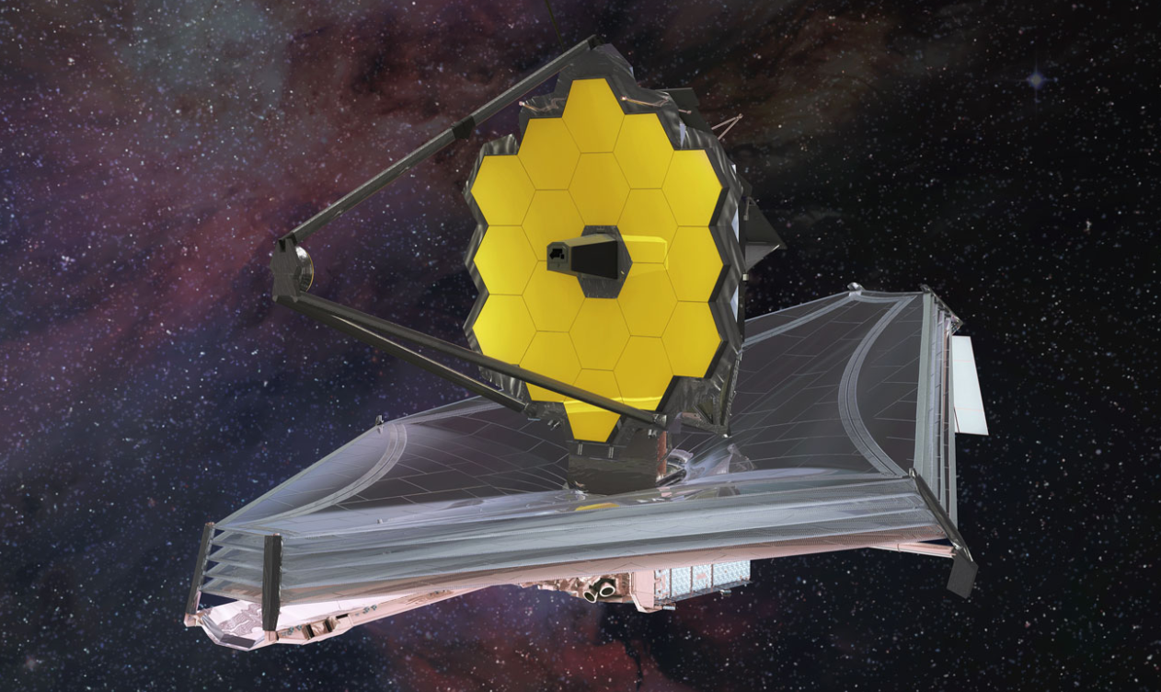
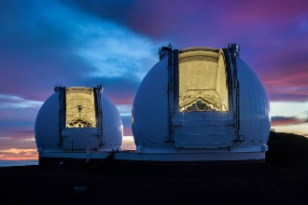
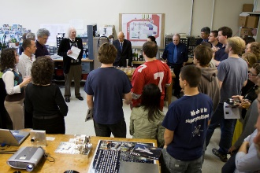
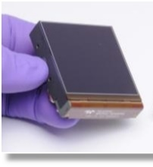
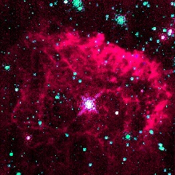
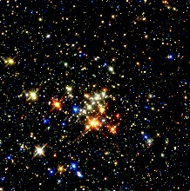
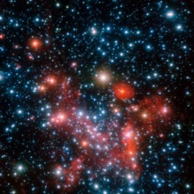
Don Figer - Speaker Bio
Professor in College of Science at RIT
Professor in Astrophysical Sciences and Technology Graduate Program
Director of the Center for Detectors
Director of the Future Photon Initiative
At RIT since 2006
Previously
  Space Telescope Science Institute (operates Hubble and JWST)
  UCLA (designed optics for infrared spectrograph on Keck)
Research Interests: Detectors, Massive Stars, Massive Star Clusters, Galactic Center

Slide 6
Sensors & Detectors: A History of Discovery

Slide 7
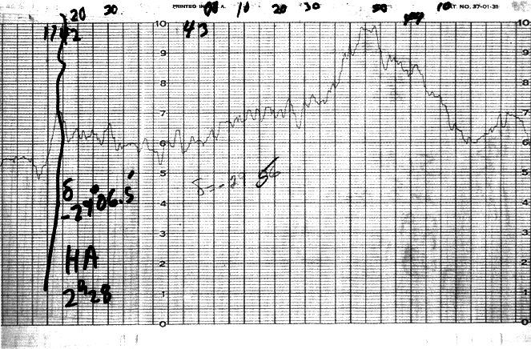
The Galactic Center with One Pixel

Slide 8
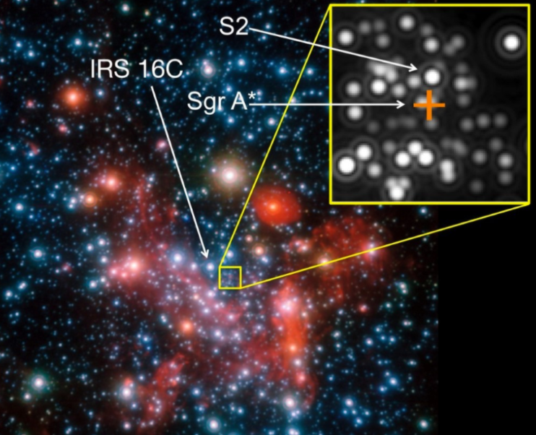
Modern Image of GC

Slide 9
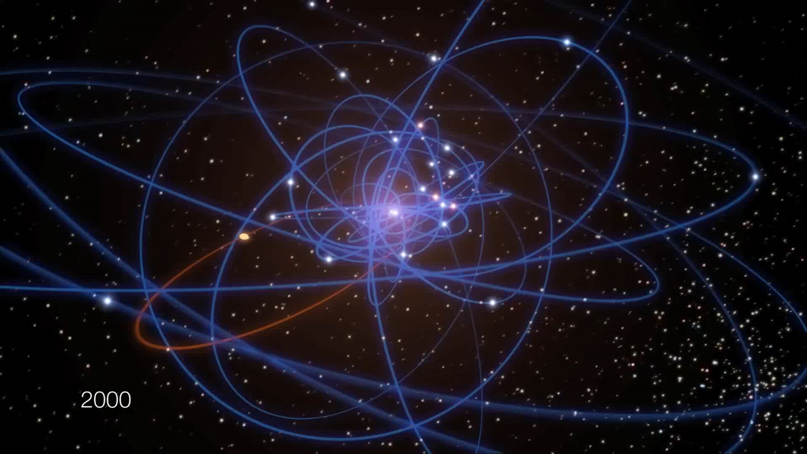
Stellar Orbits Near the GC

Slide 10
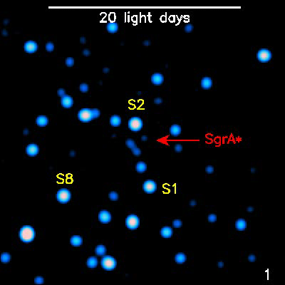
From One Pixel to Many Megapixels
Our basic understanding of key areas in astronomy is clearly a function of current technology
Advancements in science detectors have made this all possible…

Slide 11
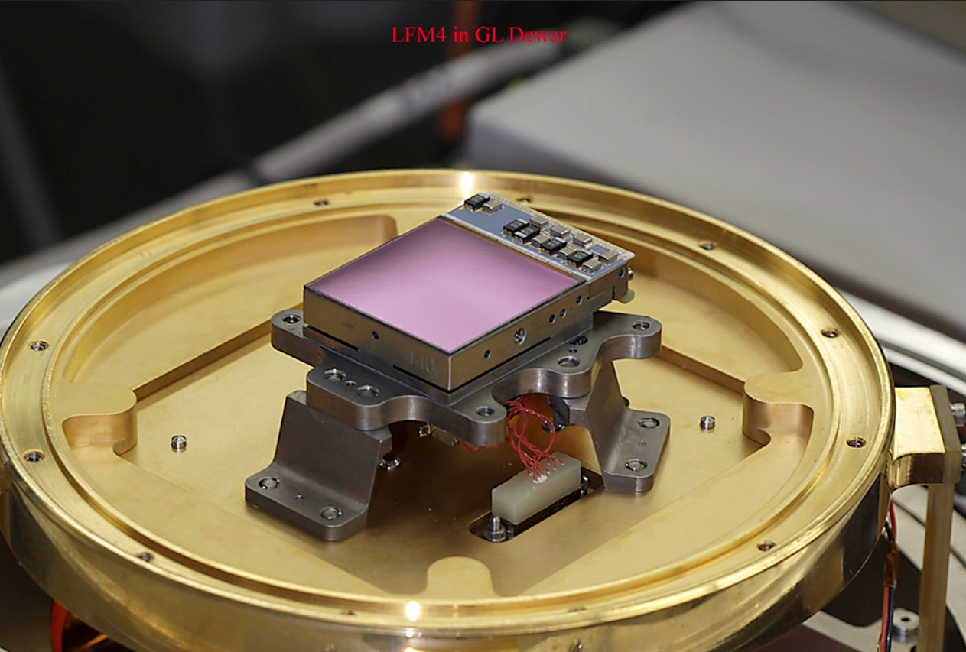
JWST Detectors
Mercury Cadmium Telluride
The picture on the right shows a James Webb Space Telescope prototype infrared detector on a mechanical mount affixed to a plate in a cryogenic dewar.

Slide 12
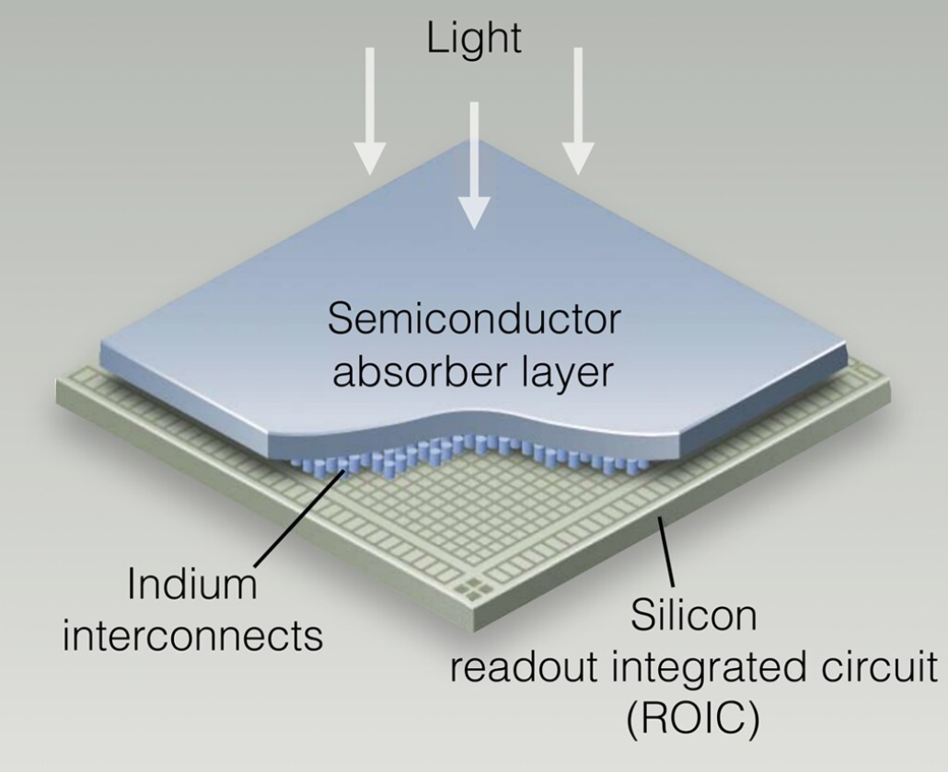
Infrared Hybrid Array
Light-sensitive material that can detect infrared photons, wavelengths beyond ~1 um
Cannot be silicon
Silicon readout integrated circuit
“Hybrid” construction, indium bonds between dissimilar materials

Slide 13
Sensors and Detectors All Around Us
Everyday applications
  phones
  cars
  defense
  medicine
Cutting edge applications
  high energy physics
  astrophysics
  quantum information science and technology
Semiconductors as enablers

Slide 14
CMOS Imaging Detectors in Astrophysics
CMOS imaging detectors transformative for Astrophysics
HST, JWST, Rubin, Roman, HWO
United States world leader in CMOS imaging detectors, although threats are constant

Slide 15
Detectors and Discovery
Charles Townes (Nobel, Laser, IR instruments)
Penzias & Wilson (Nobel, radio receiver)
Pulsars (radar)
Boyle & Smith (Nobel, CCDs)
Dark Matter (image intensifiers)
Dark Energy (Nobel, CCDs)
Cosmic Microwave Background (Nobel, COBE/detectors)
Neutrinos (Nobels, PMTs)
Reinhard Genzel (Nobel, IR instruments)
James Webb Space Telescope
Hubble Space Telescope
Basically, almost every scientific discovery is due to new detectors and/or instrumentation.

Slide 16
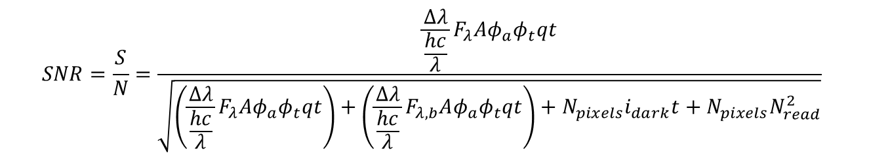
Signal-to-noise ratio (SNR)
The full expression for SNR contains a term in the numerator for the source and a denominator with terms representing the source, background, and detector properties.
A better detector can reduce the overall noise.
In some cases, SNR is dominated by the source itself.
Longer integrations increase SNR!
$$SNR=\frac{S}{N}=\frac{\frac{Δλ}{\frac{hc}{λ}}F_{λ}Aφ_{a}φ_{t}qt}{\sqrt{\left(\frac{Δλ}{\frac{hc}{λ}}F_{λ}Aφ_{a}φ_{t}qt\right)+\left(\frac{Δλ}{\frac{hc}{λ}}F_{λ,b}Aφ_{a}φ_{t}qt\right)+N_{pixels}i_{dark}t+N_{pixels}N_{read}^{2}}}$$

Slide 17
Very Low Light Level - ExoPlanet Imaging
The exposure time required to achieve SNR=1 is dramatically reduced for a zero read noise detector, as compared to detectors with state of the art read noise.
Notes:
The table gives exposures times to produce SNR=1 for a typical planet detection space mission. Note the dramatic reduction in time required for a zero noise detector. R=100 is assumed, and the effective planet flux is about 10 photons/hour per pixel. The nearby starlight is suppressed at the 10^-10 level by optical nulling. Zodiacal light contributes about 0.0015 electrons/s/pixel.

Slide 18
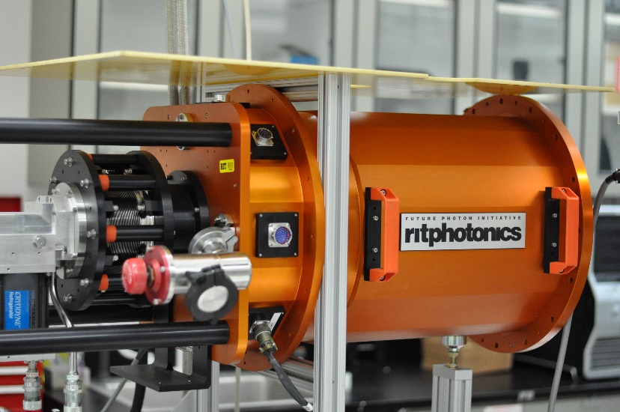
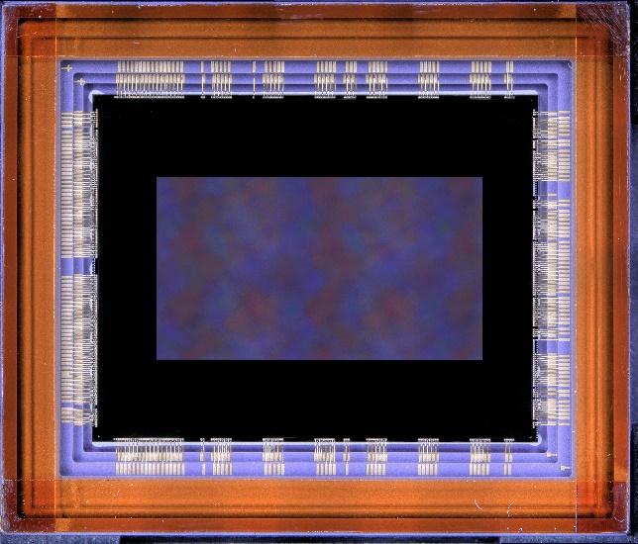
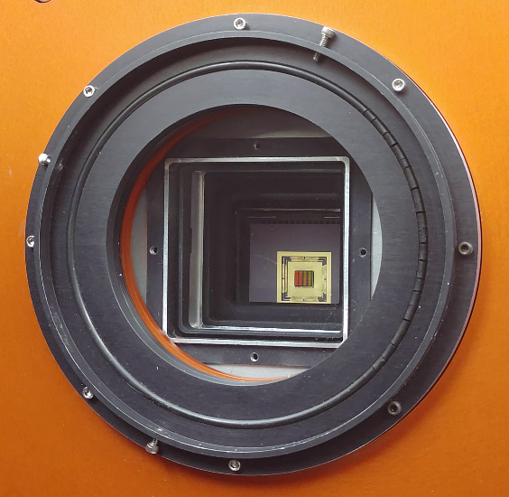

Slide 19
CMOS Imaging Detectors and Life in the Universe

Slide 20
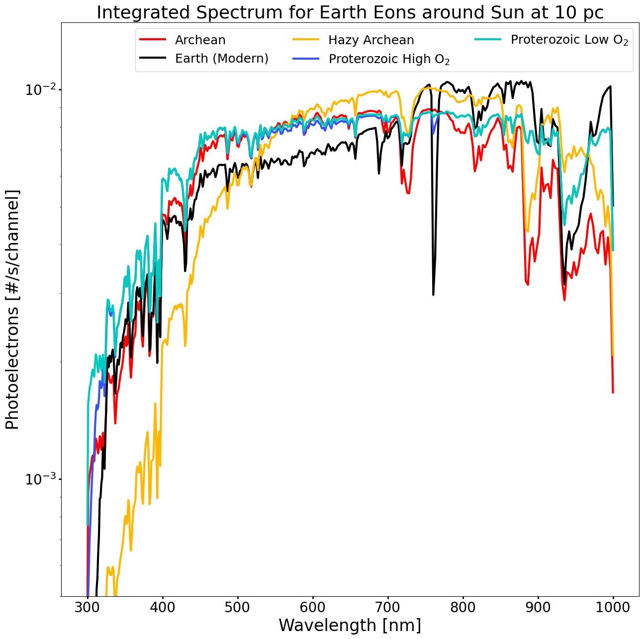
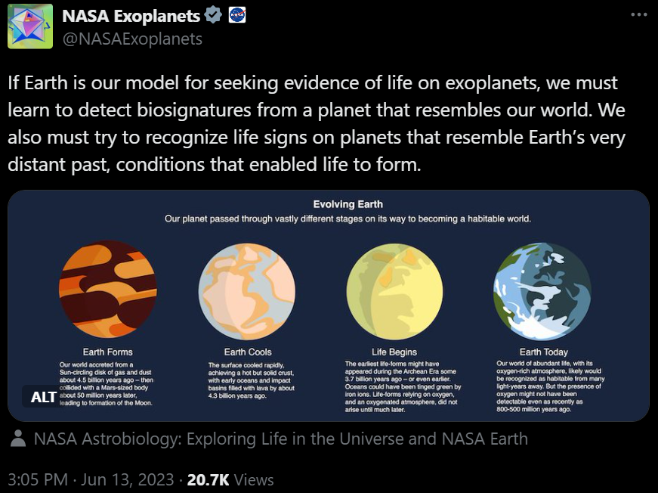
Life in the Universe

Slide 21
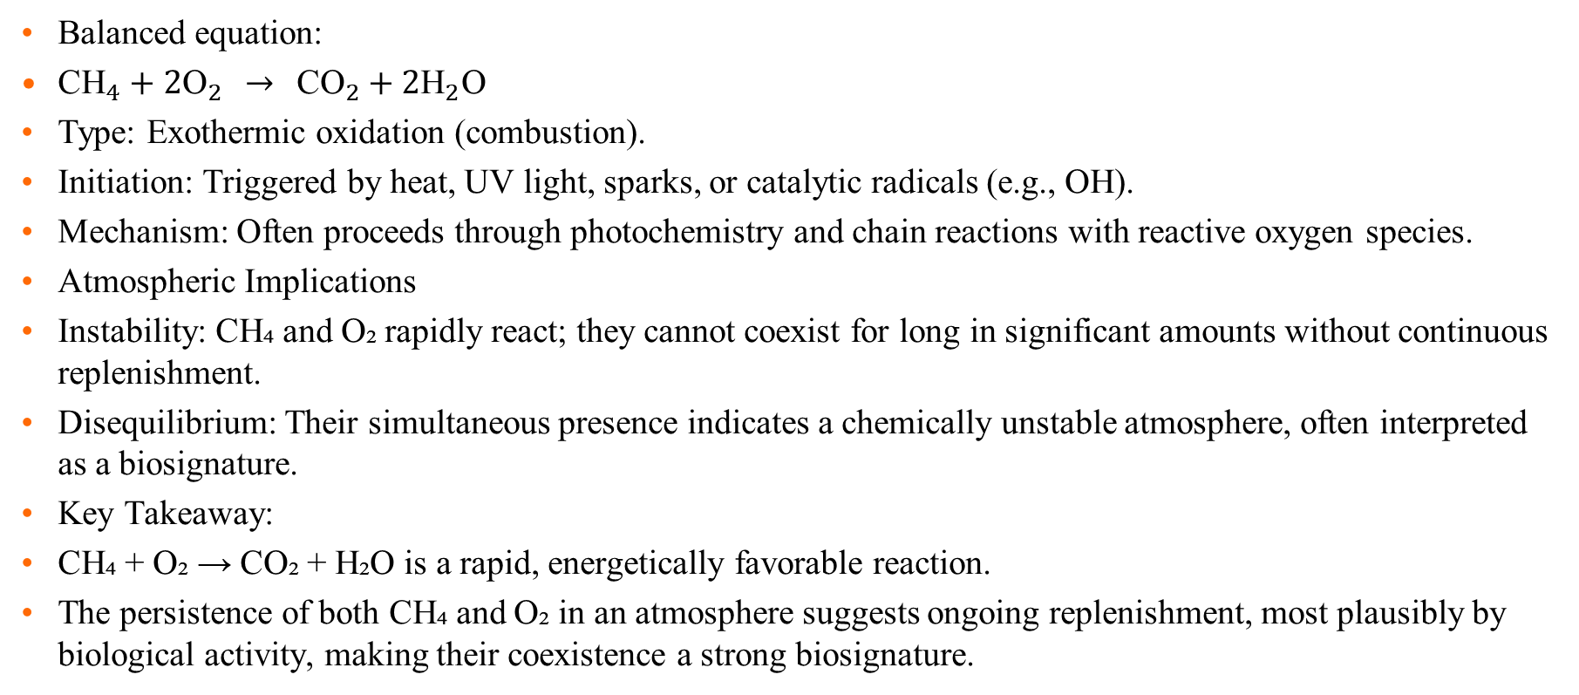
CH4 + O2 reaction
Balanced equation:
${\text{CH}}_{4}+2{\text{O}}_{2} → {\text{CO}}_{2}+2{\text{H}}_{2}\text{O}$
Type: Exothermic oxidation (combustion).
Initiation: Triggered by heat, UV light, sparks, or catalytic radicals (e.g., OH).
Mechanism: Often proceeds through photochemistry and chain reactions with reactive oxygen species.
Atmospheric Implications
Instability: CH₄ and O₂ rapidly react; they cannot coexist for long in significant amounts without continuous replenishment.
Disequilibrium: Their simultaneous presence indicates a chemically unstable atmosphere, often interpreted as a biosignature.
Key Takeaway:
CH₄ + O₂ → CO₂ + H₂O is a rapid, energetically favorable reaction.
The persistence of both CH₄ and O₂ in an atmosphere suggests ongoing replenishment, most plausibly by biological activity, making their coexistence a strong biosignature.

Slide 22
Alien Life
The coexistence of methane (CH₄) and oxygen (O₂) in a planet’s atmosphere suggests potential alien life.
CH₄ and O₂ are highly reactive and cannot persist together without continuous replenishment.
On Earth, microbes generate CH₄ while plants and algae produce O₂, sustaining disequilibrium.
Detecting both gases elsewhere may indicate biology at work.

Slide 23
Beyond CH₄ + O₂
Additional chemical reactions may hint at life or habitability:
  CO₂ + H₂ → CH₄ (geological or biological)
  N₂ + O₂ imbalance (linked to biological cycling)
  Trace gases like NH₃ or PH₃ that require active replenishment.
These broaden the search beyond methane and oxygen alone.

Slide 24
Finding Life Outside the Solar System
Spectroscopy reveals the composition of exoplanet atmospheres.
Key strategy: look for gas combinations in disequilibrium (e.g., CH₄ + O₂, N₂O, PH₃).
Context matters: planetary temperature, pressure, and other gases help interpretation.
Future observatories (HWO, Extremely Large Telescopes, JWST successors) will expand the search.

Slide 25
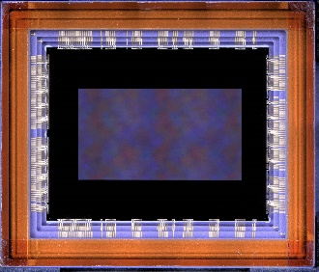
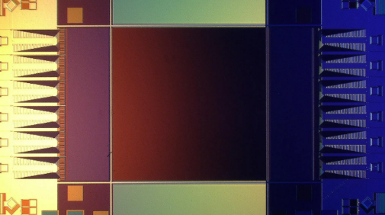
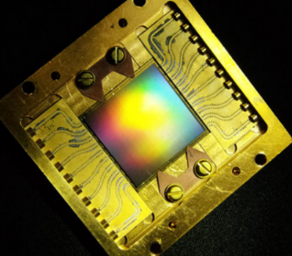
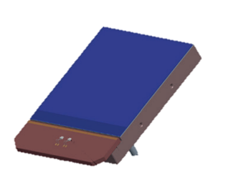
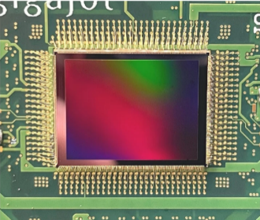
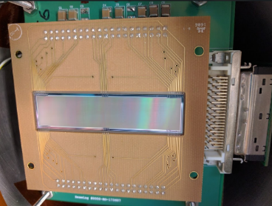
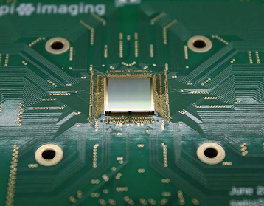
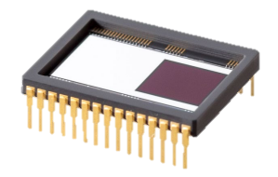
State of the Art Detector Candidates for Future Missions
challenging requirements for UV/O/IR observations
single-photon sensing
low dark current
near-zero read noise
multiple candidate detector technologies
CMOS: 9.4 Mpix
BAE HWK4123
SNSPD: 0.4 Mpix (Adam McCaughan/NIST)
MKID: 20 kpix (Mazin Lab, Breckenridge 2021)
CMOS: Teledyne e2v CIS301/302
EMCCD: Teledyne e2v CCD351-00
CMOS: 163 Mpix QIS (Ma et al. 2022)
Skipper CCD: 3.5 Mpix (SENSEI Collaboration)
SPAD: Pi Imaging SPAD 512² (Antolovic et al. 2022)

Slide 26
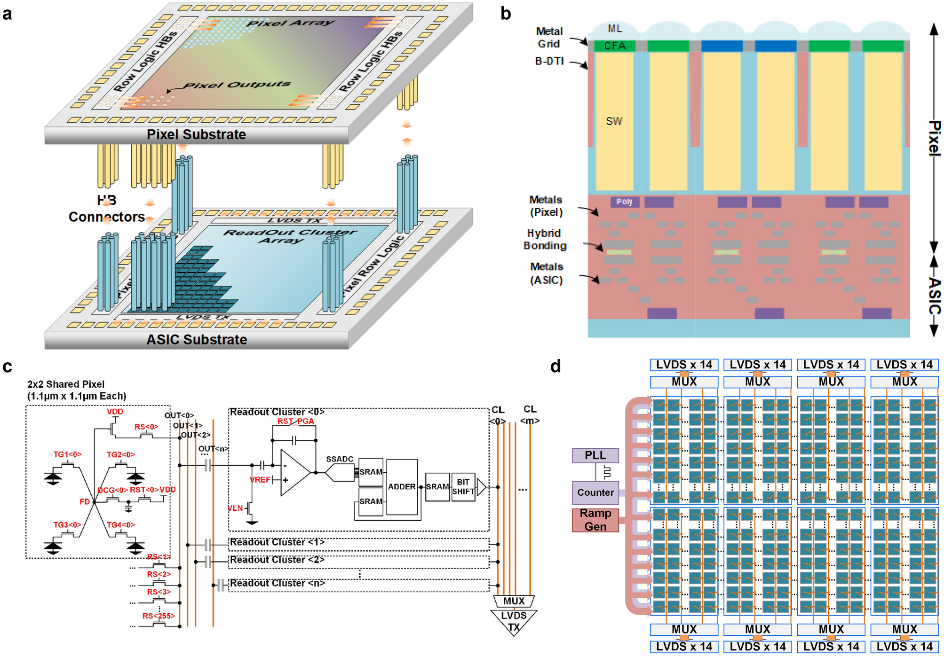
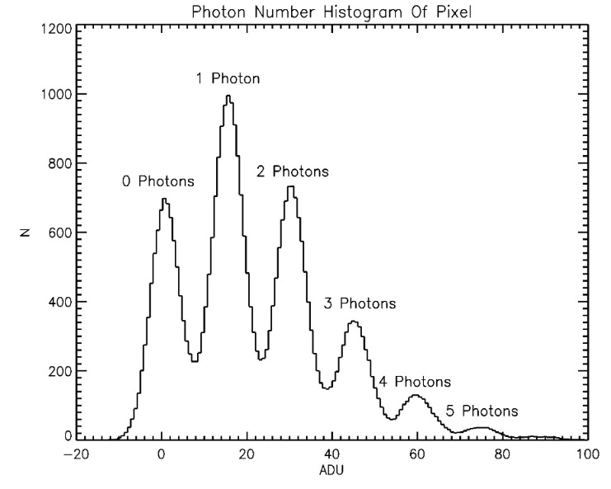
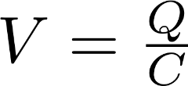
Single Photon Sensitivity
low-capacitance floating diffusion sense node
high-gain response of >320 μV/e-
exceeds electronics read noise
correlated double/multiple sampling
discrete photoelectron peaks
Ma, J. et al. Ultra-high-resolution quanta image sensor with reliable photon-number-resolving and high dynamic range capabilities. Sci Rep 12, 13869 (2022). https://doi.org/10.1038/s41598-022-17952-z

Slide 27
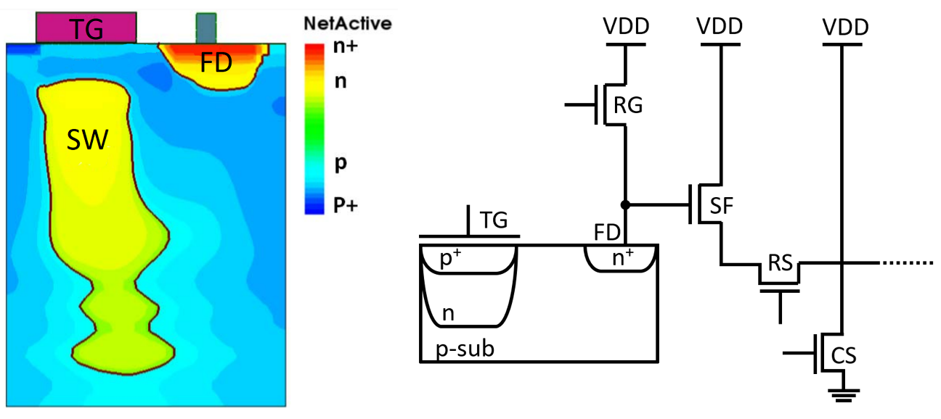

Single Photon Detector Operation

Slide 28
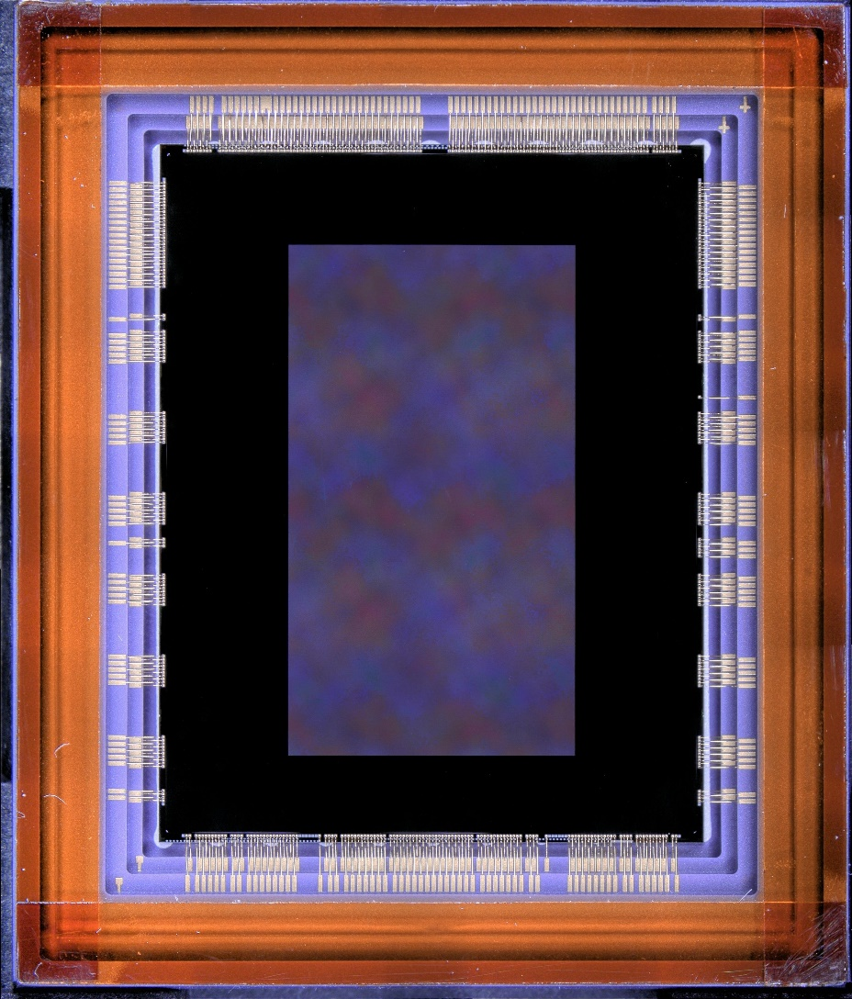
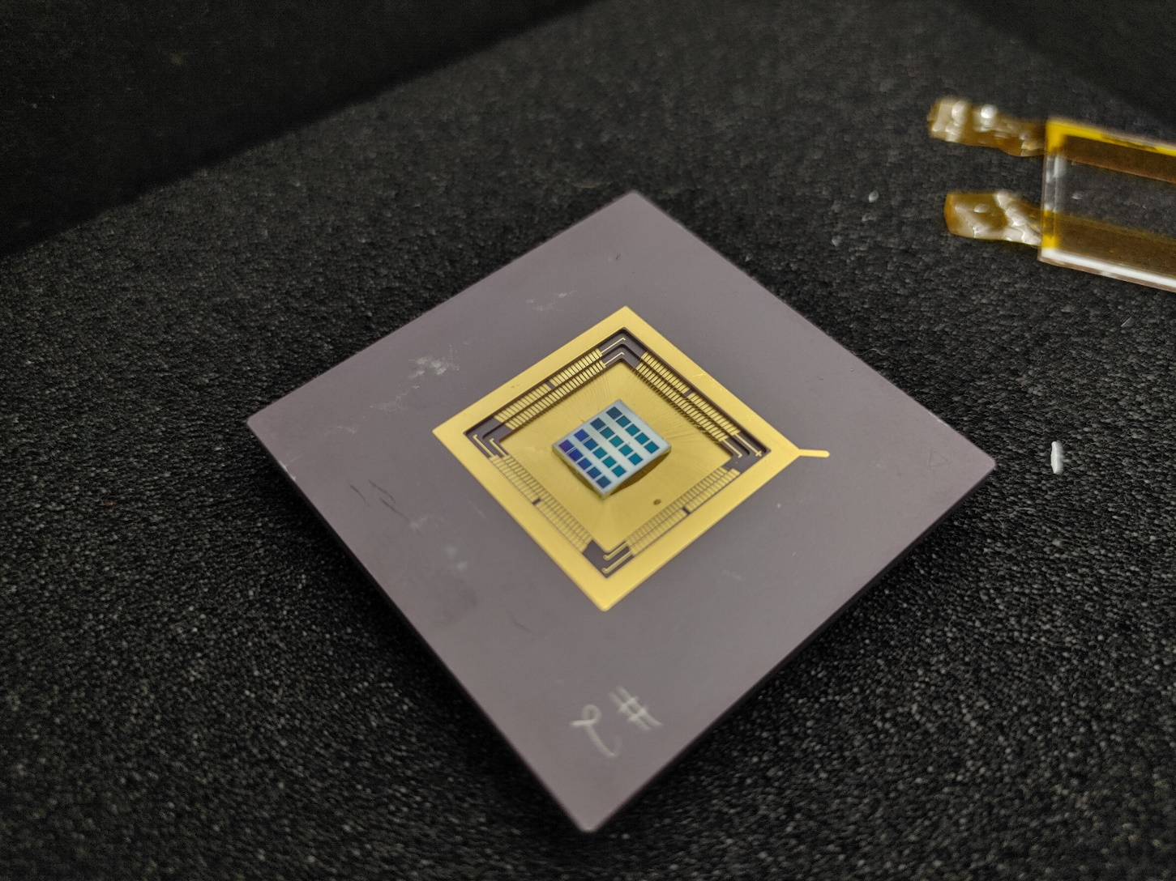
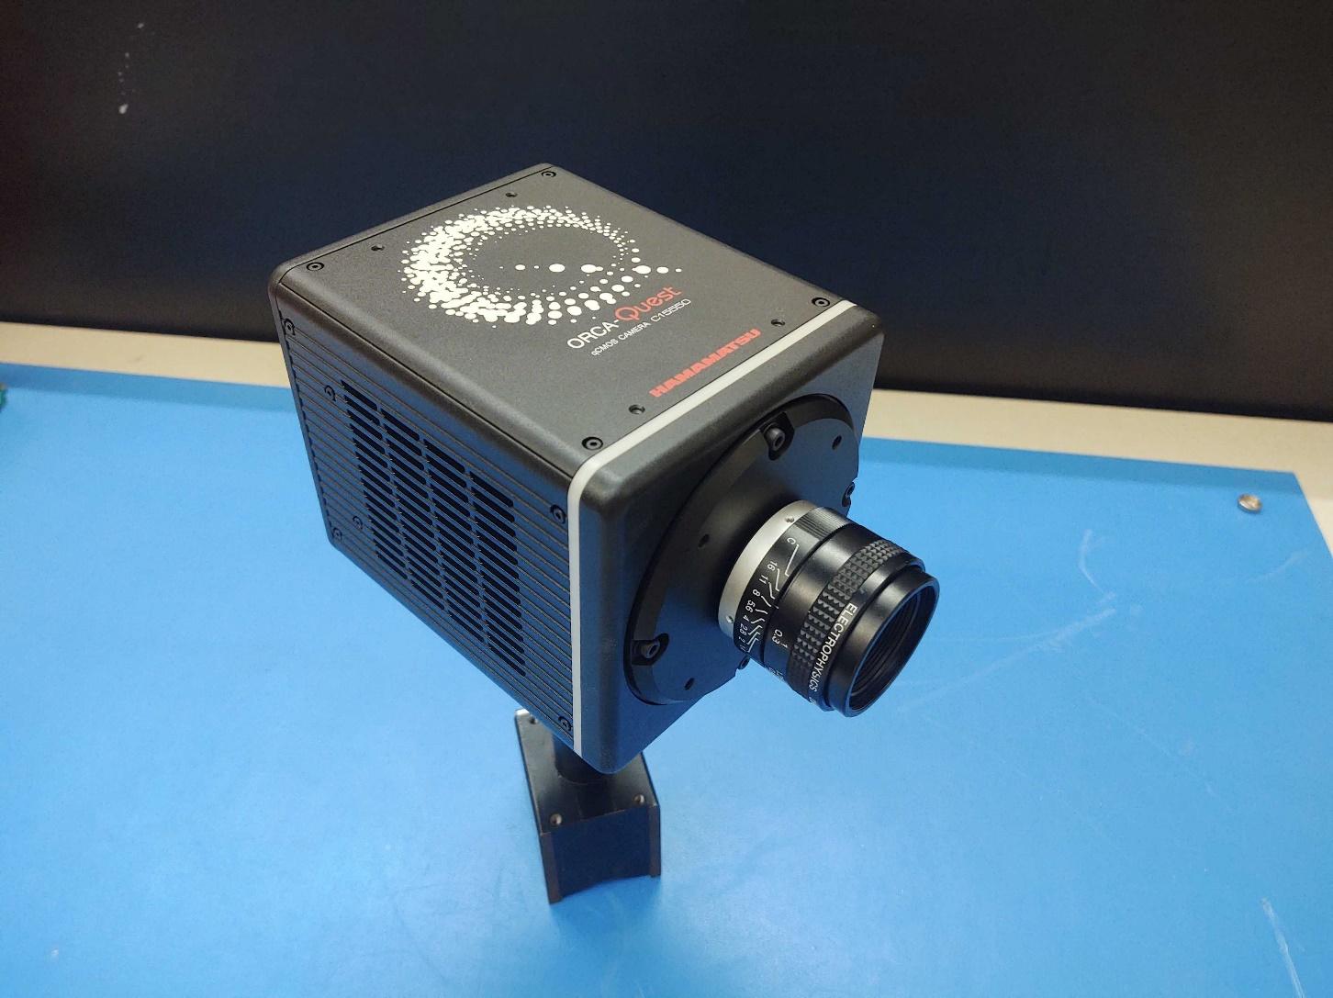
Single-Photon CMOS Image Sensors
QIS CMOS
1 Megapixel Sensors
1.1 μm pixels
HWK4123
9.4 Megapixel
4.6 μm pixels
ORCA-QUEST
HWK4123

Slide 29
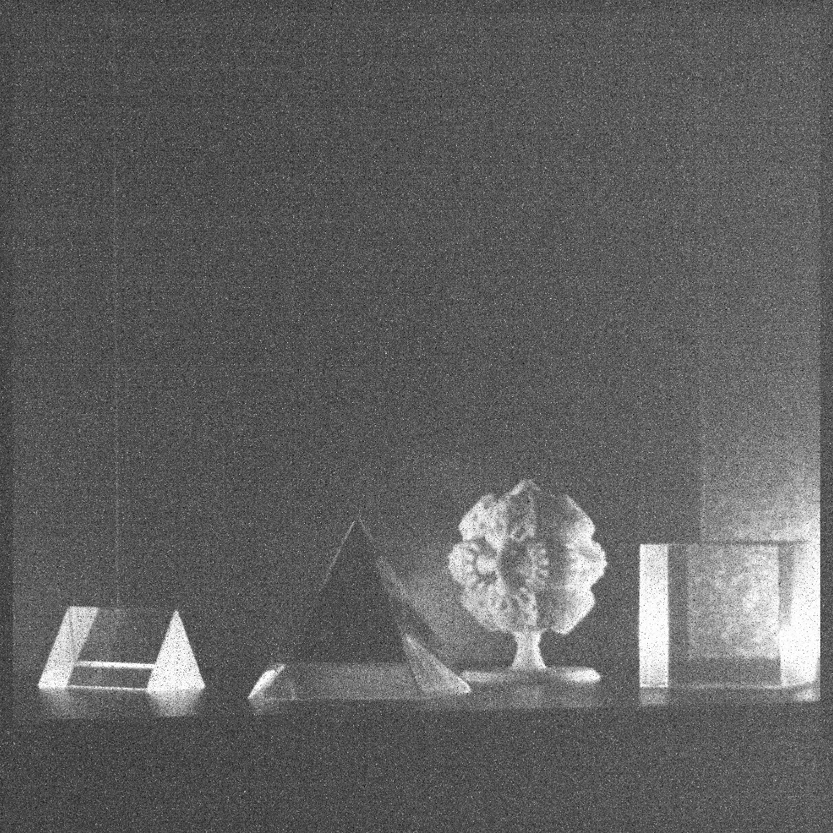
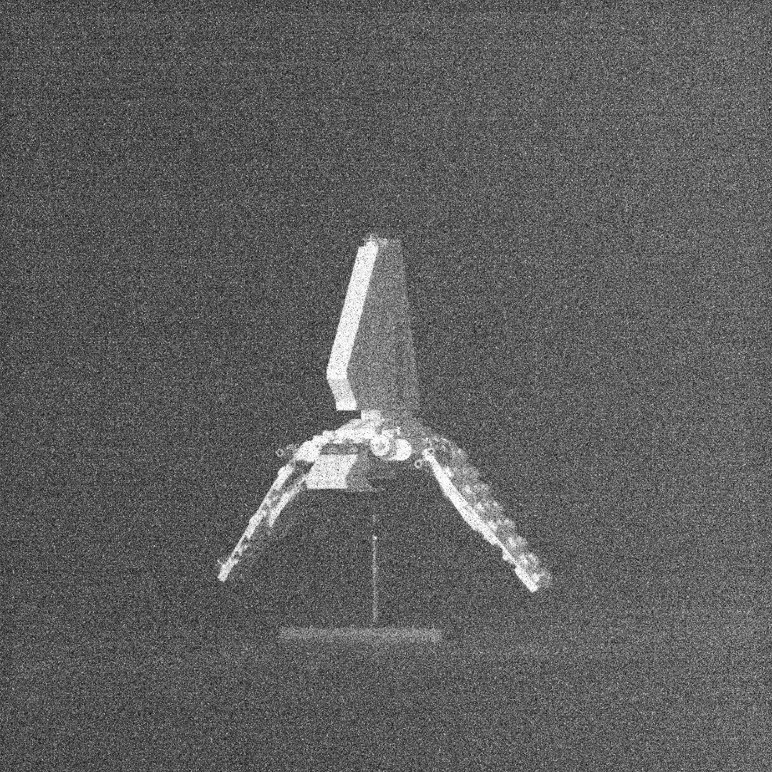
Single Photon Images
e⁻
e⁻
e⁻
e⁻
e⁻
e⁻
e⁻
e⁻

Slide 30
Sensor Parameters and Performance
Sensor Parameters
Parameter | Unit | QISSAT1-2 | HWK4123
Format | - | 1024 × 1024 | 4096 × 2304
Pixel Size | μm | 1.1 | 4.6
Sensor Performance Metrics
Dark Current | e⁻/pix/s | 0.0004 (253 K) | 0.006 (233 K)
Quantum Efficiency | % (325 nm) | 35 | 60
 | % (500 nm) | 83 | 87
 | % (940 nm) | 7 | 36
Read Noise (median) | e⁻ | 0.27 | 0.23
Full Well Depth | e⁻ | 275 | 7000
Fill Factor | % | 100 | 100
Frame Rate | fps | up to 30 | up to 120
Current TRL | - | 5 (pixels) 4 (ROIC) | 4

Slide 31
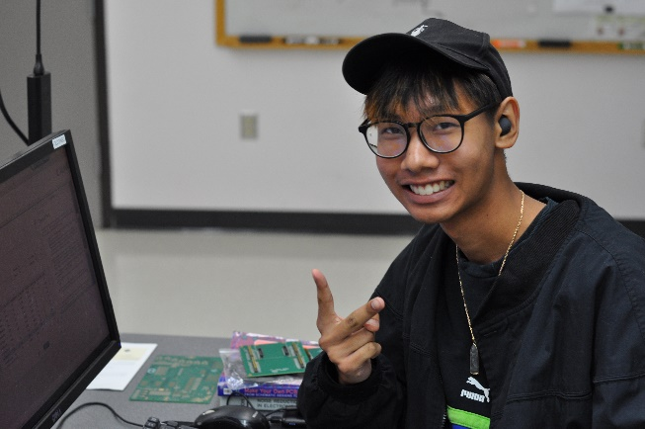
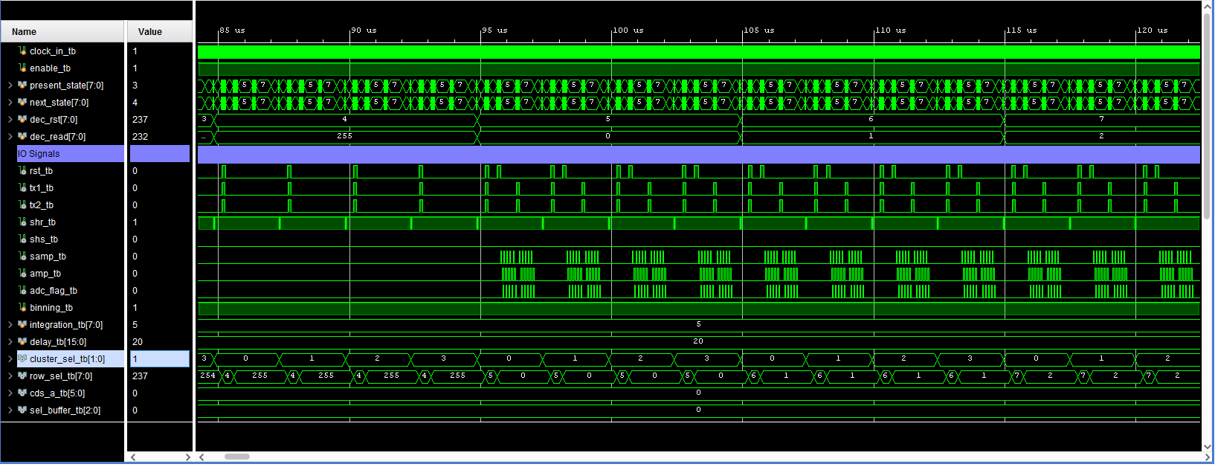
Radiation Mitigation Readout Modes
create and validate single event upset mitigation readout modes
develop and test damage mitigation operational modes
leverage CMOS digital pixel multiplexing
generate modular waveforms for custom readout
verify performance of custom modes at radiation beam line
advance new readout modes beyond TRL2

Slide 32
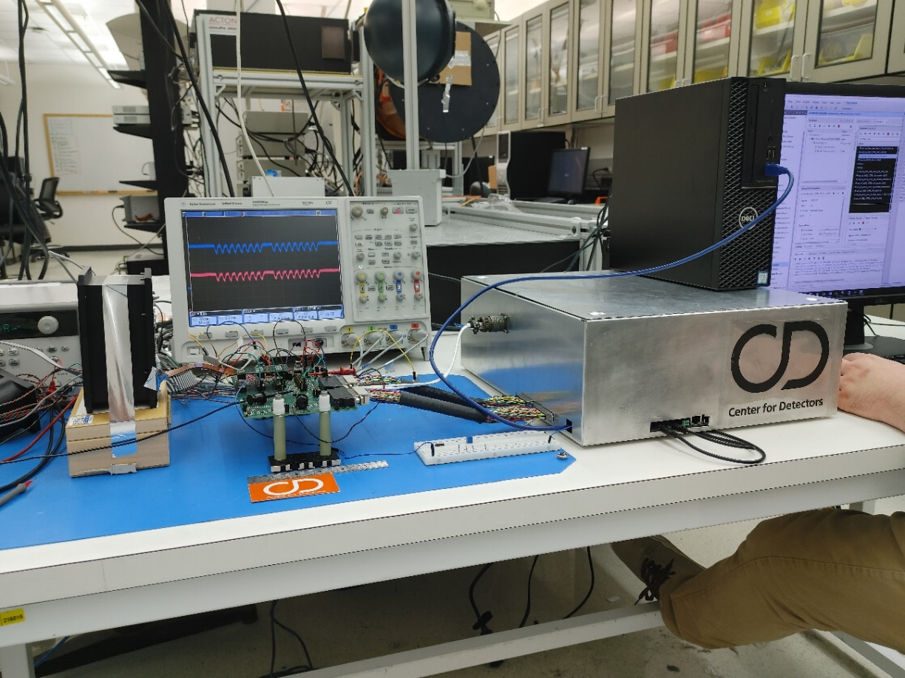
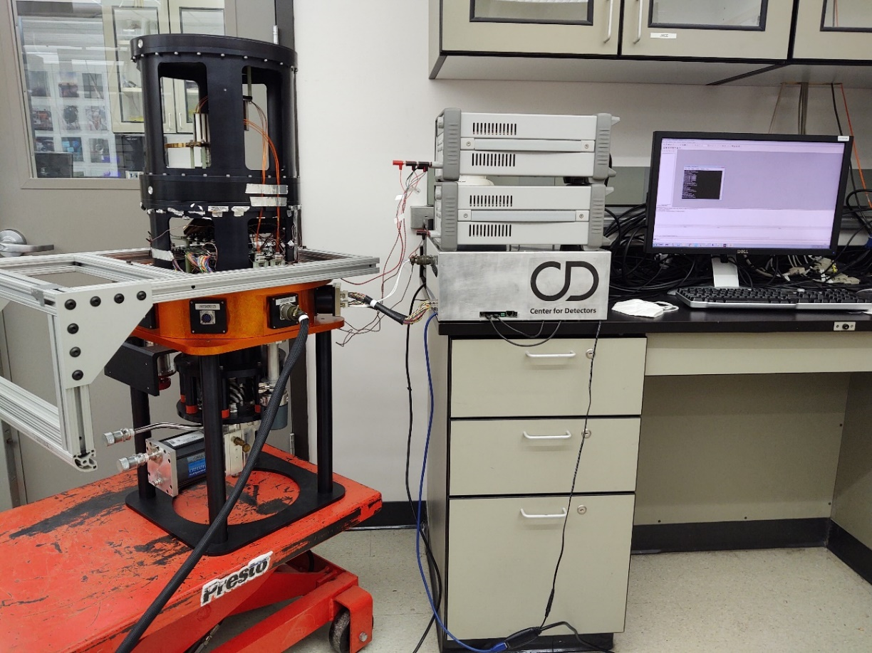
Custom Cryogenic and Vacuum Safe Readout Electronics

Slide 33
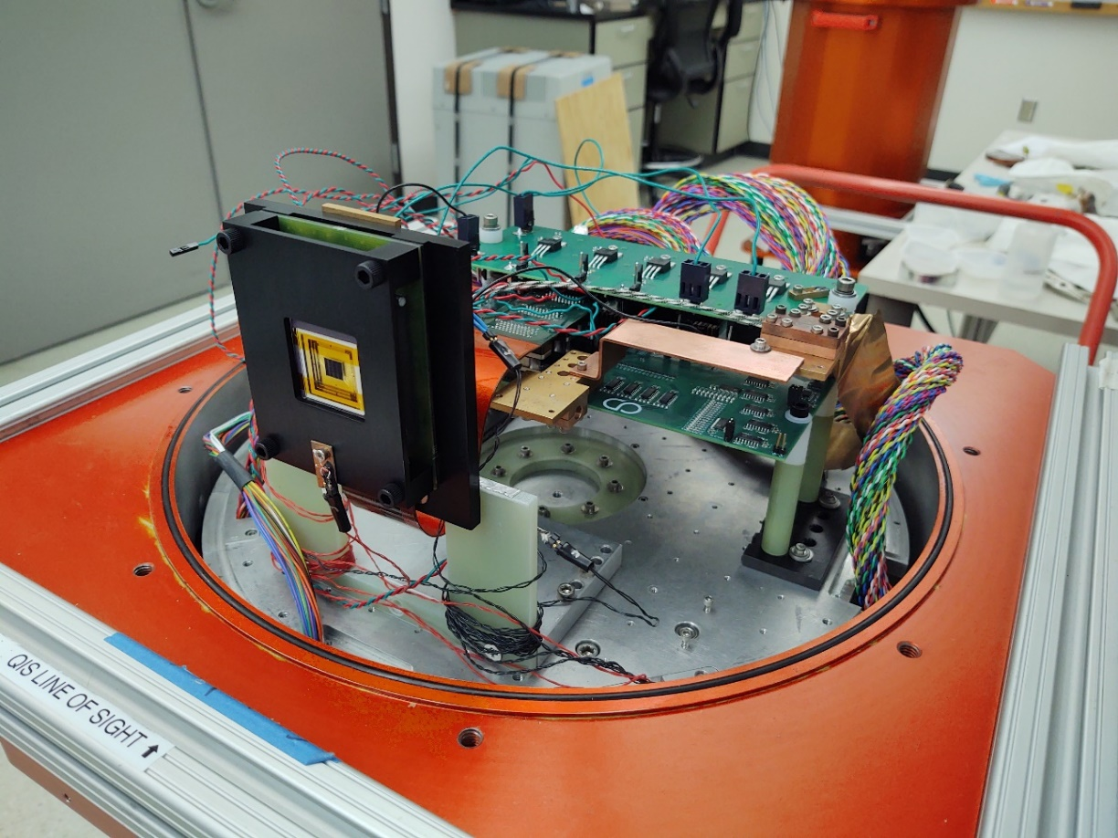
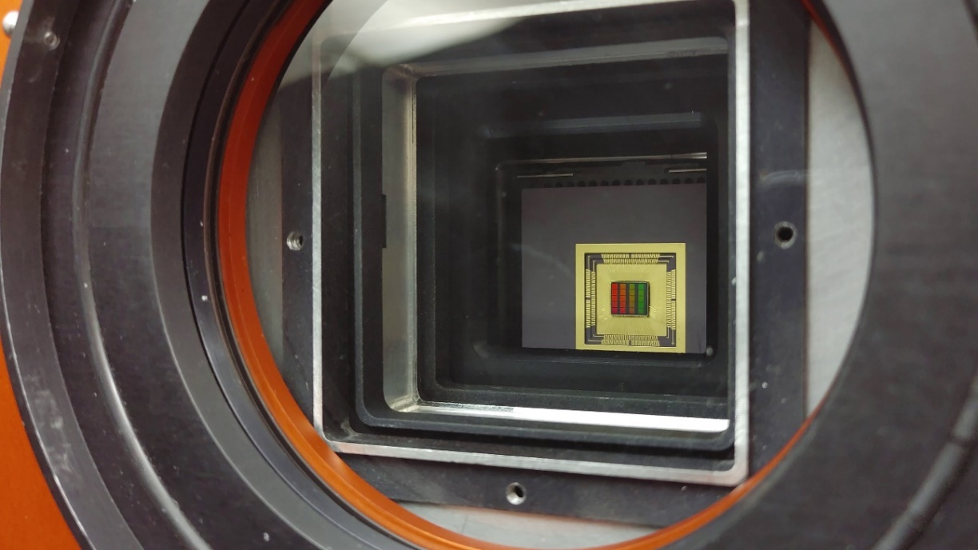
Detector Mounted for Radiation (left) and Optical (right) Testing

Slide 34
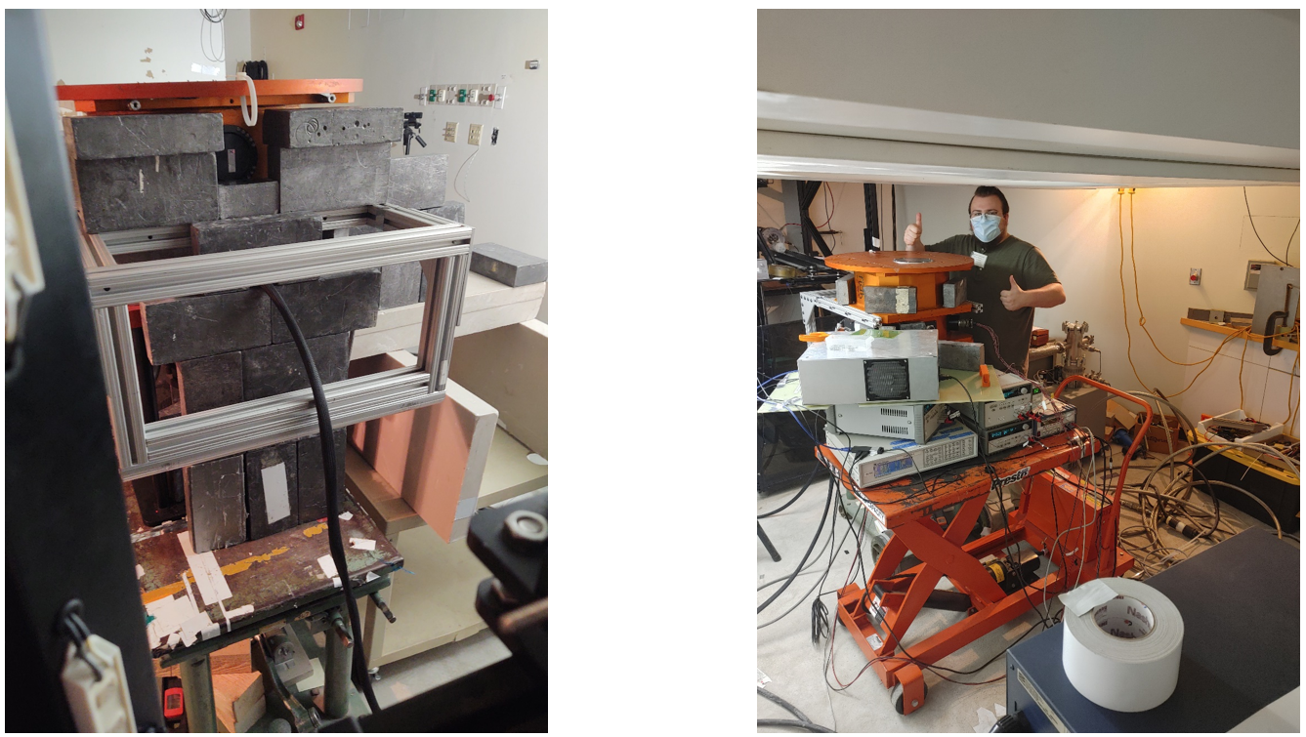
Dewar and Detector at the Proton Radiation Testing Facility

Slide 35
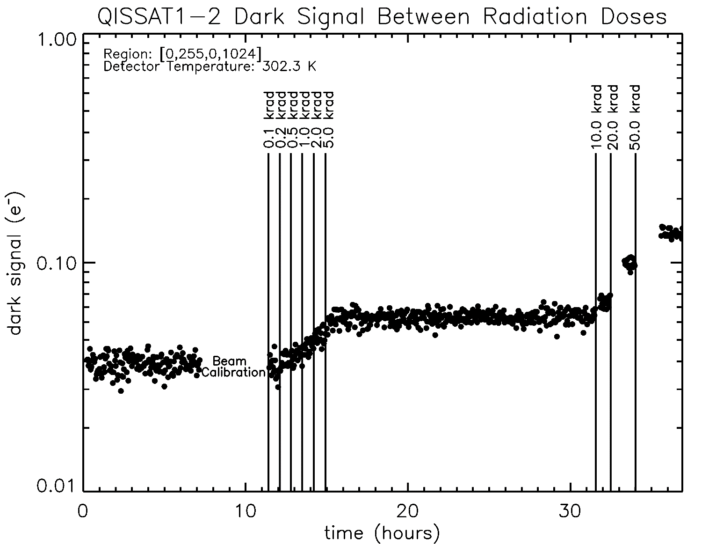
Proton Increases Dark Current
Justin P. Gallagher, Lazar Buntic, Wei Deng, Eric R. Fossum, Donald F. Figer, "Radiation tolerance of a single-photon counting complementary metal-oxide semiconductor image sensor," J. Astron. Telesc. Instrum. Syst. 10(3) 036003 (24 September 2024) https://doi.org/10.1117/1.JATIS.10.3.036003

Slide 36
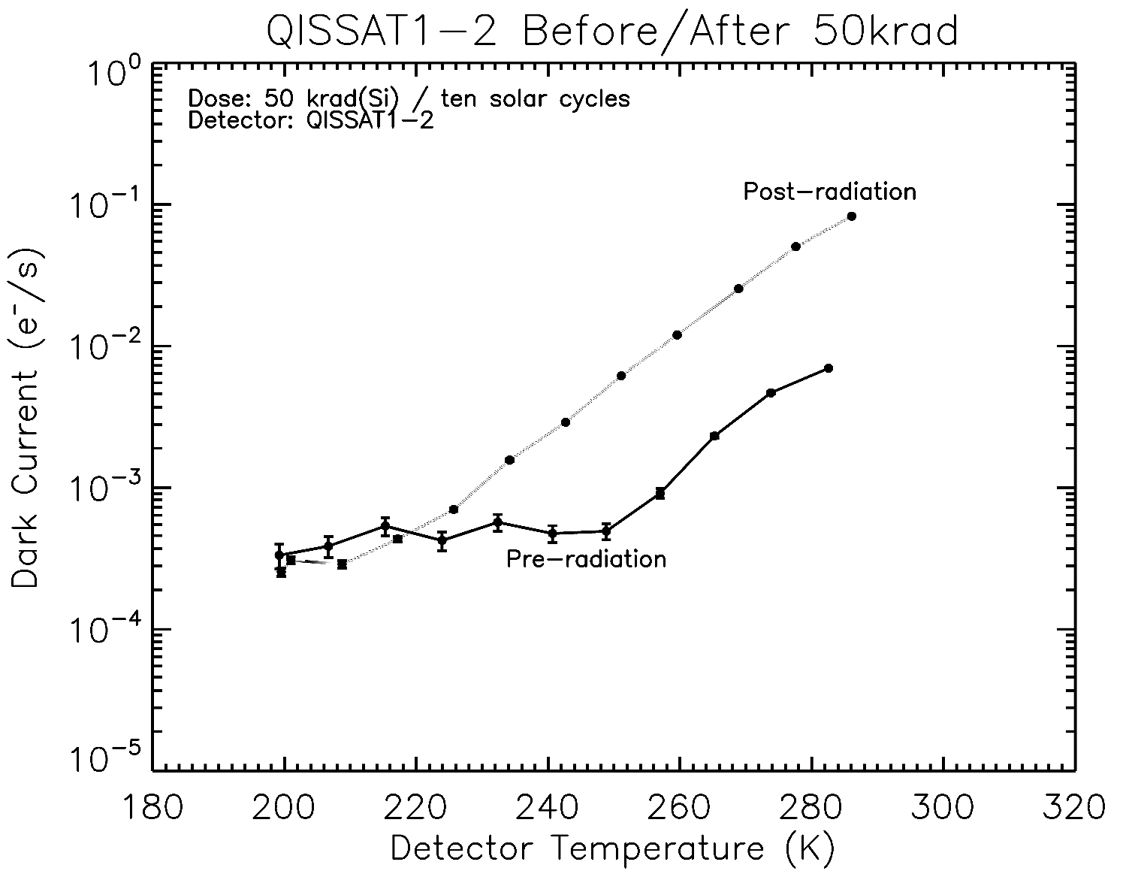
Dark Current After Exposure to 60 MeV Protons
Doubling Temperature =~8.5K
Justin P. Gallagher, Lazar Buntic, Wei Deng, Eric R. Fossum, Donald F. Figer, "Radiation tolerance of a single-photon counting complementary metal-oxide semiconductor image sensor," J. Astron. Telesc. Instrum. Syst. 10(3) 036003 (24 September 2024) https://doi.org/10.1117/1.JATIS.10.3.036003

Slide 37
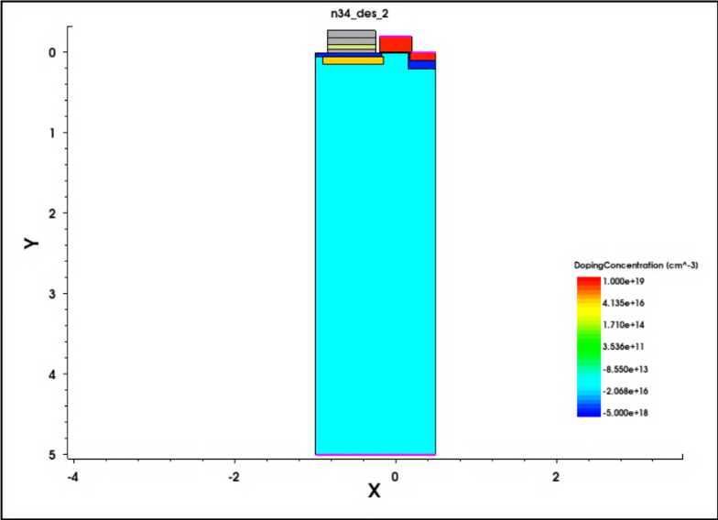
Single-Photon Sensing NIR Photodiode
develop Si TCAD model of pixel using Synopsys Sentaurus
demonstrate pixel operation and low-capacitance sense node
migrate structure to MCT material platform
simulate photodiode performance and compare to Si predecessor
advance single-photon sensing and photon-number resoling NIR photodiode beyond TRL2

Slide 38
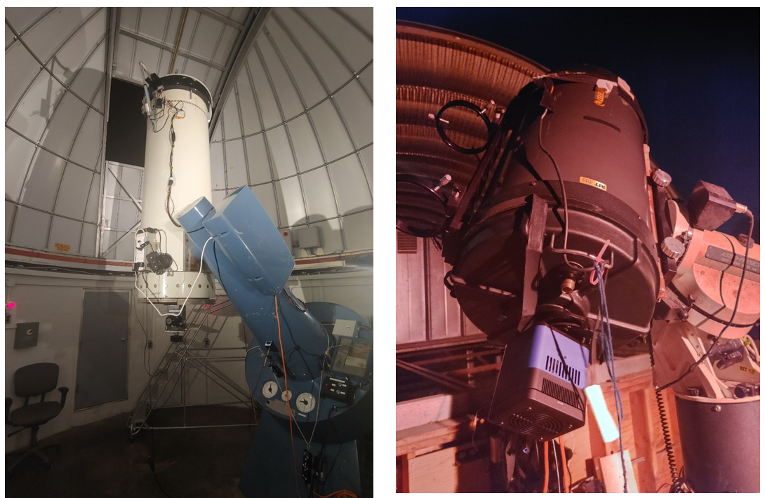
Telescopes at UofR’s Observatory (left) and RIT’s Observatory (right)

Slide 39


Image of Lunar Terminator and Saturn
Gallagher, J., Buntic, L., Figer, D. F., and Deng, W. 2022, “Characterization of single-photon sensing and photon-number resolving CMOS image sensors,” SPIE Astronomical Telescopes and Instrumentation, Montreal, Paper 12191-28

Slide 40

Raw image of M67 using QISCDK
Gallagher, J., Buntic, L., Figer, D. F., and Deng, W. 2022, “Characterization of single-photon sensing and photon-number resolving CMOS image sensors,” SPIE Astronomical Telescopes and Instrumentation, Montreal, Paper 12191-28

Slide 41

Summary
challenging science
observe low photon flux sources
detect biosignatures on exoplanets
develop detector technologies for HWO single-photon sensing in UV, optical, and NIR
Recent Publications:
Gallagher, J. P., Buntic, L., Deng, W., Fossum, E. R., and Figer, D. F. 2024, Radiation tolerance of a single-photon counting complementary metal-oxide semiconductor image sensor, J. Astron. Telesc. Instrum. Syst. 10(3), 036003, doi: 10.1117/1.JATIS.10.3.036003.
Gallagher, J. P., Buntic, L., Alexani, E., Bouthsarath, K., and Figer, D. F. 2024, Characterizing radiation-tolerant single photon resolving CMOS detectors, Proceedings Volume 13103, X-Ray, Optical, and Infrared Detectors for Astronomy XI; 131030S, Yokohama, Japan, https://doi.org/10.1117/12.3019105.
Gallagher, J. P., Buntic, L., Figer, D. F., Deng, W. 2024, Characterization of single-photon sensing and photon-number resolving CMOS image sensors, Proc. SPIE 12191, X-Ray, Optical, and Infrared Detectors for Astronomy X, Montreal, Canada, https://doi.org/10.1117/12.2629006

Slide 42



Single Photon Counting Photonic Spectrograph
combine single photon counting detector with photonic spectrograph
reduce SWaP
detect biosignatures in exoplanets
simulate performance and compare to HWO simulator
design prototype in visible range (500-800nm)

Slide 43
Future Photon Initiative and Center for Detectors

Slide 44
Future Photon Initiative
The Future Photon Initiative develops photonic devices in pursuit of answers to grand questions, leveraging efforts of existing RIT research groups using the generation, transmission, manipulation, absorption, and detection of photons.
FPI cross-disciplinary teams collaborate with external university groups, industry, and national laboratories to develop new photonic device technology.
Areas include solar energy, biophotonics, high performance imaging, astrophysics, quantum, and communication.
Eight groups: Center for Detectors, Integrated Photonics Group, Nanolithography Research Lab, NanoPower Research Labs, Photonic Systems Lab, Photonics and Optics Workforce Education Research, Semiconductor Nanofabrication Lab, and the Simone Center for Innovation and Entrepreneurship.
43 ongoing grants, with $7.7M ongoing funding

Slide 45

FPI Research Funding

Slide 46

Center for Detectors
CfD designs, develops, and implements photon devices to enable scientific discoveries. | CfD trains students through research and development in detectors, instrumentation, observational astrophysics, nanostructures, silicon photonics, quantum optics and photonics, and wide bandgap materials. | The CfD was established in 2010, and includes seven professors and over two dozen students at all levels of matriculation. | Staff and student researchers investigate high impact engineering and development problems through external financial support from federal agencies, private foundations, national laboratories, and industry. | The CfD operates nine laboratories in three buildings and has an average of 40 externally funded projects (~$4.6M/year).

Slide 47

Integrated Photonics Group
The RIT Integrated Photonics Group conducts research in the Lobozzo Photonics and Optical Characterization lab. | Dr. Preble and his team develop high performance nanophotonic devices and systems using complementary metal-oxide-semiconductor compatible materials and processes. | Their work enables unique performance and efficiency by leveraging the inherently high bandwidths and low power of photons with the intelligence of electronics.

Slide 48
CHIPs-related Activities at RIT

Slide 49



RIT-CHIPS News

Slide 50





RIT CHIPS-Related Programs
NSF ExLENT: EMERGE-MICRO
Sponsor: NSF TIP & EDU
Funding: ~$1M | 2024 – 2027
Develop a pilot pipeline for community college students through A.S. → B.S. in Microelectronic Engineering.
Hands-on cleanroom training, co-op placements, and industry-guided research.
Collaborators: MCC, FLCC, GlobalFoundries, Micron, University of Rochester evaluator.
NSF NRT: CMOS+X Graduate Training
Sponsor: NSF NRT
Funding: ~$3M | 2024 – 2029
Provide graduate (M.S. & Ph.D.) fellowships (~20 doctoral) in interdisciplinary semiconductor research.
Focus areas: CMOS + AI, biomedical, optoelectronic, photonic, nanoelectronics, quantum, packaging.
Goal: Train 170+ next-gen engineers & scientists, emphasizing technical and professional development components.
NSF: UPWARDS for the Future
Sponsor: NSF | (UW lead)
Funding: ~$10M | 2023 – 2028
U.S.–Japan university partnership engaging six U.S. and five Japanese universities.
Activities: Student exchanges, faculty visiting programs, certification, curriculum development, focused semiconductor and memory-centric research.
Objective: Build a globally connected, skilled microelectronics workforce aligned with industry needs.
DoC: BRIDGE for Microelectronics
Sponsor: Dept of Commerce/NIST CHIPS Act
Funding: ~$1.5M | 2025 – 2027
Build graduate education program to train 555 students across bachelor’s, master’s, and certificate tracks in microelectronics.
Includes new online certificate offerings, industry collaboration, and student support.
Part of NSTC Workforce Partner Alliance under CHIPS Act, scaling semiconductor workforce ecosystem.
Industry Partners: Micron, GlobalFoundries, Northrop Grumman

Slide 51
RIT-CHIPS News
This list includes NSF public records and RIT/local news releases about our CHIPS-related workforce efforts here:
NSF ExLENT:
  https://nsf.elsevierpure.com/en/projects/beginnings-empowering-minds-through-experiential-learning-researc
  https://www.rit.edu/news/rit-expands-its-workforce-initiatives-semiconductor-industry
NSF NRT:
  https://www.nsf.gov/awardsearch/showAward?AWD_ID=2345983&HistoricalAwards=false
  https://www.rit.edu/news/nsf-awards-rit-nearly-3-million-advance-semiconductor-technologies
NSF UPWARDS for the Future:
  https://nsf.elsevierpure.com/en/projects/us-japan-university-partnership-for-workforce-advancement-and-res
  https://www.rochesterfirst.com/development/inside-upwards-at-rit-an-international-semiconductor-education-exchange-program/
Department of Commerce BRIDGE for Microelectronics Program:
  https://www.nist.gov/chips/rochester-institute-technology-rit-rochester
  https://www.nist.gov/news-events/news/2024/09/biden-harris-administration-launches-nstc-workforce-center-excellence
  https://www.rochesterfirst.com/news/local-news/rit-awarded-1-5-million-to-train-555-students-in-semiconductor-program/
You can find a full list of RIT CHIPS news here: https://www.rit.edu/news/semiconductor-chips

Slide 52
Back to the Future: Chips to the COSMOS

Slide 53
Back to the Future: Chips to the COSMOS
Grand challenges:
  single-photon detection,
  scalable photonics,
  detectors for life detection.
Call to action: collaboration across science, industry, and policy.
Semiconductors don’t just power our economy — they give us the power to see the WHOLE Universe!

Slide 54
Potentially-interesting Slides

Slide 55

First Astronomical CCD Image

