Slide 1

Sensors and Detectors for Physical and Chemical Sciences
Don Figer
College of Science, Professor
Future Photon Initiative, Director
Center for Detectors, Director
October 29, 2025

Slide 2
Outline
Speaker Bio
Sensors & Detectors: Why do they matter?
Science Applications
CMOS Imaging Detectors and Life in the Universe
Future Photon Initiative & Center for Detectors
CHIPs-related Activities at RIT

Slide 3
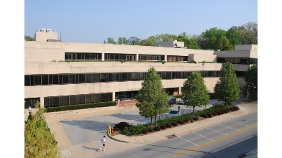
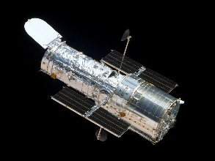
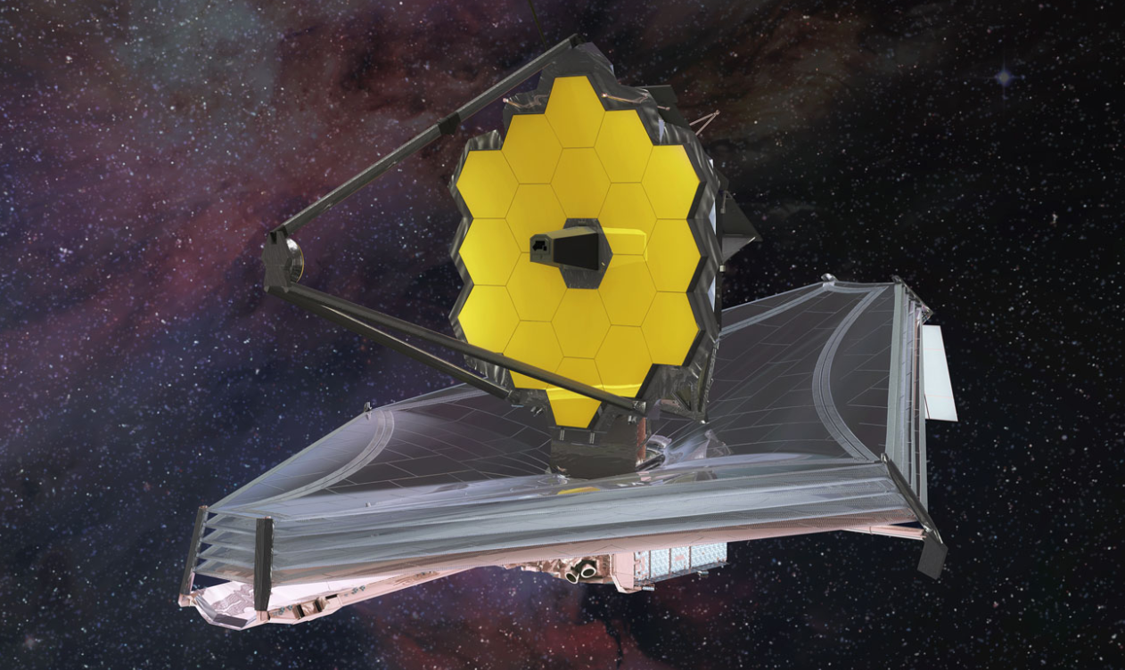
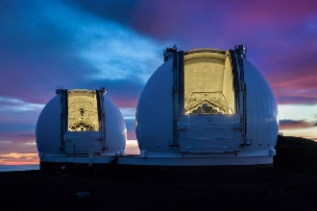
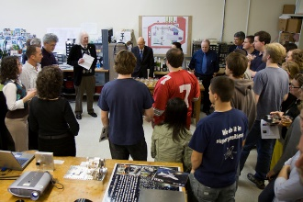
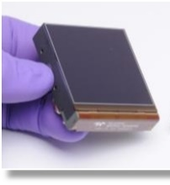
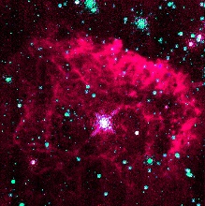
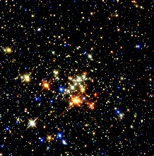
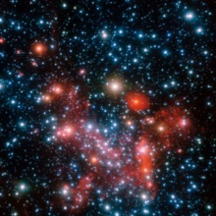
Don Figer - Speaker Bio
Professor in College of Science at RIT
Professor in Astrophysical Sciences and Technology Graduate Program
Director of the Center for Detectors
Director of the Future Photon Initiative
At RIT since 2006
Previously
  Space Telescope Science Institute (operates Hubble and JWST)
  UCLA (designed optics for infrared spectrograph on Keck)
Research Interests: Detectors, Massive Stars, Massive Star Clusters, Galactic Center

Slide 4
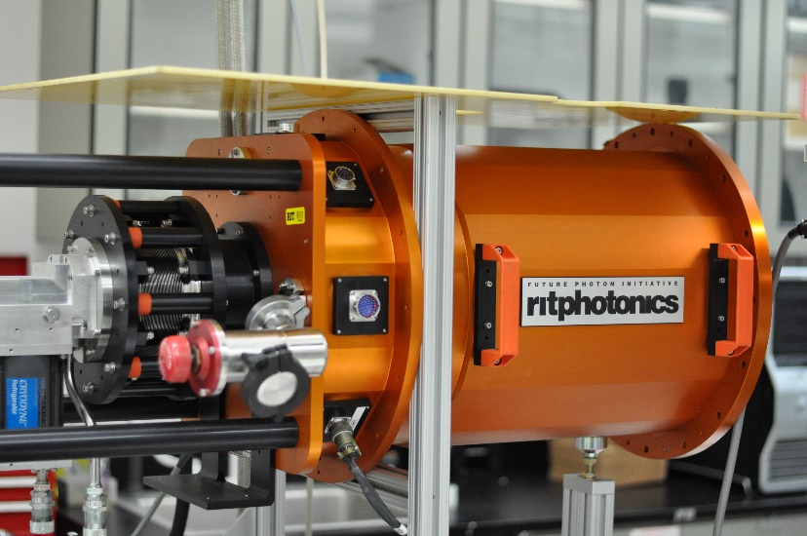
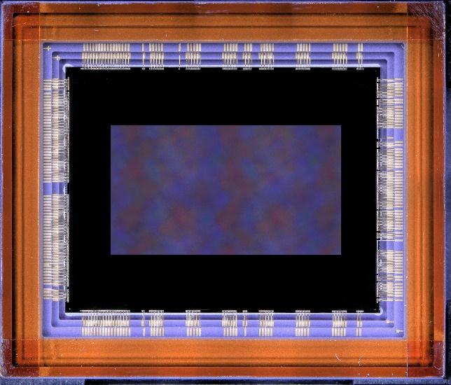
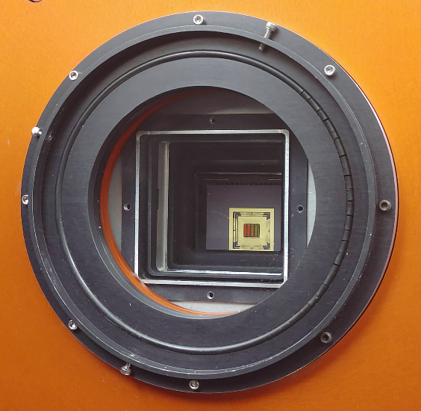
CMOS Imaging Detectors
Strategic Astrophysics Technology 2022: 80NSSC24K0372
Early Stage Innovations 2023: 80NSSC24K0279
PI: Don Figer

Slide 5
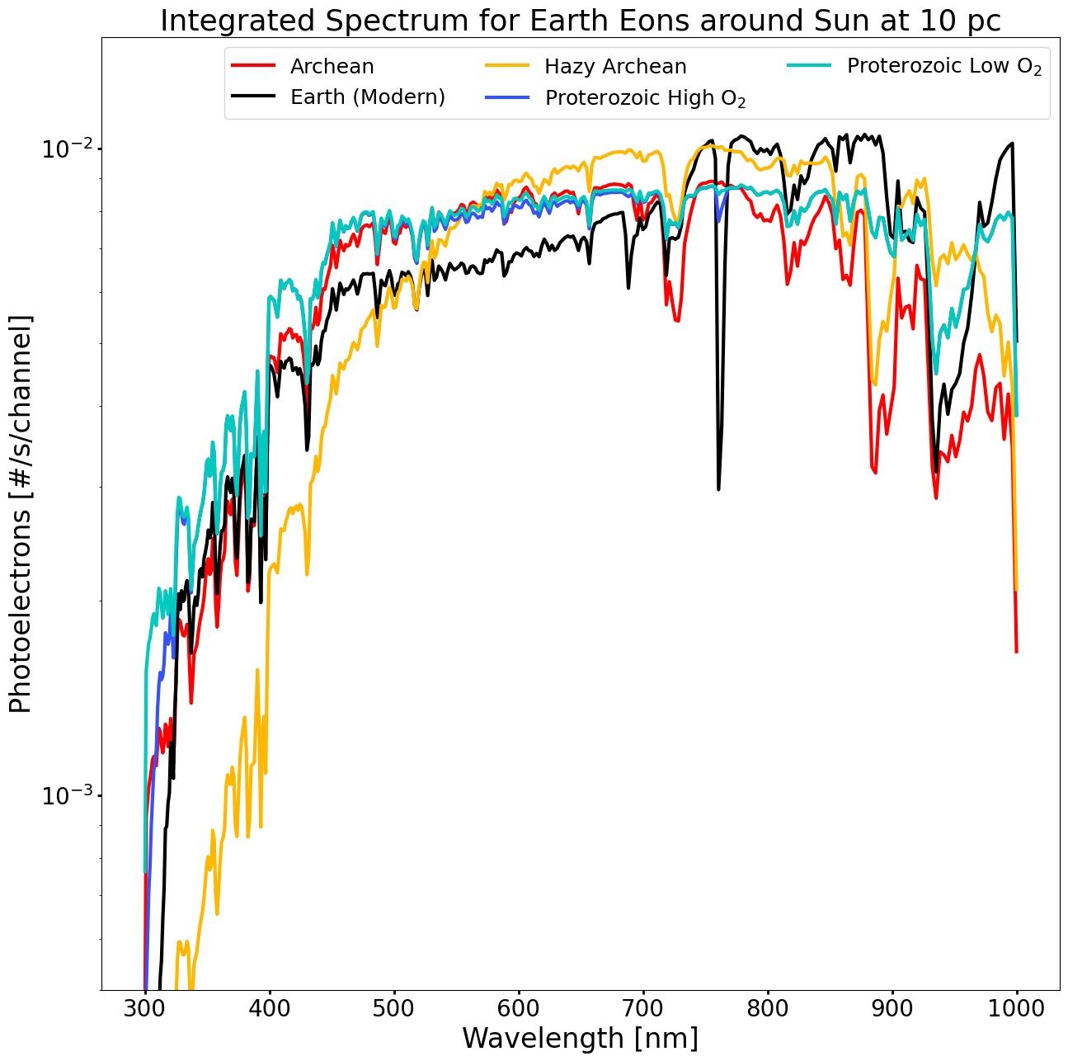

Life in the Universe

Slide 6
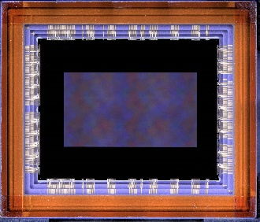
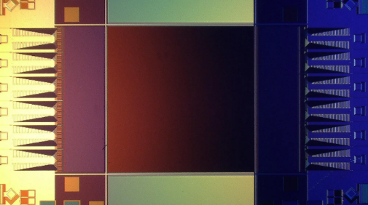
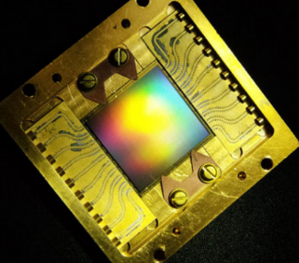
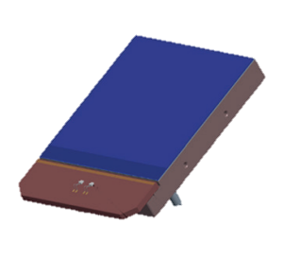
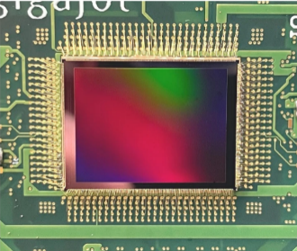
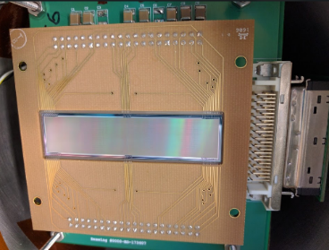
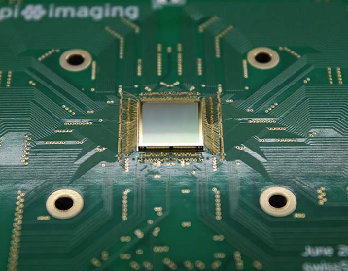
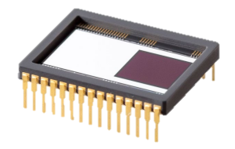
State of the Art Detector Candidates for Future Missions
challenging requirements for UV/O/IR observations
single-photon sensing
low dark current
near-zero read noise
multiple candidate detector technologies
CMOS: 9.4 Mpix
BAE HWK4123
SNSPD: 0.4 Mpix (Adam McCaughan/NIST)
MKID: 20 kpix (Mazin Lab, Breckenridge 2021)
CMOS: Teledyne e2v CIS301/302
EMCCD: Teledyne e2v CCD351-00
CMOS: 163 Mpix QIS (Ma et al. 2022)
Skipper CCD: 3.5 Mpix (SENSEI Collaboration)
SPAD: Pi Imaging SPAD 512² (Antolovic et al. 2022)

Slide 7
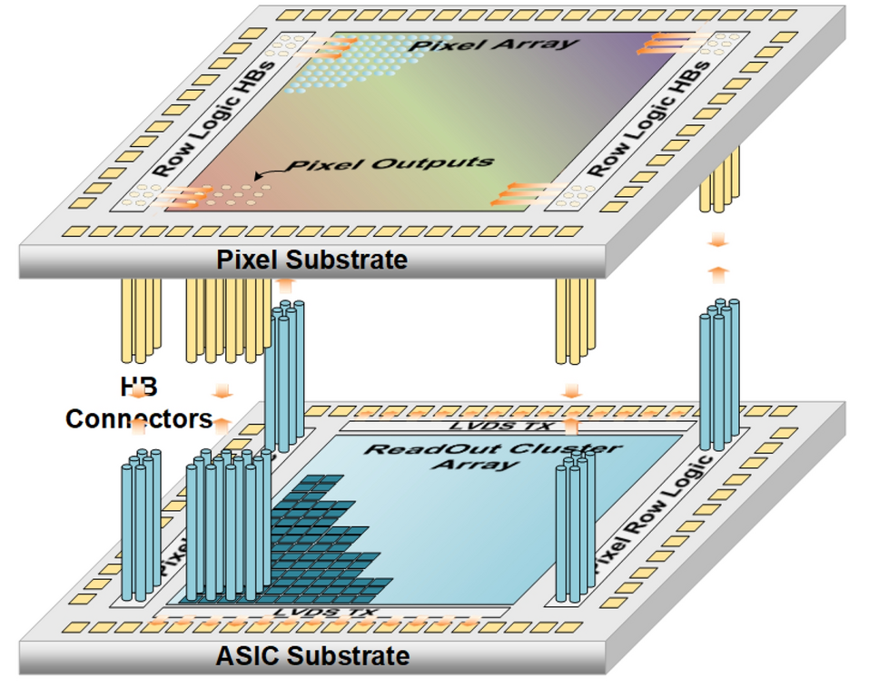
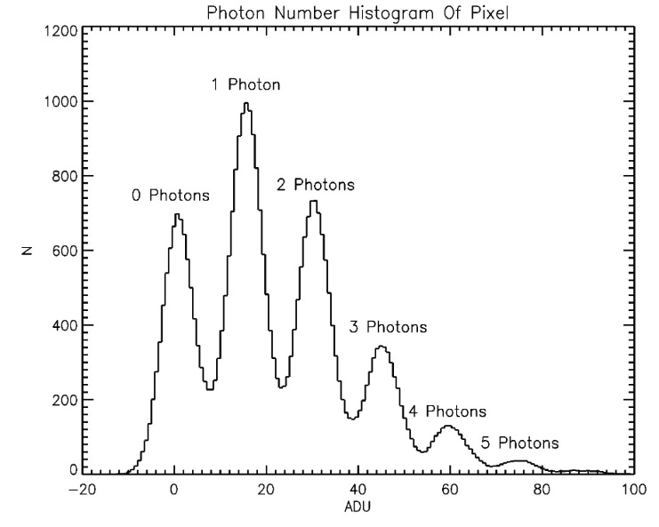
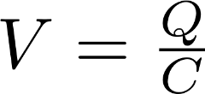
Single Photon Sensitivity
low-capacitance floating diffusion sense node
high-gain response of >320 μV/e-
exceeds electronics read noise
correlated double/multiple sampling
discrete photoelectron peaks
Ma, J. et al. Ultra-high-resolution quanta image sensor with reliable photon-number-resolving and high dynamic range capabilities. Sci Rep 12, 13869 (2022). https://doi.org/10.1038/s41598-022-17952-z

Slide 8
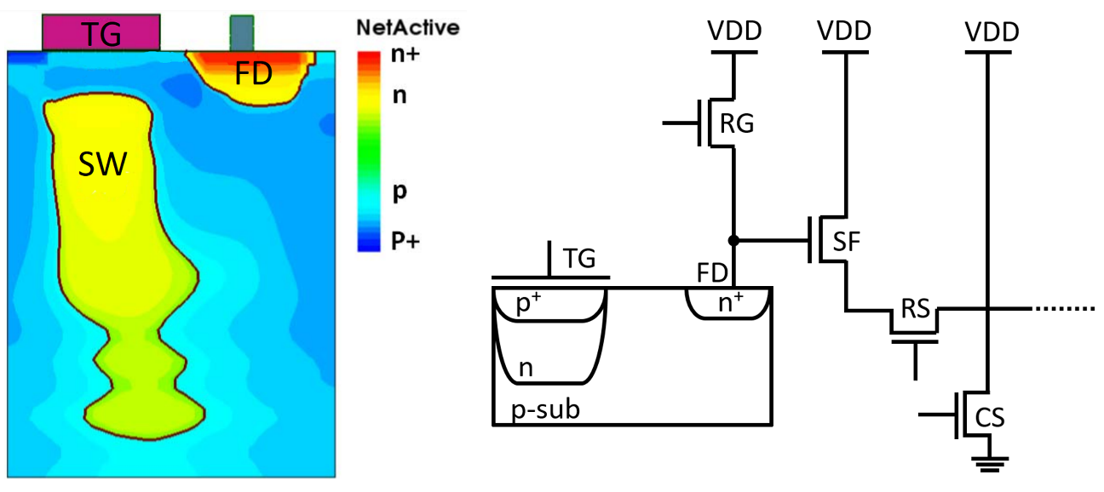

Single Photon Detector Operation

Slide 9
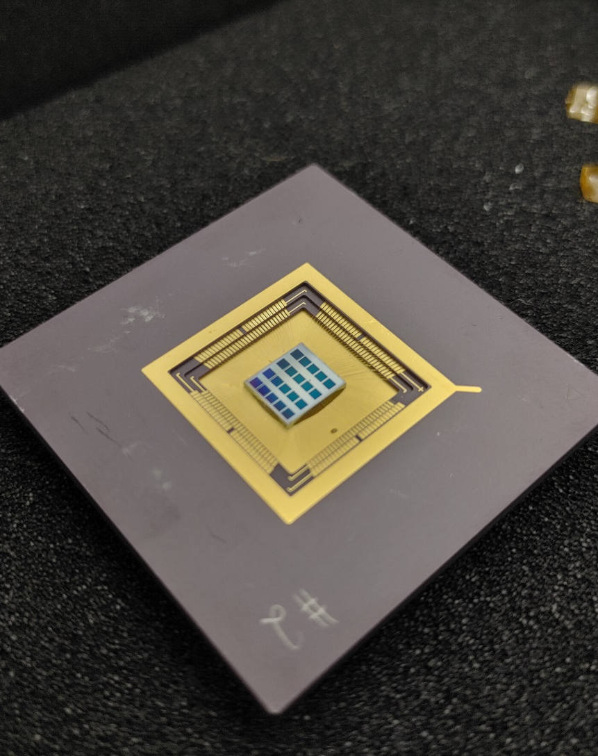
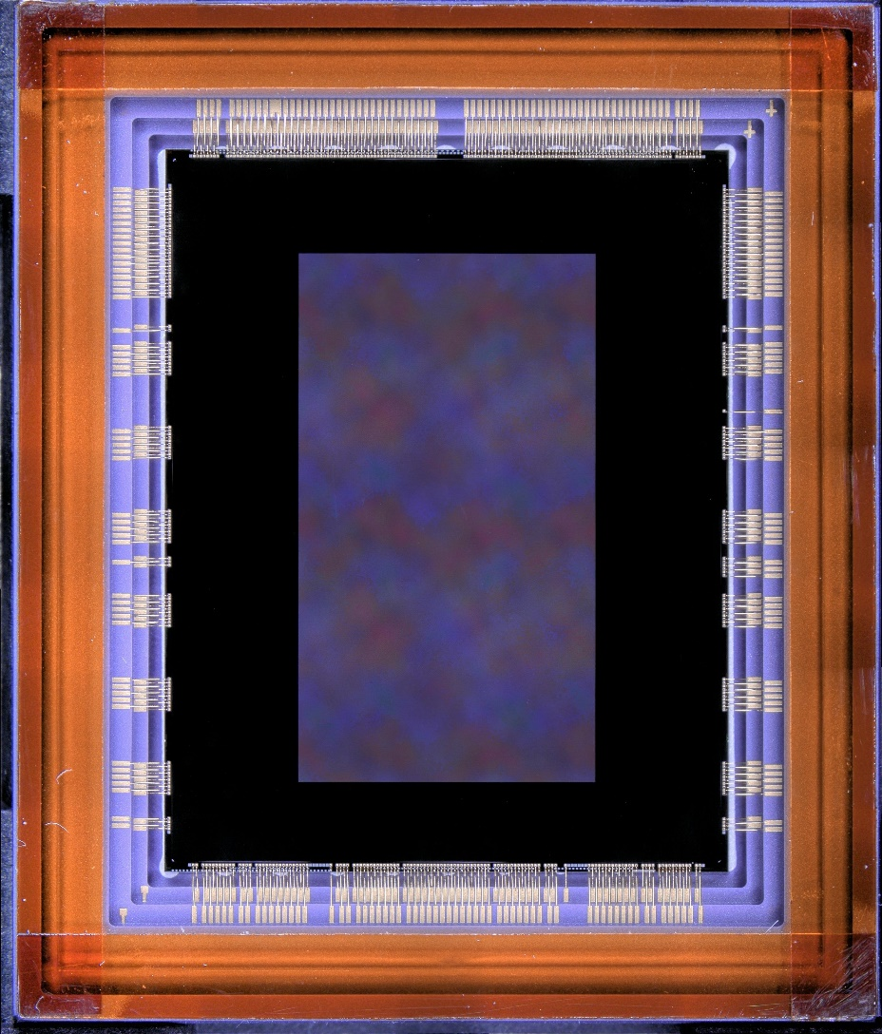
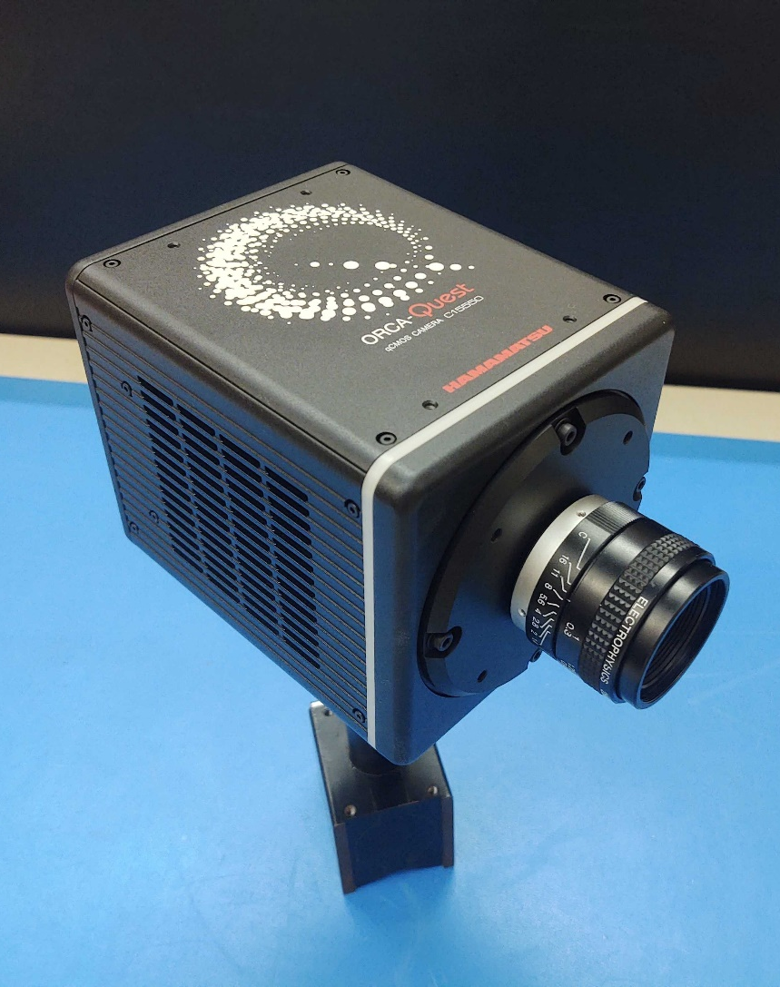
Single-Photon CMOS Image Sensors
QIS CMOS
1 Megapixel Sensors
1.1 μm pixels
HWK4123
9.4 Megapixel
4.6 μm pixels
ORCA-QUEST
HWK4123

Slide 10
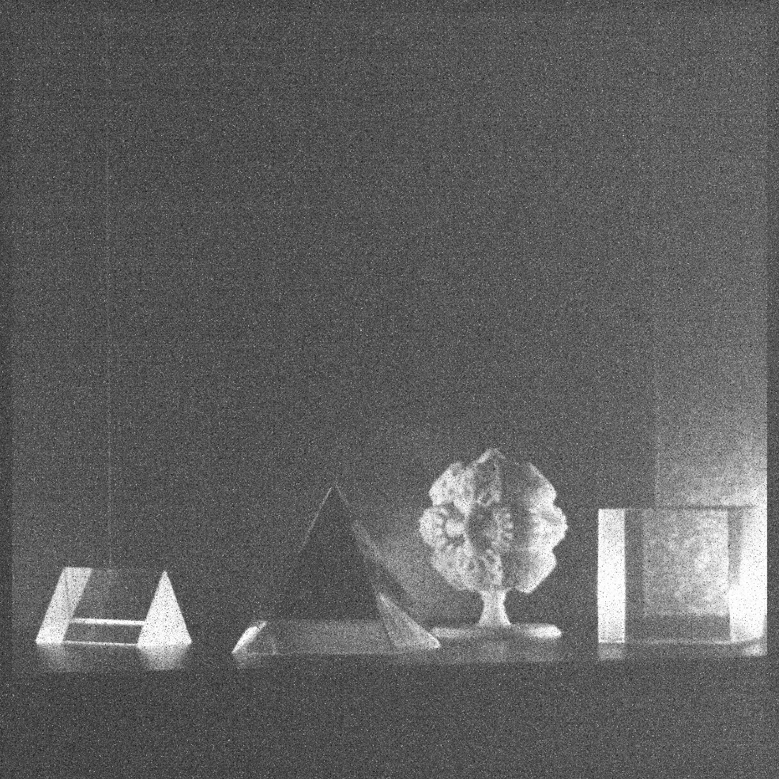
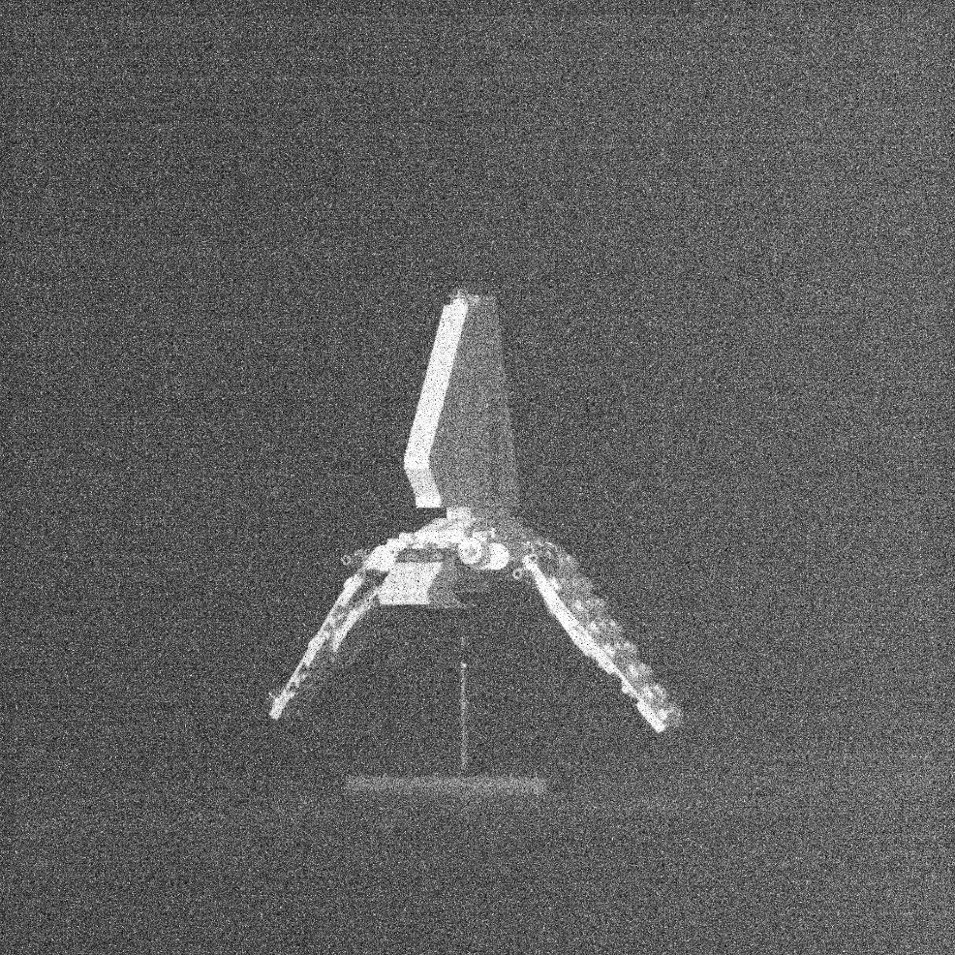
Single Photon Images
e⁻
e⁻
e⁻
e⁻
e⁻
e⁻
e⁻
e⁻

Slide 11
Sensor Parameters and Performance
Sensor Parameters
Parameter | Unit | QISSAT1-2 | HWK4123
Format | - | 1024 × 1024 | 4096 × 2304
Pixel Size | μm | 1.1 | 4.6
Sensor Performance Metrics
Dark Current | e⁻/pix/s | 0.0004 (253 K) | 0.006 (233 K)
Quantum Efficiency | % (325 nm) | 35 | 60
 | % (500 nm) | 83 | 87
 | % (940 nm) | 7 | 36
Read Noise (median) | e⁻ | 0.27 | 0.23
Full Well Depth | e⁻ | 275 | 7000
Fill Factor | % | 100 | 100
Frame Rate | fps | up to 30 | up to 120
Current TRL | - | 5 (pixels) 4 (ROIC) | 4

Slide 12
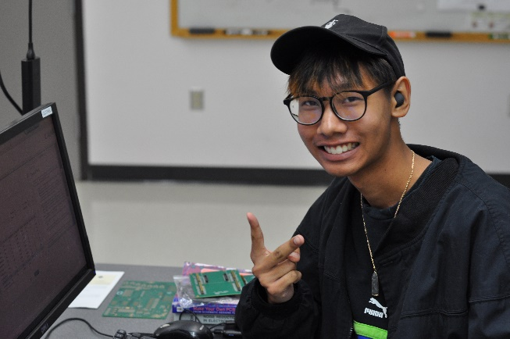
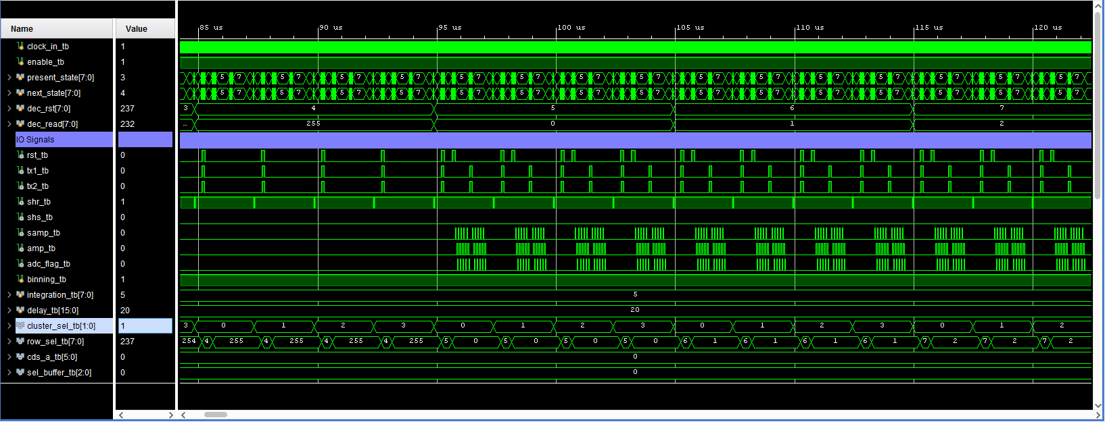
Radiation Mitigation Readout Modes
create and validate single event upset mitigation readout modes
develop and test damage mitigation operational modes
leverage CMOS digital pixel multiplexing
generate modular waveforms for custom readout
verify performance of custom modes at radiation beam line
advance new readout modes beyond TRL2

Slide 13
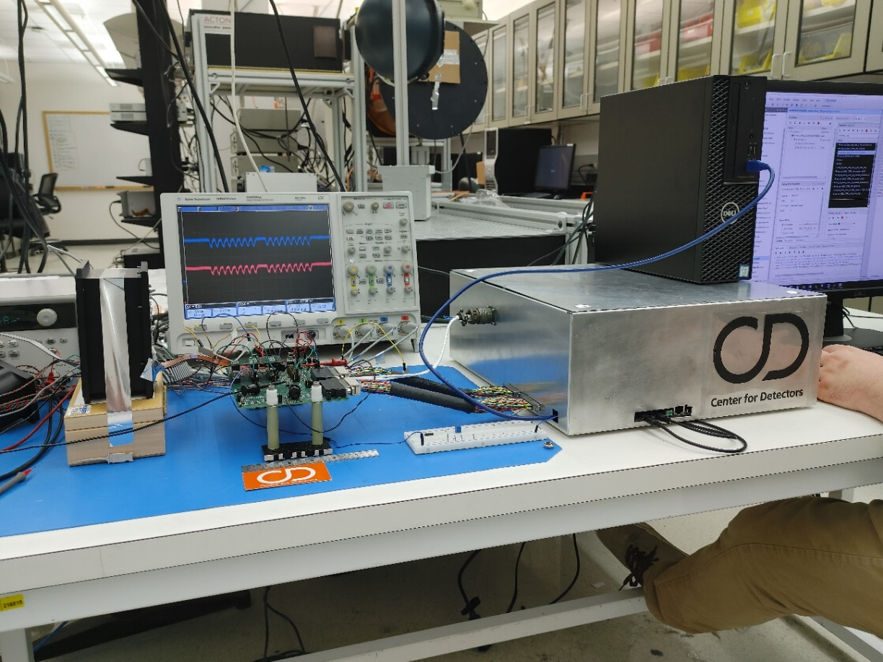
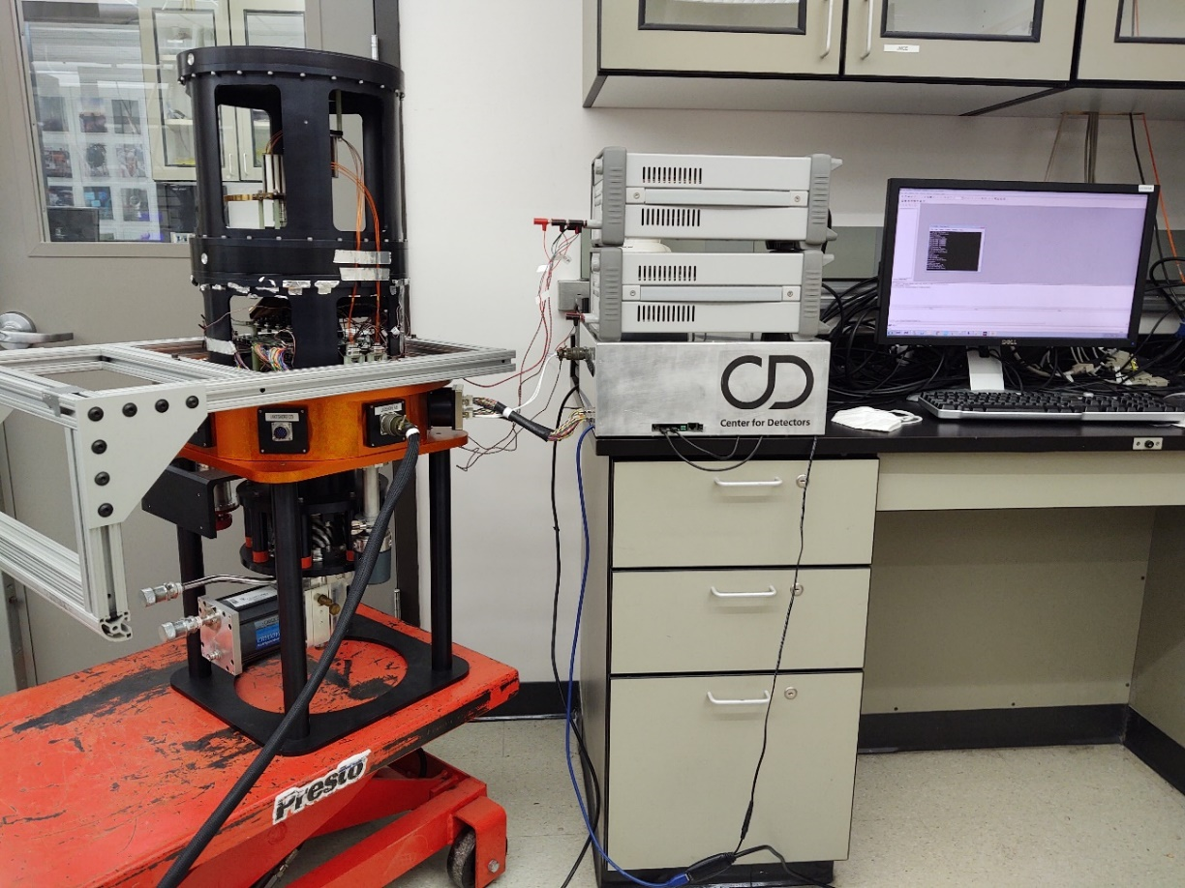
Custom Cryogenic and Vacuum Safe Readout Electronics

Slide 14
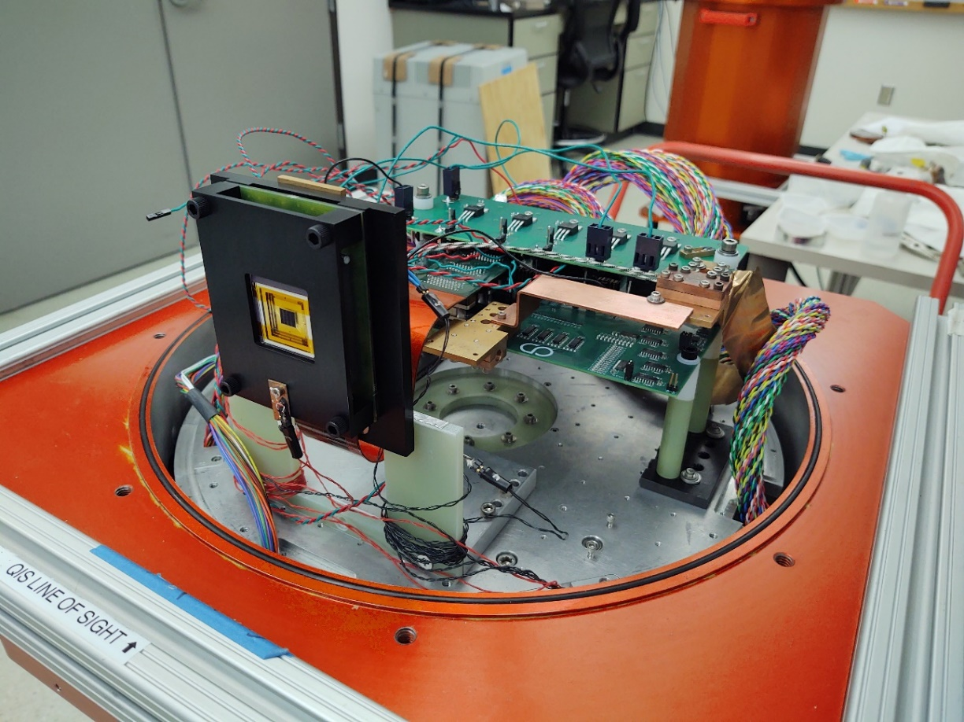
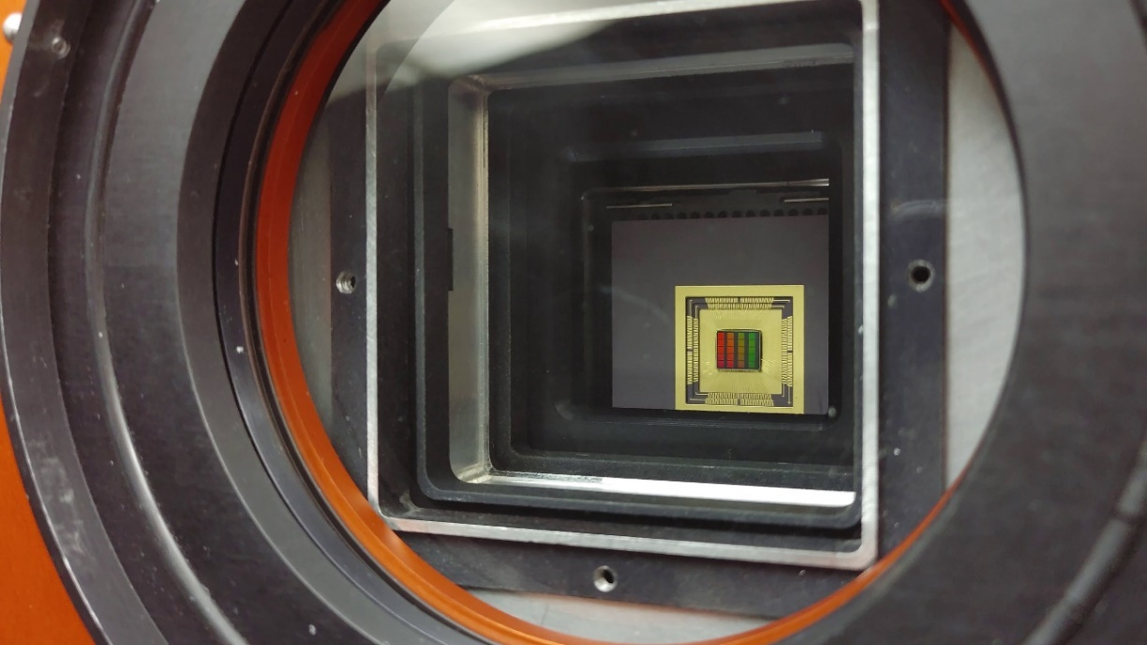
Detector Mounted for Radiation (left) and Optical (right) Testing

Slide 15
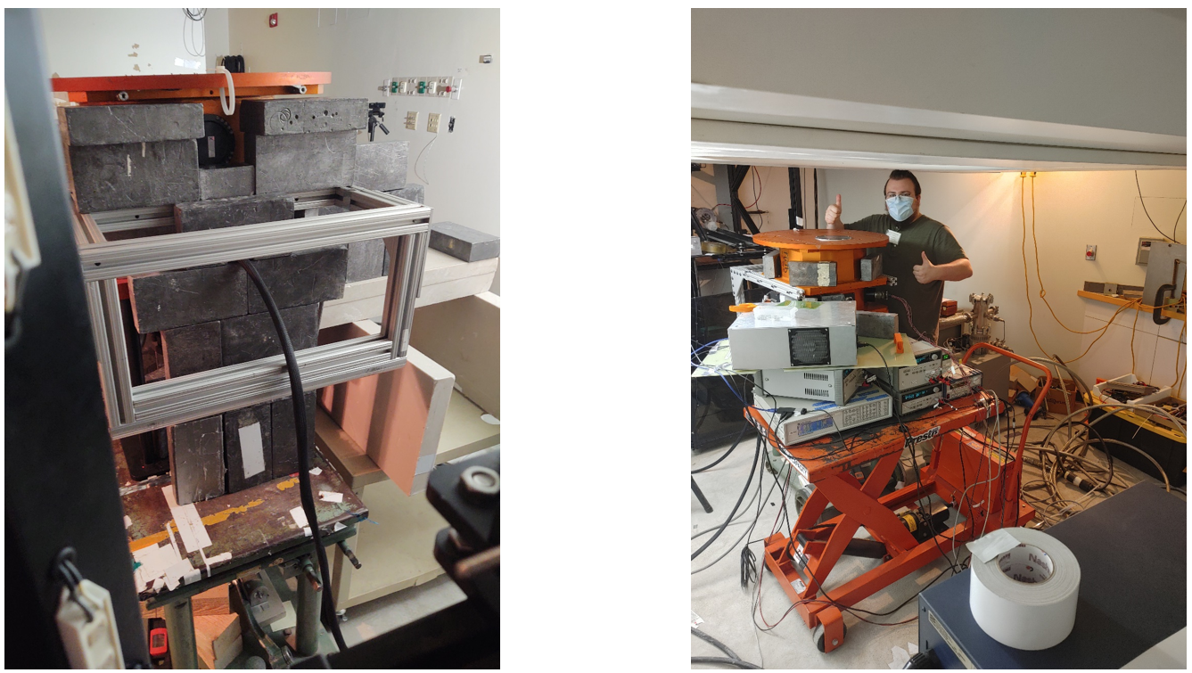
Dewar and Detector at the Proton Radiation Testing Facility

Slide 16
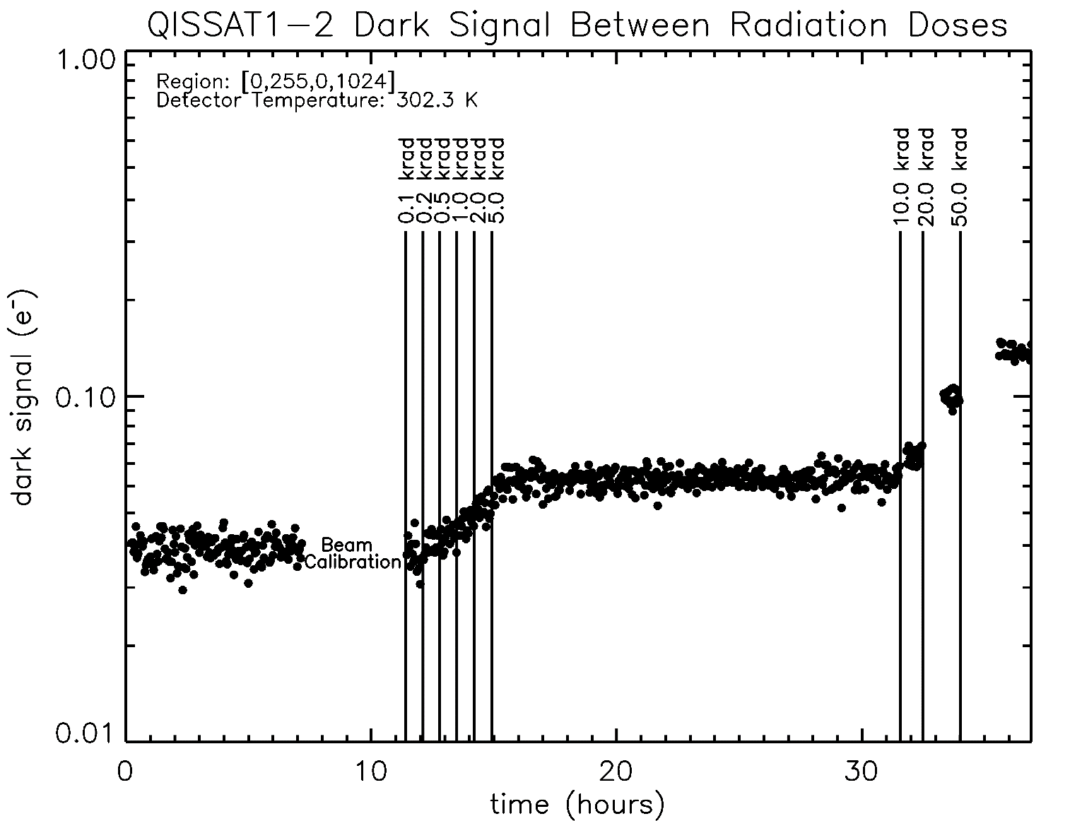
Proton Increases Dark Current
Justin P. Gallagher, Lazar Buntic, Wei Deng, Eric R. Fossum, Donald F. Figer, "Radiation tolerance of a single-photon counting complementary metal-oxide semiconductor image sensor," J. Astron. Telesc. Instrum. Syst. 10(3) 036003 (24 September 2024) https://doi.org/10.1117/1.JATIS.10.3.036003

Slide 17
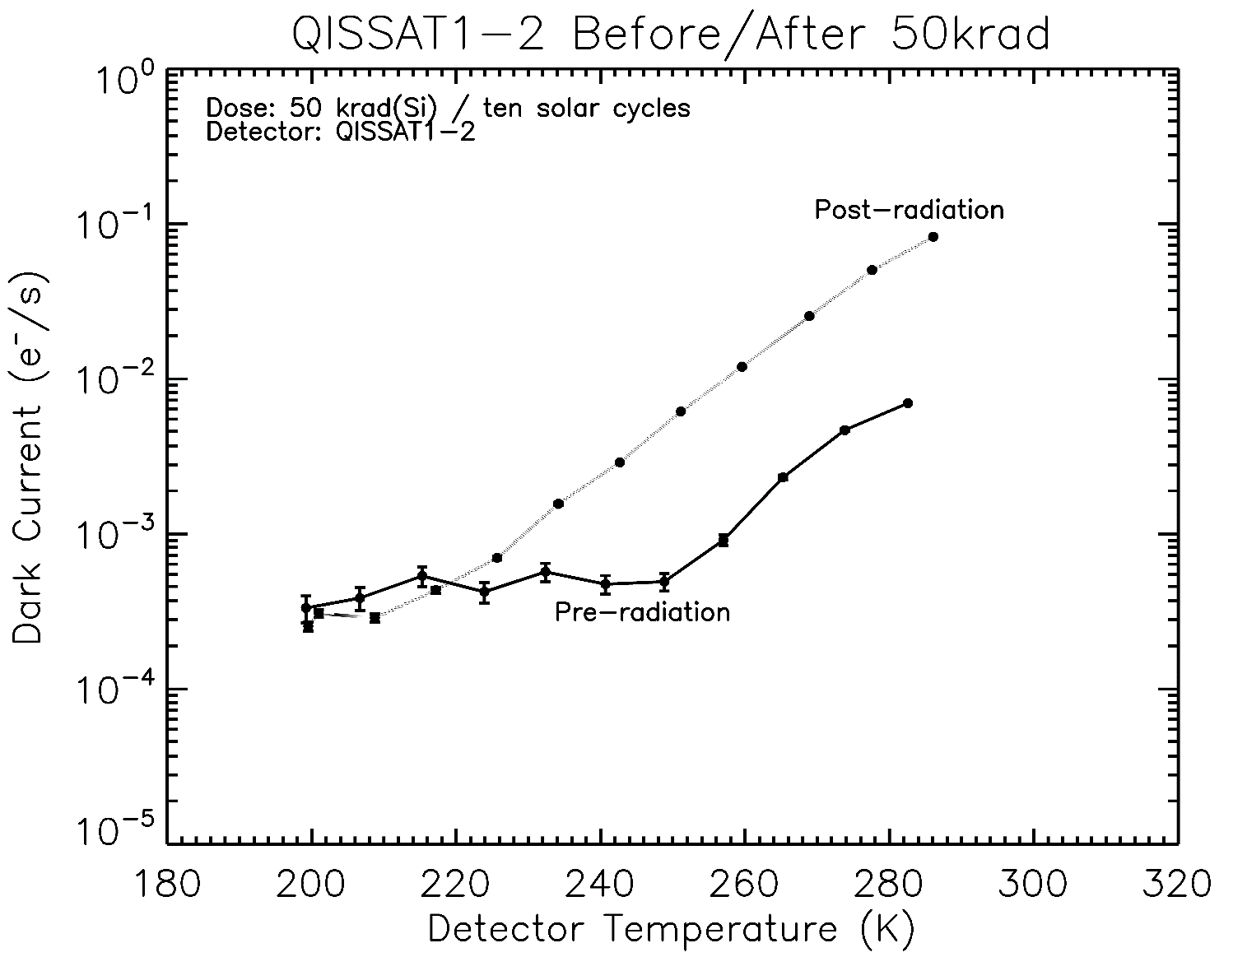
Dark Current After Exposure to 60 MeV Protons
Doubling Temperature =~8.5K
Justin P. Gallagher, Lazar Buntic, Wei Deng, Eric R. Fossum, Donald F. Figer, "Radiation tolerance of a single-photon counting complementary metal-oxide semiconductor image sensor," J. Astron. Telesc. Instrum. Syst. 10(3) 036003 (24 September 2024) https://doi.org/10.1117/1.JATIS.10.3.036003

Slide 18
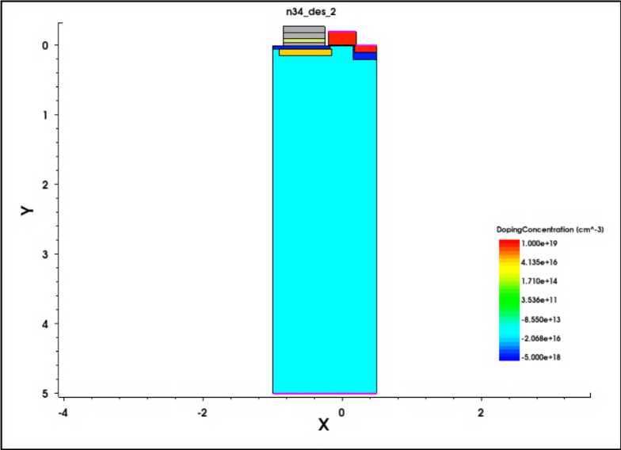
Single-Photon Sensing NIR Photodiode
develop Si TCAD model of pixel using Synopsys Sentaurus
demonstrate pixel operation and low-capacitance sense node
migrate structure to MCT material platform
simulate photodiode performance and compare to Si predecessor
advance single-photon sensing and photon-number resoling NIR photodiode beyond TRL2

Slide 19
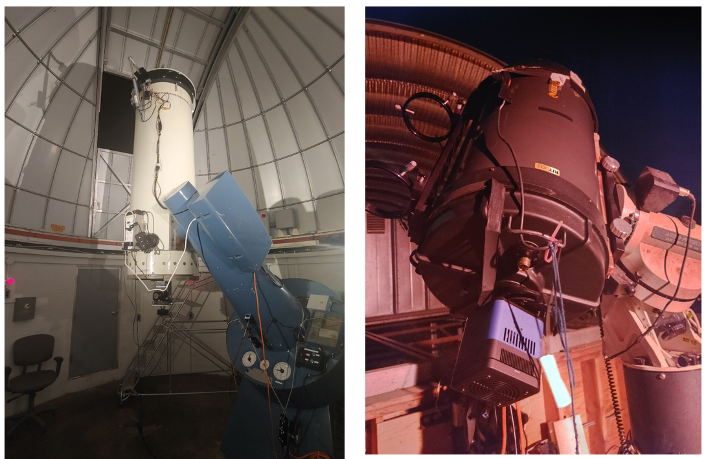
Telescopes at UofR’s Observatory (left) and RIT’s Observatory (right)

Slide 20
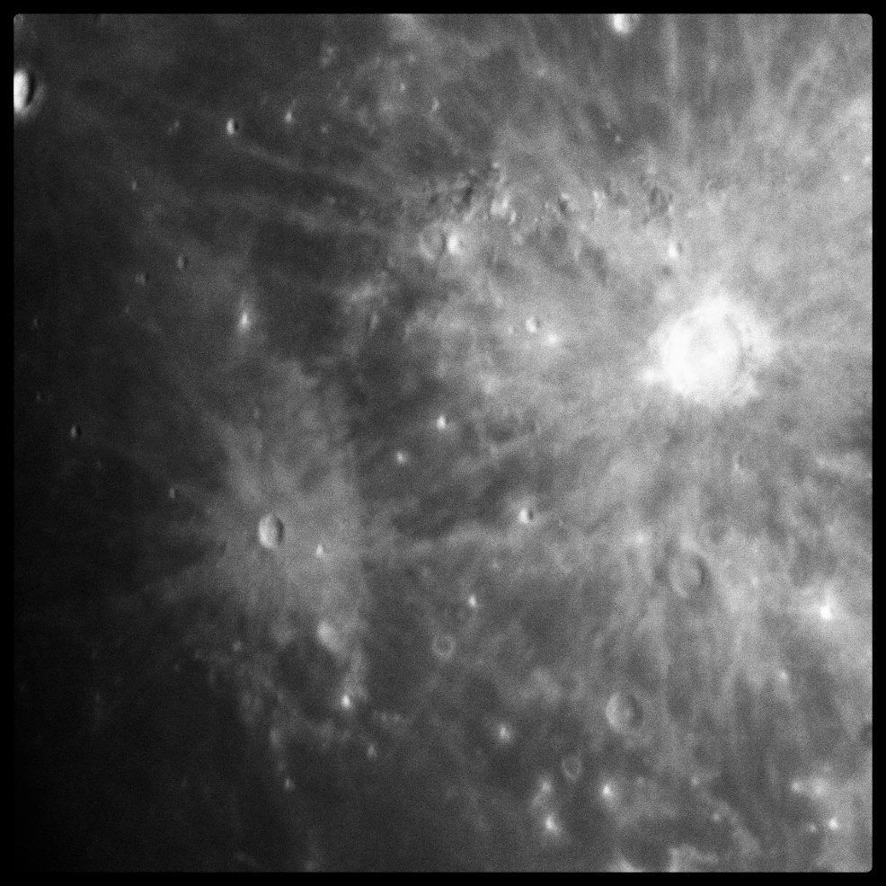
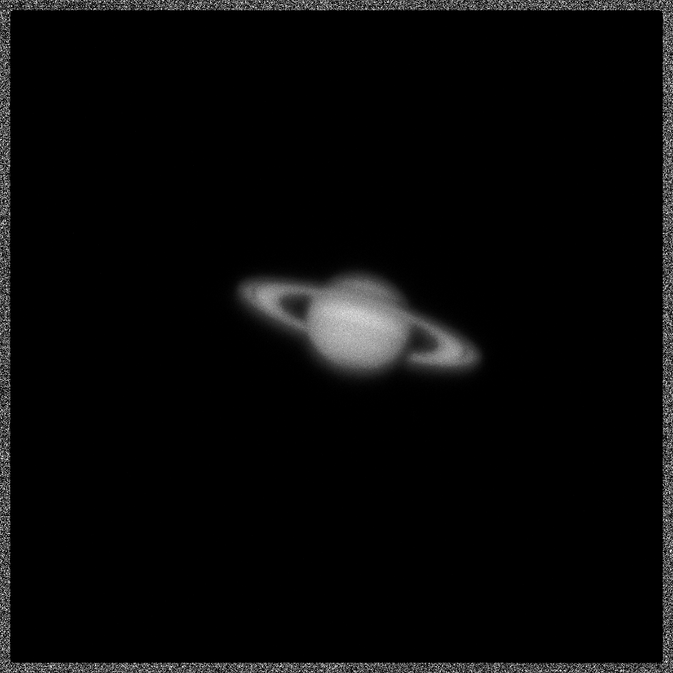
Image of Lunar Terminator and Saturn
Gallagher, J., Buntic, L., Figer, D. F., and Deng, W. 2022, “Characterization of single-photon sensing and photon-number resolving CMOS image sensors,” SPIE Astronomical Telescopes and Instrumentation, Montreal, Paper 12191-28

Slide 21
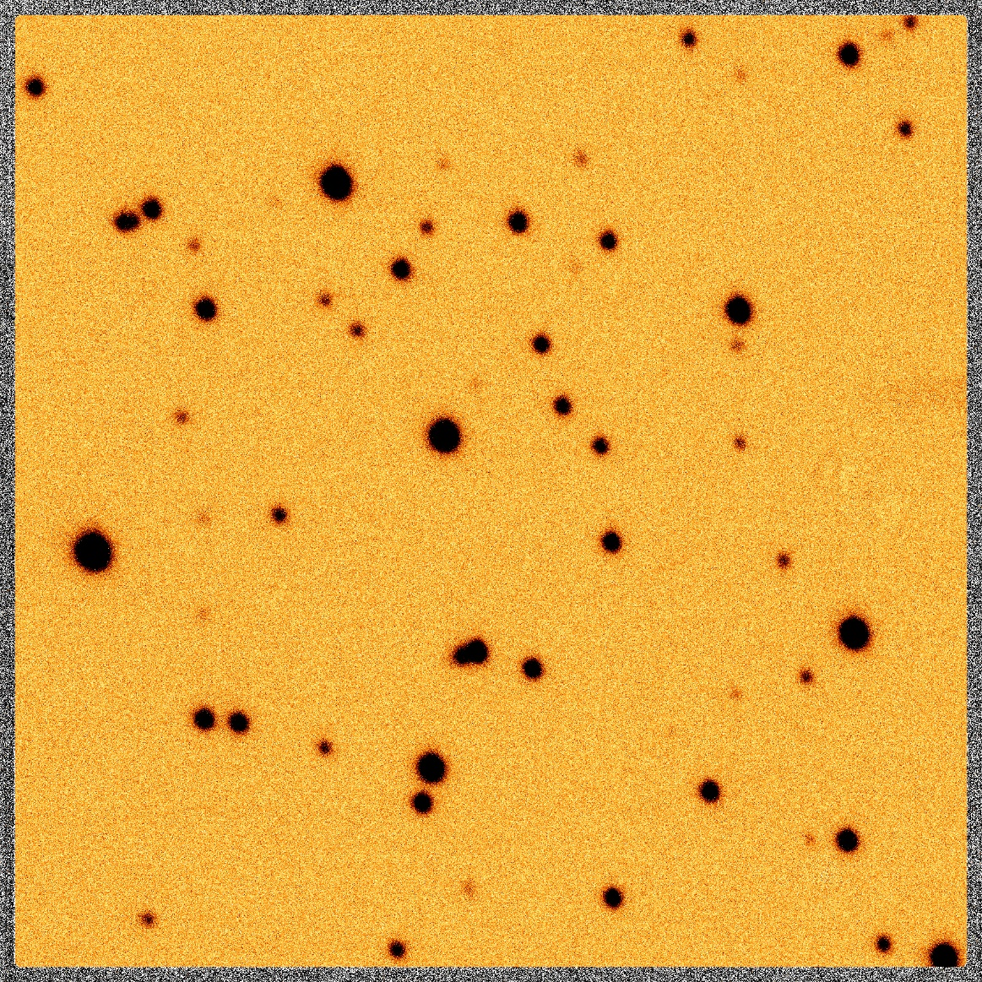
Raw image of M67 using QISCDK
Gallagher, J., Buntic, L., Figer, D. F., and Deng, W. 2022, “Characterization of single-photon sensing and photon-number resolving CMOS image sensors,” SPIE Astronomical Telescopes and Instrumentation, Montreal, Paper 12191-28

Slide 22
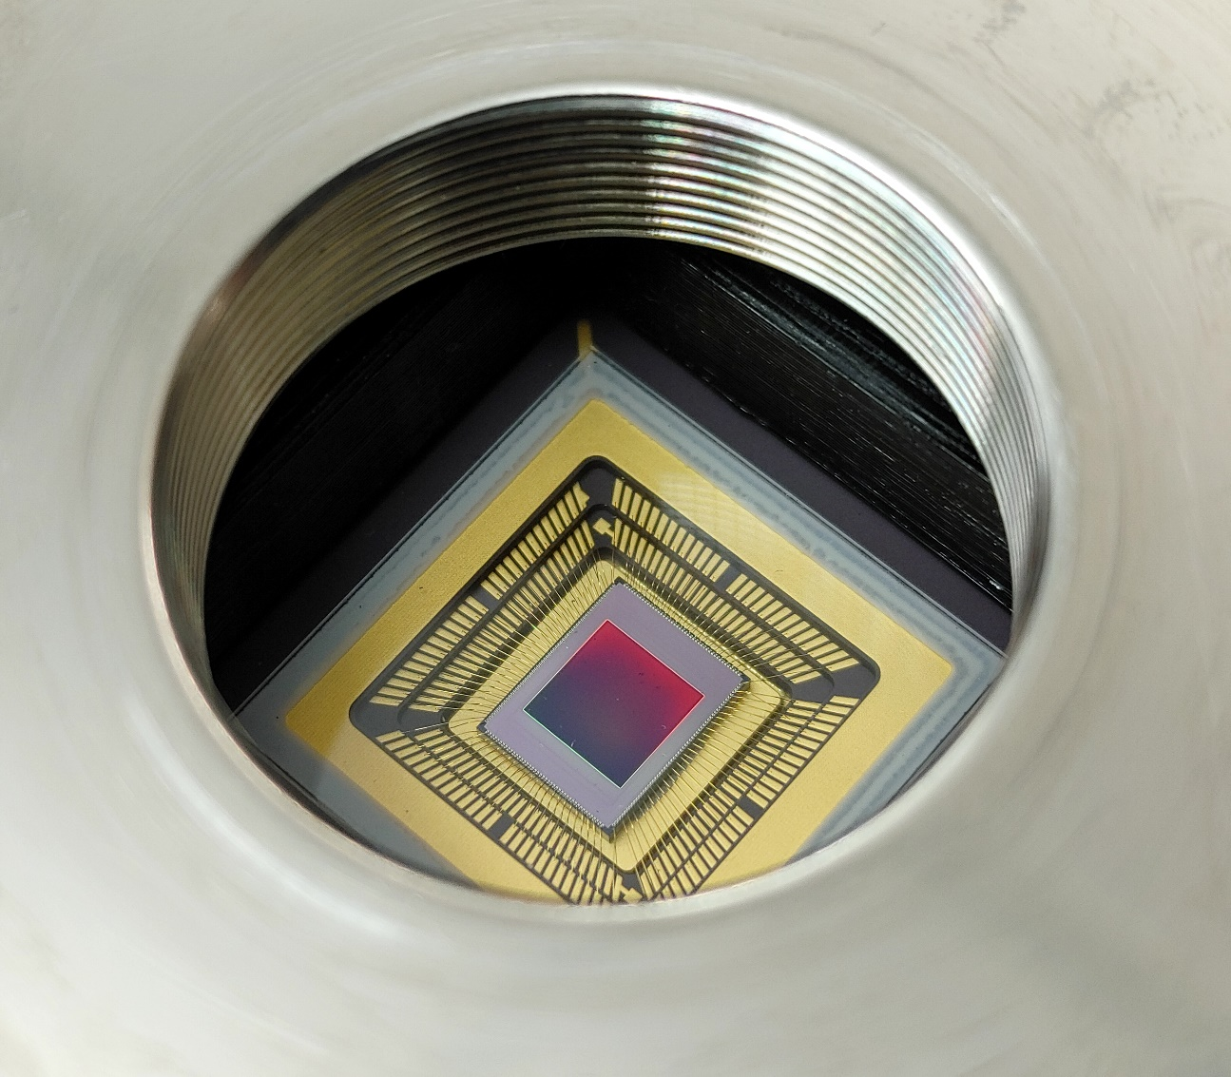
Summary
challenging science
observe low photon flux sources
detect biosignatures on exoplanets
develop detector technologies for HWO single-photon sensing in UV, optical, and NIR
Recent Publications:
Gallagher, J. P., Buntic, L., Deng, W., Fossum, E. R., and Figer, D. F. 2024, Radiation tolerance of a single-photon counting complementary metal-oxide semiconductor image sensor, J. Astron. Telesc. Instrum. Syst. 10(3), 036003, doi: 10.1117/1.JATIS.10.3.036003.
Gallagher, J. P., Buntic, L., Alexani, E., Bouthsarath, K., and Figer, D. F. 2024, Characterizing radiation-tolerant single photon resolving CMOS detectors, Proceedings Volume 13103, X-Ray, Optical, and Infrared Detectors for Astronomy XI; 131030S, Yokohama, Japan, https://doi.org/10.1117/12.3019105.
Gallagher, J. P., Buntic, L., Figer, D. F., Deng, W. 2024, Characterization of single-photon sensing and photon-number resolving CMOS image sensors, Proc. SPIE 12191, X-Ray, Optical, and Infrared Detectors for Astronomy X, Montreal, Canada, https://doi.org/10.1117/12.2629006

Slide 23
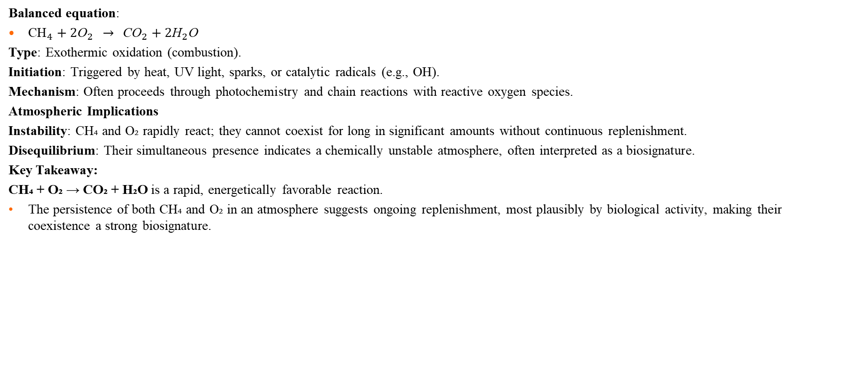
CH4 + O2 reaction
Balanced equation:
${\text{CH}}_{4}+2{\text{O}}_{2} → {\text{CO}}_{2}+2{\text{H}}_{2}\text{O}$
Type: Exothermic oxidation (combustion).
Initiation: Triggered by heat, UV light, sparks, or catalytic radicals (e.g., OH).
Mechanism: Often proceeds through photochemistry and chain reactions with reactive oxygen species.
Atmospheric Implications
Instability: CH₄ and O₂ rapidly react; they cannot coexist for long in significant amounts without continuous replenishment.
Disequilibrium: Their simultaneous presence indicates a chemically unstable atmosphere, often interpreted as a biosignature.
Key Takeaway:
CH₄ + O₂ → CO₂ + H₂O is a rapid, energetically favorable reaction.
The persistence of both CH₄ and O₂ in an atmosphere suggests ongoing replenishment, most plausibly by biological activity, making their coexistence a strong biosignature.

Slide 24
Alien Life
The coexistence of methane (CH₄) and oxygen (O₂) in a planet’s atmosphere suggests potential alien life.
CH₄ and O₂ are highly reactive and cannot persist together without continuous replenishment.
On Earth, microbes generate CH₄ while plants and algae produce O₂, sustaining disequilibrium.
Detecting both gases elsewhere may indicate biology at work.

Slide 25
Beyond CH₄ + O₂
Additional chemical reactions may hint at life or habitability:
  CO₂ + H₂ → CH₄ (geological or biological)
  N₂ + O₂ imbalance (linked to biological cycling)
  Trace gases like NH₃ or PH₃ that require active replenishment.
These broaden the search beyond methane and oxygen alone.

Slide 26
Finding Life Outside the Solar System
Spectroscopy reveals the composition of exoplanet atmospheres.
Key strategy: look for gas combinations in disequilibrium (e.g., CH₄ + O₂, N₂O, PH₃).
Context matters: planetary temperature, pressure, and other gases help interpretation.
Future observatories (HWO, Extremely Large Telescopes, JWST successors) will expand the search.

Slide 27
Future Photon Initiative and Center for Detectors

Slide 28
Future Photon Initiative
The Future Photon Initiative develops photonic devices in pursuit of answers to grand questions, leveraging efforts of existing RIT research groups using the generation, transmission, manipulation, absorption, and detection of photons.
FPI cross-disciplinary teams collaborate with external university groups, industry, and national laboratories to develop new photonic device technology.
Areas include solar energy, biophotonics, high performance imaging, astrophysics, quantum, and communication.
Eight groups: Center for Detectors, Integrated Photonics Group, Nanolithography Research Lab, NanoPower Research Labs, Photonic Systems Lab, Photonics and Optics Workforce Education Research, Semiconductor Nanofabrication Lab, and the Simone Center for Innovation and Entrepreneurship.
43 ongoing grants, with $7.7M ongoing funding

Slide 29
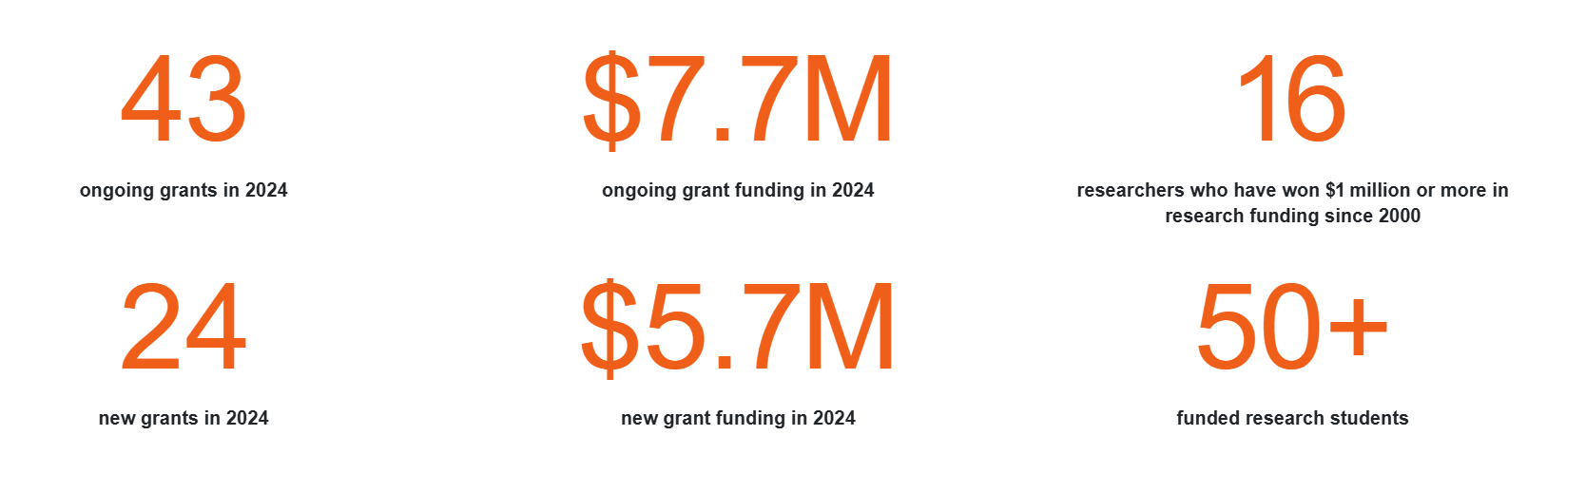
FPI Research Funding

Slide 30
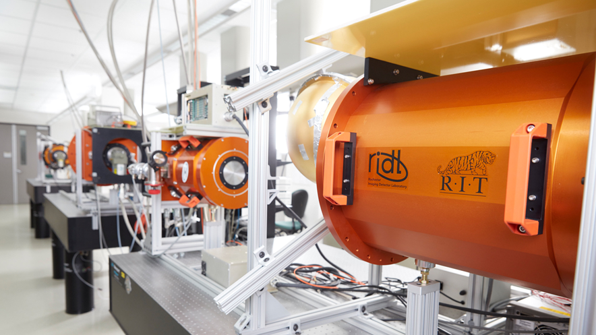
Center for Detectors
CfD designs, develops, and implements photon devices to enable scientific discoveries. | CfD trains students through research and development in detectors, instrumentation, observational astrophysics, nanostructures, silicon photonics, quantum optics and photonics, and wide bandgap materials. | The CfD was established in 2010, and includes seven professors and over two dozen students at all levels of matriculation. | Staff and student researchers investigate high impact engineering and development problems through external financial support from federal agencies, private foundations, national laboratories, and industry. | The CfD operates nine laboratories in three buildings and has an average of 32 externally funded projects (~$2.5M/year).

Slide 31
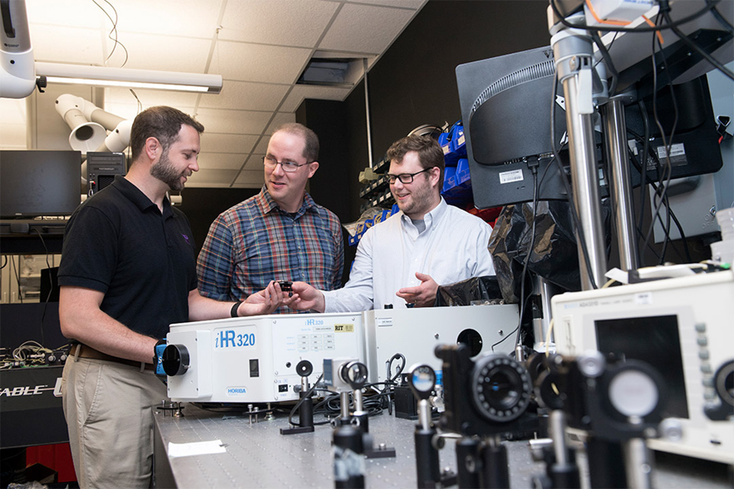
Integrated Photonics Group
The RIT Integrated Photonics Group conducts research in the Lobozzo Photonics and Optical Characterization lab. | Dr. Preble and his team develop high performance nanophotonic devices and systems using complementary metal-oxide-semiconductor compatible materials and processes. | Their work enables unique performance and efficiency by leveraging the inherently high bandwidths and low power of photons with the intelligence of electronics.

Slide 32
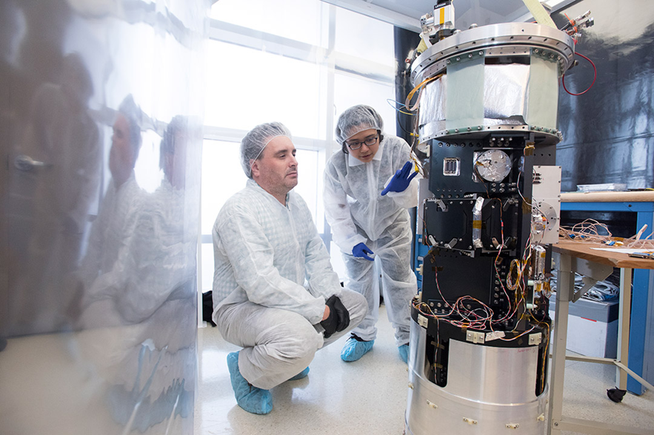
Suborbital Astrophysics Lab
The Suborbital Astrophysics Laboratory designs, integrates, and launches sounding rocket payloads for astrophysical science. | It includes clean facilities to allow disassembly and assembly of rocket instruments, optical and electronic development and validation instruments, and cryogenic and vacuum capabilities. | In this lab, Dr. Zemcov and his team prepared the CSTARS and CIBER-2 payloads for flight at White Sands Missile Range, NM.

Slide 33
CHIPs-related Activities at RIT

Slide 34





RIT CHIPS-Related Programs
NSF ExLENT: EMERGE-MICRO
Sponsor: NSF TIP & EDU
Funding: ~$1M | 2024 – 2027
Develop a pilot pipeline for community college students through A.S. → B.S. in Microelectronic Engineering.
Hands-on cleanroom training, co-op placements, and industry-guided research.
Collaborators: MCC, FLCC, GlobalFoundries, Micron, University of Rochester evaluator.
NSF: UPWARDS for the Future
Sponsor: NSF | (UW lead)
Funding: ~$10M | 2023 – 2028
U.S.–Japan university partnership engaging six U.S. and five Japanese universities.
Activities: Student exchanges, faculty visiting programs, certification, curriculum development, focused semiconductor and memory-centric research.
Objective: Build a globally connected, skilled microelectronics workforce aligned with industry needs.
NSF NRT: CMOS+X Graduate Training
Sponsor: NSF NRT
Funding: ~$3M | 2024 – 2029
Provide graduate (M.S. & Ph.D.) fellowships (~20 doctoral) in interdisciplinary semiconductor research.
Focus areas: CMOS + AI, biomedical, optoelectronic, photonic, nanoelectronics, quantum, packaging.
Goal: Train 170+ next-gen engineers & scientists, emphasizing technical and professional development components.
DoC: BRIDGE for Microelectronics
Sponsor: Dept of Commerce/NIST CHIPS Act
Funding: ~$1.5M | 2025 – 2027
Build graduate education program to train 555 students across bachelor’s, master’s, and certificate tracks in microelectronics.
Includes new online certificate offerings, industry collaboration, and student support.
Part of NSTC Workforce Partner Alliance under CHIPS Act, scaling semiconductor workforce ecosystem.
Industry Partners: Micron, GlobalFoundries, Northrop Grumman

Slide 35



RIT-CHIPS News

Slide 36
RIT CHIPS-Related Programs
NSF ExLENT: EMERGE-MICRO
Sponsor: NSF TIP & EDU
Funding: ~$1M | 2024 – 2027
Develop a pilot pipeline for community college students through A.S. → B.S. in Microelectronic Engineering.
Hands-on cleanroom training, co-op placements, and industry-guided research.
Collaborators: MCC, FLCC, GlobalFoundries, Micron, University of Rochester evaluator.
NSF NRT: CMOS+X Graduate Training
Sponsor: NSF NRT
Funding: ~$3M | 2024 – 2029
Provide graduate (M.S. & Ph.D.) fellowships (~20 doctoral) in interdisciplinary semiconductor research.
Focus areas: CMOS + AI, biomedical, optoelectronic, photonic, nanoelectronics, quantum, packaging.
Goal: Train 170+ next-gen engineers & scientists, emphasizing technical and professional development components.
NSF: UPWARDS for the Future
Sponsor: NSF | (UW lead)
Funding: ~$10M | 2023 – 2028
U.S.–Japan university partnership engaging six U.S. and five Japanese universities.
Activities: Student exchanges, faculty visiting programs, certification, curriculum development, focused semiconductor and memory-centric research.
Objective: Build a globally connected, skilled microelectronics workforce aligned with industry needs.
DoC: BRIDGE for Microelectronics
Sponsor: Dept of Commerce/NIST CHIPS Act
Funding: ~$1.5M | 2025 – 2027
Build graduate education program to train 555 students across bachelor’s, master’s, and certificate tracks in microelectronics.
Includes new online certificate offerings, industry collaboration, and student support.
Part of NSTC Workforce Partner Alliance under CHIPS Act, scaling semiconductor workforce ecosystem.
Industry Partners: Micron, GlobalFoundries, Northrop Grumman

Slide 37
RIT-CHIPS News
This list includes NSF public records and RIT/local news releases about our CHIPS-related workforce efforts here:
NSF ExLENT:
  https://nsf.elsevierpure.com/en/projects/beginnings-empowering-minds-through-experiential-learning-researc
  https://www.rit.edu/news/rit-expands-its-workforce-initiatives-semiconductor-industry
NSF NRT:
  https://www.nsf.gov/awardsearch/showAward?AWD_ID=2345983&HistoricalAwards=false
  https://www.rit.edu/news/nsf-awards-rit-nearly-3-million-advance-semiconductor-technologies
NSF UPWARDS for the Future:
  https://nsf.elsevierpure.com/en/projects/us-japan-university-partnership-for-workforce-advancement-and-res
  https://www.rochesterfirst.com/development/inside-upwards-at-rit-an-international-semiconductor-education-exchange-program/
Department of Commerce BRIDGE for Microelectronics Program:
  https://www.nist.gov/chips/rochester-institute-technology-rit-rochester
  https://www.nist.gov/news-events/news/2024/09/biden-harris-administration-launches-nstc-workforce-center-excellence
  https://www.rochesterfirst.com/news/local-news/rit-awarded-1-5-million-to-train-555-students-in-semiconductor-program/
You can find a full list of RIT CHIPS news here: https://www.rit.edu/news/semiconductor-chips

