Slide 1
Factors Affecting use of CCDs for Precision Astronomy
Andrew Holland, Neil Murray, Konstantin Stefanov

Slide 2
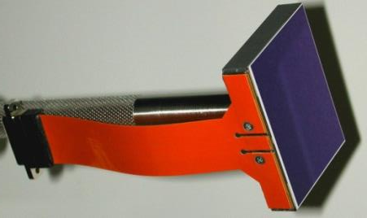
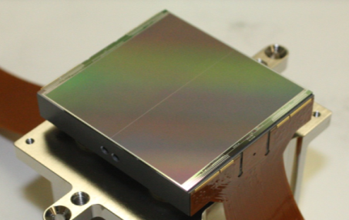
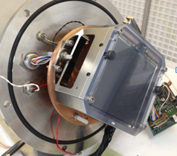
Talk Summary
Missions we are working on :
  Gaia (2013) (precision Astrometry)
  Euclid (2020) (weak lensing though accurate PSF shape measurement)
  JUICE, LSST, Plato, Solar-C, Sentinel-4,…
Understanding radiation damage effects on PSF shape
Trap identification techniques; CTE, EPER, Pocket Pumping
Blooming in CCDs
Clocked anti-blooming
Large signal re-distribution leading to non-linear PTCs and PSF shape distortion
Euclid
Plato
Gaia

Slide 3

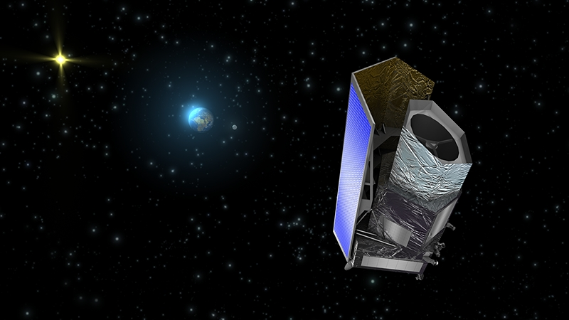
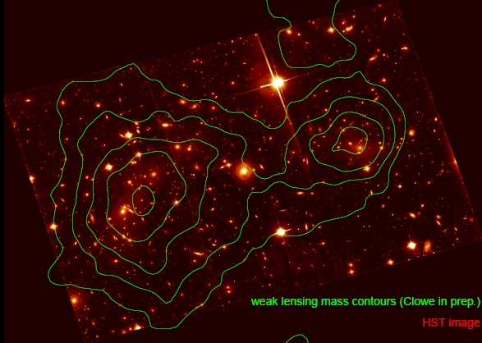
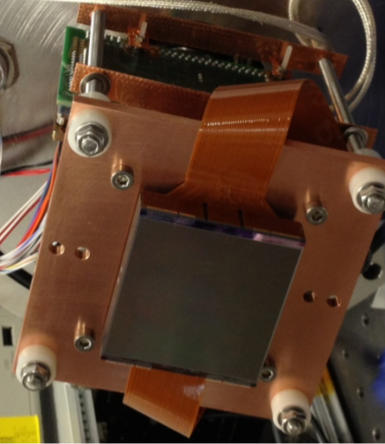
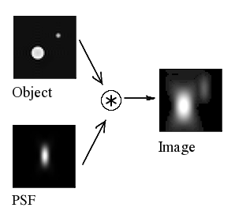
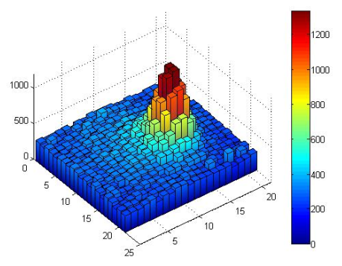
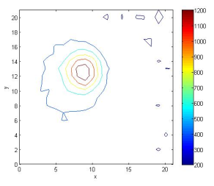
Just focussing on the Euclid Mission…
Euclid - VIS
Weak Lensing
PSF Requirement
CCD273
Measurement is affected by
- Radiation Damage
to CTI (~300x spec.)
Signal re-distribution
Notes:
This slide summarises what you should know so far and thus the rationale behind the study.
Euclid, relies on weak lensing which has a PSF requirement. I have a development Eulid CCD which I am testing optically using a spot projection system – this all feeds into the rationale behind the study.
For the rest of the presentation I shall describe the development and data from the optical test bench designed especially to investigate the Euclid PSF.

Slide 4
What We Are Doing
Modelling
Activities
David Hall
Konstantin Stefanov
Andy Clarke
David Burt
Radiation Damage
Studies
Neil Murray
Jason Gow
Edgar Allanwood
Ben Dryer
Silvaco in 3D
and 2D
Hardening design
and operation
Monte Carlo
Modelling
Trapping/De-Trapping
CTI Measurements
X-ray, EPER, PP
Mitigation &
Correction
Thin Oxide Effects
Blooming etc
Charge Re-Distribution
PSF Shape Models
Clocked Anti-
Blooming
PTC non-linearity
Corrective Modelling
Clock-Induced
Charge (CIC)
PSF Distortions
~10 people working on aspects of
simulation, measurement and
mission activities
PP+CIC for
Calibration

Slide 5
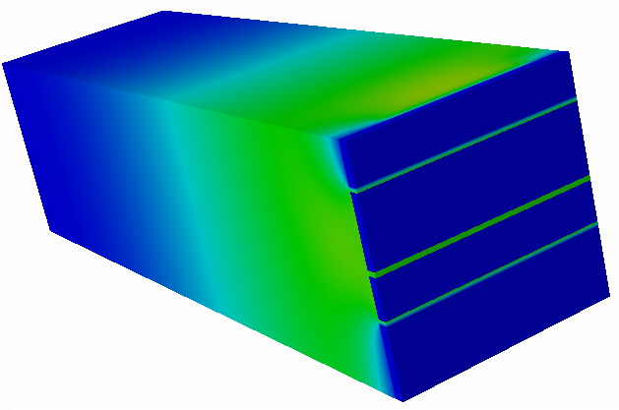
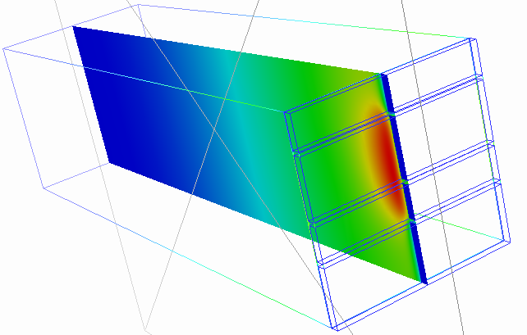
Generation of Accurate 3D Models of the CCDs
Extensive 3D modelling of the Euclid CCD271 to give signal volume versus size

Slide 6
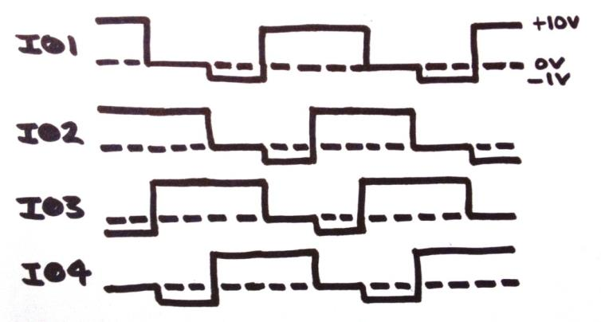
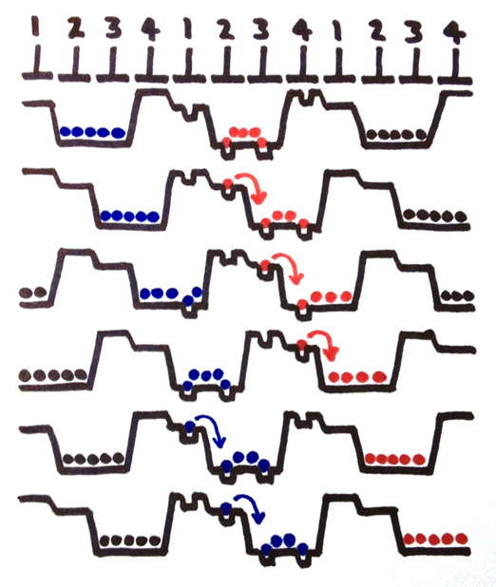
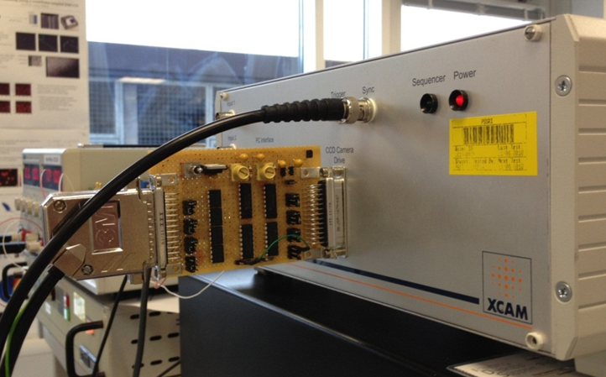
Tri-level parallel clocking sequence
1st implementation

Slide 7
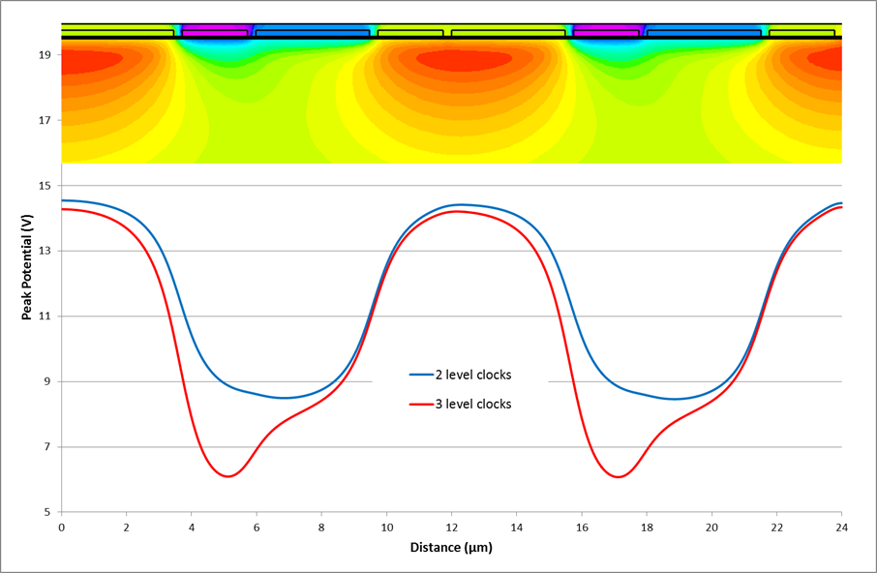
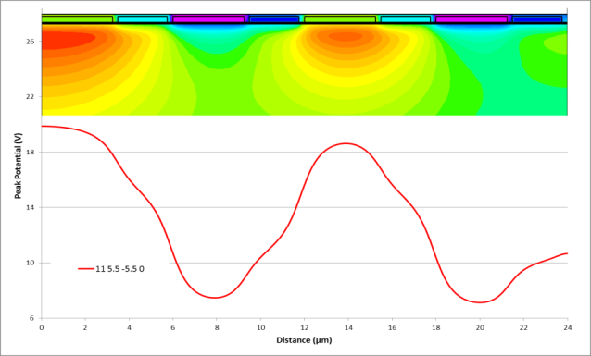
Multi-level well models – Silvaco (KS)
Tri-level
Quad-level
Traps causing CTI with 2 level clocking
Traps causing CTI with 3 level clocking – smaller volume of Si

Slide 8
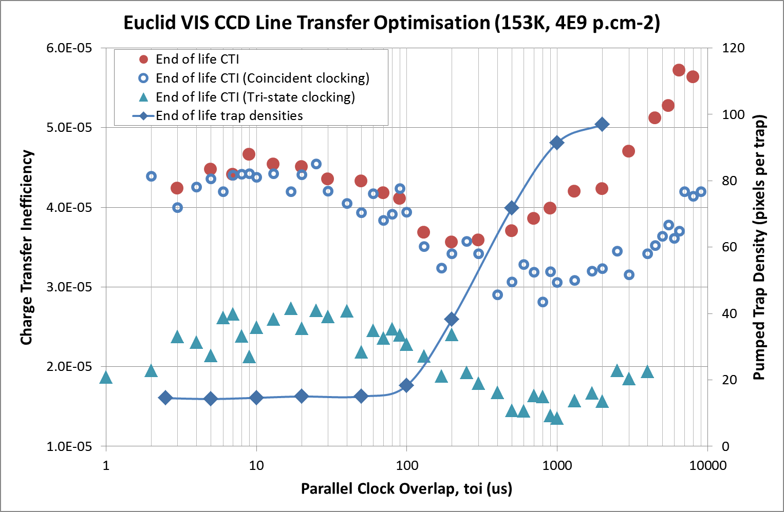

Results with Tri-level clocking
Neil Murray , 8th May 2013

Slide 9
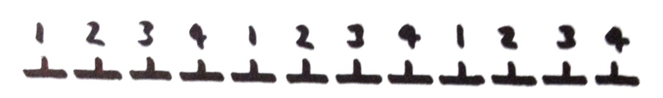




Pocket Pumping – Sub-pixel trap locations
From sequence diagrams collecting phase traps are not pumped.
Phase 1 trap – trap is in bright pixel
Phase 4 trap – trap is in dark pixel
Readout direction
Notes:
Cost estimates ~ $ for these two to keep me from espionage over the 1.5 weeks on base

Slide 10
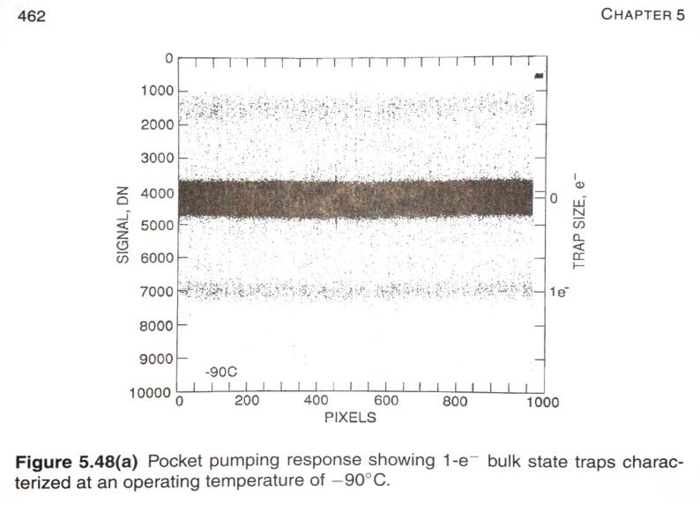
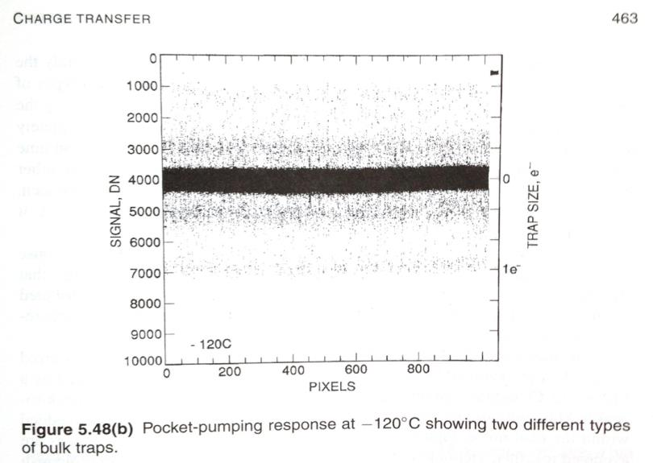

Trap pumping efficiency vs. temp
Trap pumping efficiency vs. temp
Changing the device temperature will change the emission time constants of the traps.

Slide 11
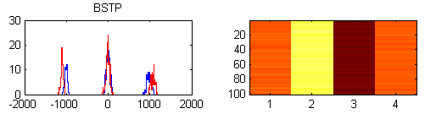
Gain calibration
A number intrinsic traps are present in any CCD. Pre-flight these can be calibrated in terms of pumping efficiency under the strict operating conditions for the mission (transfer time and temperature) to a known signal such as Fe55.
This then allows the pumped signal for the same number of cycles and similar background level to be converted into electrons.
Only at the point that additional radiation induced traps interfere with a known trap does its gain calibration become unreliable. However as there are many to use the probability of losing gain calibration for each device remains low.
Histogram of a multiple serial register trap samples pumped at 70 kHz and 200 kHz

Slide 12
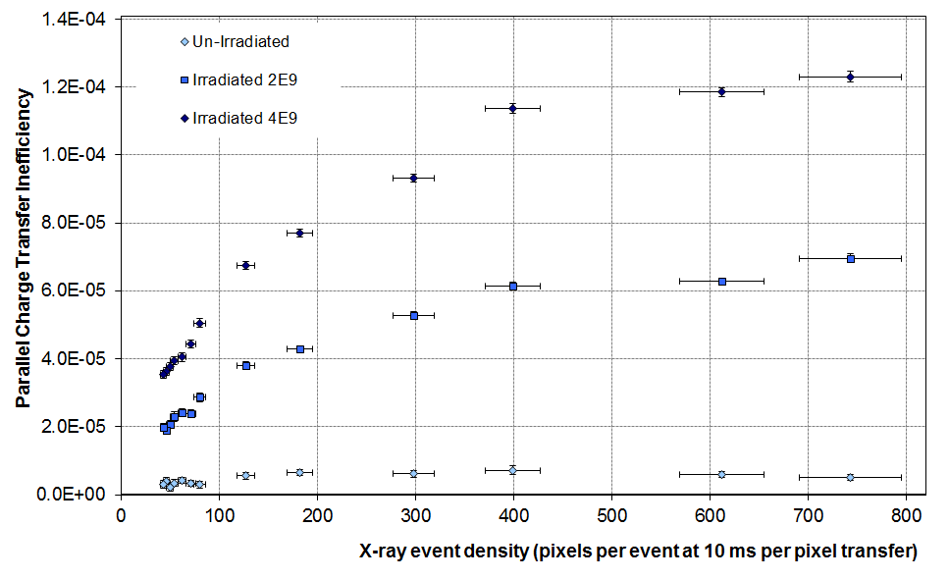
Trap identification through t_{e} determination
CCD204 (12 µm square pixel) at -114 °C (159K) measured by CEI using ⁵⁵Fe
Traps/pixel
0.2
0.1
Proton-irradiated (10 MeV) results show t_{e} ~ 1.5 seconds
n.b. this data set took about 1 week to generate

Slide 13
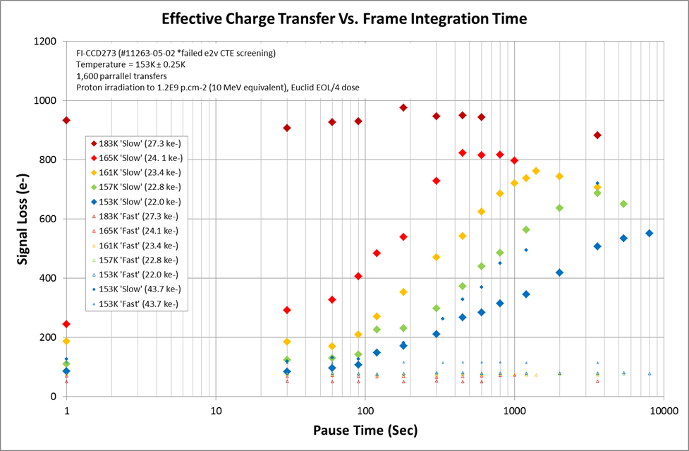
Example of t_{e} determination – parallel (slow A)
CCD273 (12 µm square pixel) measured by CEI using edge response
Effective t_{e} values (loss ~ 63% of maximum) shown by:

Slide 14
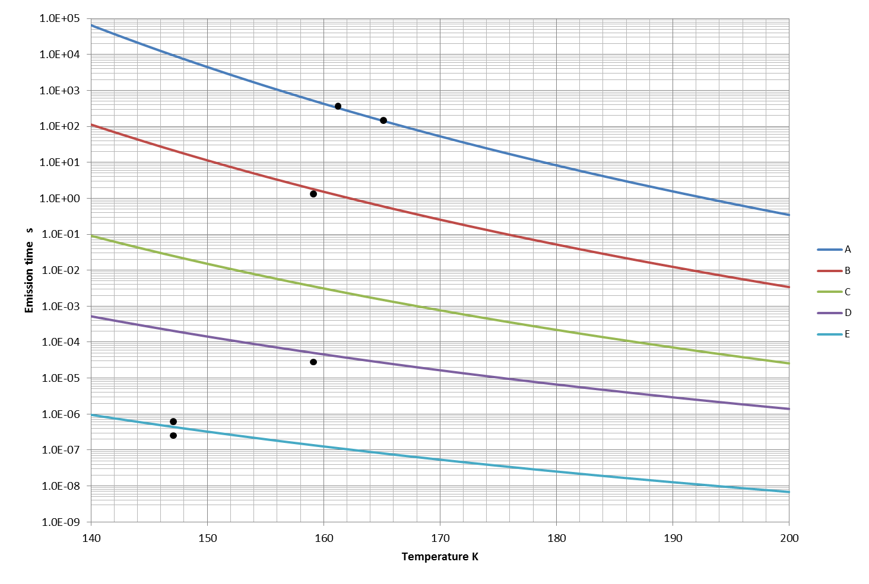
Trap Release Time Measurements
(note these data points are created from staff months of effort!!)
Plotted results are from the following work:
Black - CEI from EUCLID testing (CCD204 & CCD273)
Green - SIRA from Gaia testing (CCD91)
Red - JPL from WFC3 HST testing (CCD44). :
E-centre (P-V)
Divacancy (V-V-)
?
Divacancy (V-V--)
A-centre

Slide 15
Compilation of all known proton-irradiated t_{e} values in e2v n-channel CCDs
These trap species are then used in modelling used to correct for the PSF distortions in missions such as Euclid
Trap | E_{T} eV | σ x 10⁻¹⁵ cm² | Possible type | Density
A | 0.46 | 4 | E-centre (P-V) | 2 x 10¹⁰ /cm³
B | 0.39 | 7 | Divacancy (V-V-) | 1 x 10¹⁰ /cm³
C | 0.30 | 5 | ? | None
D | 0.21 | 0.5 | Divacancy (V-V--) | 1 x 10⁹ /cm³
E | 0.17 | 10 | A-centre (O-V) | 1 x 10¹⁰ /cm³
The densities are after an irradiation of ~ 1 x 10⁹ protons/cm² (10 MeV).

Slide 16
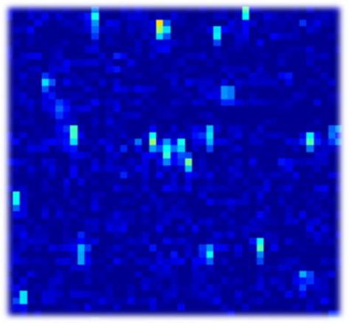
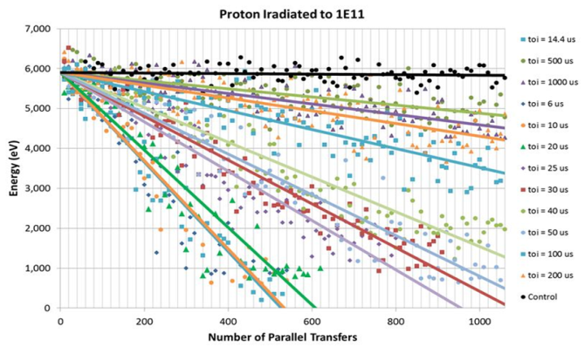
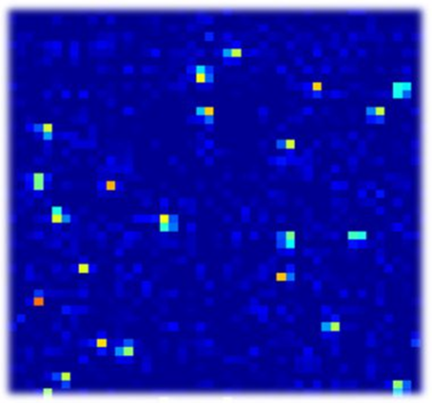
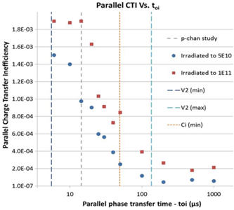
So we are getting on-top of traps in the CCD…..
Unless we move to p-channel CCDs!
In which case we start over again…
Early results were generated using setting optimised
for n-channel CCDs
However, indicates that devices could be up to 10x harder
A major characterisation study is now underway for ESA
Fe55 events, 1,000 transfers
T=153K
1E11p.cm-2 (10 MeV equivalent)
t_{oi} = 14 µs
X-ray Row Stack Plots reduce in gradient with increased toi
t_{oi} =1,000 µs

Slide 17
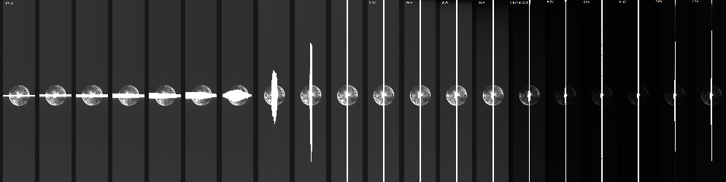
Blooming in Thin Gate CCDs
The field structure close to the gate oxide is different in the thin-oxide CCDs developed for enhanced space radiation tolerance
Thin gate dielectrics are being used on SDO, Euclid and Plato
The blooming profile of the PSFs can change depending on gate bias
Vertical blooming switches to horizontal blooming

Slide 18
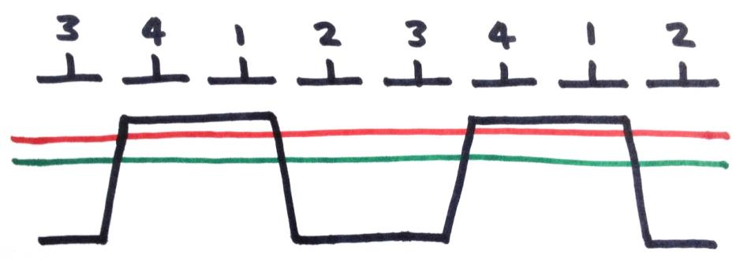
Two-level clocking/CAB
Using potential well model
Charge is collected under phases 2 and 3
As the well capacity is exceeded (green), charge comes into contact with the surface (red)
Surface traps (o) begin to fill with excess charge
10’s of thousands of surface traps per pixel
Before all the surface traps are filled, the pixel is clocked forward by 1 electrode
Phase 2 is now pinned by taking it negative and the trapped charge is annihilated
Surface traps under phase 4 begin to fill with excess charge
The pixel is clock backwards by 1 electrode to the original position
Phase 4 is now pinned by taking it negative and the trapped charge is annihilated
Surface traps under phase 2 begin to fill with excess charge

Slide 19
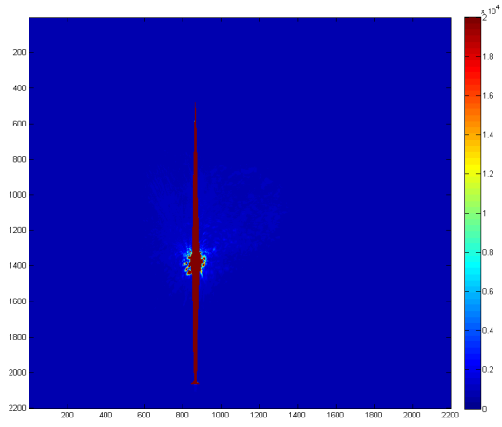
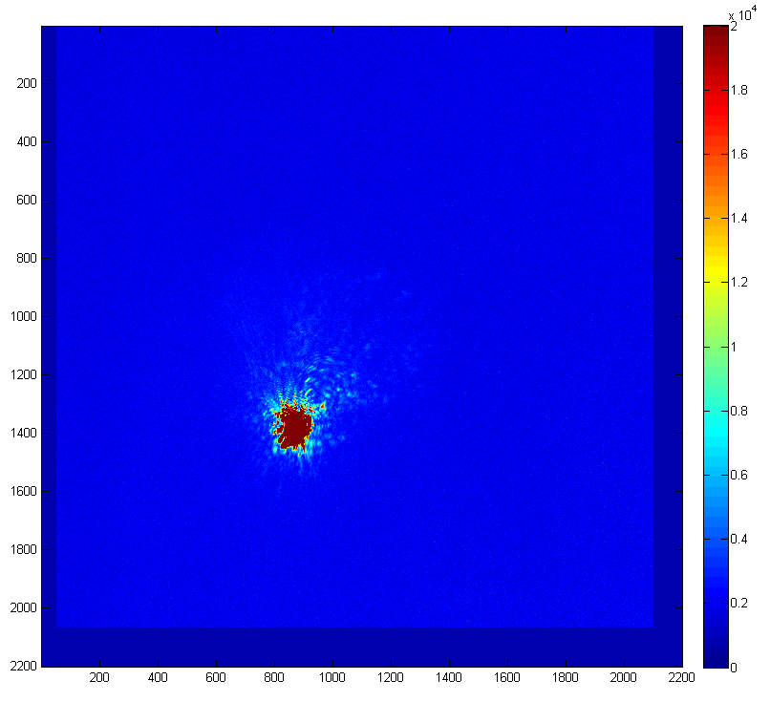
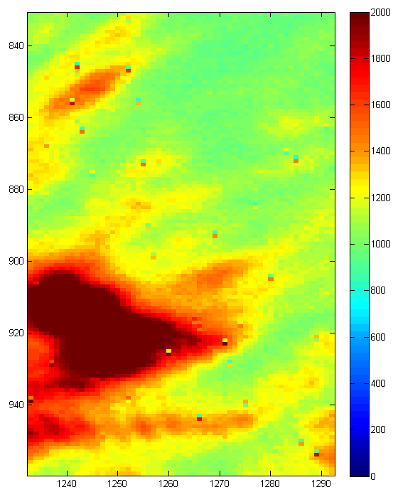
Clocked Anti Blooming (CAB)
Problems associated with such a technique is Clock Induced Charge (CIC) from the high field created by V+ and V- and Trap Pumping due to the dithering.
Astronomers do not want to see a large noisy background from the CIC, nor do they want to see dipoles everywhere (well only in calibration frames maybe)!
Good job we have four electrodes per pixel these days, so we can reduce the field strength and know how to optimise/de-optimise the pumping process – basically don’t dither too far!
Standard image
CABed image with large CIC background
Example of trap pumping diploes

Slide 20
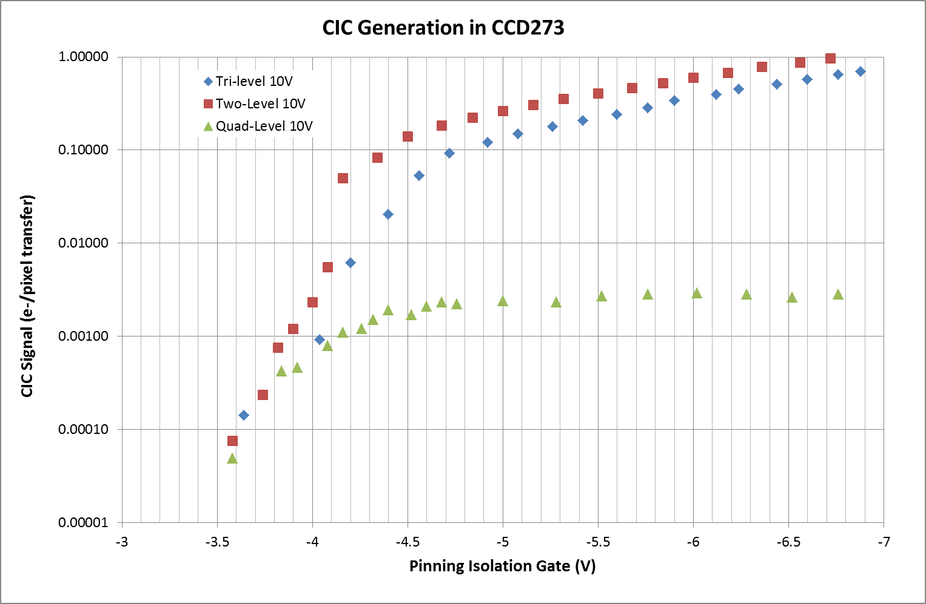
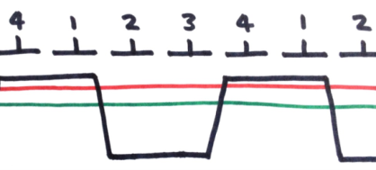
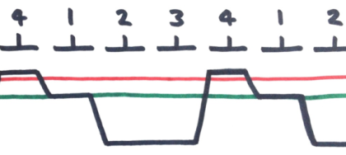
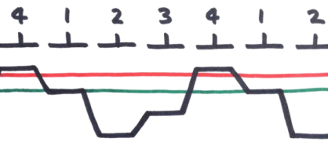

Comparison of CIC generation
Two-level
Three-level
Pinning regime
Quad-level
Neil Murray , 8860-20 26th August 2013

Slide 21
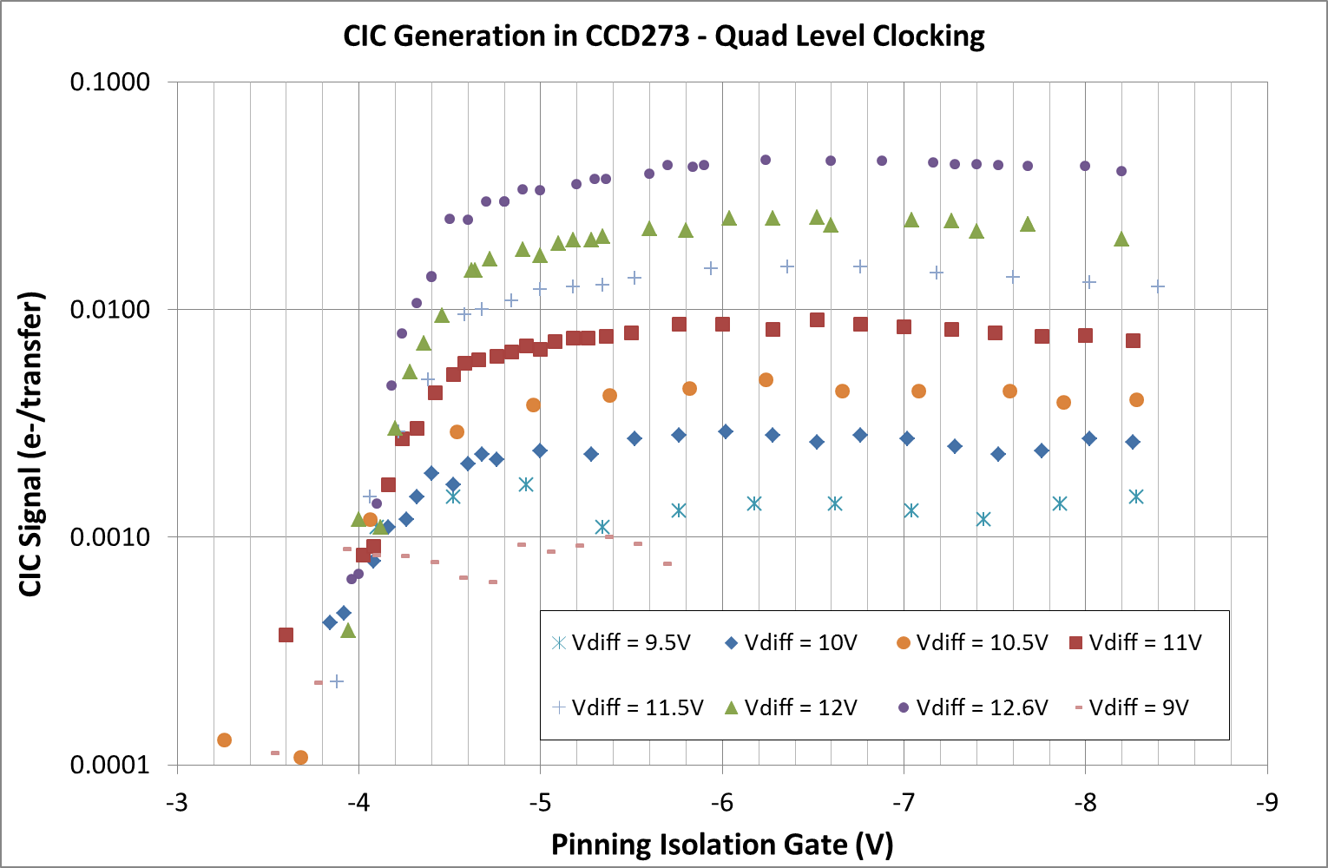
CIC Quad-level generation rates
Need to balance the degree of CAB against the amount of CIC which can be tolerated in the application
Stronger CAB
200 e⁻
per Euclid VIS frame
Pinning regime
20 e⁻
per Euclid VIS frame
2 e⁻
per Euclid VIS frame
0.2 e⁻
per Euclid VIS frame

Slide 22
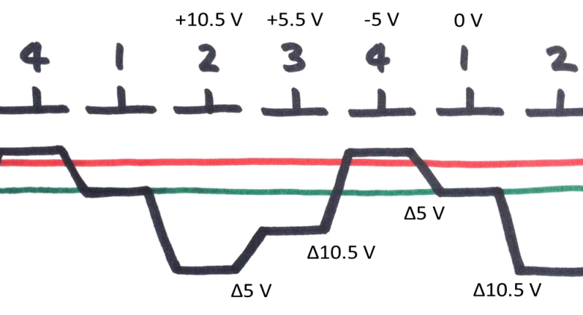
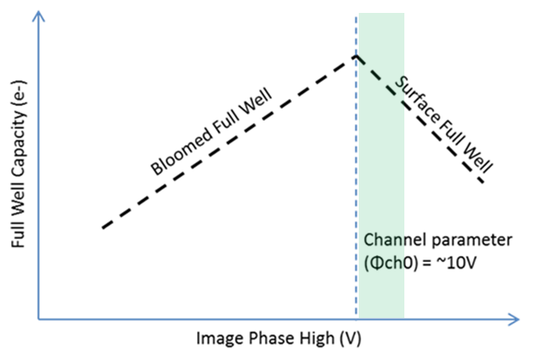
Quad-Level Clocking/CAB
Fourth level reduces the field strength between clock high and pinned gate
Want to operate in the surface full well regime to make use of surface traps (Image clock high >10 V)
Want isolation gate to be fully pinned (<-5 V) allowing all mid band traps available for anti-blooming

Slide 23
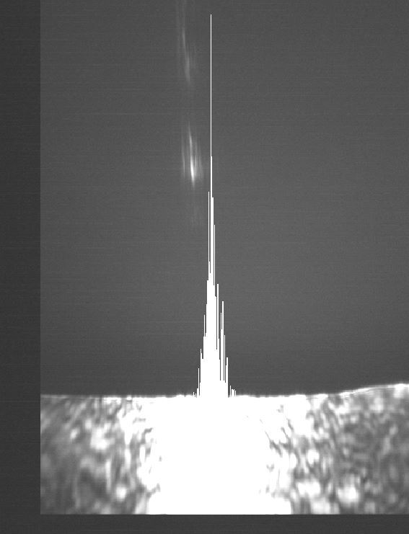
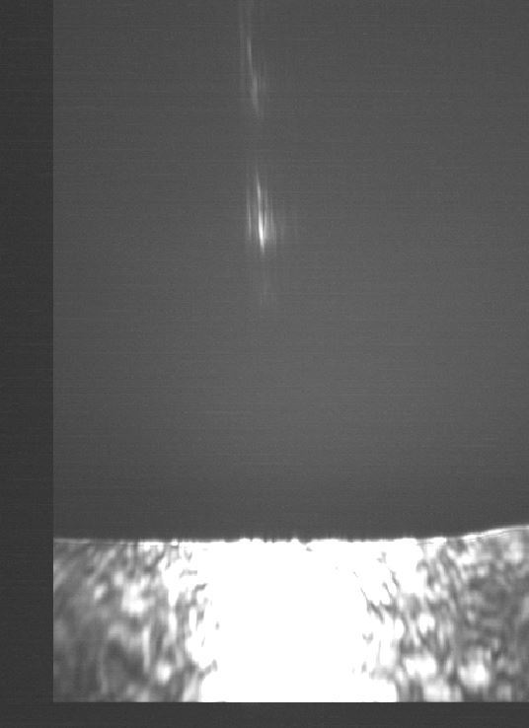
Quad-level CAB example
660 nm laser diode example on CCD273
~170 ke⁻/pixel/sec
Blooming observed without CAB – charge drains into the central charge injection structure
CAB at 40 µs per cycle
No blooming!
< 4 e⁻ CIC per frame (could be reduced, but at a cost to the anti-blooming rate)
No pumping – no dipoles
Without CAB
With CAB

Slide 24
Signal-Dependent Signal Re-Distribution
Modelling Charge Sharing
Charge sharing in CCDs can be simulated using semiconductor device simulation software (e.g. Silvaco) – simulated PSF shown
Silvaco includes drift and diffusion, and takes into account the changing potential of the collecting wells. Those are signal-independent and signal-dependent charge sharing components.
Experimentally single pixel PSF is not easy to measure due to vibrations, diffraction and focusing issues.
Modelling Charge Statistics
However, the drift/diffusion equations do not explain the statistics of the signal.
Non-linear, sub-Poisson variance routinely observed in thick, back-illuminated CCDs
This must be modelled using Monte Carlo techniques

Slide 25
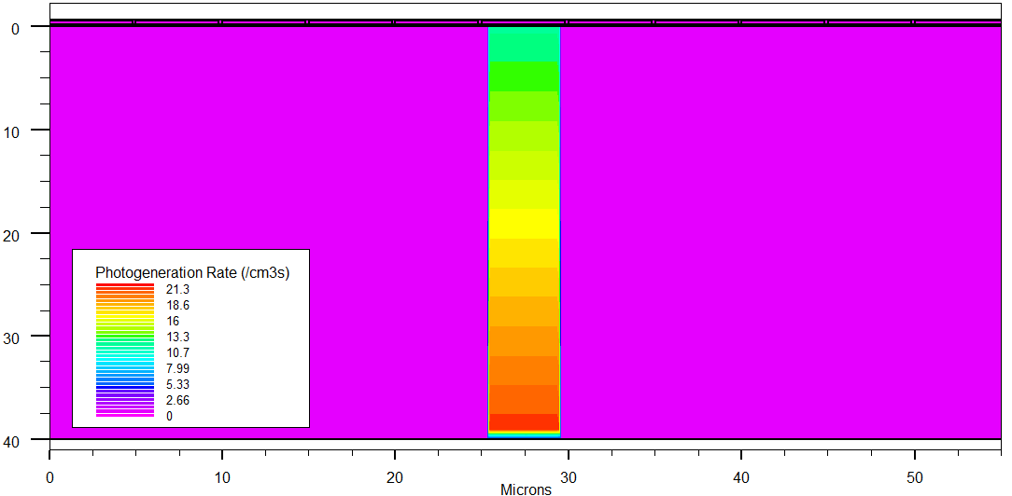
Point Spread Function – 2D simulation using Silvaco
Simulating 5 adjacent pixels using narrow light beam illumination from the back
  2D simulation (1 µm thick in the third dimension)
  10 µm pixels, 5 µm + 5 µm gates
  40 µm thickness
  Fully depleted
  Beam centred on a potential well
4 µm wide beam @ 600 nm
Simulation by Silvaco ATLAS in 2D : photogeneration

Slide 26
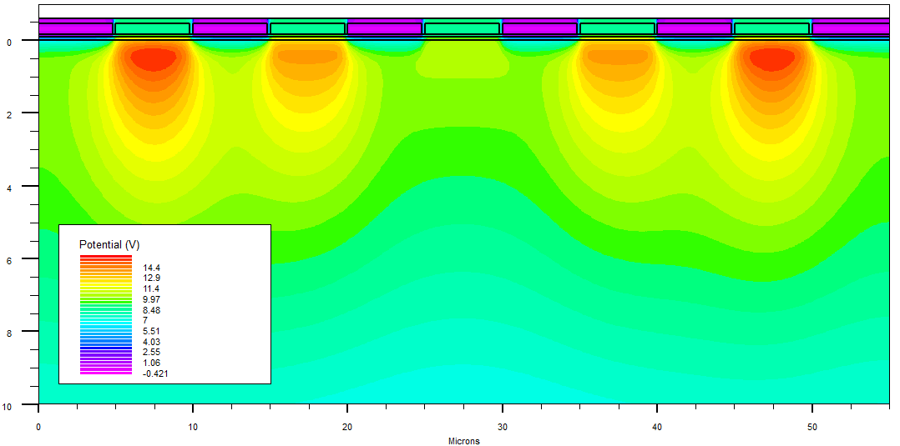
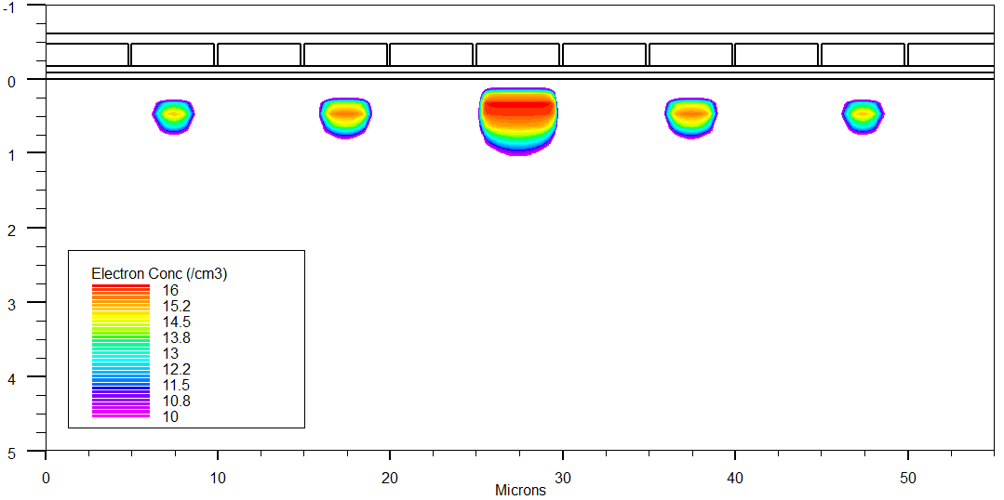
Silvaco Modelling Outputs
Electon Density
Shared charge

Slide 27
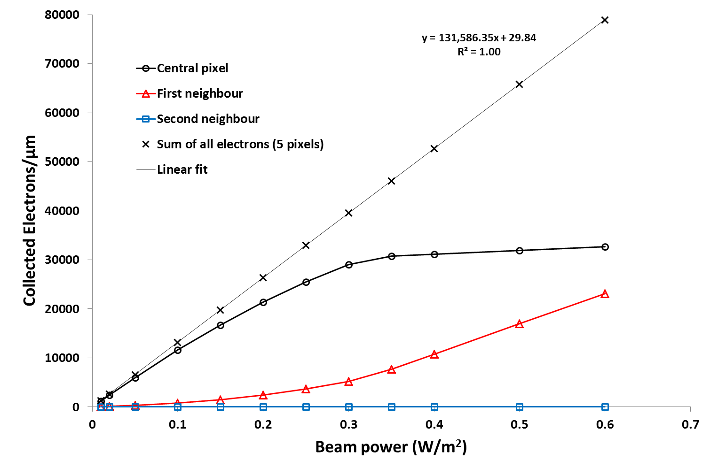
Charge Collection – Results
Full well capacity reached
“Blooming”
Charge sharing

Slide 28
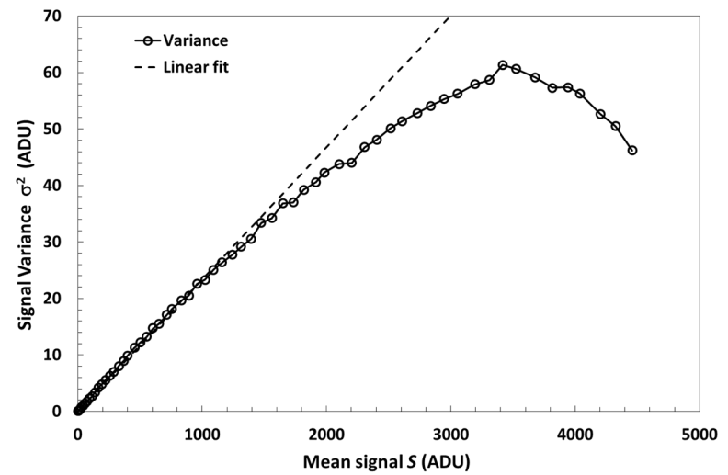
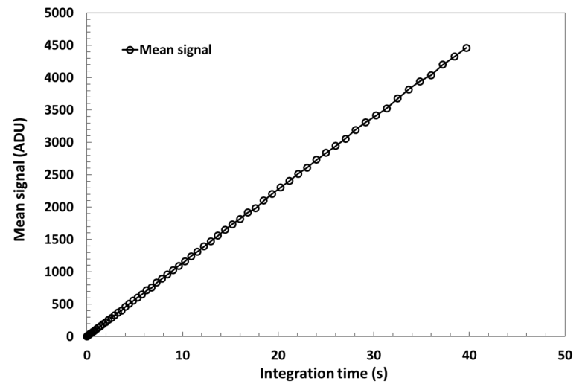
Non-Linear Signal Variance
3500 ADU
3500 ADU
Signal variance: not linear
Signal: linear to 0.2% (up to ≈120ke-)
Despite the CCD being very linear the variance vs signal is clearly non-linear in flat-filed illumination
  The effect gets stronger in thick, fully depleted devices;
  The effect occurs in the image area and has something to do with the charge collection.
  First reported by Mark Downing in 2006 (SPIE)

Slide 29
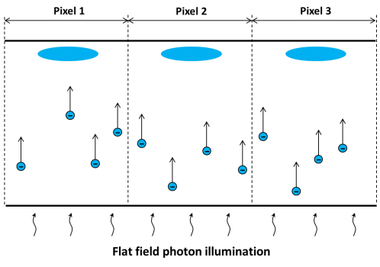
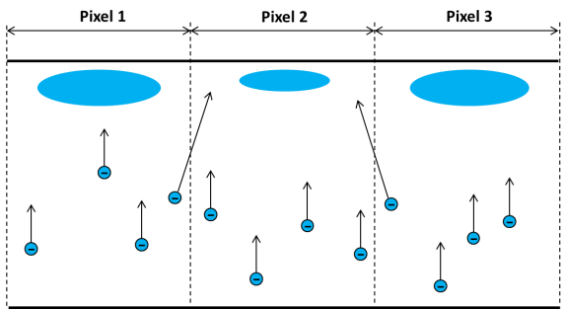

Signal-Dependent Charge Collection
Ideal charge collection – no sharing
Probability of electron sharing
Pixel 2 has fewer electrons than the neighbours – incoming electrons have slightly higher chance of going to Pixel 2.
Pixel 2 has more electrons than the neighbours – incoming electrons have slightly higher chance of going to the neighbour pixels.

Slide 30


Monte Carlo Model – Simulated Results
Probability of charge sharing:
Simulated data shows sub-Poisson variance, introduced by charge sharing.
Quadratic fit is a very good match:
$$Var=γS −νS^{2}$$
$$γ≈1$$

Slide 31

Experimental Data – Wavelength Dependence
= 1/Gain [e-/ADU]
Quadratic function is an excellent fit to the data
Data courtesy of Andrew Clarke, The Open University
Measured with BSI CCD204 (40 μm thick)

Slide 32

Experimental Data – Dependence on CCD thickness
Quadratic function is an excellent fit to the data
Data courtesy of Mark Downing, ESO

Slide 33
Dependencies and Implications
The PTC is more non-linear:
  At shorter wavelengths in BSI devices (longer electron path, higher chance of sharing)
  In thicker CCDs (longer electron path, higher chance of sharing)
  At lower electric fields (higher chance of sharing due to lower attraction to the wells)
The quadratic formula could be a better way to derive system gain from the PTC:
  All data up to full well can be used, there is no need to choose “linear-looking” part at low signals
In the CCD204 data:
  The gain difference between a linear fit to all points and the quadratic fit is 23%.
  The gain difference between linear fit to the first few points (almost linear PTC) and the quadratic fit is 8%.
A paper has been submitted to IEEE Transactions on Electron Devices – available soon
The effect should occur as signal from a PSF is generated producing PSF-distortion

Slide 34
Charge Redistribution Experiment
Ideally…
PSF only
PSF+Backbround
Spot only.
Spot, followed by a flat illumination (diffuse LED) – not to be confused with “flat fielding”.
Notes:
I decided to do the experiment more analytically myself using my spot and flat field illuminator.
<<explain image>>

Slide 35
Charge Redistribution Experiment
Ideally… However with charge redistribution
PSF only
PSF+Backbround
Frame 1 (Mean of 100)
Spot only.
Spot, followed by a flat illumination (diffuse LED) – not to be confused with “flat fielding”.
This is what should be observed in the event of charge spreading
Notes:
I decided to do the experiment more analytically myself using my spot and flat field illuminator.
<<explain image>>

Slide 36

Quick and Easy Demo of Large Signal Redistribution :
Line and Line+Flat Images
Generate a single line but illuminating a CCD, then dumping the image except 1 row, and move the single row back into the image
Provide a second flash on the image
Analyse the results…

Slide 37



Averaged Line Profiles
Peak with background is reduced by 1050 DN
Wings with background are increased by 500 DN
This result clearly demonstrates the charge
redistribution effect in the vicinity of filled
potential wells
This will affect PSF shape vs. signal size

Slide 38

Spot Measurements
Studies are underway into PSF measurements
Below: Average images of spots projected with increasing brightness.
Notes:
Using a conversion gain calculated with a flat field PTC from frame pairs, this spot plot attempts to estimate the charge distribution as the integration time is increased. Initially this data was recorded with the aim of generating a single pixel photon transfer curve, however vibration in the system caused smearing of the spots. The above spots are averages of spots lucky imaged to within 2%.
This was achieved using the spot projection optics and increasing numbers of LED pulses.
With greater illumination the spot appears to widen, before returning to vertical stretching as the pixel becomes close to full well.
This was interesting data and it provoked us to investigate why charge appears to be redistributed in such a manner. This coincides with work done by Mark Downing in 2006 where it was noted that as the illumination level is increased there is an apparent spreading of charge between pixels, resulting in a flattening of the PTC from shot noise, and this is more apparent, the thicker the device.

Slide 39
Conclusions
Understanding the subtle effects when using CCDs is far from complete
Radiation damage is still providing a wealth of new data leading to improved understanding and better correction techniques when in-orbit
Significant advances have been made in optimisation of clocking in the presence of radiation-induced traps; optimising clock periods and 3 and 4-level clocking
Clock induced charge (CIC) and Pocket pumping (PP) can be used to characterise traps in-orbit and to provide calibration signals for system gain measurements
Recently, theoretical understanding of non-linear PTC in thick back-illuminated CCDs has been achieved; with implications for using PTCs for gain calibration
Furthermore, the signal-dependent charge re-distribution can lead to distortions in PSF shapes which also need calibration
In future, p-channel CCDs may be more commonplace with enhanced radiation tolerance (requiring yet more characterisation and understanding…)

Slide 40






1,603 trap-pump examples on CIC backgrounds
Noisy, but pattern fixed by pixel geometry
Pumping and parallel shifting can be used to smooth out this noisy pattern
0 shifts
1,603 cycles
1 shift
2*801 cycles
3 shifts
4*,401 cycles
7 shifts
8*200 cycles
15 shifts
16*100 cycles
31 shifts
32*50 cycles

