Slide 1
Highlights Friday Oct. 11th, 2013

Slide 2
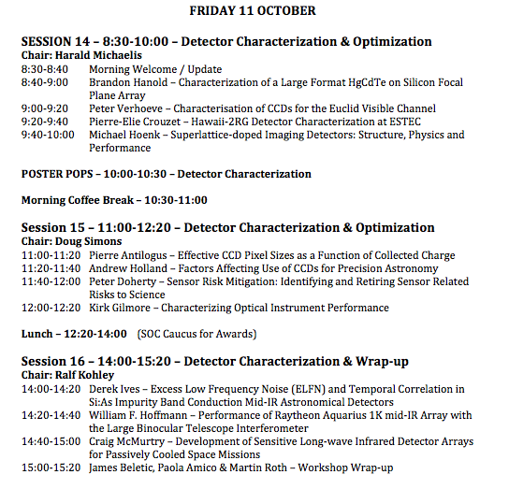
Moved to 15:20

Slide 3
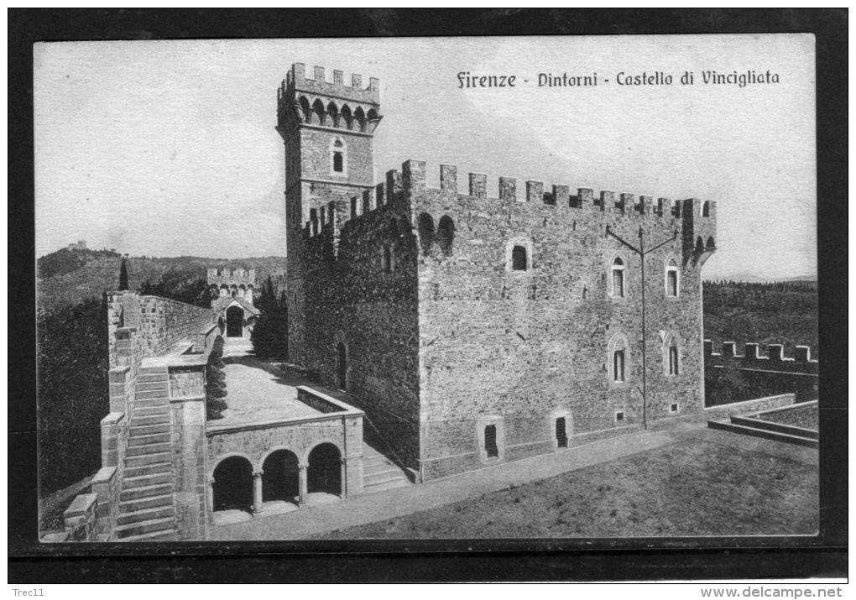
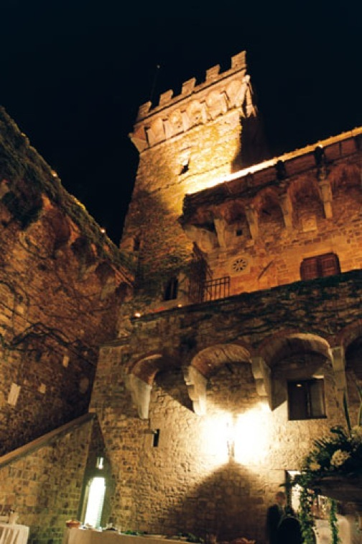
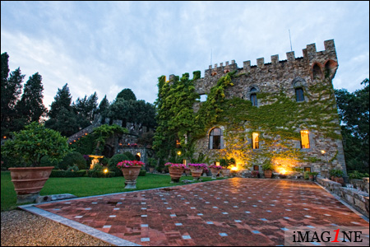
Gala Dinner
Venue: Castello di Vincigliata, Fiesole

Slide 4
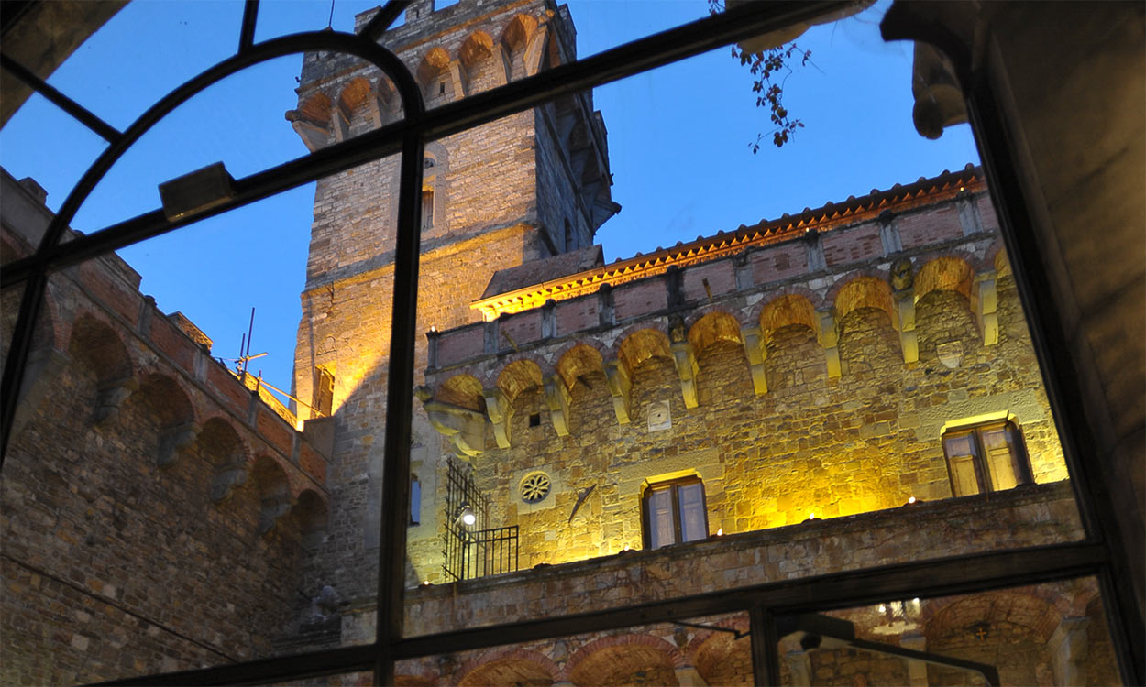
THE LEGEND:
Bianca was the daughter of the family who owned the castle.
She fell in love with the son of an arch-enemy family.
On the day of their wedding she climbed the tower to wait for the arrival of her beloved, but instead she saw him ambushed and killed by his own brothers.
Her heart broke and she dropped dead in her wedding gown.
To date, her ghost roams and moans in the castle (but she is said to protect all loves, especially the impossible ones)
THE HISTORY
Built in ~1000, (1013?)
Sold, lost at card games, destroyed in battles for 800 years
In 1840 acquired by a british lord’s family and restored to its original look.

Slide 5
LOGISTICS
17:00 Meet in the garden close to the main entrance (Piazza Adua)
Trip will take ~30 min
Get off at the castle’s entrance, which is on the main street → Be careful and quick!
18:00: Arrival and Aperitivo on the terrace
18:38: Watch sunset over Firenze (Jim ordered good weather…)
19:00: Gala Dinner
21:30-22:00 Buses will depart the castle

Slide 6
Speak Italian one gesture a day
Master Test for your Diploma in
Studies of Nonverbal Communications in
Italian language

Slide 7
Solution
E: Finisci!
P: What do you want?
E: I’m hungry, it’s time to go eat
P: At your place? Will we eat pasta?
E: Yes
P: mhh, good, let’s go.

