Slide 1

Lessons Learned from a Decade of SIDECAR ASIC Applications
Markus Loose
Oct 10, 2013
Scientific Detector Workshop, Florence, 2013

Slide 2
Outline
SIDECAR Overview
Preamps: desired and undesired consequences
A/D Conversion: the inside scoop
Bias Generation: to filter or not to filter
Cryogenic Peculiarities: the infamous LVDS receiver
Multi-ASIC Synchronization: how large can you go

Slide 3
SIDECAR Overview

Slide 4
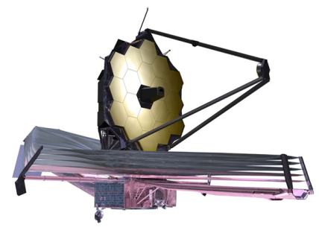
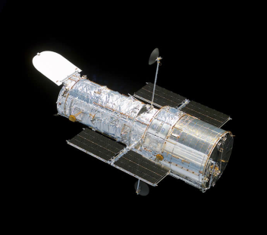
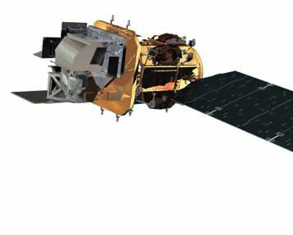
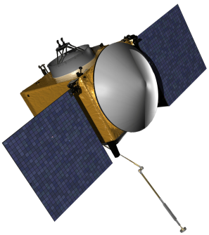
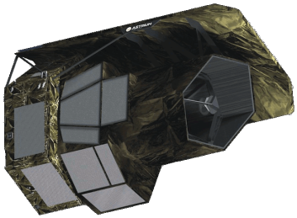
Missions Employing SIDECAR ASICs
James Webb Space Telescope
  NIRCam, NIRSpec, FGS/NIRISS instruments
  H2RG IR detectors, T = 38K (ASIC), planned launch in 2018
Hubble Space Telescope
  ACS (Advanced Camera for Surveys)
  CCD detector, T = 300K (ASIC), launched in 2009
Landsat Data Continuity Mission
  TIRS (Thermal InfraRed Sensor) instrument
  QWIP detector, T = 300K (ASIC), launched in 2013
OSIRIS-REx Asteroid Mission
  OVIRS (OSIRIS-REx Visible and IR Spectrometer) instrument
  H1RG IR detector, T = 300K (ASIC), planned launch in 2016
Euclid Mission
  NISP (Near IR Spectrometer Photometer) instrument
  H2RG IR detector, T = ~140K (ASIC), planned launch in 2020
MOSFIRE (Multi-Object Spectrometer For Infra-Red Exploration)
  H2RG IR detector, T < 120K (ASIC), deployed at the Keck Telescope
FourStar Wide Field Infrared Camera
  H2RG IR detector, T < 120K (ASIC), deployed at the Magellan Baade 6.5m Telescope
JWST
LDCM
HST
OSIRIS-REx
Euclid

Slide 5
PreAmp Operation
Preamp is a fully differential amplifier with capacitive feedback
  Provides programmable gain (change in capacitor value)
  Provides high impedance wide input range from rail to rail (even beyond rail)
  Downside: requires period resetting of capacitors to counteract leakage currents
Simplified Preamp Diagram
Inputs
C2
V1
C1
V3
+
to ADC
V4
-
V2
C1
C2

Slide 6
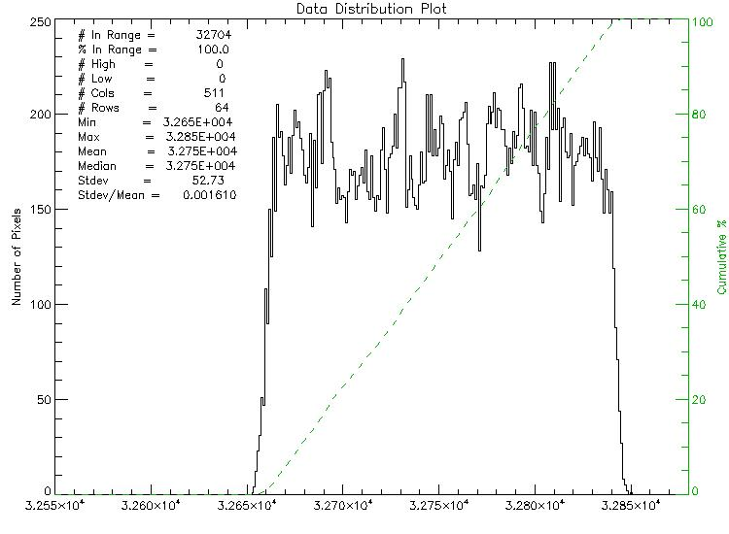

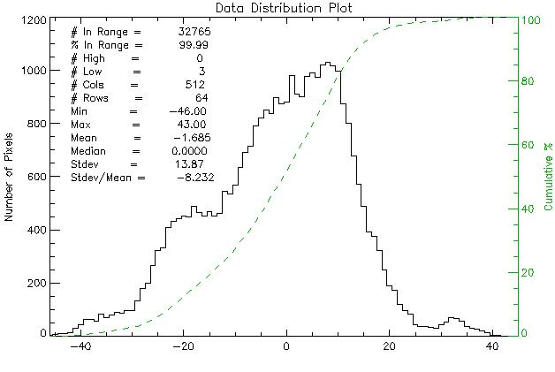

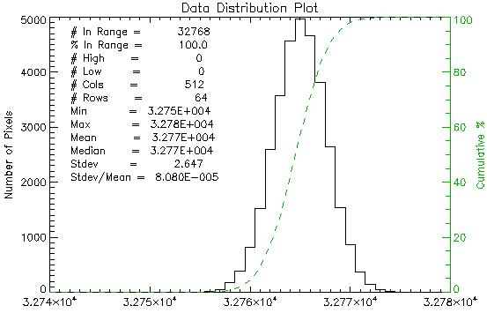

PreAmp Drift in Different Operating Modes
Preamp set to gain of 4, shorted inputs
Room temperature drift
No preamp reset
σ= 52 ADU
Preamp reset per row:
kTC noise dominates
σ= 13.9 ADU
Cryo performance or kTC removal mode at room temperature
σ= 2.6 ADU

Slide 7







PreAmp + ADC Noise Measurements
PreAmp inputs shorted to ground
Noise measured as a function of gain
White noise up to the highest gain (different scaling for each picture on the left)
Gain = 1 (0dB)
Gain = 2 (6dB)
Output and input referred noise as a function of gain
Gain = 4 (12dB)
Gain = 5.6 (15dB)
ADC noise limited
Gain = 8 (18dB)
PreAmp noise limited
Gain = 11.3 (21dB)
Gain = 16 (24dB)
kTC noise removed:σ= 2.7 ADU
Gain = 22.6 (27dB)

Slide 8
16-bit ADC Linearity
DNL
INL
DNL [ LSB ]
INL [ LSB ]
Output Code
Differential Non-Linearity: < ± 0.3 LSB
Integral Non-Linearity: < ± 0.2 LSB
Temporal Noise: 2.7 LSB
Output Code

Slide 9
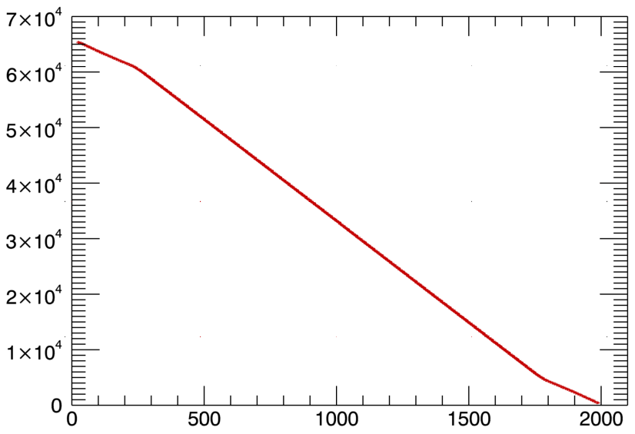
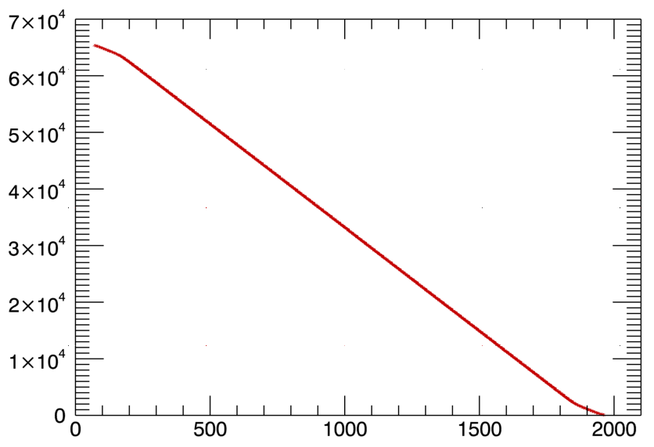
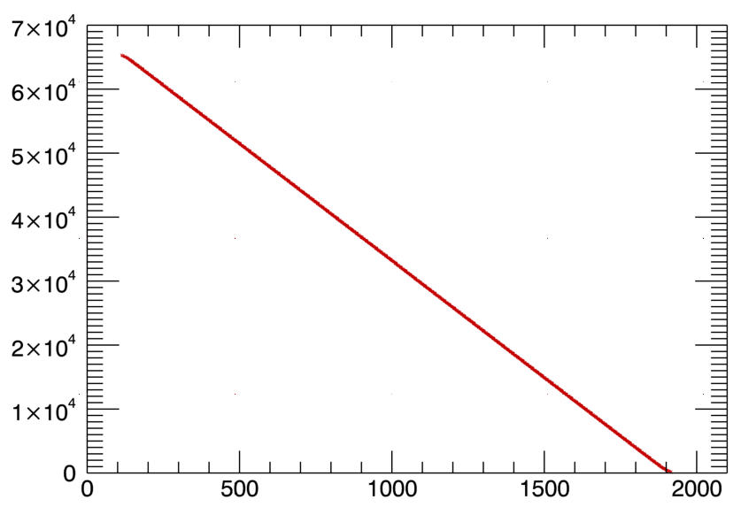
ADC Linearity Pitfalls
Differential ADC is composed of 2 separate single-ended ADCs
  If one of the two ADCs saturates before the second one does, the transfer slope changes by 2
Slope change
Slope change
Vcm off by 160 mV
Vcm off by 80 mV
Requires careful adjustment of the ADC reference and common mode voltages
Simultaneous optimal tuning for all channels does not exist due to component mismatch
  Avoid lower and upper end of ADC for science
Optimal Vcm

Slide 10
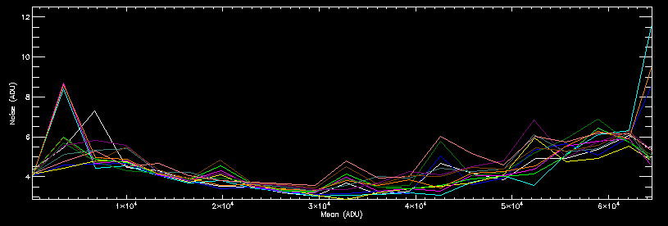
Offset Dependent ADC Noise
ADCs can show “noise hotspots” that are caused by incomplete amplifier settling or mis-tuned common mode voltage settings
  These hot spots are tricky to detect because they may only occur at a few ADU levels
  Susceptibility increases for higher sampling rates, limits the maximum ADC speed to about 400 kHz
Hot spot locations vary between ADC channels due to component mismatch
Optimized tuning for the specific mode of operation and the specific part may be required to completely eliminate the hot spots.
ADC noise as a function of ADU Level, 500kHz sample rate
12 different channels of the same ASIC are shown

Slide 11


Noise Characteristic of the Bias Output Voltages
Bias output routed back into PreAmp
PreAmp gain set to 22 (27 dB)
Use 4 ADCs in parallel to reduce PreAmp & ADC noise
Noise on bias without filtering is about 35µV (11.6 ADU)
Noise can be reduced by RC filtering to less than 5µV
Unfiltered Noise of Bias Output
Bias noise as a function of RC filter time constant
Filtered Noise of Bias Output (t_{RC} = 360 ms)
PreAmp & ADC noise floor

Slide 12
Filtering Limitations
Bias and reference voltage filtering is important, but it is not the “cure all” solution.
  Simple RC filters lead to high output impedance, i.e. not suitable for current carrying biases
  Low frequency 1/f noise cannot be effectively filtered
Tuning of programmable bias generator settings can help (opamp bandwidth, compensation capacitors, opamp mode, etc.)
Bias noise mitigation can be applied during readout or in post-processing
  Differential readout to subtract reference output from signal output
  IRS^2 Mode (Improved Reference Sampling and Subtraction) investigated by JWST for noise improvements on the NIRSpec instrument
External active filters can be used to provide low output impedance
  Necessary for SIDECAR-internal references when using kTC removal mode
  Optional for detector biases

Slide 13
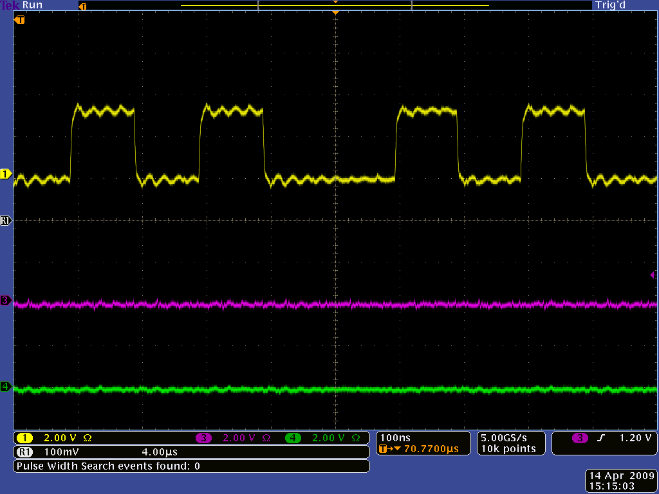
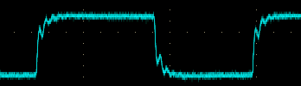
LVDS Receiver Concern
Yellow trace (= serial data out) should toggle with every falling edge of the blue trace (ext. LVDS data clock in).
LVDS clock (n-side)
Vcm = 0.75V
Serial Data out
Missing toggle in data bit indicates missed clock pulse inside the SIDECAR ASIC

Slide 14
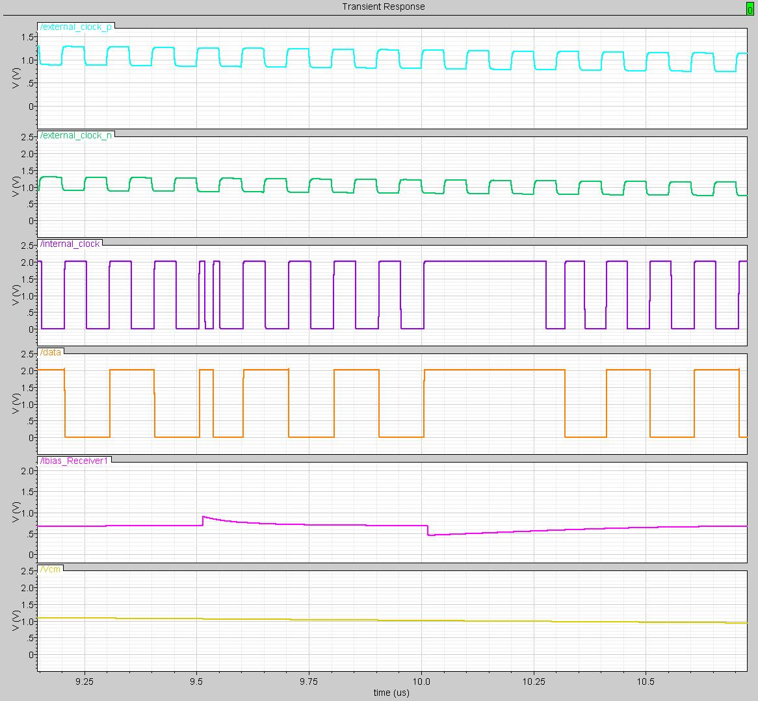
Simulation of LVDS Receiver
LVDS clock (p-side)
LVDS clock (n-side)
Detected clock (int.)
Flip Flop Data
Double clock detected
Two clock cycles missing
Receiver bias
Positive kick
Negative kick
LVDS common mode
Vcm = ~1.05V

Slide 15
Mitigation for LVDS Receiver Concern
LVDS receiver is most robust for a common mode voltage in the range of 1.6V to 2.0V
  Raise nominal LVDS common mode voltage from 1.2V to 1.8V
LVDS dropouts are caused by charge injection into the internal bias line
  Minimize charge injection by imposing restrictions on the assembly code
Use CMOS receiver and CMOS level signal transmission for clock / data to SIDECAR ASIC
  No clock drop-out issue, independent of temperature
  Attention has to be given to signal termination
Comments:
  The LVDS receiver issue is temperature dependent (more severe at cryogenic temperatures than at room temperature)
  Teledyne is working on updated SIDECAR ASIC that eliminates the issue

Slide 16
Multi-ASIC Synchronization
When using multiple ASICs in the same system, synchronization of detector clocking and pixel synchronization becomes critical
  Running detectors synchronously reduces noise crosstalk issues
  Synchronization requires:
    Identical master clocks for all ASICs
    Perform the identical actions inside all ASICs to provide synchronous clocking to the detectors
    Start exposures synchronously
  ASICs have to be resynchronized periodically to mitigate possible loss of synchronization by events like clock glitches or asynchronous commanding activities
Control Electronics
clk
cmd
clk
cmd
clk
cmd
clk
cmd
SIDECAR 1
SIDECAR 2
SIDECAR 3
SIDECAR 4
Detector
Detector
Detector
Detector

Slide 17
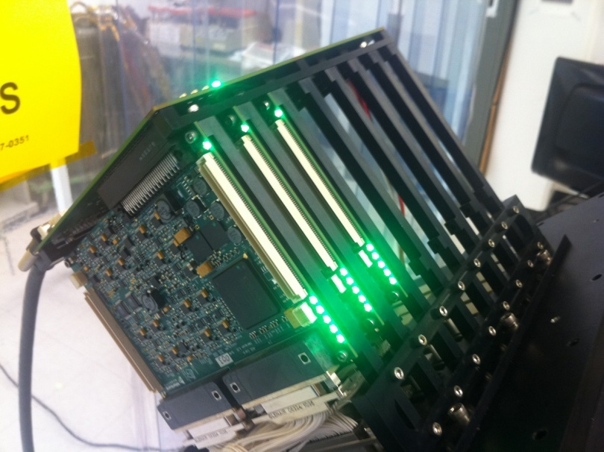
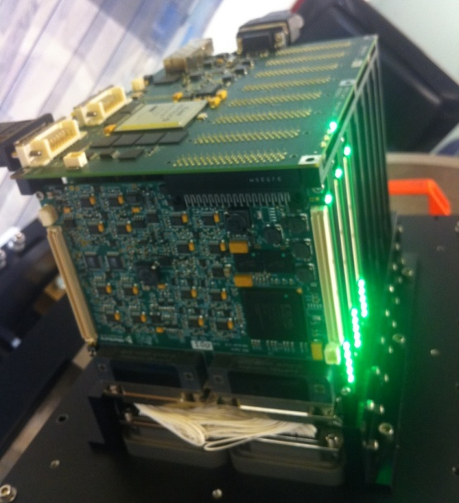
Multi-ASIC Control Electronics
Operates up to 32 SIDECAR ASICs and detectors in parallel
Performs synchronization and simultaneous data acquisition
Supports data rates of up to 5.4 Gbit/s (full mode CameraLink)

Slide 18
Summary
Over the course of the last decade, the SIDECAR ASIC has been successfully integrated in a variety of different instruments and space missions
Valuable lessons have been learned with respect to operation and performance
  How to best configure and operate the preamps to mitigate drift and kTC noise
  How to tune the ADC to provide best possible linearity and noise performance
  How to mitigate noise on the bias and reference voltages
  How to deal with clock issues caused by the LVDS receiver
  How to operate and synchronize large arrays of ASICs and detectors
Lessons learned will help in building and planning future applications, and have created ideas/desires for next generation ASICs

