Slide 1



The KMTNet 340 Megapixel focal planes
Paul Jorden
7 Oct 2013
Scientific Detector Workshop, Florence
Co-authors
Bruce Atwood, Tom O’Brien, Mark O Johnson, Jerry Mason, Dan Pappalardo. OSU
Isobel Crockford, Steve Darby, Tim Eaton, Ryan Renshaw, Ian Swindells, Alex Walker, Patrick Wheeler. e2v

Slide 2
Introduction
Korea Micro-lensing Telescope Network (KMTN)- focal planes
Three 1.6-m southern-hemisphere telescopes.
Continuous monitoring of micro-lensing events in the galactic bulge.
Each telescope equipped with a 340 megapixel camera.
OSU designs and builds the three cameras with electronics
e2v designs and builds the three focal planes with sensors
Custom-designed precision cryogenic detector mounting plates
Optimised custom sensors

Slide 3
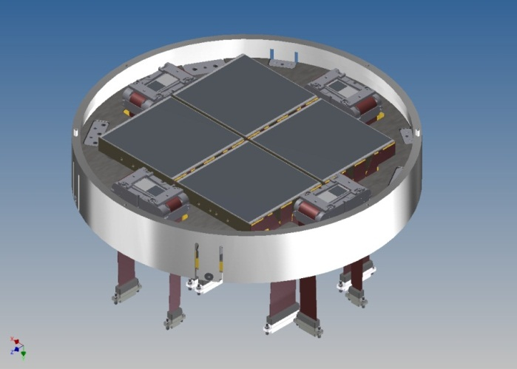
Contents
CONTENTS
KMTN project
CCD camera overview
Plate design and layout
FEA modelling of plate
Science sensors
Guide sensors
Plate assembly
Status
Summary

Slide 4
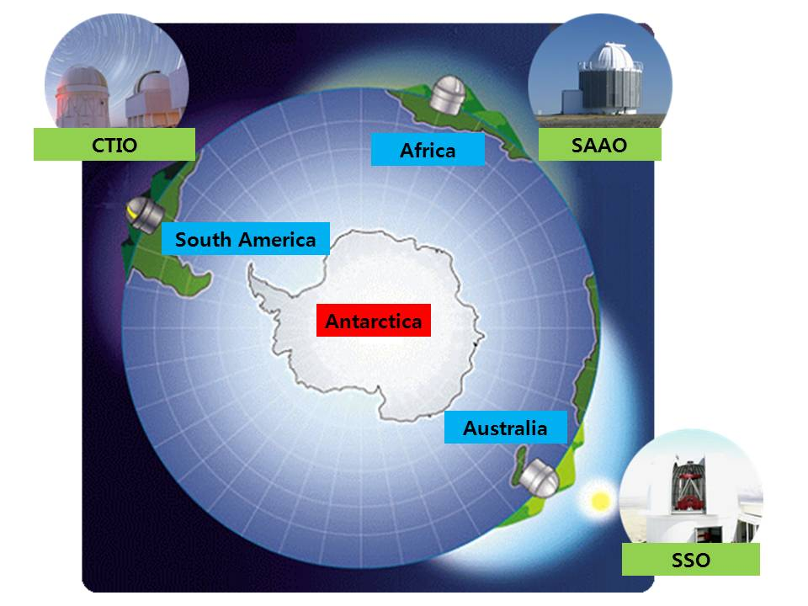
The Korea Microlensing Telescope Network
Discovering extrasolar planets using microlensing
Planet searches with microlensing have mostly been done with wide field surveys to find candidates and then follow-up observations with a heterogeneous data set to get the required temporal coverage.
KMTNet will have one primary data set covering 16 square degrees.
Continuous 24 hour coverage of >100 million objects in the galactic bulge. Light curves for objects down to magnitude 20.
Southern Hemisphere KMTNet sites:
Cerro Tololo Inter-American Observatory
South African Astronomical Observatory
Siding Springs Observatory
Three 1.6m telescopes
Each with a 340 megapixel camera
e2v sensors → OSU cameras

Slide 5
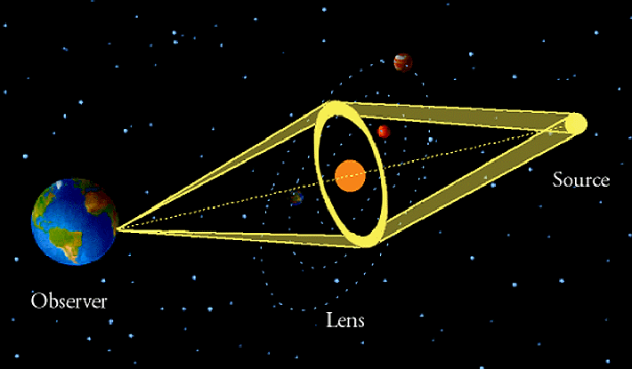
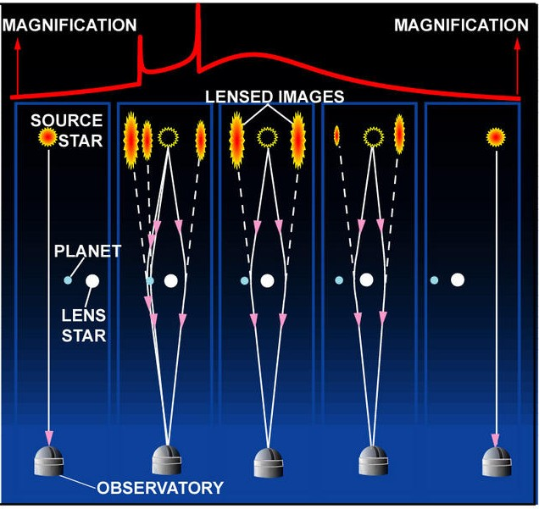
The Korea Microlensing Telescope Network
The microlensing technique
Matter in nearby object bends light (gravitational lens) of distant source
Source is magnified and extrasolar planets can be detected.
KMTNet measures light curves to detect planets efficiently.
Planetary systems and variable objects explored.

Slide 6

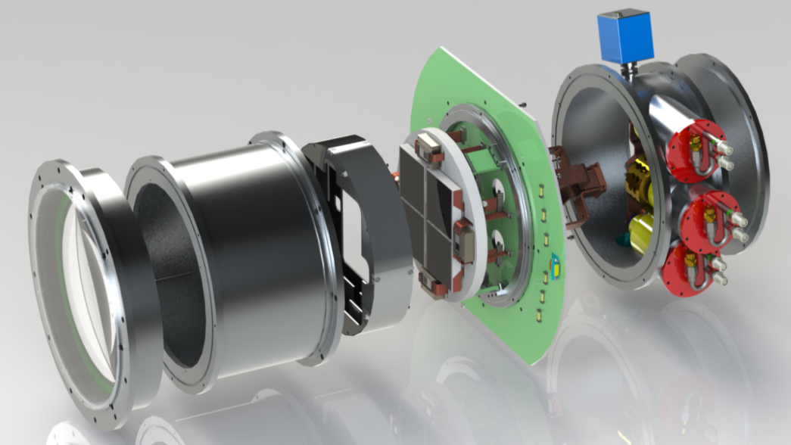
CCD Camera overview
Cryogenic focal plane assembly
Four 9k x 9k Science CCDs
Four 1k x 1k FT Guide CCDs
Closed Cycle Cooling System
e2v detector mounting plate
OSU cryogenic camera

Slide 7
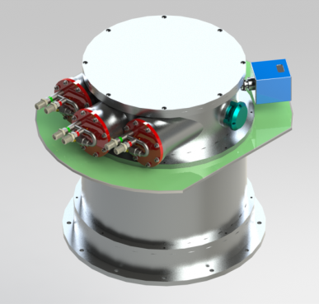
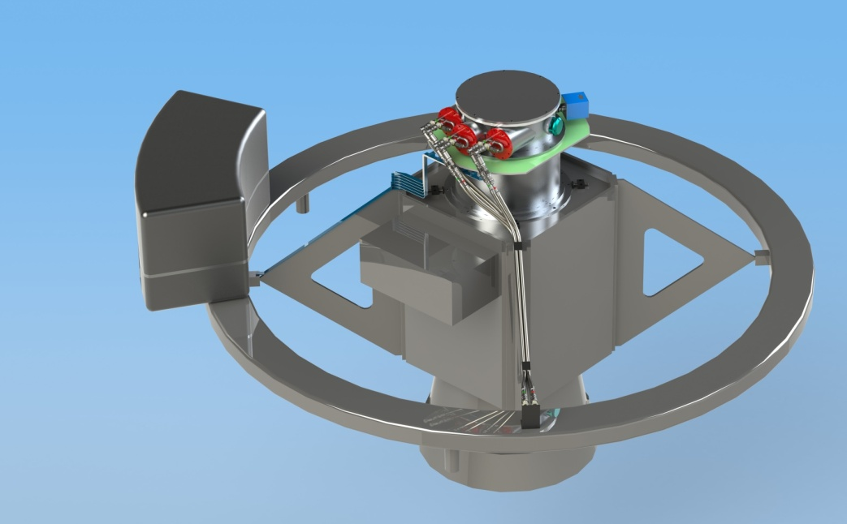
CCD Camera overview
OSU Camera System
4 Element Prime Focus Corrector
Closed Cycle Cooling System
Three systems under construction
Camera at prime focus

Slide 8
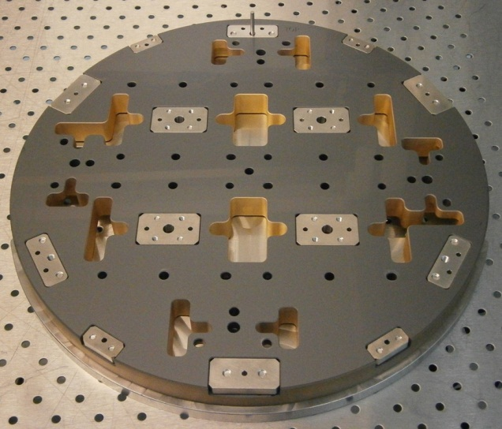
Detector Mounting Plate (DMP) Design
Key Features
Material: Silicon Carbide
Size: 320mm diameter x 20mm thick
Low emissivity gold sputtered on lower surface and side walls
Mounting holes/plates for science sensors
Mounting holes/plates for guide sensors
Provision for guide rods and support of flex-cables
Features to facilitate device assembly
Annular side ring for protection
Provision for temporary glass cover during handling
Mounting fixtures for plate heaters
Mounting fixtures for temperature sensors
Fixtures for cold strap attachment
Fixtures for plate mechanical fixing to camera
Provision for retention in handling ring during assembly
Plate with Invar fixtures

Slide 9
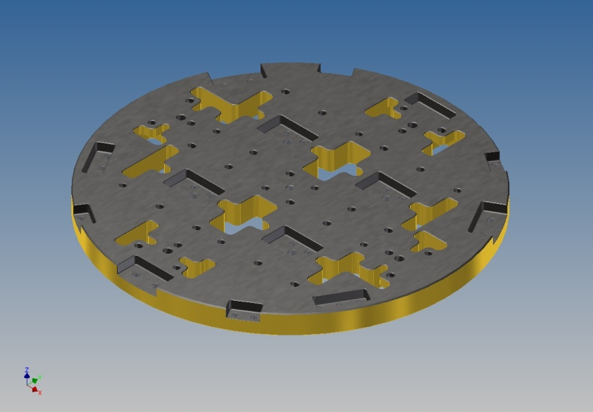
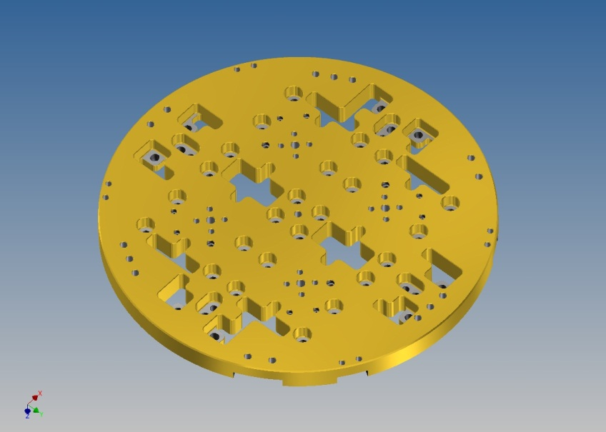
Detector Mounting Plate (DMP) Design
Finish: Lapped to within 5µm flatness on top and bottom faces, and 50µm parallelism
Features on top surface:
  Holes to control alignment of devices
  Pockets to retain Invar plates used to assemble components
Features on bottom surface:
  Blind holes to accept Invar threaded inserts to assemble components
  Pockets to allow clearance around device assembly fasteners
Other Features:
  Slots to allow access of Flexi Connectors and assembly tools
  Holes to allow access of device handling tools
  Clearance holes for component assembly screws
Top and lower plate views

Slide 10
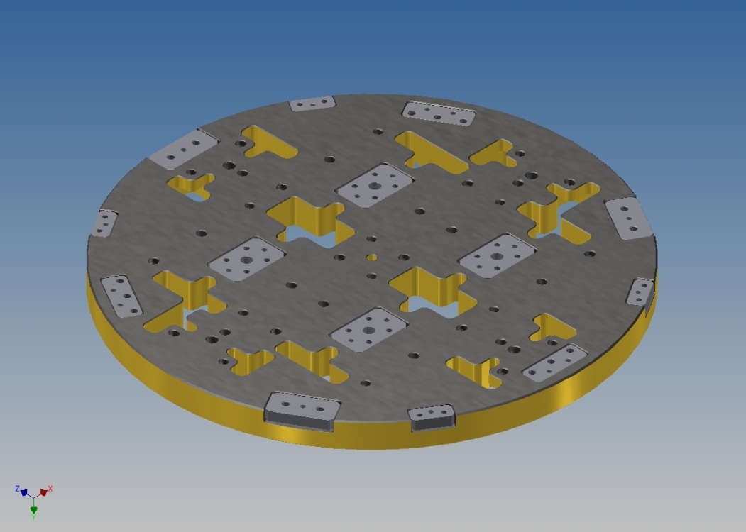
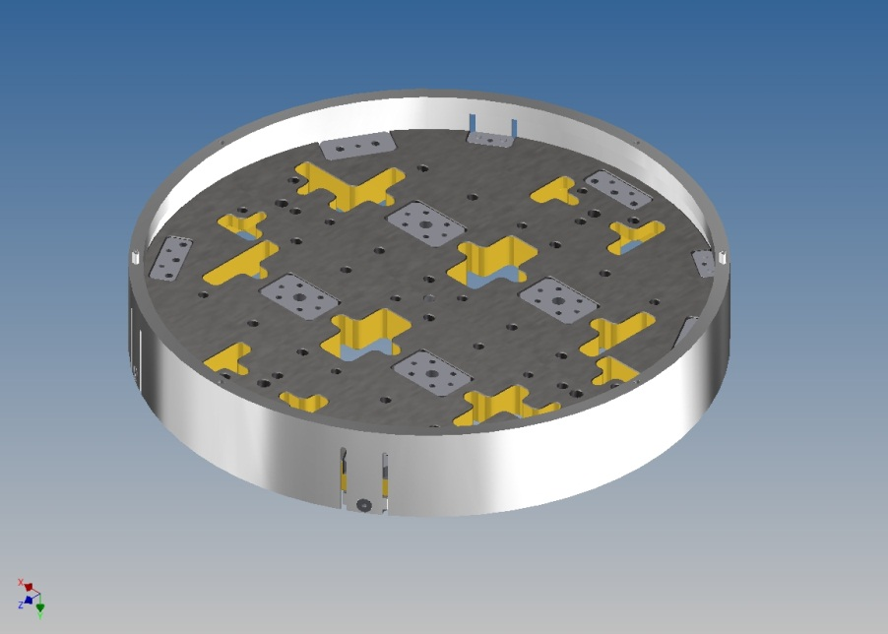
Detector Mounting Plate (DMP) Design
DMP with Invar parts attached
Invar plates are used to assemble:
  Protection Ring assembly
  Support Jig during device assembly
  Copper Heat Blocks (for OSU)
  Support Web Assemblies (for OSU)
  Thermal Resistors (for OSU)
  Temperature Sensors (for OSU)
DMP with Protection Ring attached

Slide 11
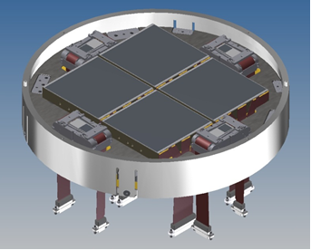
DMP layout
Four CCD290-99 Image Sensors; 92.16 x 92.32 mm image area each
Specified dead space between science image sensor areas <34 cm² (90% fill factor); 93% achieved
Four CCD47-20 Guide Sensors; 13.32 x 13.33 mm image area each; centre-lines of image areas align with centre-lines of Detector Mounting Plate ± 0.45 mm
Each Sensor’s image area is 20.00 mm above the plate mounting surface
The flatness of all image surfaces fall within a peak to valley range of 40 µm

Slide 12
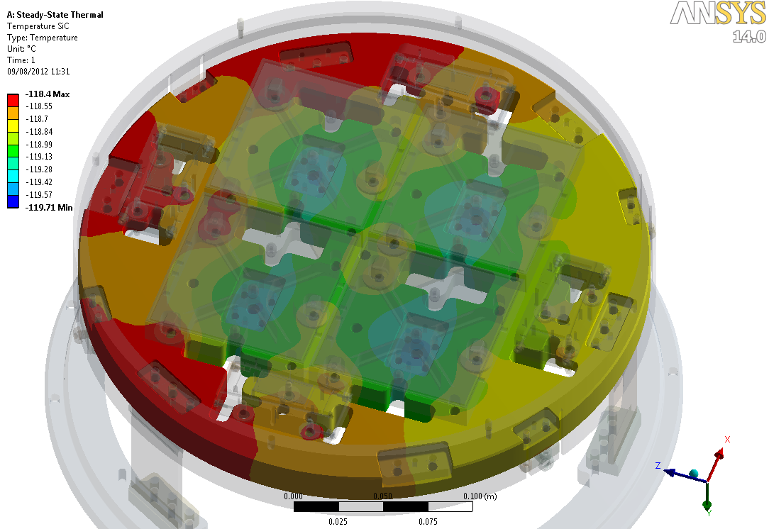
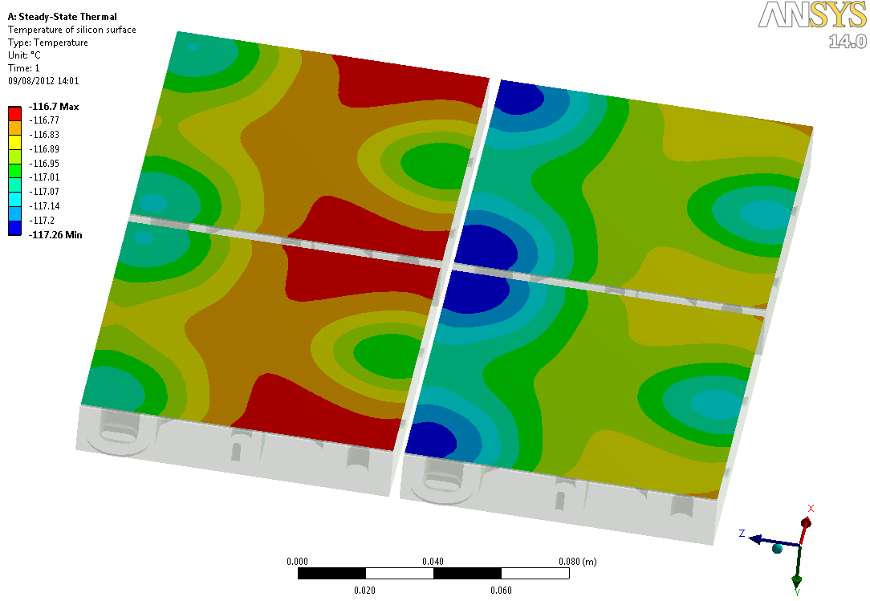
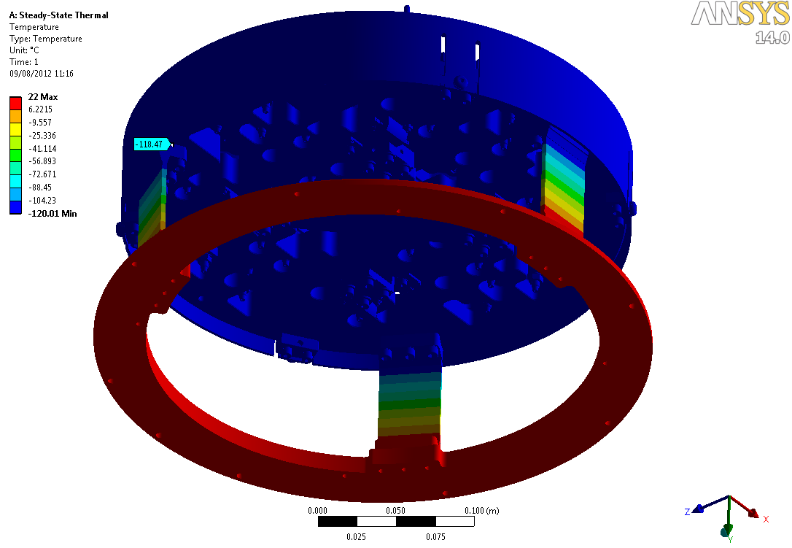
DMP FEA modelling
Temperature plots obtained through thermal analysis
G10 struts used to insulate plate from warm cryostat mounting ring
The entire plate has a temperature delta of 1.3K (analysis includes radiation heat input)
Temperature of the CCD devices can be studied with particular focus on the image areas

Slide 13
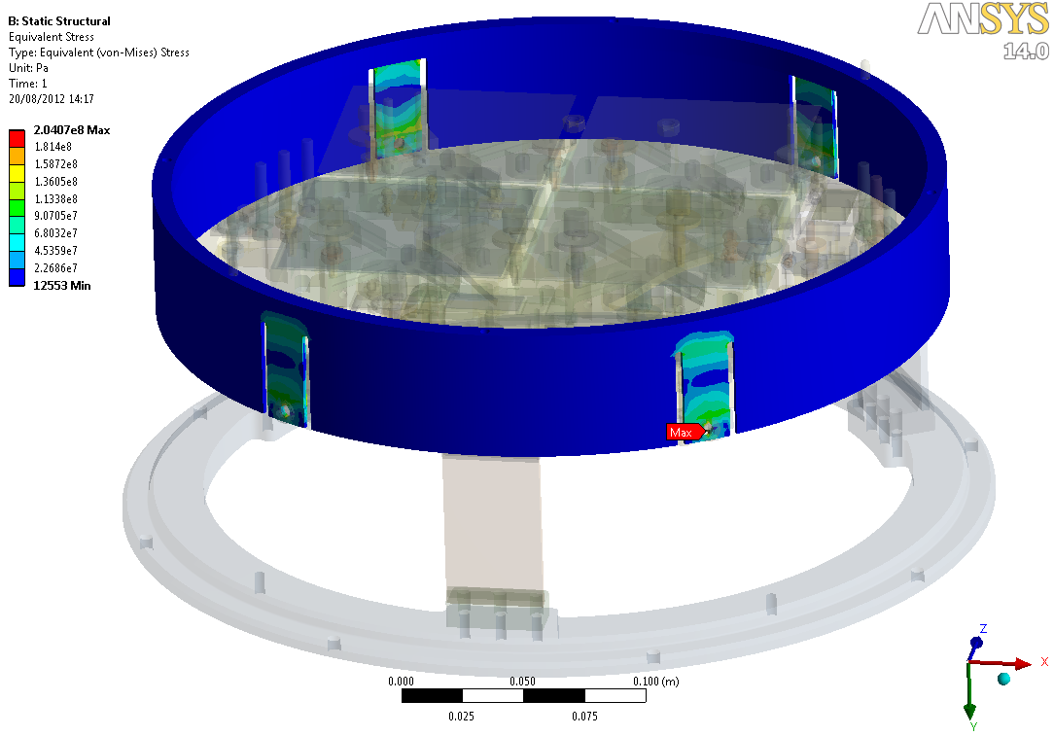
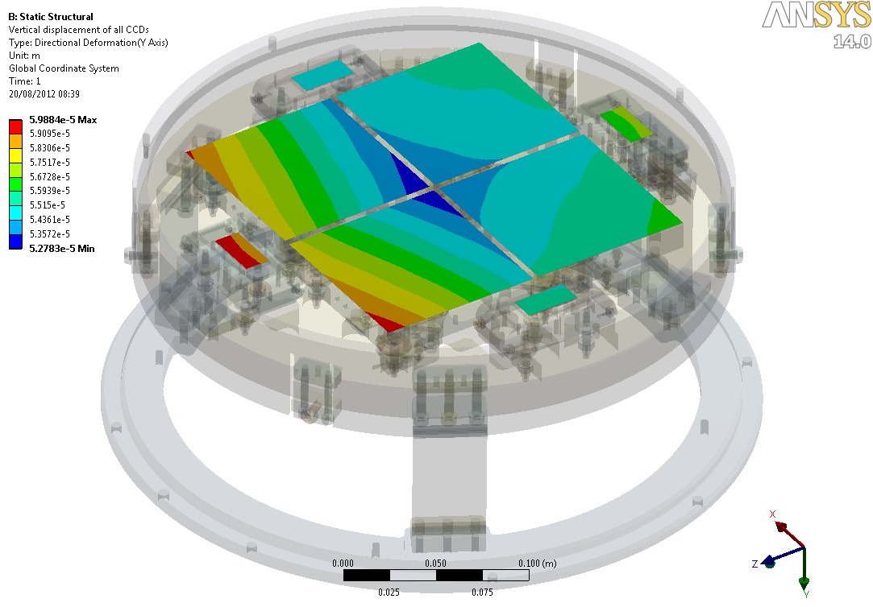
DMP FEA modelling
Thermal results are fed into the structural analysis to deduce stresses and non-flatness of the array
The Al alloy protective ring and the G10 struts were engineered so that the thermal expansion mis-match of the ring and the mounting plane had a minimal effect on the flatness of the plate.
Non-flatness of the entire CCD array due to thermal contraction is predicted to be 7.1 µm

Slide 14
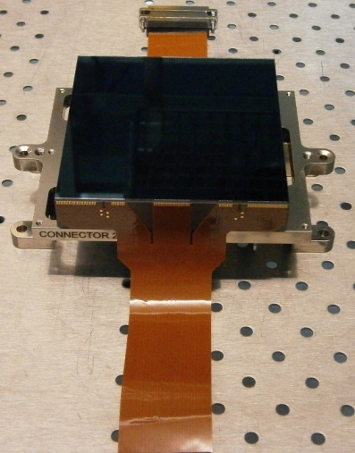
Science CCD sensors
CCD290-99
Non-inverted, Full frame, Deep depletion, Astro multi-2
Silicon Carbide package (20.0 mm height)
Flexi-cables; two 51W micro-D connectors
9216 X 9232 10 µm pixel image area
16 outputs for low readout time
CCD290-99 replace?
Device Architecture

Slide 15
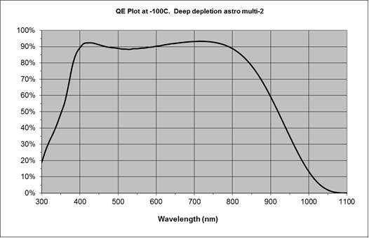
Science CCD sensors
>90% Peak QE; wide spectral range
< 5 e- Read-noise at 500 kHz
Differential outputs available
Low output impedance
>99.9990% CTE
40 µm flatness; precision height package

Slide 16
Guide CCD sensors
CCD47-20
  Non-inverted, frame transfer (with store shield), deep depletion, astro multi-2
  Established device type; customised for this focal plane application
  Custom Invar package (20.0 mm precision height including shims)
  Custom flexi-cables; two micro-D connectors
  1024 X 1024 13 µm pixel image area
  Same Spectral response as science sensors
Device Architecture; ignore pin numbers

Slide 17
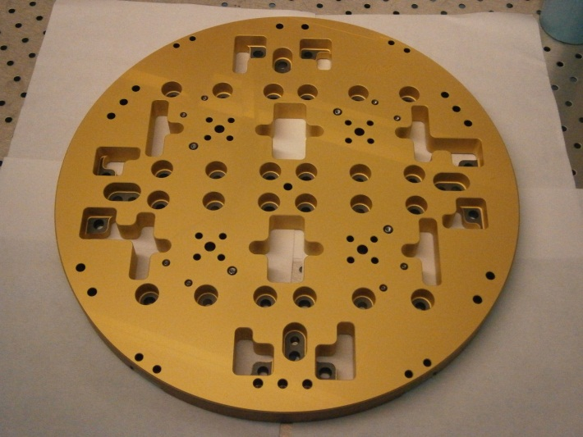
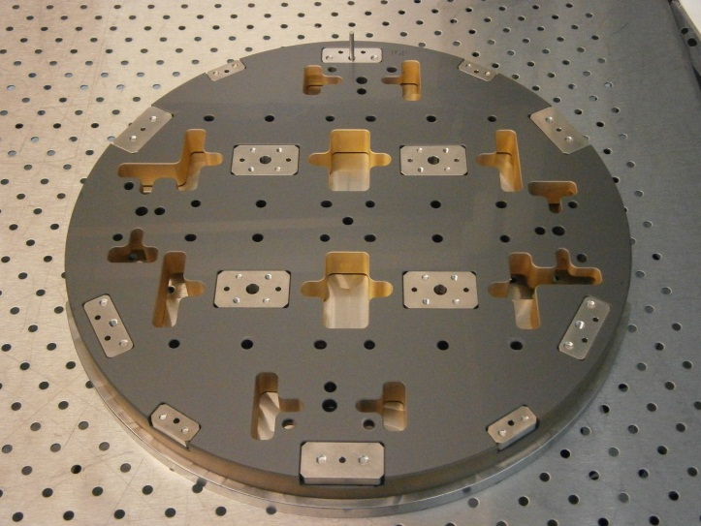
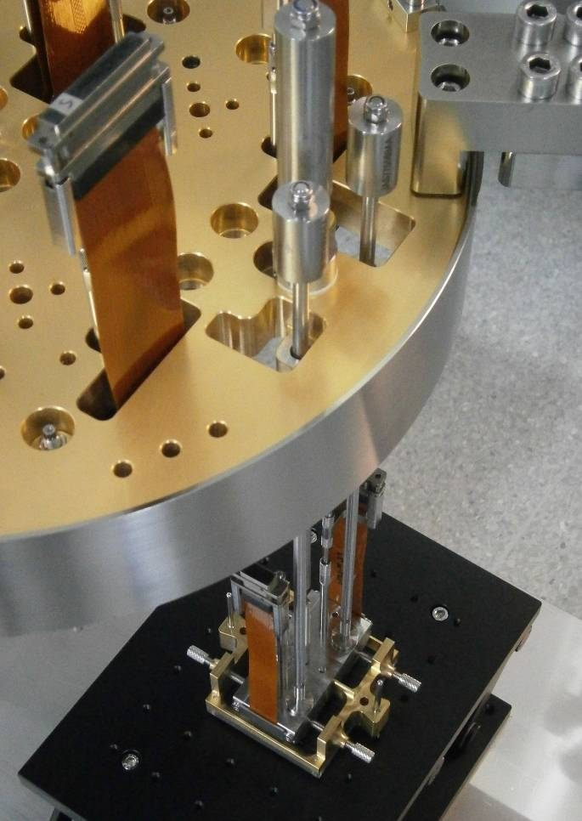
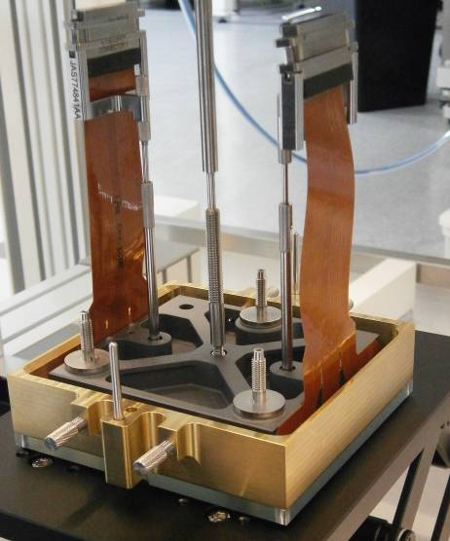
DMP assembly pictures
Gold-plated Silicon Carbide plate (lower surface)
Top surface of plate
CCD290 prepared for insertion
CCD47 being inserted

Slide 18
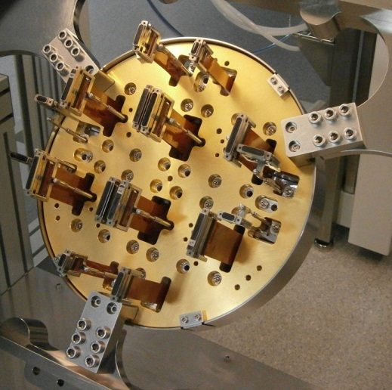
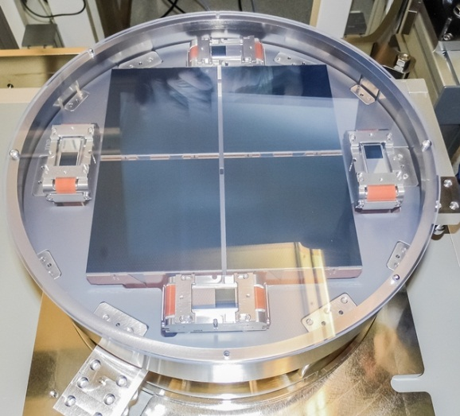
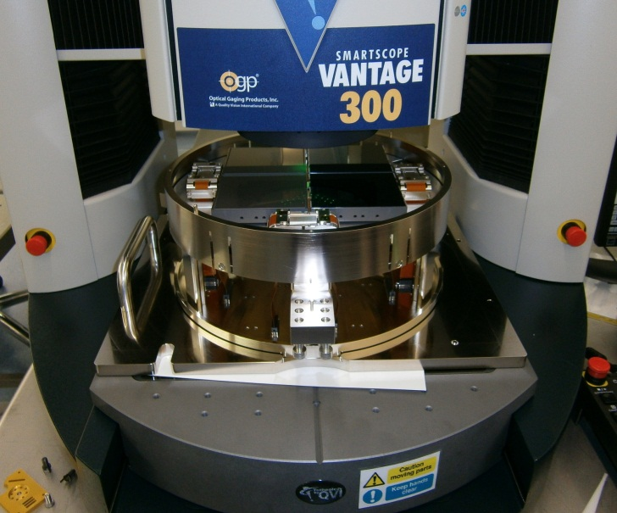
DMP assembly pictures
Underside of plate with sensors installed
All sensors assembled onto plate
It fits in the metrology machine!

Slide 19
Status
Plate design complete
Plate procurement complete (3), including gold coating (in-house)
Trial plate fully assembled with dummy devices
First deliverable DMP assembled with all fixtures and sensors
CCDs in progress for following two DMPs
Custom transport box designed and manufactured
Packing crate and transport box have been drop & vibration tested
Delivery of first DMP – Due Oct 2013
Delivery of following DMPs- Due Jan 2014 & March 2014
Installation in OSU camera and cryogenic tests to follow

Slide 20
Summary
KMTNet detector mounting plates
Plate design meets specification
Science CCDs- designed, manufactured, and fitted to first plate
Guide CCDs- designed, manufactured and fitted to first plate
Plate assembly- jigs and fixtures complete
e2v Generic capability
Optimised sensor designs (science and guide)
Custom plate design for cryogenic use
Detailed FEA model; thermal & mechanical
Precision plate manufacture
Precision assembly and metrology
Other shapes & sizes
Electronics and cryogenic camera capability [J-PAS paper SPIE 8453-20]

Slide 21
Acknowledgements
Many members of the teams at Ohio State University and e2v technologies contributed to the work presented here.
The detailed design was done at e2v but with multiple constructive dialogues with OSU.
The design and manufacture of a precision plate with high performance (flatness etc) relies on well defined interface definition.
A plug for 2014 SPIE Montreal-
e2v also does large-area backthinned CMOS. Look for-
TAOS. 2k4k science sensors; 20 fps with ~ 100 ROI’s. Prototype results in 2014.
NGSD. ~800X800 WFS, 700 fps. [Mark Downing; Wed am,] Prototype results in 2014.
4k4k FT EMCCD >5 fps photon counting chip. Doug Jordan. Wed. am.
Thanks for your attention

