Slide 2
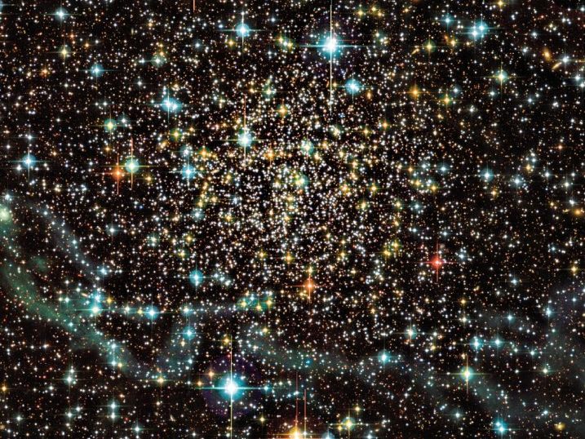
and the space between…
Doug Simons
Executive Director
Canada-France-Hawaii Telescope

Slide 3


Slide 4
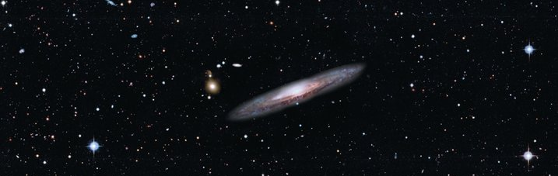

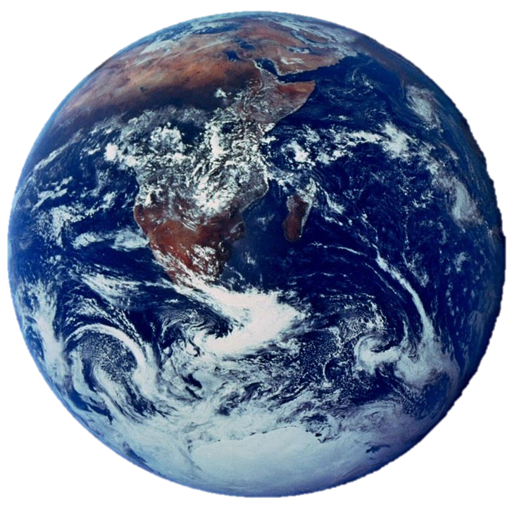
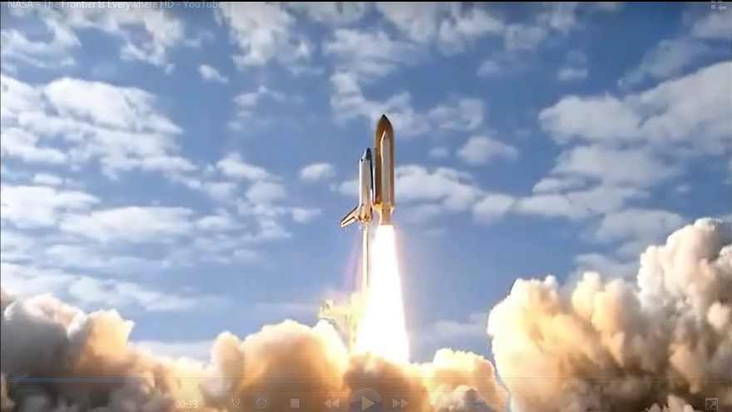
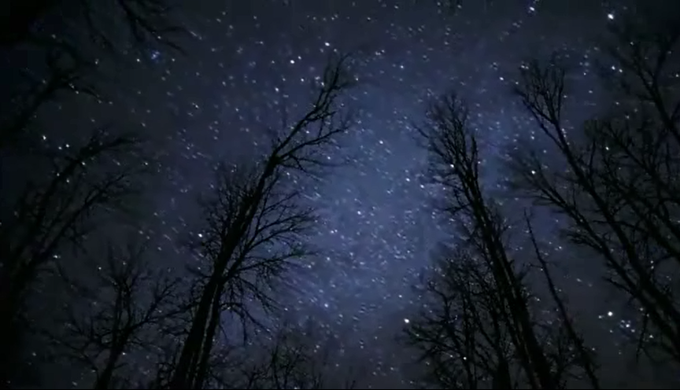
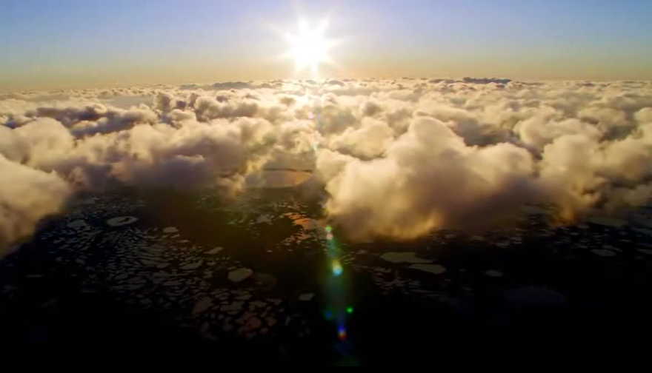
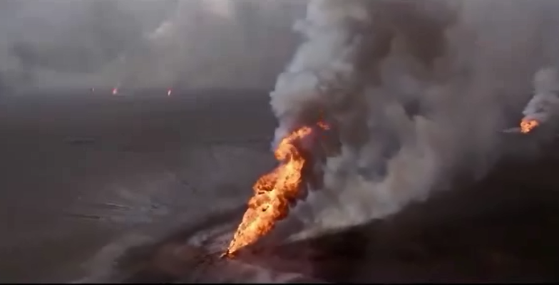
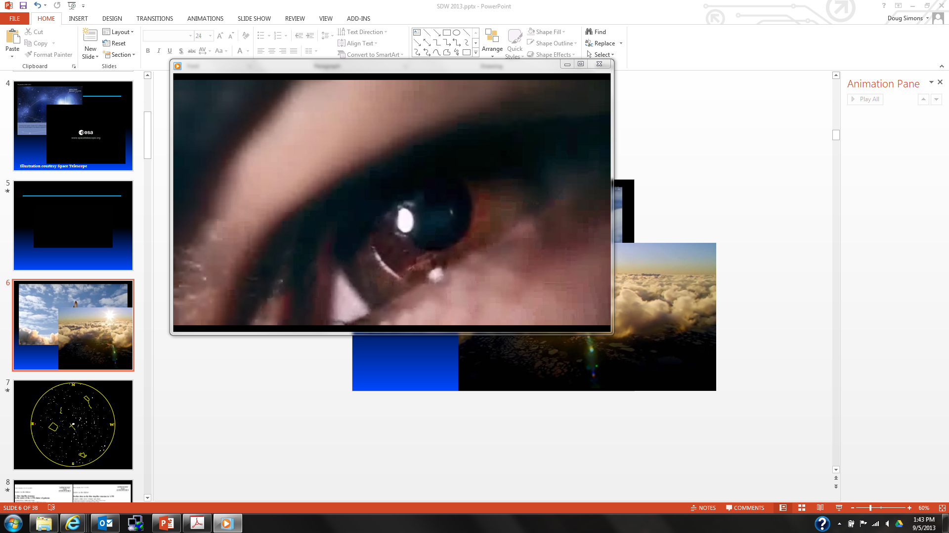
“The Frontier is Everywhere”
Exploration and Discovery

Slide 5
N
E
W
S

Slide 7
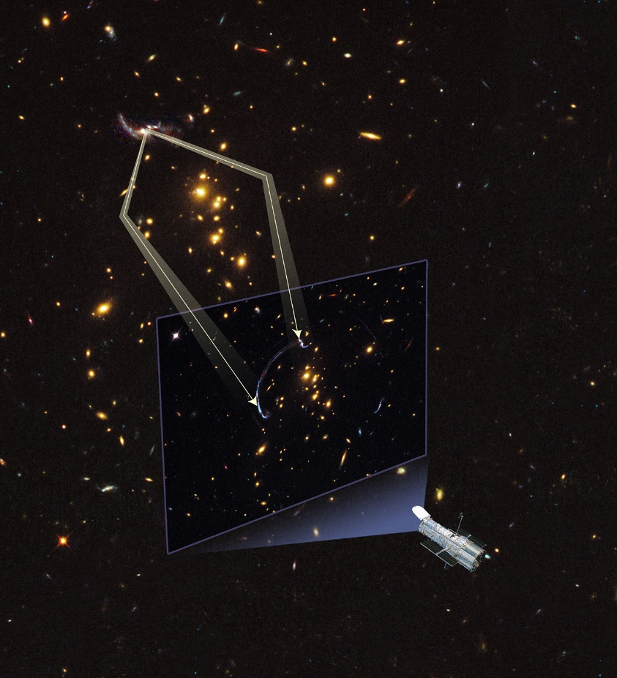
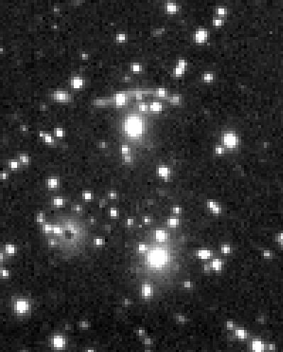
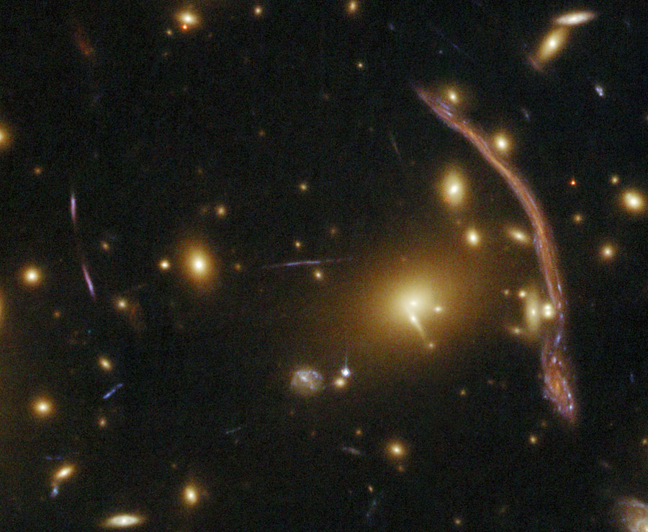
Image from CFHT – 1985
Object: Abel 370
CCD: “RCA1”
Space
Telescope
Image
512 pixels
320 pixels

Slide 8
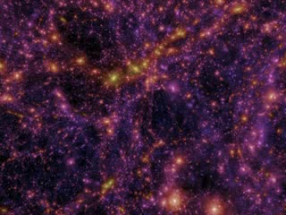
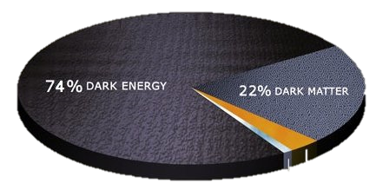
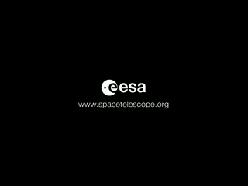
Millennium Simulation
the space between…
3.6% INTERSTELLAR GAS
0.4% STARS
Observed Dark Matter Distribution in 3D
(based upon data from several telescopes including CFHT)

Slide 9
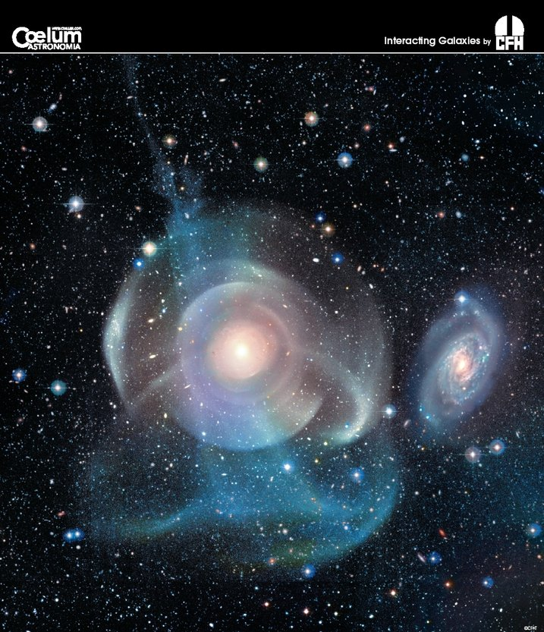
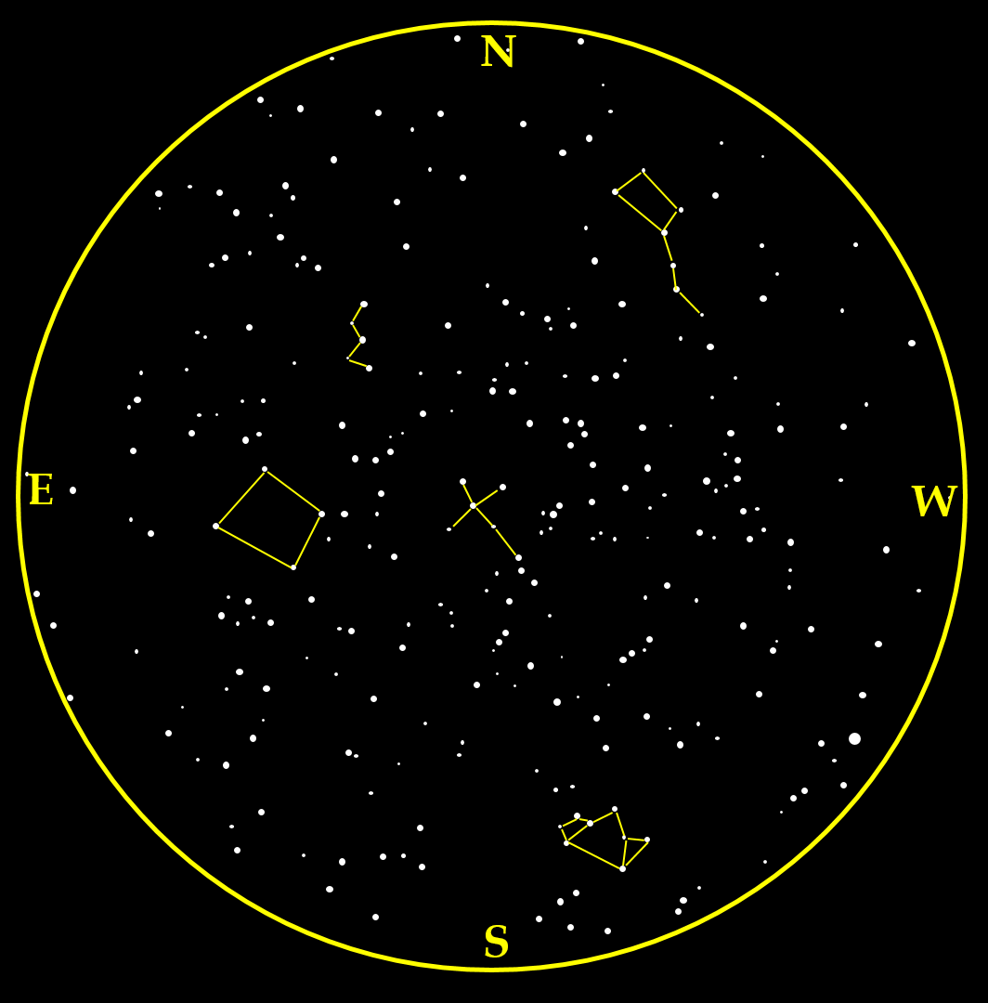
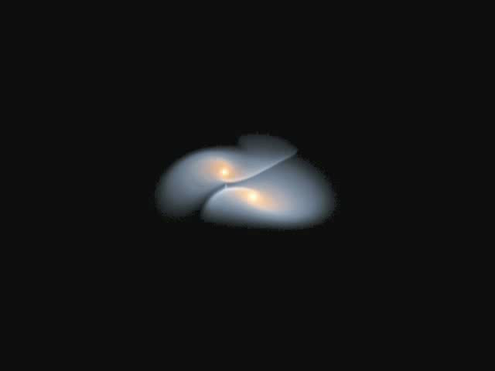
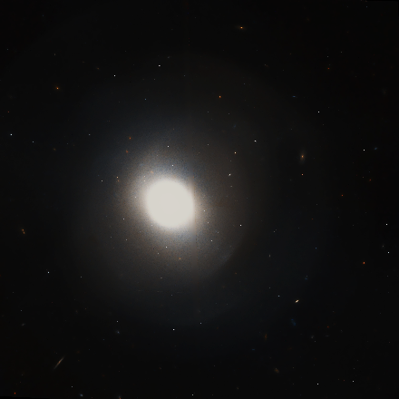
NGC 474 imaged with CFHT’s MegaCam Using ELIXIR – Low Surface Brightness Technique
HST image of NGC 474 - an elliptical galaxy about 100 million light years distant
Simulated Galaxy Merger

Slide 10
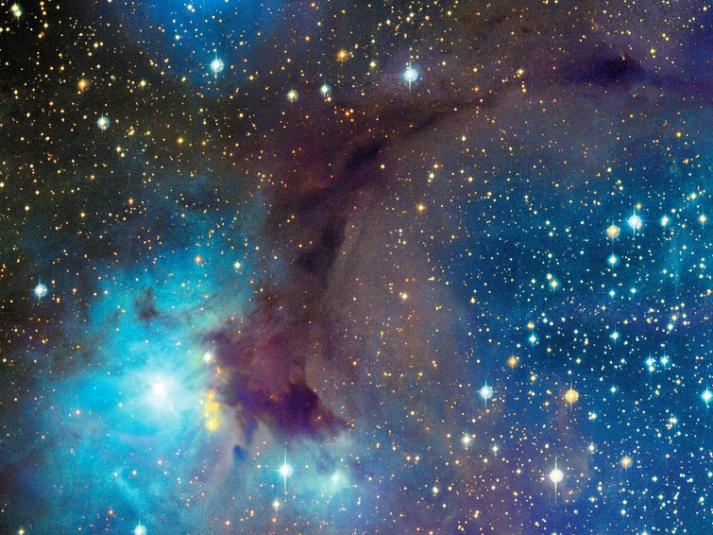
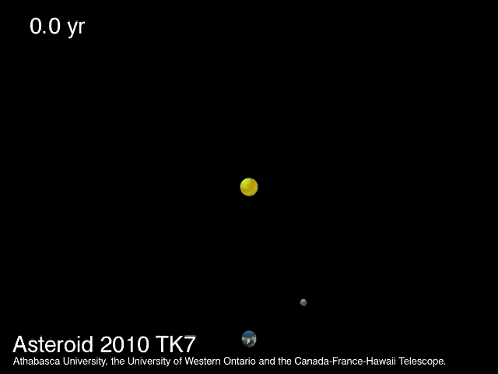
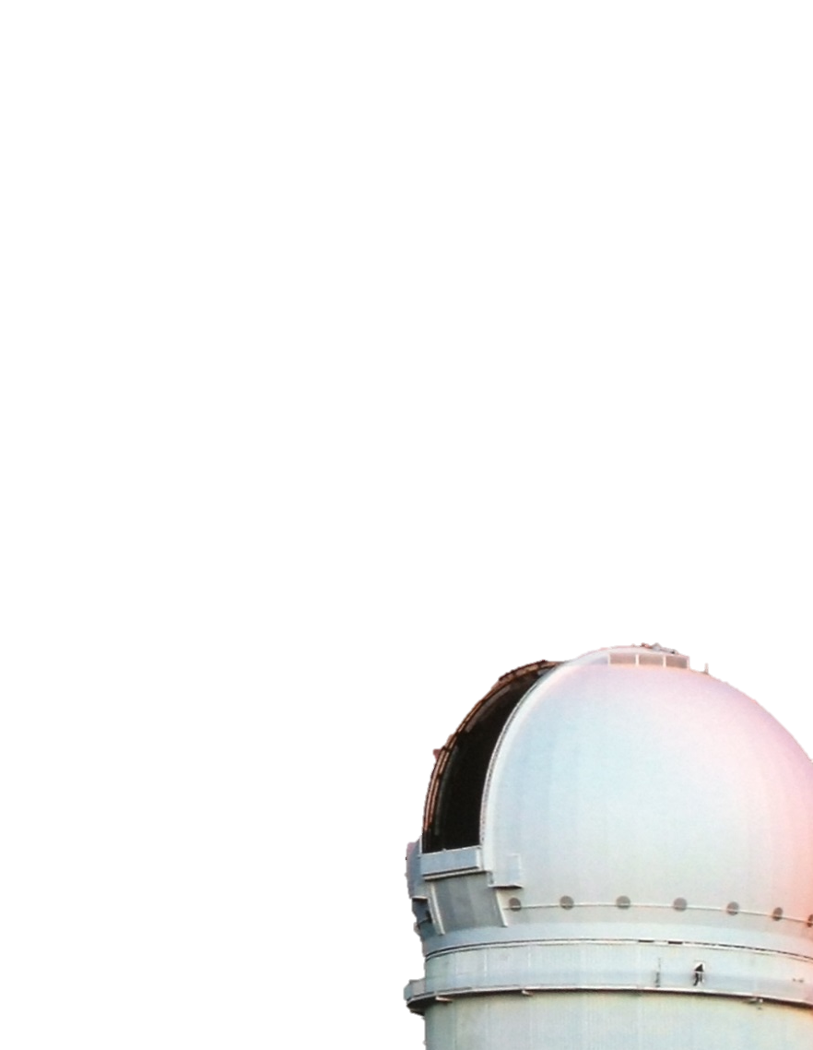
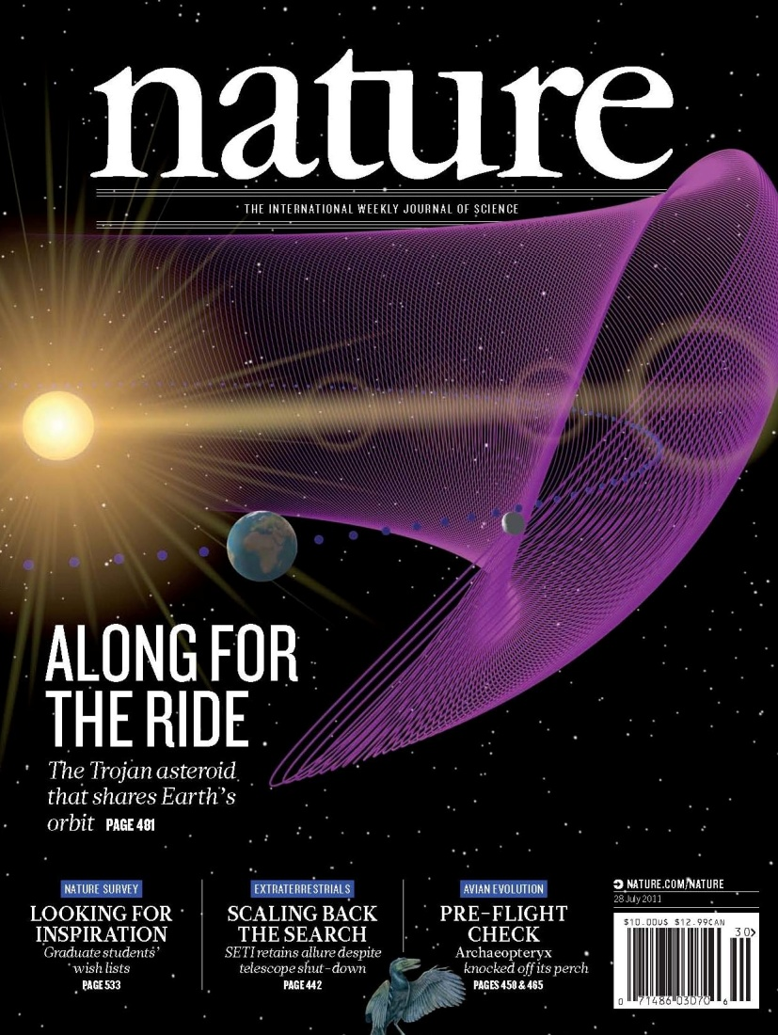

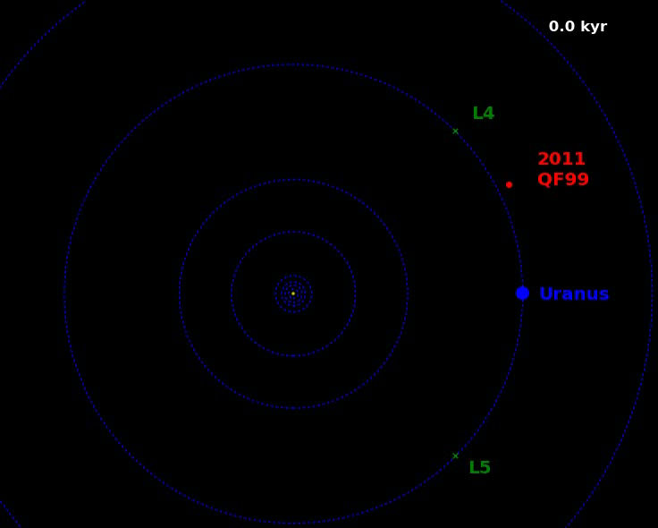
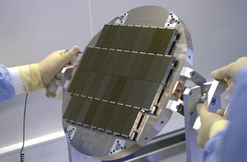
CFHT’s Discovery Horizon
From the very near…
First earth trojan asteroid
Megacam
CFHT’s MegaCam
(330,000,000 pixels)
First Uranus trojan asteroid

Slide 11
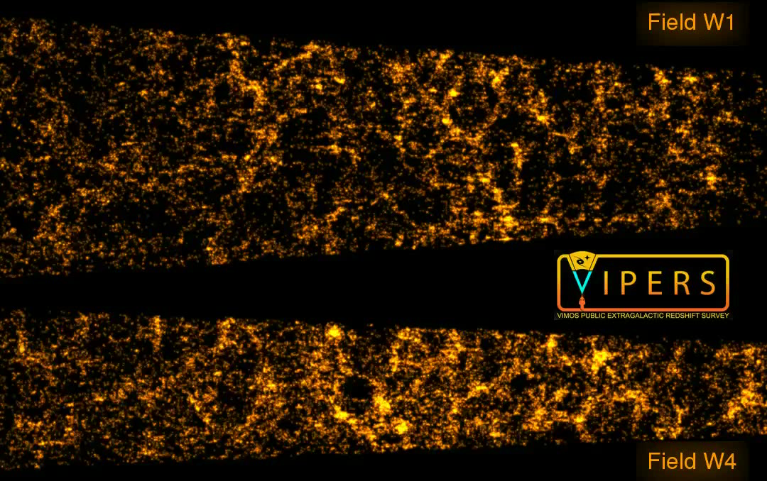
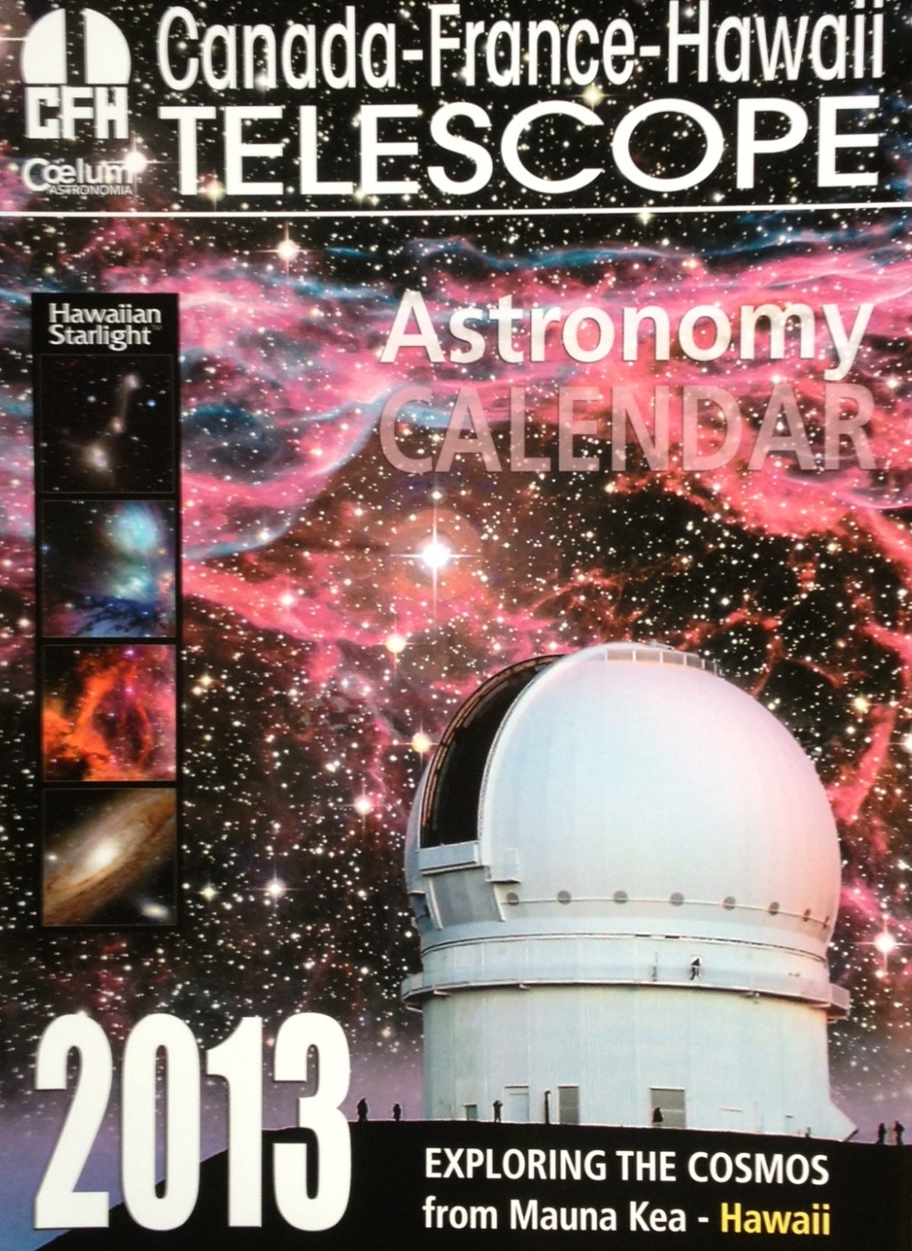
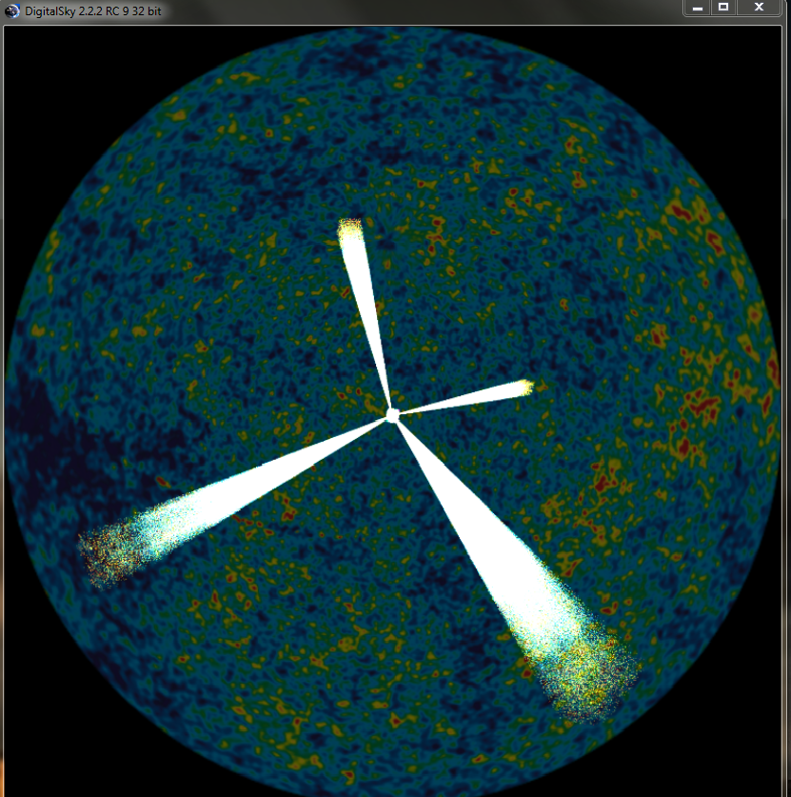
CFHT’s Discovery Horizon
From the very near…
To the very far…
+ ESO spectroscopy
CFHT Legacy Survey
(~40 million objects)

Slide 12
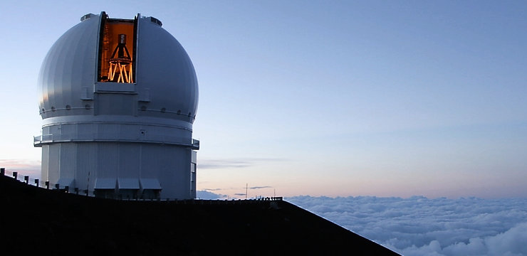
CFHT’s Future as an Observatory?
→ ngCFHT
10 M

Slide 13
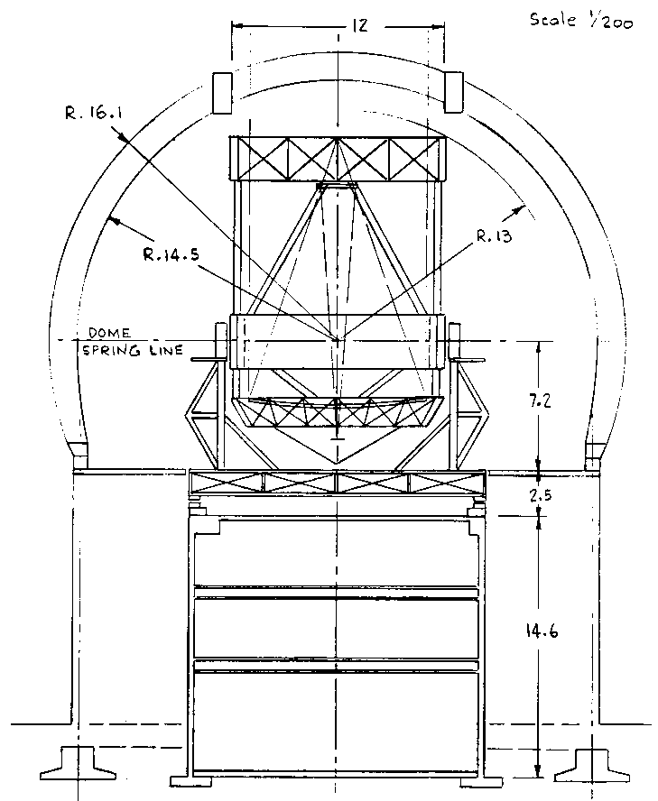
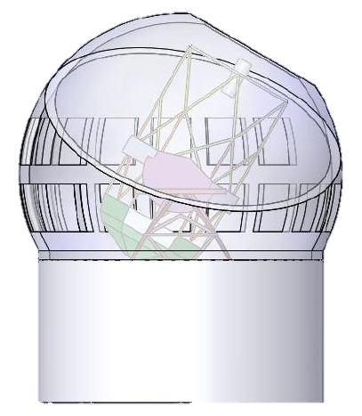
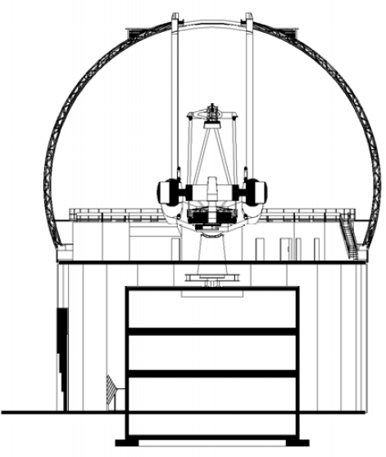
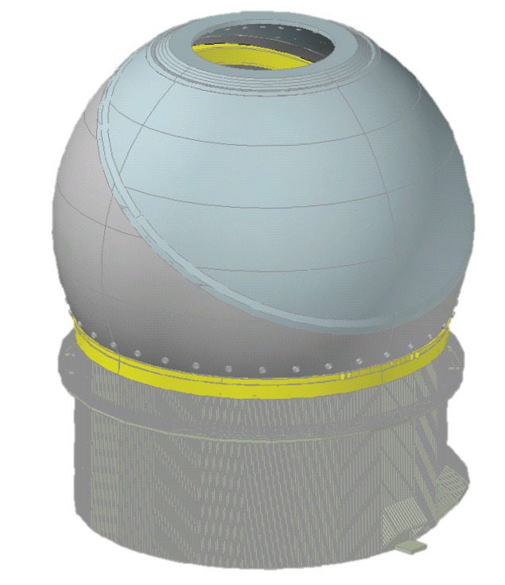
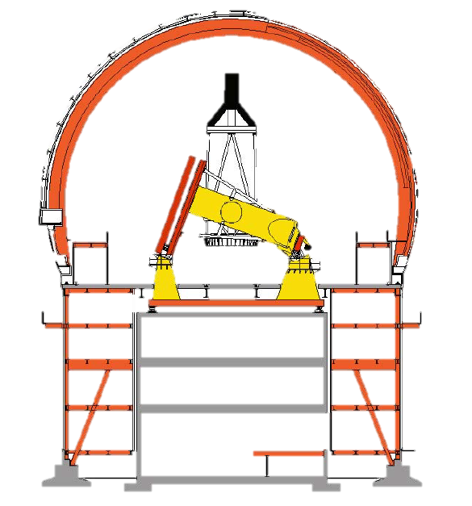

ngCFHT Concept
15 m
CFHT
30 m
ngCFHT

Slide 14
ngCFHT Concept
3000 Fiber
Positioner
Fiber Coupling
1.5° Wide Field
Corrector
10 m Primary
Bank of spectrometers
R~2000-20,000
Existing Pier & Support Building
See ngcfht.org for additional details…

Slide 15
and the space between…

Slide 16
and the space between…

