Slide 1


Enhancing Optical Nonlinearities via Gaussian Operations for Coherent Photonic Quantum Information Processing
Virtual Photonics for Quantum 2
Ryotatsu Yanagimoto*, Tatsuhiro Onodera*, Edwin Ng, Logan G. Wright, Peter L. McMahon, and Hideo Mabuchi
July 28th 2020
PHI Labs
McMahon Lab

Slide 2
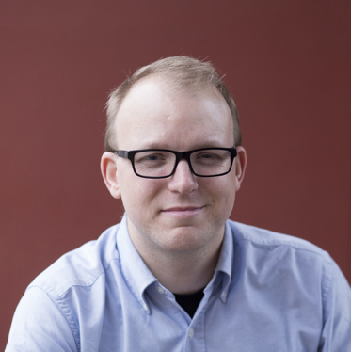
Ryotatsu Yanagimoto
@Stanford
Edwin Ng
@Stanford
Logan G. Wright
@Cornell
Peter L. McMahon
@Cornell
Hideo Mabuchi
@Stanford

Slide 3

The case for optical information processing
High information capacity
Room temperature
Low intrinsic nonlinearity
Nonlinear material

Slide 4
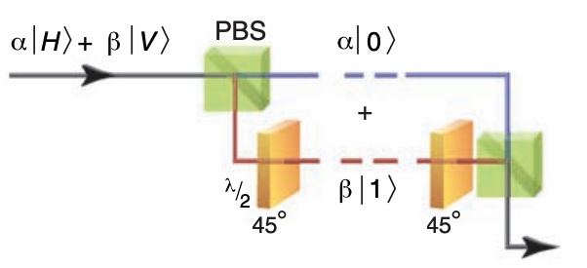
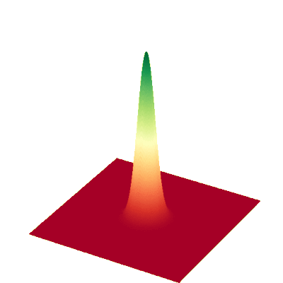
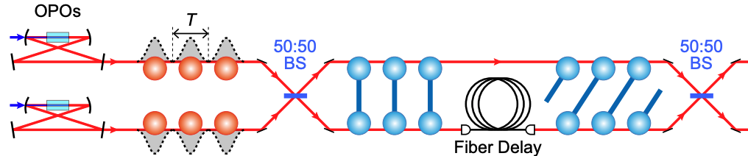


Photonic quantum information processing
Discrete variable
Continuous variable (this talk)
Single photons
States in phase space
$$x$$
$$p$$
10.1126/science.1142892, 10.1038/nphoton.2013.287 https://strawberryfields.ai/photonics/demos/run_gate_visualization.html

Slide 5
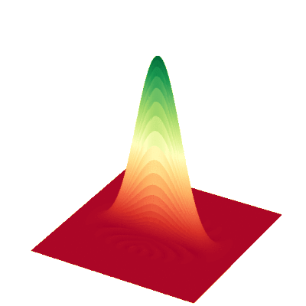
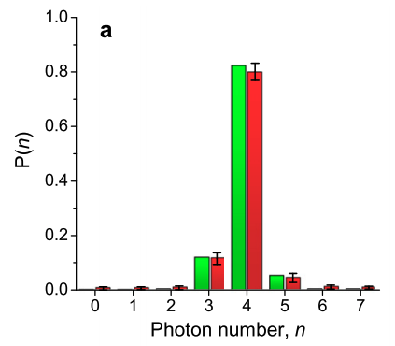
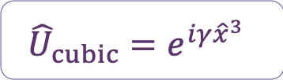




Continuous variable optical QC
Gottesman–Knill theorem says
Gaussian operations are insufficient
Non-gaussian operations are required
$${{\hat{U}}_{cubic}=e}^{iγ{\hat{x}}^{3}}$$
$$x$$
$$p$$
or
$$x$$
$$p$$
Photon resolving detection
quant-ph/9807006, 10.1103/PhysRevLett.88.097904, 10.1088/1367-2630/14/11/115007
https://strawberryfields.ai/photonics/demos/run_gate_visualization.html

Slide 6



Continuous variable optical QC
Measurement-based QC
If ${\hat{U}}_{cubic}$ can be realized…
Generate Cluster state
Non-gaussian measurement
Multimode squeezed state
Interfero-meter
$${\hat{U}}_{cubic}$$
Feedforward operation
$${\hat{U}}_{cubic}$$
https://arxiv.org/abs/2006.11537
https://medium.com/xanaduai/photonic-quantum-neural-networks-ee0cbaefe4ac

Slide 7
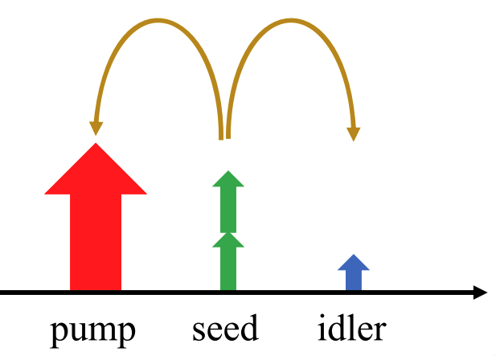
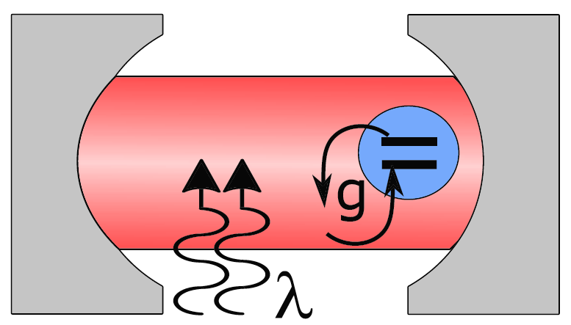
Enhancing nonlinearity via gaussian operations
  Intrinsic nonlinearity is low
Nonlinear material
  Coherent photon conversion
  Squeezing enhancement in cavity QED
10.1103/PhysRevLett.122.153906, 10.1103/PhysRevLett.120.093602

Slide 8
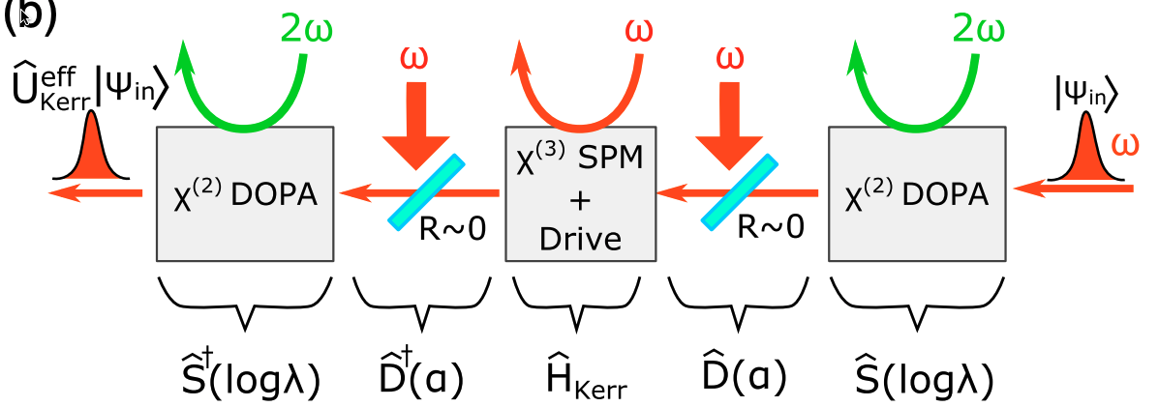
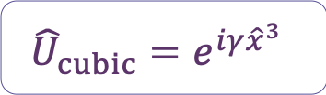


Cubic phase gate with nonlinearity enhancement
$${{\hat{U}}_{cubic}=e}^{iγ{\hat{x}}^{3}}$$
$$x$$
$$p$$
Schematic
10.1103/PhysRevLett.124.240503

Slide 9
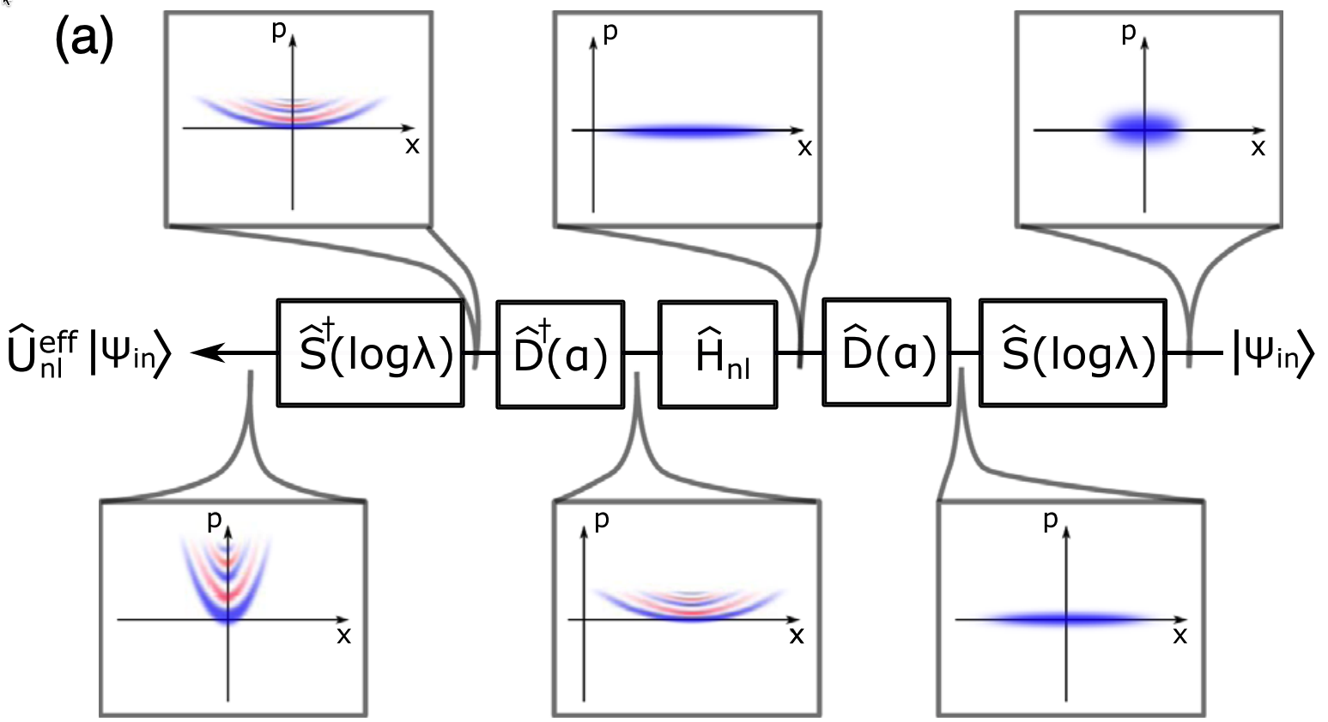
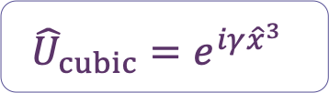

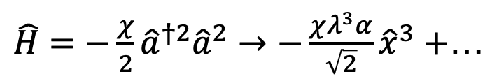
Why conjugate?
$${{\hat{U}}_{cubic}=e}^{iγ{\hat{x}}^{3}}$$
Algebraic argument:
$$\hat{a}≈→\frac{λ}{\sqrt{2}}\hat{x}+α$$
$\hat{H}=−\frac{χ}{2}{\hat{a}}^{†2}{\hat{a}}^{2}→$ $−\frac{χλ^{3}α}{\sqrt{2}}{\hat{x}}^{3}+$…
Gaussian enhancement
10.1103/PhysRevLett.124.240503

Slide 10
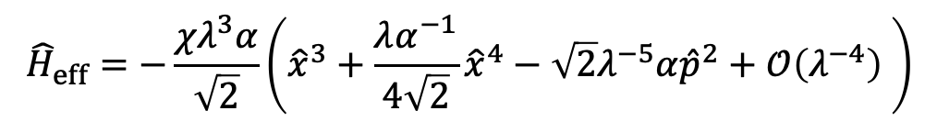


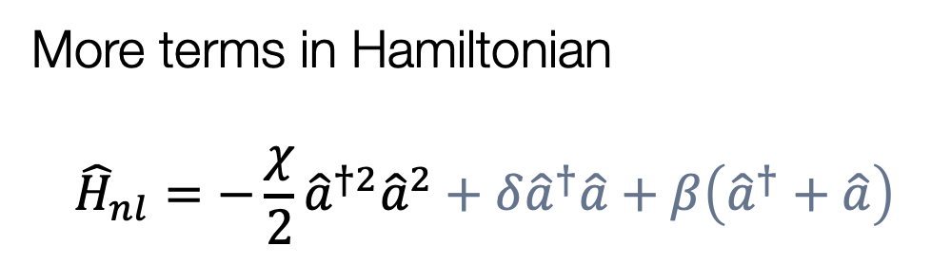
Details
$${{\hat{U}}_{cubic}=e}^{iγ{\hat{x}}^{3}}$$
More terms in Hamiltonian
$${\hat{H}}_{nl}=−\frac{χ}{2}{\hat{a}}^{†2}{\hat{a}}^{2}+δ{\hat{a}}^{†}\hat{a}+β\left({\hat{a}}^{†}+\hat{a}\right)$$
$$δ=3χα^{2}−χ$$
$$β=−2χα^{3}$$
$${\hat{H}}_{eff}=−\frac{χλ^{3}α}{\sqrt{2}}\left({\hat{x}}^{3}+\frac{λα^{−1}}{4\sqrt{2}}{\hat{x}}^{4}−\sqrt{2}λ^{−5}α{\hat{p}}^{2}+𝒪\left(λ^{−4}\right) \right)$$
10.1103/PhysRevLett.124.240503

Slide 11
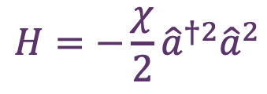
Interpretation based on potential forms
$${{\hat{U}}_{cubic}=e}^{iγ{\hat{x}}^{3}}$$
$$H=−\frac{χ}{2}{\hat{a}}^{†2}{\hat{a}}^{2}$$
10.1103/PhysRevLett.124.240503

Slide 12
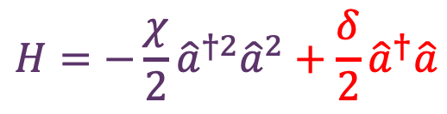
Interpretation based on potential forms
$${{\hat{U}}_{cubic}=e}^{iγ{\hat{x}}^{3}}$$
$$H=−\frac{χ}{2}{\hat{a}}^{†2}{\hat{a}}^{2}+\frac{δ}{2}{\hat{a}}^{†}\hat{a}$$
10.1103/PhysRevLett.124.240503

Slide 13
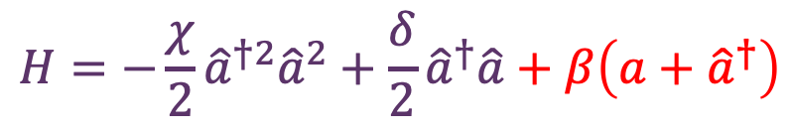
Interpretation based on potential forms
$${{\hat{U}}_{cubic}=e}^{iγ{\hat{x}}^{3}}$$
$$H=−\frac{χ}{2}{\hat{a}}^{†2}{\hat{a}}^{2}+\frac{δ}{2}{\hat{a}}^{†}\hat{a}+β\left(a+{\hat{a}}^{†}\right)$$
10.1103/PhysRevLett.124.240503

Slide 14
Interpretation based on potential forms
$${{\hat{U}}_{cubic}=e}^{iγ{\hat{x}}^{3}}$$
$$H=−\frac{χ}{2}{\left({\hat{a}}^{†}+α\right)}^{2}{\left(\hat{a}+α\right)}^{2}+\frac{δ}{2}\left({\hat{a}}^{†}+α\right)\left(\hat{a}+α\right)+β\left(a+{\hat{a}}^{†}+2α\right)$$
10.1103/PhysRevLett.124.240503

Slide 15
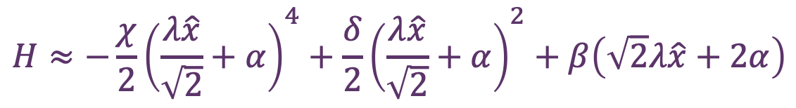
Interpretation based on potential forms
$${{\hat{U}}_{cubic}=e}^{iγ{\hat{x}}^{3}}$$
$$H≈−\frac{χ}{2}{\left(\frac{λ\hat{x}}{\sqrt{2}}+α\right)}^{4}+\frac{δ}{2}{\left(\frac{λ\hat{x}}{\sqrt{2}}+α\right)}^{2}+β\left(\sqrt{2}λ\hat{x}+2α\right)$$
10.1103/PhysRevLett.124.240503

Slide 16
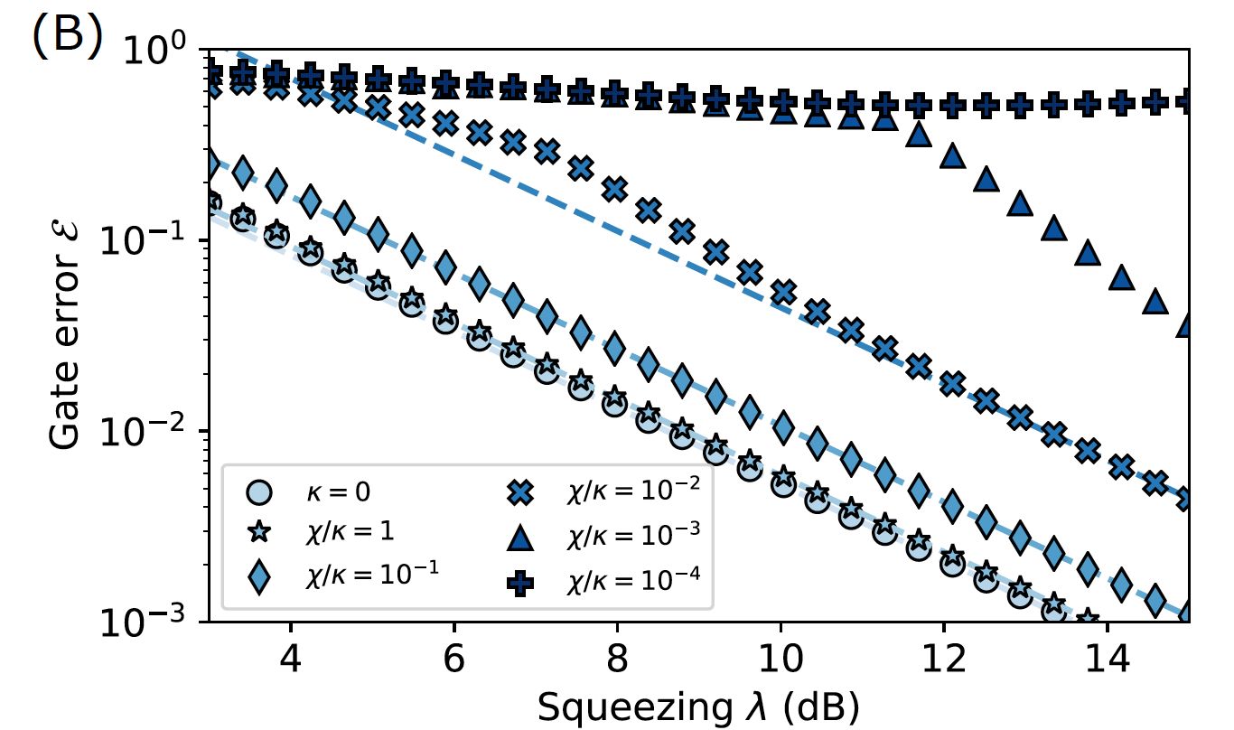

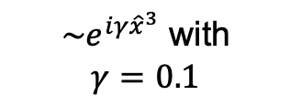
Performance the cubic phase gate
$${{\hat{U}}_{cubic}=e}^{iγ{\hat{x}}^{3}}$$
Evaluate with GKP state
${\sim e}^{iγ{\hat{x}}^{3}}$ with
$$γ=0.1$$
Linear Loss Lindblad $\hat{L}=\sqrt{κ}\hat{a}$
10.1103/PhysRevLett.124.240503

Slide 17
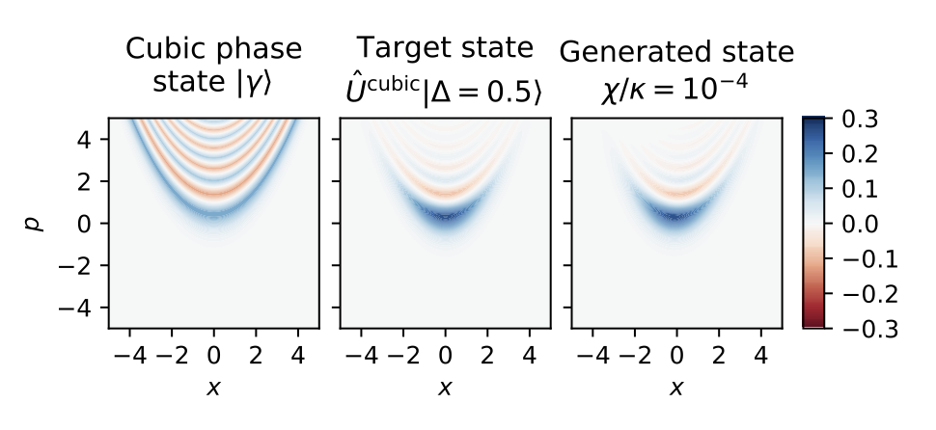
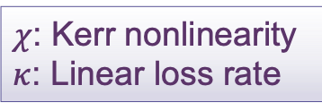
Performance the cubic phase gate
$${{\hat{U}}_{cubic}=e}^{iγ{\hat{x}}^{3}}$$
Generate cubic phase state
$χ$: Kerr nonlinearity
$κ$: Linear loss rate
10.1103/PhysRevLett.124.240503

Slide 18
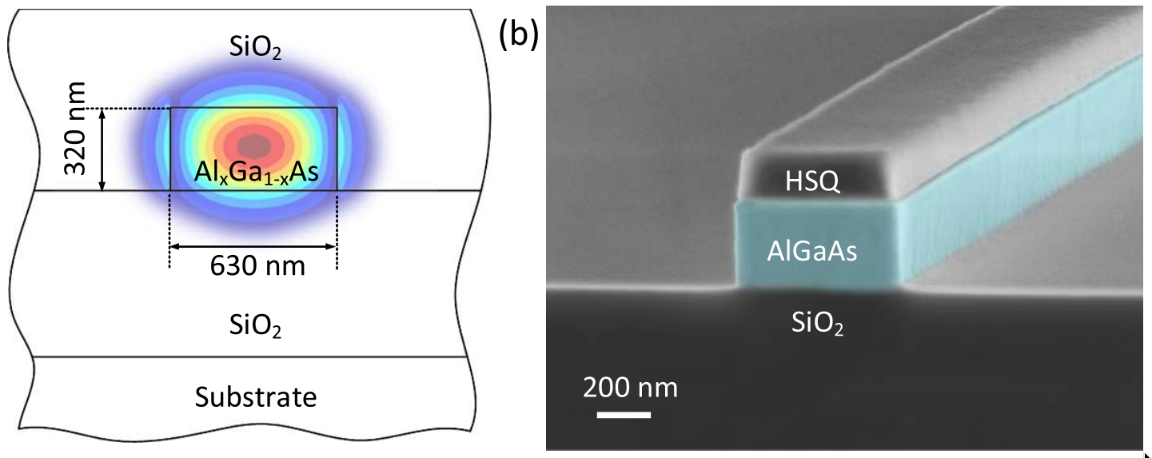
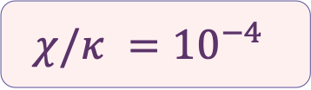
Experimental feasibility
$$χ/κ ={10}^{−4}$$
Spatial confinement
10.1103/PhysRevLett.124.240503, 10.1364/OPTICA.3.000823

Slide 19
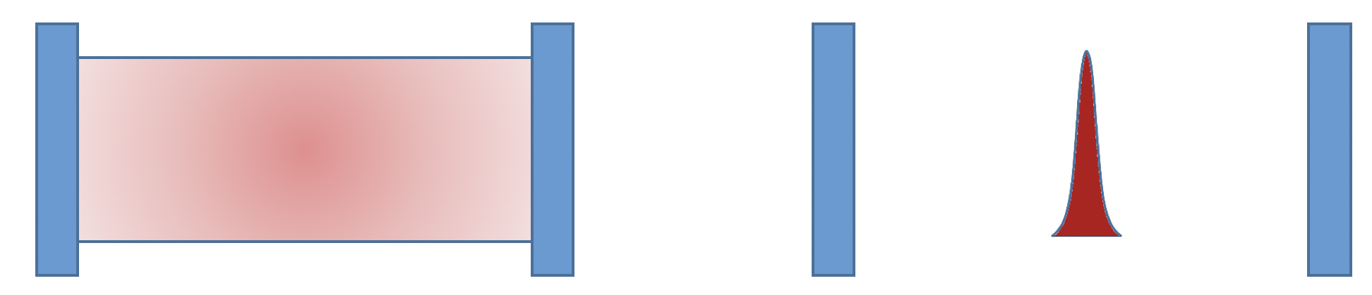




Experimental feasibility
$$χ/κ ={10}^{−4}$$
Temporal confinement
Pulses are multimode
Use quantum solitons!
$${\hat{a}}_{i−1}$$
$${\hat{a}}_{i}$$
$${\hat{a}}_{i+1}$$
$${\hat{a}}_{i+2}$$
10.1103/PhysRevLett.124.240503

Slide 20
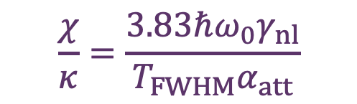
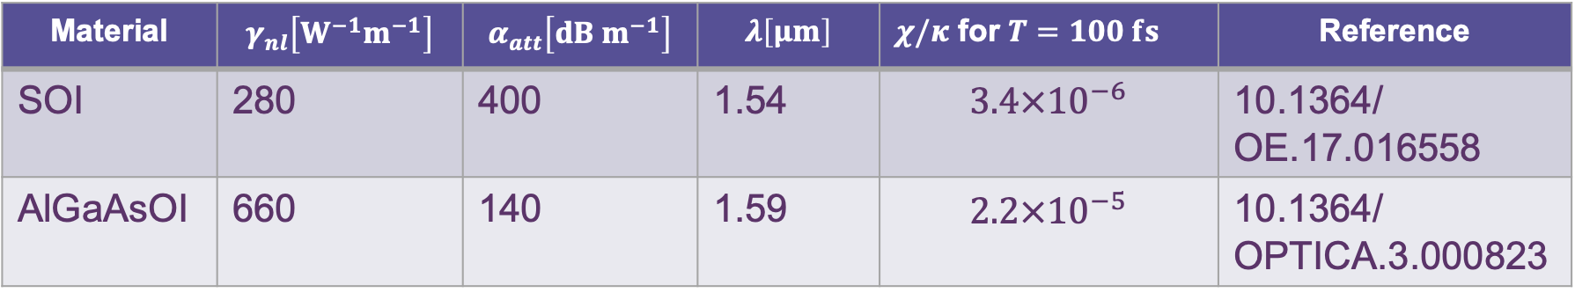
Experimental feasibility
$$χ/κ ={10}^{−4}$$
With quantum solitons
$$\frac{χ}{κ}=\frac{3.83ℏω_{0}γ_{nl}}{T_{FWHM}α_{att}}$$
Material | $$γ_{nl}\left[W^{−1}m^{−1}\right]$$ | $$α_{att}\left[dB{ m}^{−1}\right]$$ | $$λ\left[μm\right]$$ | $χ/κ$ for $T=100 fs$ | Reference
SOI | 280 | 400 | 1.54 | $$3.4×{10}^{−6}$$ | 10.1364/ OE.17.016558
AlGaAsOI | 660 | 140 | 1.59 | $$2.2×{10}^{−5}$$ | 10.1364/ OPTICA.3.000823
10.1103/PhysRevLett.124.240503

Slide 21
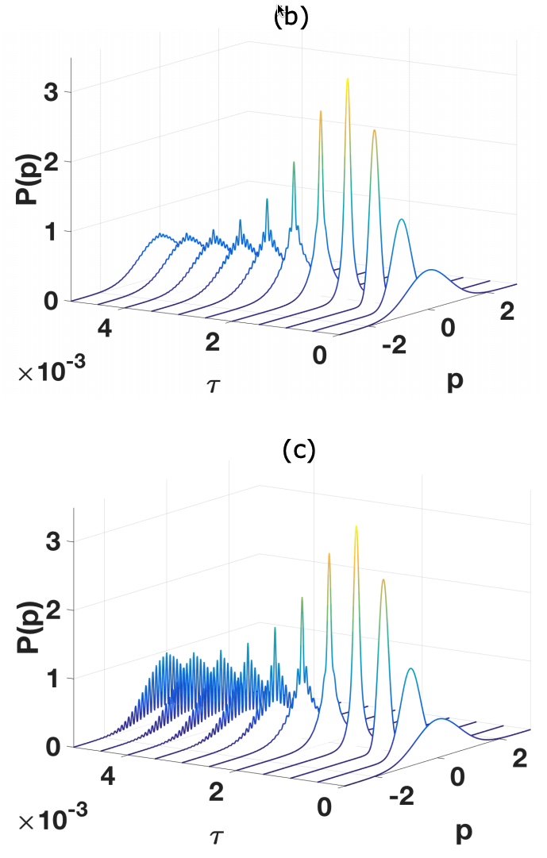
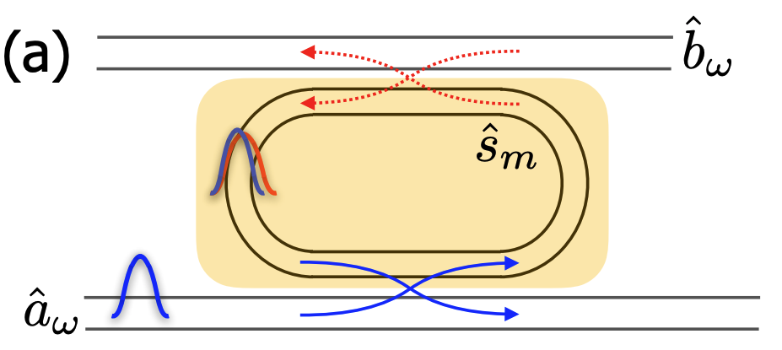
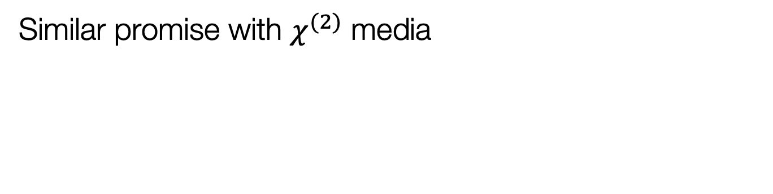
Outlook for ultrafast nonlinear quantum optics
Similar promise with $χ^{(2)}$ media
No
squeezing
With
squeezing
https://arxiv.org/abs/1811.10583, https://arxiv.org/abs/2006.12725

Slide 22
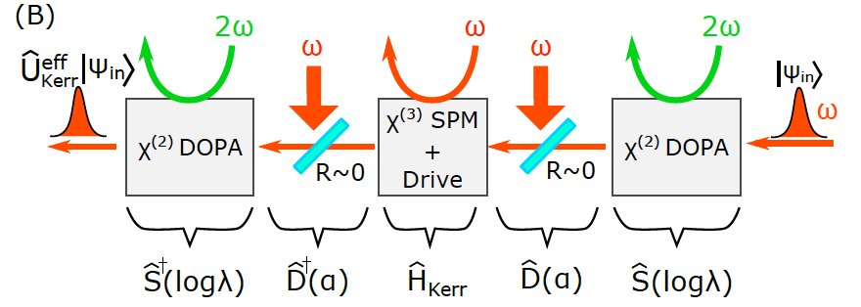
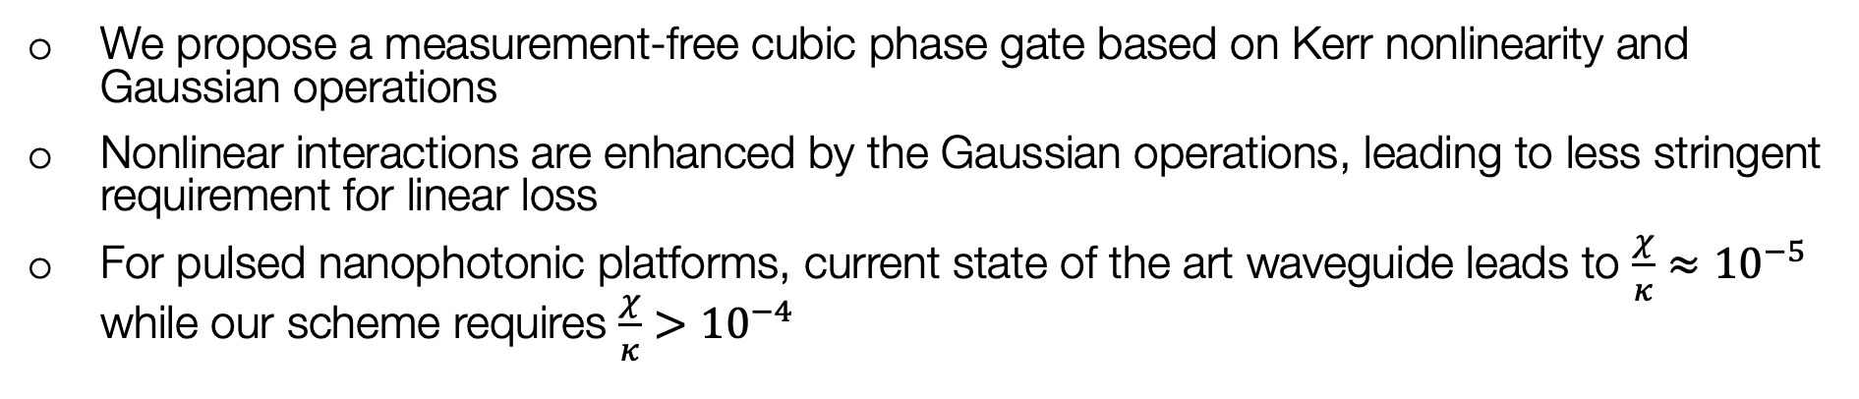
Summary
We propose a measurement-free cubic phase gate based on Kerr nonlinearity and Gaussian operations
Nonlinear interactions are enhanced by the Gaussian operations, leading to less stringent requirement for linear loss
For pulsed nanophotonic platforms, current state of the art waveguide leads to $\frac{χ}{κ}≈{10}^{−5}$ while our scheme requires $\frac{χ}{κ}>{10}^{−4}$
https://arxiv.org/abs/1811.10583, https://arxiv.org/abs/2006.12725

